Slide 1

INTRODUCTION TO SERVICE NOW
STREAMLINING IT AND BUSINESS WORKFLOWS

Slide 2

AGENDA
WHAT IS SERVICENOW?
KEY FEATURES OF SERVICENOW
SERVICENOW ARCHITECTURE
MODULES IN SERVICENOW
BENEFITS OF USING SERVICENOW
REAL-WORLD USE CASES
CONCLUSION

Slide 3
WHAT IS SERVICENOW?
ServiceNow is a cloud-based platform for automating IT Service Management (ITSM)
Helps organizations manage digital workflows for enterprise operations
Offers solutions for IT, HR, Customer Service, Security, and more

Slide 4
KEY FEATURES OF SERVICENOW
Incident, Problem, and Change Management
Self-service portals and knowledge bases
Workflow automation and orchestration
Integration with third-party tools
AI and machine learning capabilities

Slide 5
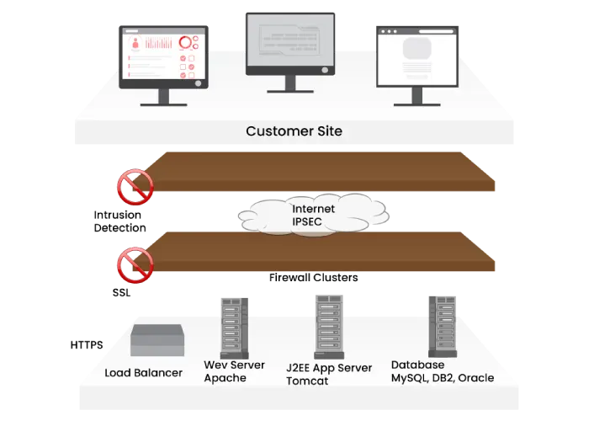
SERVICENOW ARCHITECTURE

Slide 6
MODULES IN SERVICENOW
IT Service Management (ITSM)
IT Operations Management (ITOM)
IT Business Management (ITBM)
Security Operations (SecOps)
HR Service Delivery
Customer Service Management (CSM)

Slide 7

BENEFITS OF USING SERVICENOW
Improved efficiency through automation
Centralized service management
Enhanced user experience
Scalable and customizable
Real-time reporting and analytics

Slide 8
REAL-WORLD USE CASES
Automating employee onboarding
Managing IT incidents and requests
Tracking software assets and licenses
Handling customer support tickets

Slide 9

CONCLUSION
ServiceNow is a powerful platform for digital transformation
Supports end-to-end workflow automation
Widely used across industries for IT and business process management

