Slide 1


SSL AND X.500
SECURING COMMUNICATION AND DIRECTORY SERVICES

Slide 2

AGENDA
WHAT IS SSL?
HOW SSL WORKS
SSL KEY COMPONENTS
WHAT IS X.500?
X.500 DIRECTORY STRUCTURE
SSL vs X.500
CONCLUSION

Slide 3
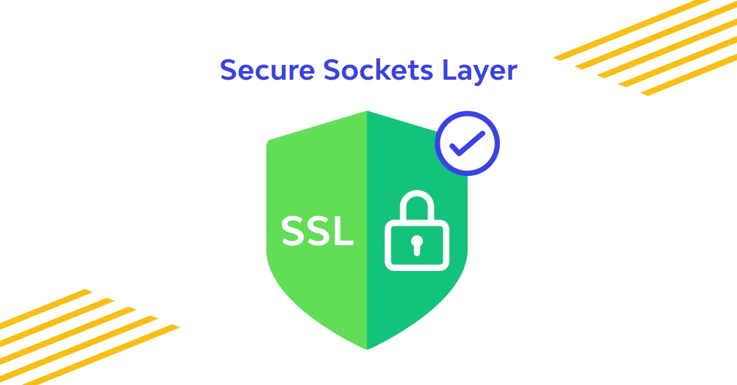
WHAT IS SSL?
SSL (Secure Sockets Layer) is a security protocol for establishing encrypted links between web servers and browsers
Ensures data confidentiality, integrity, and authentication
Replaced by TLS (Transport Layer Security) in modern systems

Slide 4
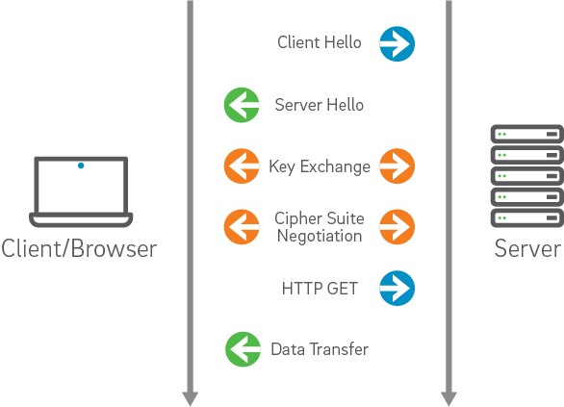
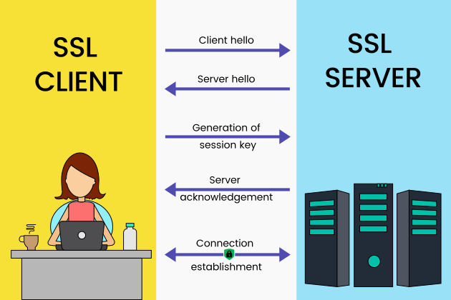
HOW SSL WORKS
Handshake between client and server
Exchange of digital certificates
Session key generation
Encrypted communication begins

Slide 5
X.500 is a standard for directory services developed by ITU-T
Provides a framework for storing and retrieving identity information
Basis for LDAP (Lightweight Directory Access Protocol)
WHAT IS X.500?

Slide 6
X.500 DIRECTORY STRUCTURE
Organized as a hierarchical tree (Directory Information Tree - DIT)
Entries are called Directory Service Entries (DSEs)
Each entry has a Distinguished Name (DN)

Slide 7
SSL vs X.500
Feature | SSL | X.500
Purpose | Secure communication | Directory services
Protocol Type | Security protocol | Directory access model
Usage | Web encryption (HTTPS) | Identity and access management
Related Standard | TLS, X.509 | LDAP, DAP

Slide 8

CONCLUSION
SSL secures data transmission over networks
X.500 organizes and manages identity information
Both are essential in enterprise security and communication systems

