Slide 1
20210730 LTXM source size
A = ~82mm
B = 1200mm (bis chip)
1px = 15um
→ M=15
35um Pinhole

Slide 2
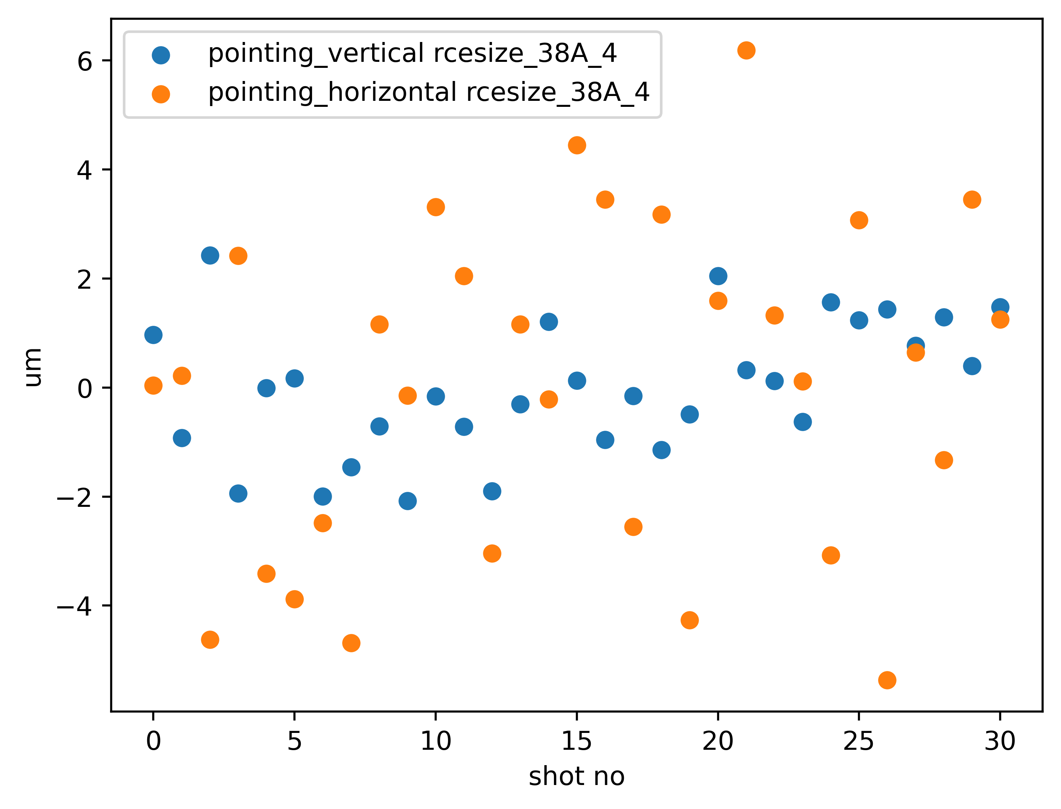
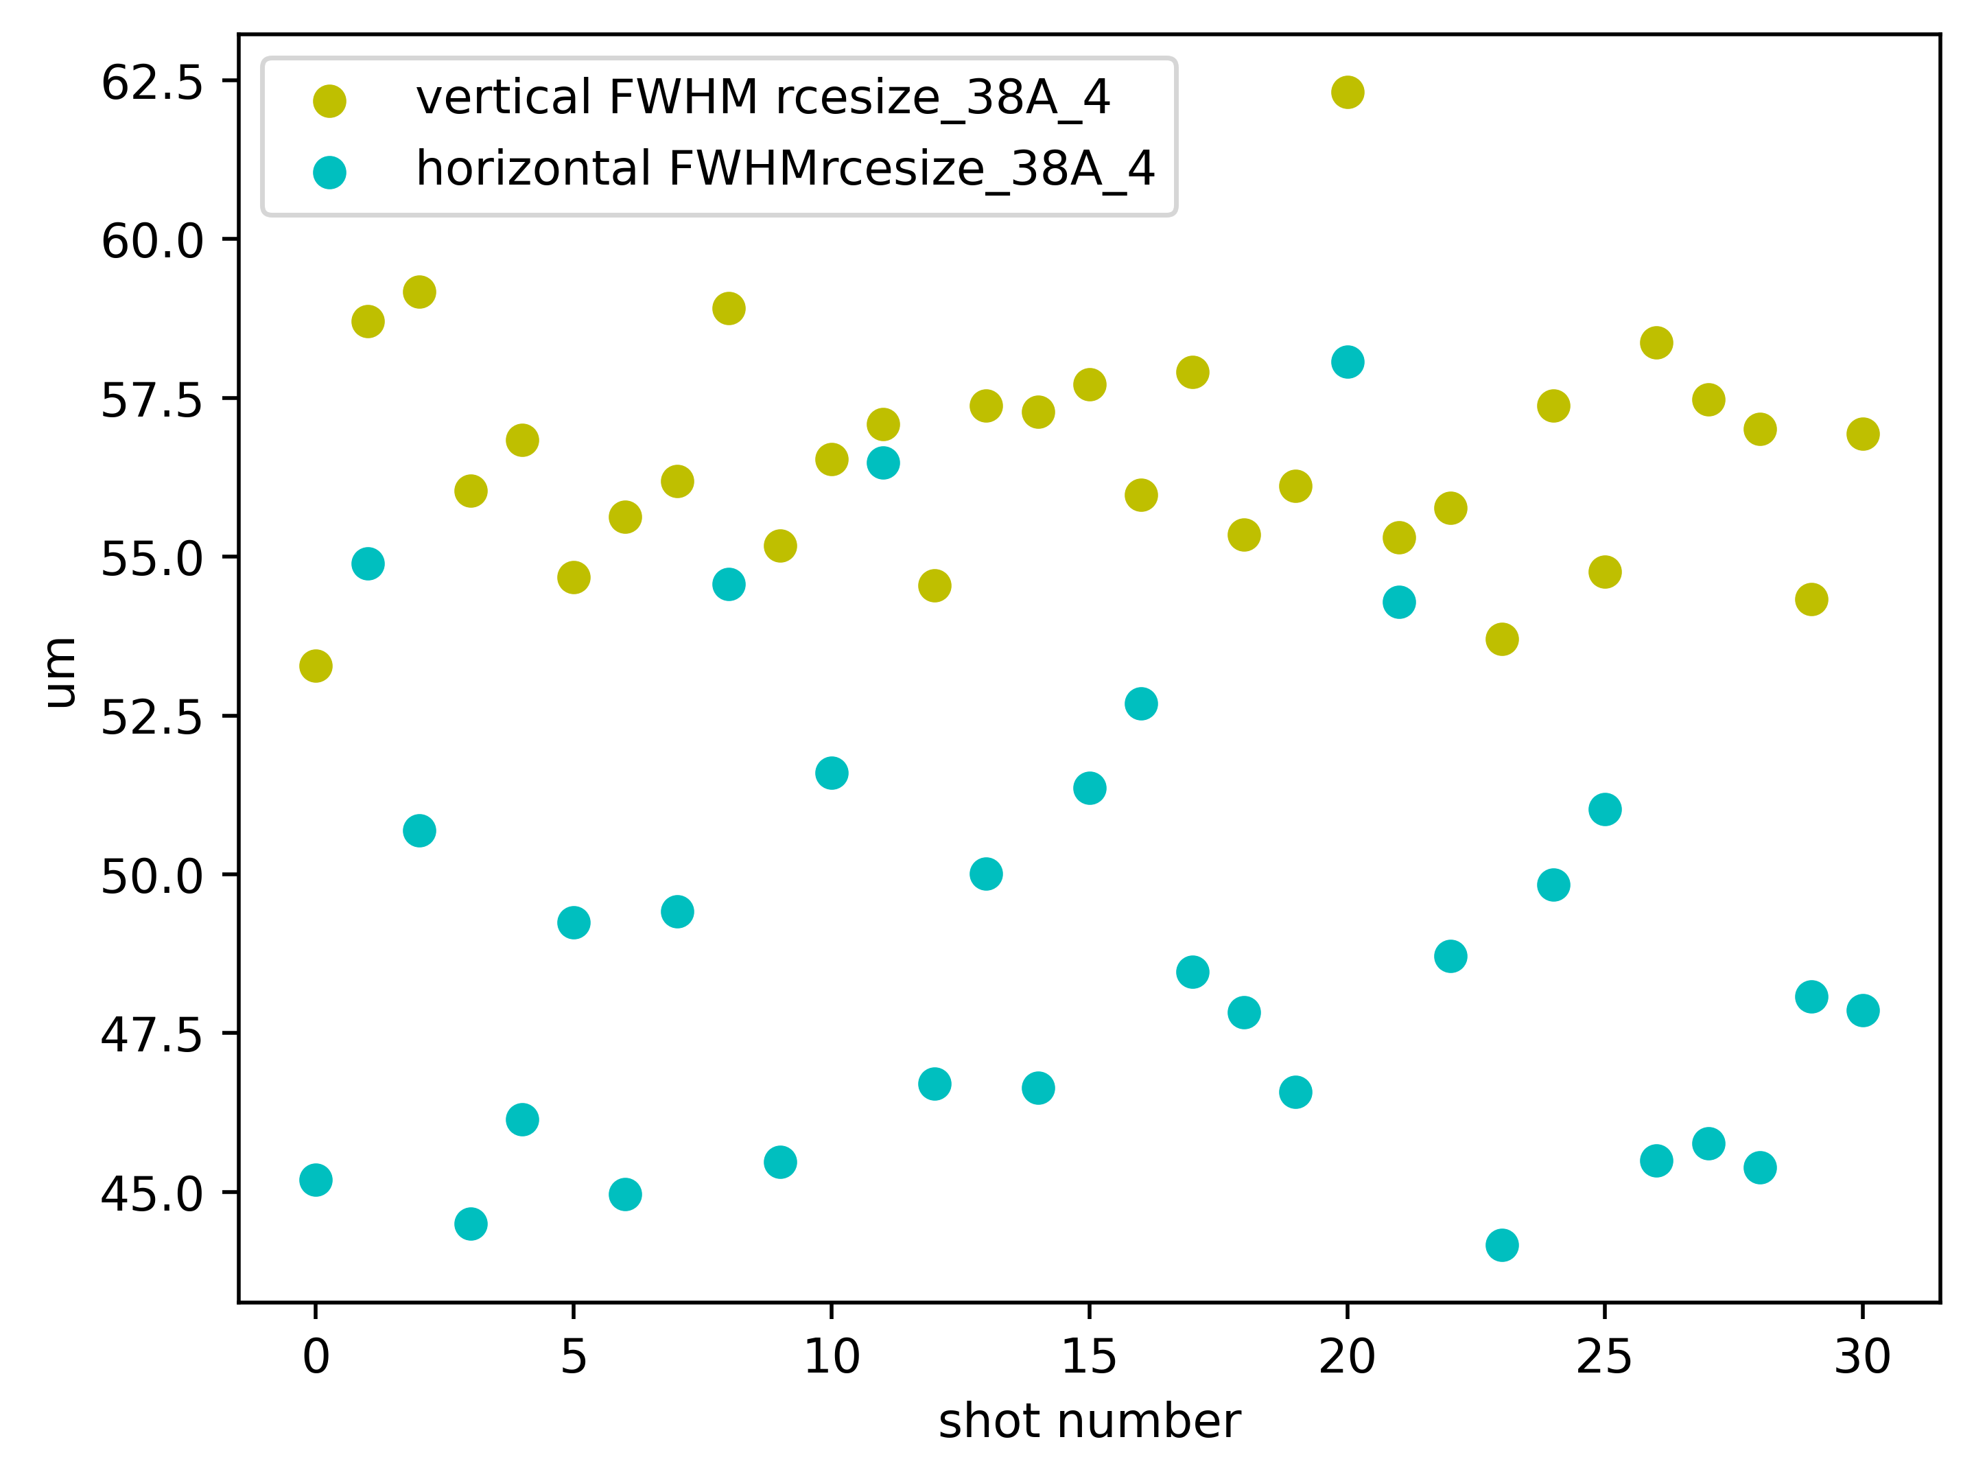
4x4, 1s, 38A
Intensity stability: +/- 6% std
21 +/- 2 um sigma v
24 +/- 1 um sigma h

Slide 3
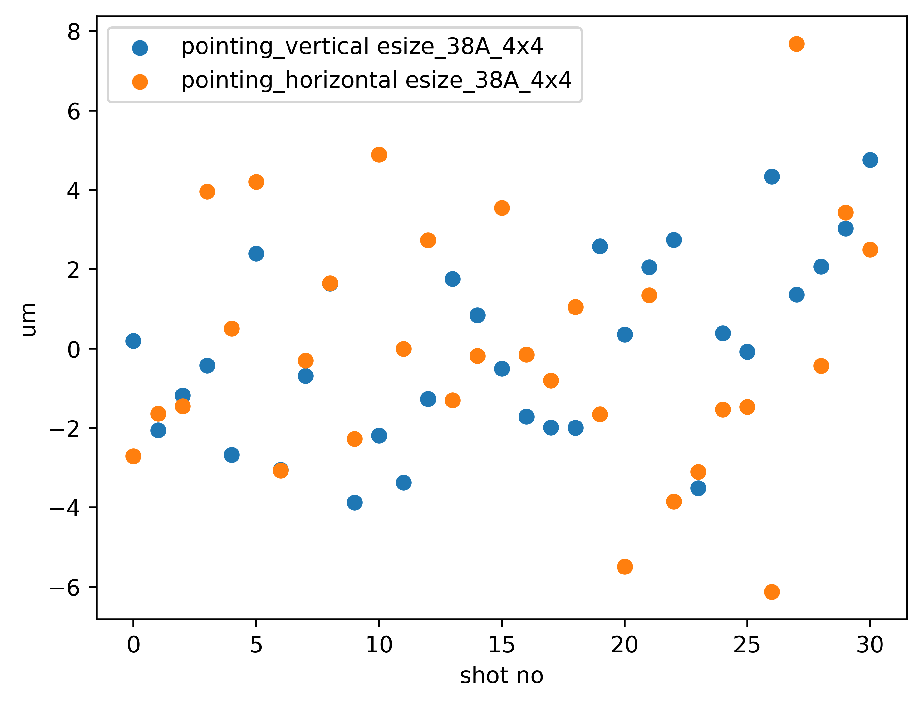
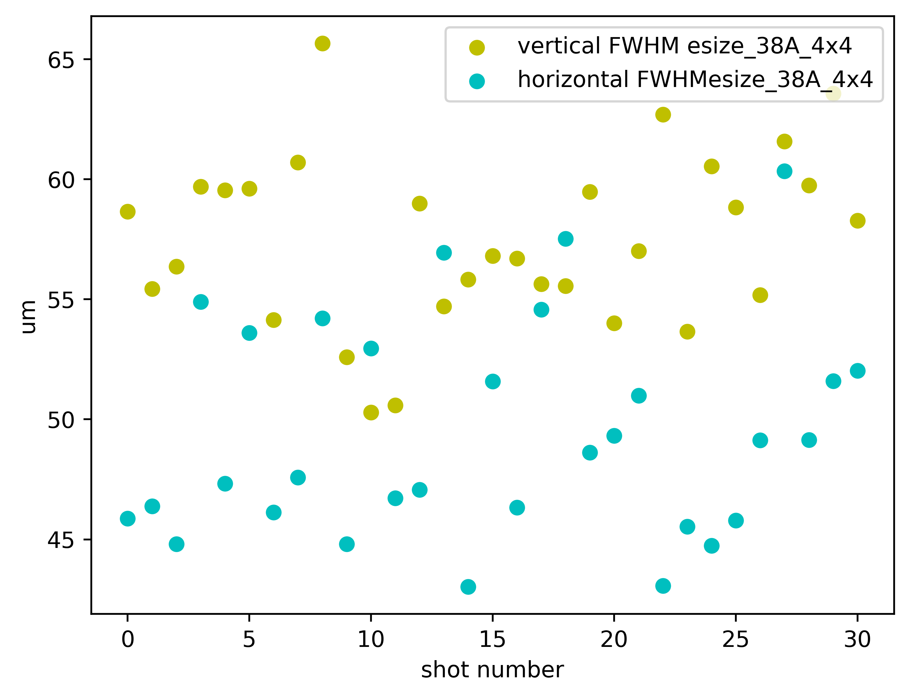
4x4, 0.5s, 38A
Intensity stability: +/- 8% std
21 +/- 2 um sigma v
25 +/- 2 um sigma h

Slide 4
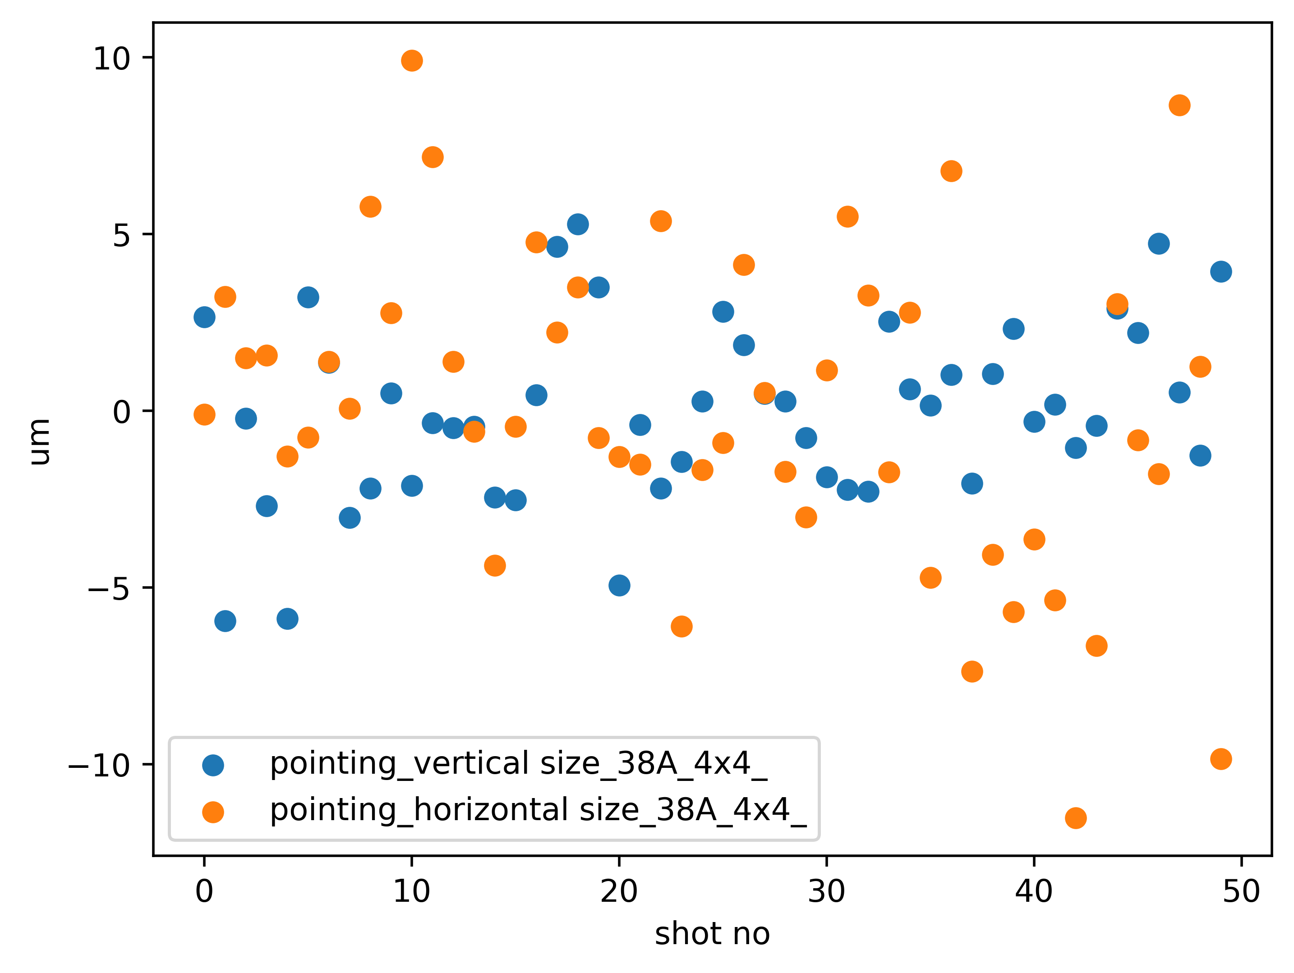
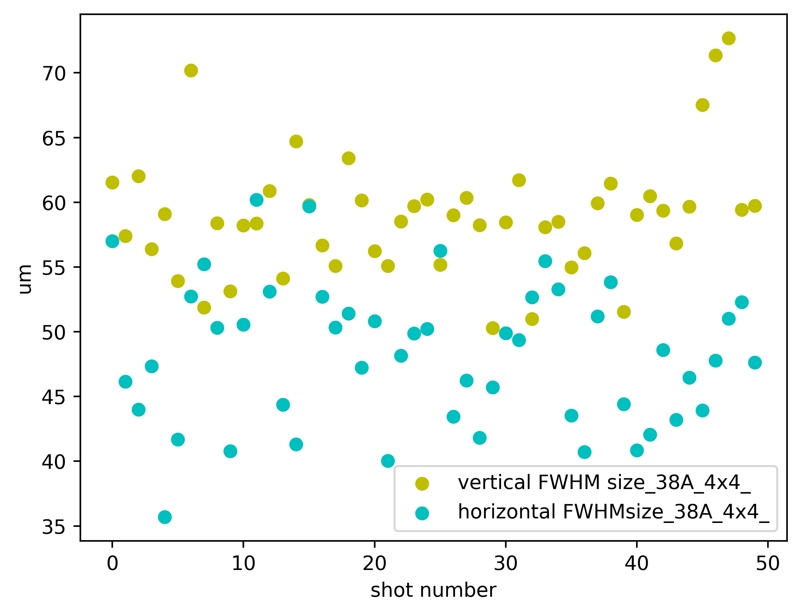
4x4, 0.25s, 38A
Intensity stability: +/- 10% std
21 +/- 2 um sigma v
25 +/- 2 um sigma h

Slide 5
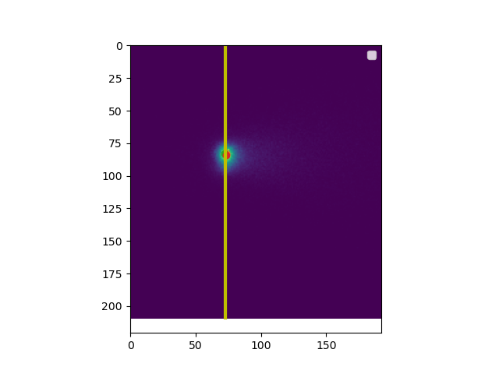
Laser | Integrated counts | ratio
35A | 200000/s | 17%
36A | 313000/s | 26%
37A | 710000/s | 59%
38A | 1200000/s | 100%
Evaluation integrated in a ROI of 100x100 px around center position, shots with integration time of 3s in 4x4 binning were used

