Slide 1
SwiftLog Logistics
Supply chain analytics and business intelligence
Oluwayomi Precious Similoluwa | AnalystLab Africa Experience Lab, Week 5 | Data Analytics

Slide 2
Business overview
SwiftLog is a fast-growing Nigerian logistics company with 15 warehouses in Lagos, Abuja and Kano.
Growth has brought late deliveries, uneven stock, returns and little executive visibility.
Our job: turn raw data from eleven files into one decision-ready Power BI report.
5,000
orders from 991 customers
N7.11M
delivered revenue
15
warehouses, 200 staff
2

Slide 3
Project objectives
Monitor performance
Improve delivery
Revenue, orders and customers in one view
Find where and why shipments run late
Manage inventory
Reduce returns
Spot low stock and slow-moving stock
Link returns to products and causes
3

Slide 4
Data preparation process
1
2
3
4
5
Import 11 files
Clean and type
Merge delivery data
Add flags and revenue
Model and relate
Dates converted, Date table added, text trimmed
Delay flag: 3 or more delay days counts as delayed
Revenue = quantity x unit price (delivered orders)
Inventory summed per warehouse and product; assumptions documented
4

Slide 5
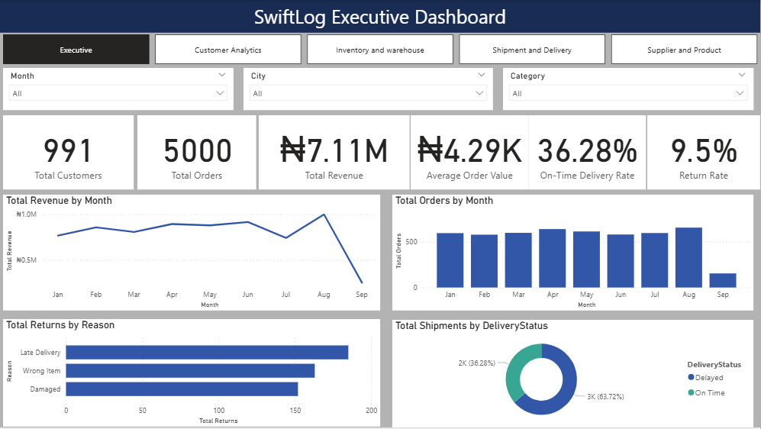
Executive dashboard
Only 36% of shipments are on time
Revenue and orders peak in August; September is a partial month.
5

Slide 6
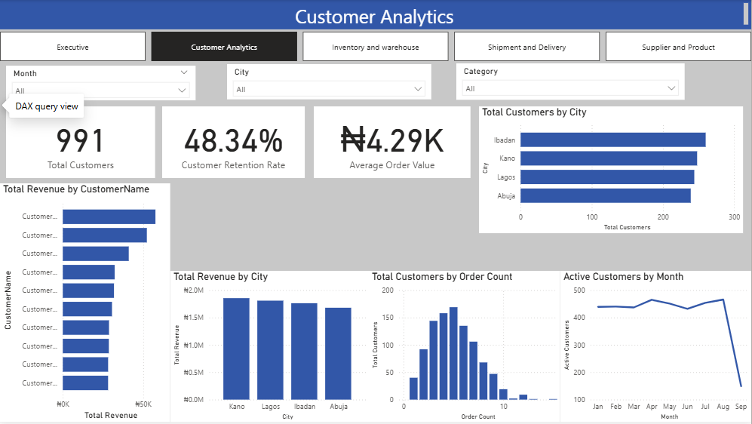
Customer analytics
Revenue is spread across customers
Top 10 customers hold about 5% of revenue; retention is 48%.
6

Slide 7
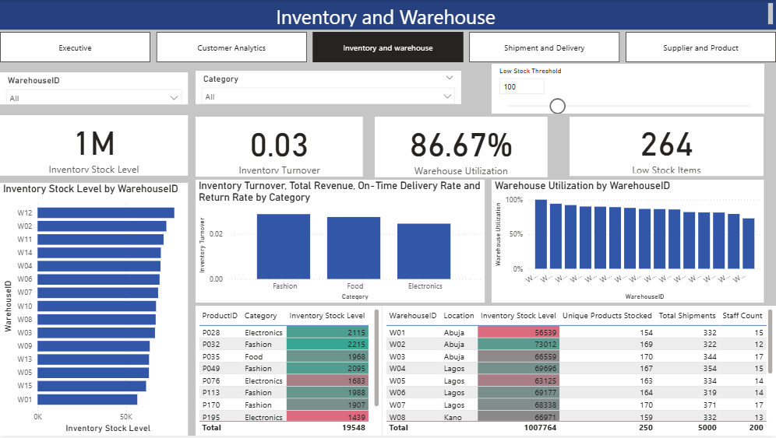
Inventory and warehouse
Lots of stock, very slow movement
Turnover is 0.03 while 264 pairs sit below the low-stock line.
7

Slide 8
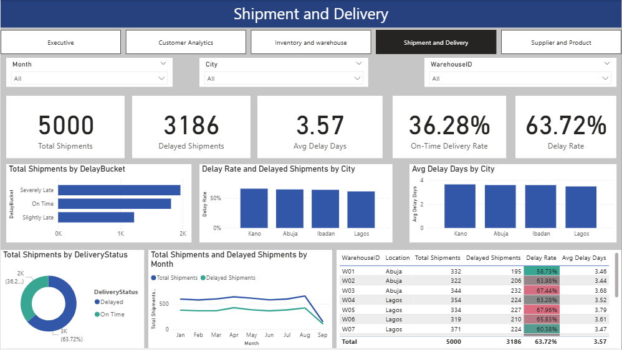
Shipment and delivery
Delays are company-wide
Delay rates run 59% to 68% in every warehouse and city.
8

Slide 9
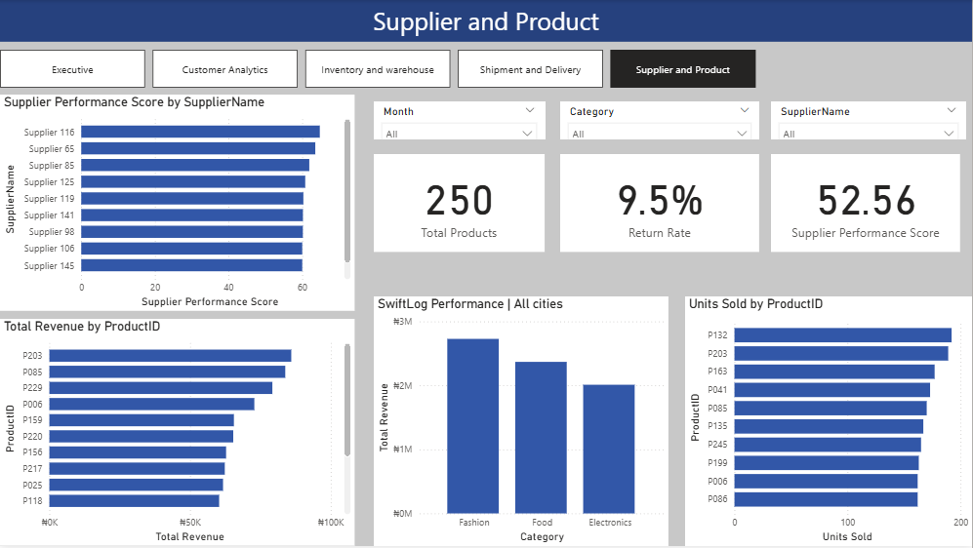
Supplier and product
Returns point to specific products
P032, P017 and P108 return far above the 9.5% average. Supplier scores are illustrative.
9

Slide 10
KPI summary
36.3%
3.57 days
9.5%
On-time delivery
Average delay
Return rate
0.03
48.3%
N4.29K
Inventory turnover
Customer retention
Average order value
10

Slide 11
Key insights
Delays are everywhere, so the cause is process, not place.
Late delivery is the top return reason (185 of 500).
Fashion earns 38% of revenue; August is the peak month.
Ibadan has the most customers but no warehouse.
11

Slide 12
Business recommendations
Run a delivery recovery plan: target 70% on time in two quarters
Alert at 2 days of delay; escalate at 3
Copy W01, W10 and W07 practices into W05, W09 and W03
Rebalance stock and restock 264 low-stock pairs
Rebalance staffing toward W14, W15 and W12 workloads
Open or partner for an Ibadan hub
Quality-check P032, P017 and P108
Loyalty offer for one-time buyers; track KPIs weekly
12

Slide 13
Expected business impact
Fewer returns
More revenue
Fixing late delivery targets the biggest return reason
Delivered orders and repeat buyers both rise
Lower stock cost
Clear control
Less slow stock and fewer stock-outs
Five pages leaders can check every week
13

Slide 14
Conclusion
SwiftLog's challenge is delivery, not growth. Fix on-time delivery first, then rebalance stock and staff. The dashboard shows the way and tracks progress.
Limits: supplier links, warehouse capacity and delivery dates were not in the data, so these views rely on documented assumptions.

