Slide 1
Simulation Parameters
Parameter | Values
Number of ONUs | around 16
Distance between ONU and OLT | 20 km
Packet size | 15000 byte
Ethernet overhead bits | 304 bits
Upstream BW | 1GBps
Max cycling time | 2ms
Buffer size | 10 Mbyte
Two way fiber delay | 200 micro second
Guard time | 5 micro second
Request message size | 570 bit
Max transition window(packet) | 10 for Maat& S-Maat
9

Slide 2
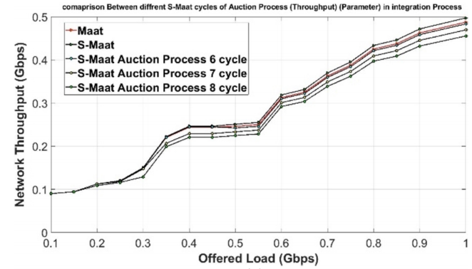
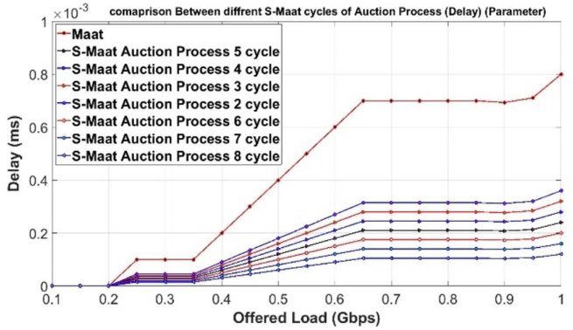
Throughput and Delay Analysis
Fig-1: Comparison of throughput in different cycles
Fig-2: Comparison of delays in different cycles
10

Slide 3
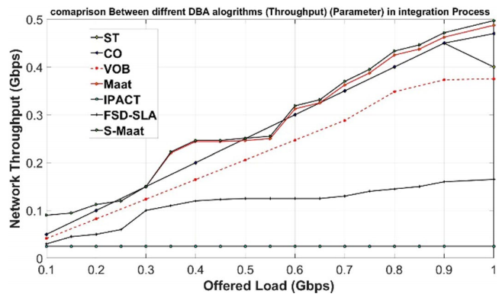
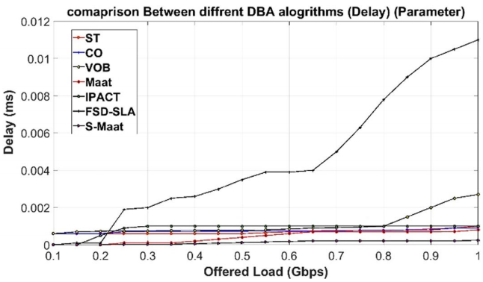
Performance comparison in different method
Fig-3: Throughput comparison
Fig-4:Delay Comparison
11

Slide 4
Semi Dynamic BW allocation process used.
Uses Auction process.
Demand of each user determined by Dynamic BW allocation.
Five cycle used in every auction process.
Several steps used to improve BW in every auction cycle.

Slide 5
Advantages
Bandwidth request is being predicted
Differentiate highly loaded ONUs.
Priority check of ONUs.
Reduce overall end to end delay.
Improve Network throughput.

Slide 6
future plan
Modification in DBA Algoritm.
Use software (MATLAB, Google Colab IDE) for performance analysis of
Requested Window.
Bandwidth Requirement of each ONU.
Prediction of highly Loaded ONUs.
System Throughputs and Improvements

