Slide 1
Flexible Wavelength and Dynamic Bandwidth Allocation for NG-EPONs
Source: Optical Society of America(2018) 1943-0620/18/060643-10
Course No: ECE-4130
Course Name: Seminar
Authors:
Syed Baqar Hussain
Weisheng Hu
Haiyun Xin
Ahmed Mohammed Mikaeil
Amber Sultan
Presented by:
Simina Mannan Trisha
Roll No:1709043

Slide 2

Basics about NG-EPON.
About FW-DBA model.
Objectives.
How FW-DBA works.
Comparison of FW-DBA and WF-DBA model.
Simulation parameters.
Performance Evaluation.
Conclusion
Overviews:
2

Slide 3

What is EPON?
• EPON (Ethernet Passive Optical Network)
provides Internet, voice, video access by Ethernet packets
use Ethernet than ATM cells
• Point-to-multipoint technology
• Delivers 1 Gbps upstream and downstream in FTTH and FTTP
3

Slide 4
What is NG-EPON?
• Next Generation Ethernet Passive Optical Network (NG-EPON)
future prospective access technology
possible to achieve 100 Gbps data rate.
• Supports four wavelength channels with data rate of 25Gbps each.
4

Slide 5
FW-DBA
Flexible Wavelength and Dynamic Bandwidth Allocation
FW-DBA is a centralized facility
OLT supports to receive BW requests from different ONUs.
flexibily assign wavelengths.
Wavelength Division Multiplexing is multiplexing technique for NG-EPON.
5

Slide 6
OBJECTIVES
To achieve improved delay performance.
To improve better transmission data rate.
To achieve flexibility to assign wavelength.
Compare the model performance with some previous models (WF-DBA, FF-DBA)
6

Slide 7
How does FW-DBA model work:
High Load offer
TW on each wavelength is high
TW>grant overhead
another wavelength allocate
reported BW> guard time
guard time increase
flexible number ONU assigned
delay reduced
7

Slide 8
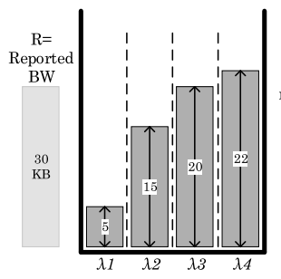
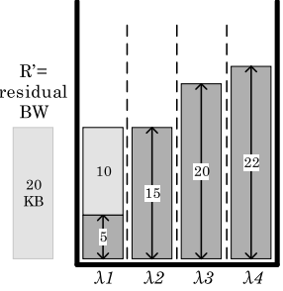
Working of FW-DBA(1)
α (grant utilization parameter)=2
Fig-1: Innitial step of FW-DBA
Fig-2:After first and second step
8

Slide 9
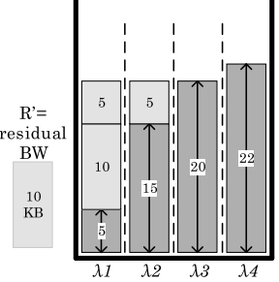
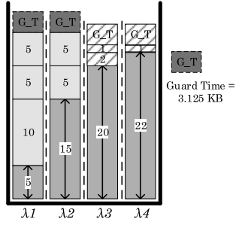
Working of FW-DBA(2)
α (grant utilization parameter)=2
Fig-3: After another iteration of first and second step
Fig-4: Final Allocation
9

Slide 10
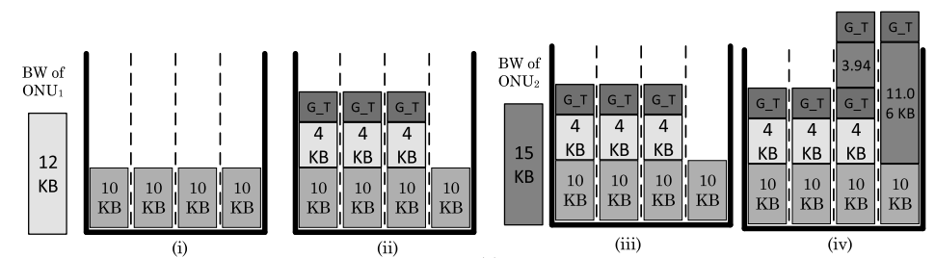
Comparision of FW-DBA and WF-DBA(1)
Fig-5: Working of FW-DBA with α=1
10

Slide 11
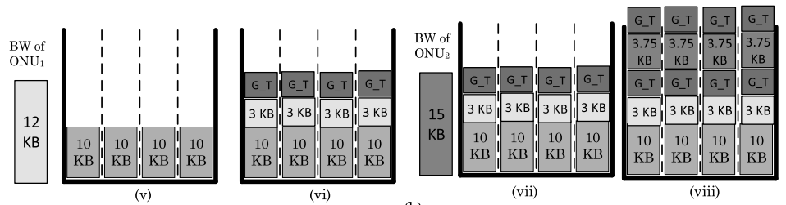
Comparision of FW-DBA and WF-DBA(2)
Fig-6: Working of WF-DBA with α=1
11

Slide 12
Simulation Parameters
Parameter | Values
Number of wavelengths | 4
Data rate per wavelength | 25Gb/s
Number of ONUs | 32,64,128
Buffer size of each ONU | Infinite
Ethernet Packet Size distribution | 64-1518 bytes
Control Message(MPCP) | 64 bytes
Inter-frame gap in upstream | 12 bytes
Frame preamble | 8 bytes
Guard time | 1 micro second
RTT_{i} | 100 micro sec
alpha | 1,3
12

Slide 13
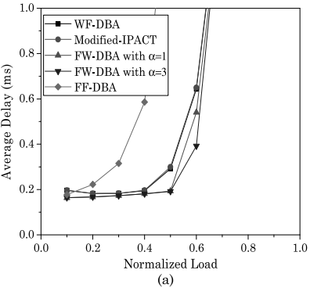
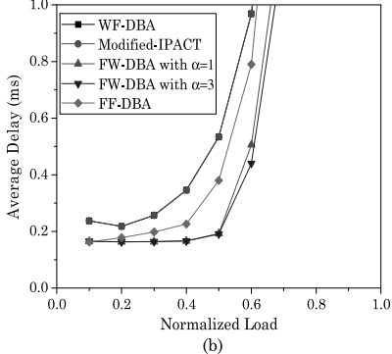
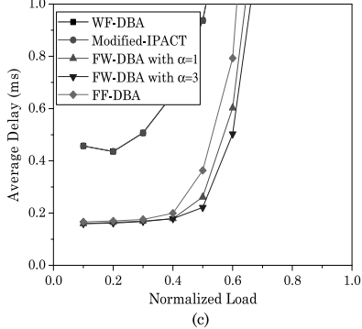
Average Packet delay
Fig-7: Average packet delay: (a) N = 32, (b) N = 64, and (c) N = 128.
13

Slide 14
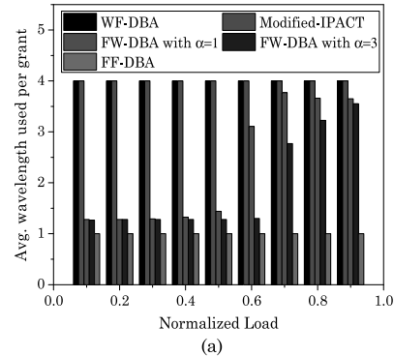
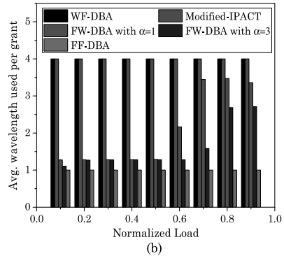
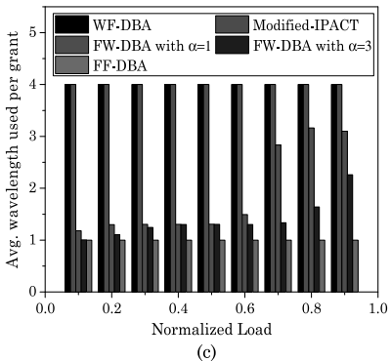
Flexibility to assign wavelengths
Fig- 8: Average number of wavelengths used per grant: (a) N = 32, (b) N = 64, (c) N = 128.
14

Slide 15
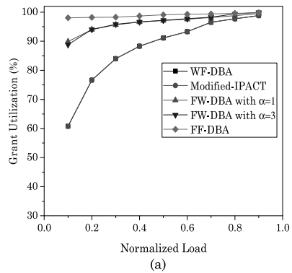
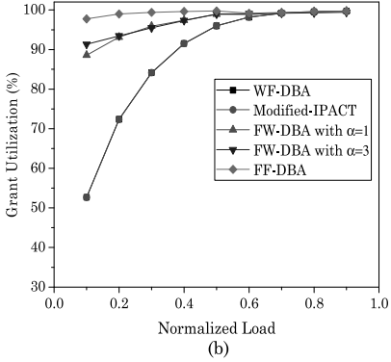
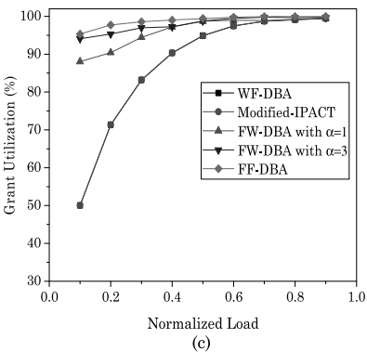
Grant Utilization
Fig:9- Grant utilization: (a) N = 32, (b) N = 64, and (d) N = 128.
15

Slide 16
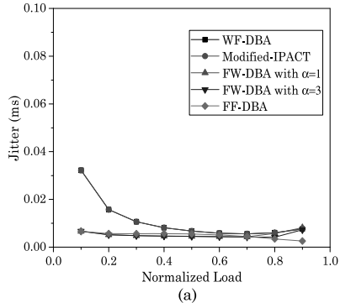
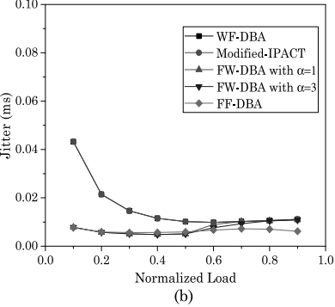
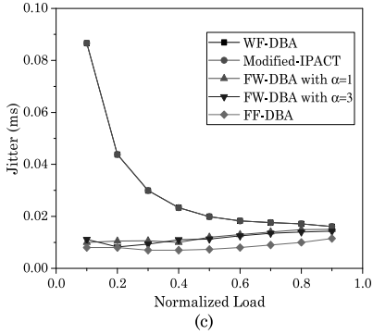
Jitter Analysis
Fig-10: Jitter analysis: (a) N = 32, (b) N = 64, and (c) N = 128.
16

Slide 17
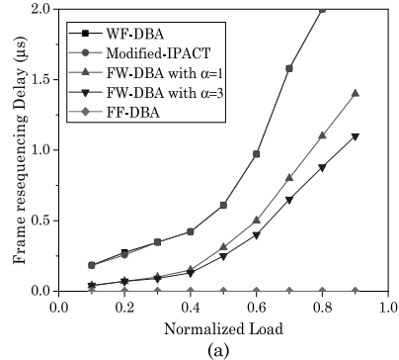
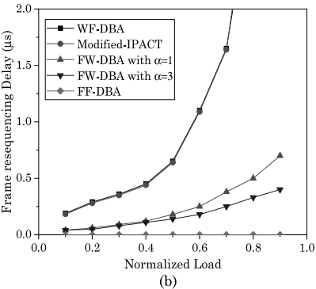
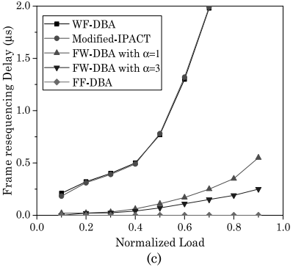
Frame Resequencing delay analysis
Fig-11: Frame resequencing delay: (a) N = 32, (b) N = 64, and (c) N = 128.
17

Slide 18
Conclusion
Lower average packet delay is obtained
better utilization and data transmission rate achieved
able to as_x0002_sign a flexible number of wavelengths to every ONU .
18

Slide 19
References:
[1] “Cisco Visual Networking Index: Forecast and Methodology, 2016–2021,” Cisco White Paper, June 2017. Available: https://www.cisco.com/c/dam/en/us/solutions/collateral/service_x0002_provider/visual-networking-index vni/complete-white-paper_x0002_c11-481360.pdf.
[2] “OnePON: addressing the alphabet soup of PON,” 2016 [Online]. Available: http://www.cablelabs.com/onepon_x0002_addressing-the-alphabet-soup-of-pon/.
[3] T. Pfeiffer, “Next generation mobile fronthaul and midhaul architectures,” J. Opt. Commun. Netw., vol. 7, no. 11,
pp. B38–B45, 2015.
[4] L. Peterson, A. Al-Shabibi, T. Anshutz, S. Baker, A. Bavier, S.Das, J. Hart, G. Palukar, and W. Snow, “Central office re_x0002_architected as a data center,” IEEE Commun. Magazine, vol. 54, no. 10, pp. 96–101, 2016.
[5] J. Li and J. Chen, “Passive optical network based mobile backhaul enabling ultra-low latency for communications among base stations,” J. Opt. Commun. Netw., vol. 9, no. 10, pp. 855–863, 2017.
[6] R. Mijumbi, J. Serrat, J. L. Gorricho, N. Bouten, F. De Turck, and R. Boutaba, “Network function virtualization State-of-the-art and research challenges,” IEEE Commun.Surv. Tutorials, vol. 18, no. 1, pp. 236–262, 2016.
[7] A. S. Thyagaturu, A. Mercian, M. P. McGarry, M. Reisslein, and W. Kellerer, “Software defined optical networks
(SDONs): a comprehensive survey,” IEEE Commun. Surv.Tutorials, vol. 18, no. 4, pp. 2738–2786, 2016.
[8] http://www.ieee802.org/3/ca/.
[9] G. Kramer, B. Mukherjee, and G. Pesavento, “Ethernet PON (ePON): design and analysis of an optical access network,”Photon. Netw. Commun., vol. 3, no. 3, pp. 307–319, 2001.
[10] G. Kramer and G. Pesavento, “Ethernet passive optical net_x0002_work (EPON): building a next-generation optical access net_x0002_work,” IEEE Commun. Mag., vol. 40, no. 2, pp. 66–73, 2002.
[11] IEEE, “Ethernet in the first mile task force,” IEEE 802.3ah Standards.
19

Slide 20
References(2):
[12] IEEE 802.3 Ethernet Working Group, “IEEE 802.3 industry connections feasibility assessment for next generation of EPON,” in IEEE 802.3 Plenary Meeting, Mar. 2015.
[13] G. Kramer, “A proposal for channel bonding at MAC control sublayer,” in IEEE 802.3ca 100G-EPON Task Force, 2016.
[14] G. Kramer, “MPCP+: a proposal for channel bonding at MAC control sublayer,” in IEEE Interim Meeting 100G EPON, Macau, China, 2016.
[15] L. Zhang, Y. Luo, B. Gao, X. Liu, F. Effenberger, and N. Ansari, “Channel bonding design for 100 Gb/s PON based on FEC code word alignment,” in Optical Fiber Communications Conf. and Exhibition (OFC), 2017.
[16] V. Houtsma, D. van Veen, and E. Harstead, “Recent progress on standardization of next-generation 25, 50, and 100G EPON,” J. Lightwave Technol., vol. 35, no. 6, pp. 1228–1234, 2017
[17] K. Taguchi, K. Asaka, M. Fujiwara, S. Kaneko, T. Yoshida, Y.Fujita, H. Iwamura, M. Kashima, S. Furusawa, M. Sarashina, H. Tamai, A. Suzuki, T. Mukojima, S. Kimura, K. Suzuki, and A. Otaka, “Field trial of long-reach and high-splitting tunable TWDM-PON,” J. Lightwave Technol., vol. 34, no. 1, pp. 213–221, Jan. 2016.
[18] D. Chitimalla, K. Kondepu, L. Valcarenghi, M. Tornatore, and B. Mukherjee, “5G fronthaul-latency and jitter studies of CPRI over ethernet,” J. Opt. Commun. Netw., vol. 9, no. 2, pp. 172–182, 2017.
[19] S. B. Hussain, W. Hu, H. Xin, and A. M. Mikaeil, “Low-latency dynamic wavelength and bandwidth allocation algorithm for NG-EPON,” J. Opt. Commun. Netw., vol. 9, no. 12, pp. 1108–1115, 2017.
[20] L. Wang, X. Wang, M. Tornatore, H. S. Chung, H. H. Lee, S. Park, and B. Mukherjee, “Dynamic bandwidth and wavelength allocation scheme for next-generation wavelength_x0002_agile EPON,” J. Opt. Commun. Netw., vol. 9, no. 3, pp. B33–B42, 2017.
[21] K. Kanonakis and I. Tomkos, “Improving the efficiency of online upstream scheduling and wavelength assignment in hybrid WDM/TDMA EPON networks,” IEEE J. Sel. Areas Commun., vol. 28, no. 6, pp. 838–848, 2010.
[22] M. P. McGarry and M. Reisslein, “Investigation of the DBA algorithm design space for EPONs,” J. Lightwave Technol., vol. 30, no. 14, pp. 2271–2280, 2012.
20

Slide 21
References(3):
[23] F. Usmani, S. M. H. Zaidi, A. Awais, and M. Y. A. Raja, “Efficient dynamic bandwidth allocation schemes in long_x0002_reach passive optical networks—A survey,” in 11th Annual High-Capacity Optical Networks and Emerging/Enabling “Technologies (HONET), 2014.
[24] G. Kramer, B. Mukherjee, and G. Pesavento, “IPACT a dynamic protocol for an Ethernet PON (EPON),” IEEE Commun. Mag., vol. 40, no. 2, pp. 74–80, 2002.
[25] C. A. Kyriakopoulos and G. I. Papadimitriou, “Bandwidth efficiency in the next generation access architecture XG-PON,” in 8th Int. Conf. on Ubiquitous and Future Networks (ICUFN), IEEE, 2016, pp. 833–838.
[26] A. M. Mikaeil, W. Hu, T. Ye, and S. B. Hussain, “Performance evaluation of XG-PON based mobile front-haul transport in cloud-RAN architecture,” J. Opt. Commun. Netw., vol. 9, no. 11, pp. 984–994, 2017.
[27] C. Knittle, “IEEE 100G-EPON,” in Optical Fiber Communication Conf., 2016.
[28] Z. Vujicic, A. Shahpari, B. Neto, N. Pavlovic, A. Almeida, A. Tavares, M. Ribeiro, S. Ziaie, R. Ferreira, R. Bastos, and A. Teixeira,“Considerations on performance, cost and power consumption of candidate 100G EPON architectures,” in 18th Int. Conf. Transparent Optical Networks (ICTON), 2016.
[29] G. Kramer, Ethernet Passive Optical Networks, McGraw-Hil Professional, 2005.
[30]A. Mercian, M. P. McGarry, and M. Reisslein, “Offline and online multi-thread polling in long-reach PONs: a critical evaluation,” J. Lightwave Technol., vol. 31, no. 12, pp. 2018–2028, 2013.
[31] A. Buttaboni, M. De Andrade, and M. Tornatore, “A multi_x0002_threaded dynamic bandwidth and wavelength allocation scheme with void filling for long reach WDM/TDM PONs,” J. Lightwave Technol., vol. 31, no. 8, pp. 1149–1157, 2013.
[32] A. Helmy, H. Fathallah, and H. Mouftah, “Interleaved polling versus multi-thread polling for bandwidth allocation in long-reach PONs,” J. Opt. Commun. Netw., vol. 4, no. 3, pp. 210–218, 2012.
[33] R. G. Gallager, Information Theory and Reliable Communication, Wiley, 1968, pp. 344–354.
[34] W. Wang, G. Wei, and W. Hu, “A fair and flexible dynamic wavelength and bandwidth allocation algorithm for IEEE 100G-EPON,” in
19th Int. Conf. Transparent Optical Networks (ICTON), 2017, pp. 1–4.
21

Slide 22


