Slide 1


27th International Conference on Computer and Information
Technology (ICCIT 2024)
Paper ID: 123
Performance Evaluation of Deep Learning Techniques for Wireless Intrusion Detection System: A Comparative Feature Selection Approach
Simina Mannan Trisha
Department of Electronics and Communication Engineering
Khulna University of Engineering & Technology, Khulna-9203
Soyabul Islam
Department of Electronics and Communication Engineering
Khulna University of Engineering & Technology, Khulna-9203
Monir Hossen
Professor,
Department of Electronics and Communication Engineering
Khulna University of Engineering & Technology, Khulna-9203

Slide 2
Outline
Introduction
Background
Problem Statement and Objective
Dataset Description
Proposed Methodology
Result Analysis and Discussion
Impact on Wireless Sytems, Security and Safety
Conclusion & Future Work
Reference

Slide 3
INTRODUCTION
Intrusion Detection System:
A system that monitors, detects, and responds to unauthorized activities or security threats in a network.
Protects networks from malicious attacks, ensuring confidentiality, integrity, and availability of data.
The rise in cyber threats, including phishing, malware, DDoS attacks, and zero-day vulnerabilities, has heightened the need for robust security measures to protect networks and systems.
Recently, many deep learning methods have been used for an efficient IDS.
For data-driven approach, feature engineering is a crucial aspect.
In this paper, we have focused on various feature selection techniques like filter, wrapper and embedded methods and built an efficient IDS by hybrid deep learning model.

Slide 4
BACKGROUND
Author | Work | Limitation
Amol D.Vibhute et al. (2024) | Chose some features by RF and used traditional machine learning to classify intrusions | Feature engineering wasn’t adopted properly. Usual traditional architecture doesn’t perform efficiently.
Chakrawarti et al. (2024) | Worked on several machine learning algorithms and compared the performances by accuracy | Used all the features of the dataset which led to computational enefficiency and time complexity
Arun et al. (2023) | To improve performance, they worked on different types of optimizers. | Only focusing on optimizers led to model overfitting and huge numbers of neurons usage led to resource constraints.
Zhai et al. (2023) | Proposed a combinational approach of deep learning and federated learning to predict intruders | Overall model performance became less efficient like 78.79% only because of the complex architecture.
Xu et al. (2023) | An attention-based CNN-BiLSTM model have been followed | No explicit feature selection method have been followed which causes to data redundancy.
Our Proposed Model | Worked on different feature selection techniques to identify the most important features and combined CNN and RNN based approach was followed for efficient model | Key Feature: Selected the most optimal features that resolves data redundancy and ensures 99.38% accurate intrusion detection

Slide 5
PROBLEM STATEMENT & OBJECTIVE
After literature review the major problems are observed:
Proper Feature Selection Strategies
Complex model architecture
Low Robustness
Resource Constraints
The Objectives of the Proposed systems are:
To find out the most efficient feature selection techniques.
To Design a robust CNN-RNN-DNN based hybrid deep neural network model to efficiently classify intrusions.
To develop a comparative feature selection method and evaluate it’s role to enhance robustness.

Slide 6
Dataset Description
The NSL-KDD dataset is a benchmark dataset which is derived from the KDD'99 dataset.
Contains 41 features grouped into categories like basic, content, and traffic-based features.
Includes 5 classes: Normal traffic and four attack categories (DoS, Probe, U2R, and R2L).
Comprehensive details of dataset:
Dataset | Total | Normal | DoS | Probe | U2R | R2L
Train Set | 118813 | 61809 | 42597 | 11197 | 98 | 3112
Test Set | 29704 | 15245 | 10790 | 2880 | 21 | 768

Slide 7
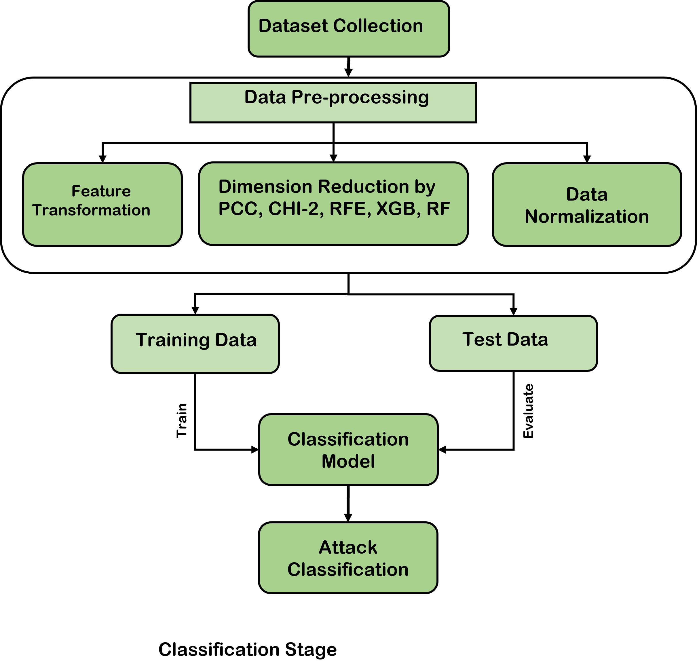
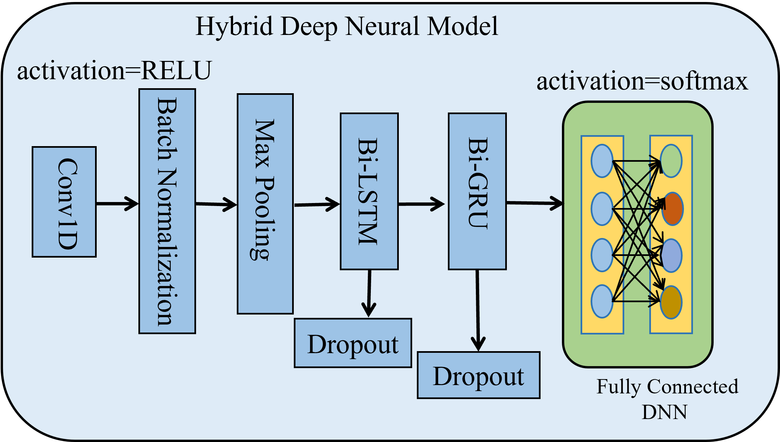
PROPOSED METHODOLOGY
Fig-2: Hybrid Deep Learning Classification Model
Fig-1: Overall workflow of the proposed scheme

Slide 8
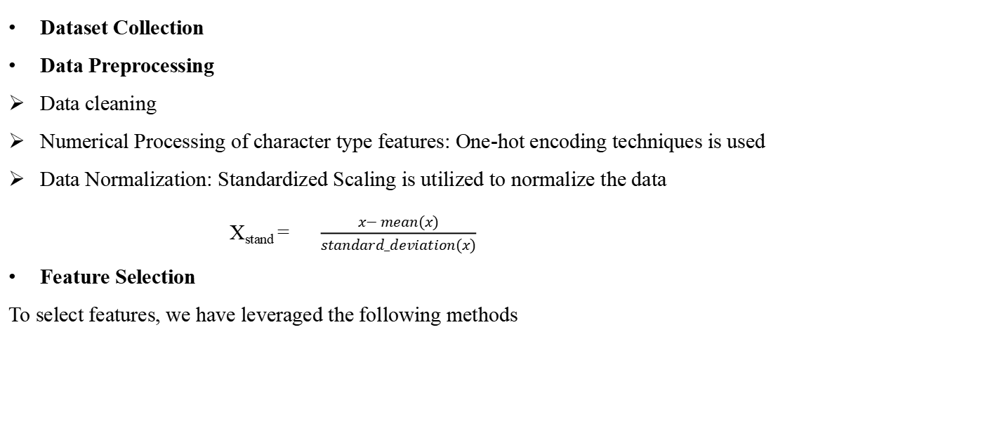
PROPOSED METHODOLOGY(Cont..)
Dataset Collection
Data Preprocessing
Data cleaning
Numerical Processing of character type features: One-hot encoding techniques is used
Data Normalization: Standardized Scaling is utilized to normalize the data
X_{stand} = $\frac{x− mean(x)}{standard_deviation(x)}$
Feature Selection
To select features, we have leveraged the following methods
Pearson Correlation Coefficient (PCC)
Chi Square
Recursive Feature Elimination (RFE)
Extreme Gradient Boosting (XGBoost)
Random Forest (RF)

Slide 9
PROPOSED METHODOLOGY(Cont..)
A hybrid deep neural model is developed combined CNN-RNN-DNN to classify intruders.
Convolutional Neural Network: 1D Convolutional layer is chosen to extract spatio-temporal features.
BiLSTM: Captures bidirectional dependencies in sequential data, enhancing the ability to analyze temporal patterns and improving the accuracy.
BiGRU: Reduces computational complexity while effectively capturing bidirectional context, making it suitable for analyzing time-series data.
Fully Connected Dense Layer: Aggregating features learned by previous layers to make precise predictions.
The Layer Description of Proposed Deep Learning
architecture:
Layer Name | Details
Conv 1D | Filters=128,kernel size=5,activation=ReLU
BiLSTM | Units= 128, return sequence=False
BiGRU | Units= 128, return sequence=False
DNN(1) | activation=ReLU, Neurons=5,
DNN(2) | activation= softmax

Slide 10
RESULT AND DISCUSSION
The most important features are extracted by different Feature Selection Techniques.
Feature Selection Methods | Index of Selected features | Number of Selected Feature
PCC | 0, 13, 24, 3, 4, 5, 26, 17, 28, 9, 20, 1,22, 11,14, 16, 7, 18, 19, 10, 31, 12, 23,2, 6, 8, 29, 30, 21, 32, 34, 35, 36, 41 | 34
Chi Square | 4, 5, 0, 22, 32, 31, 23, 2, 9, 3, 38, 25,24, 37, 15, 12, 11, 33 | 18
RFE | 1, 2, 3, 4, 5, 22, 23, 24, 28, 29, 32, 33,34, 35, 36, 38, 39 | 17
XGBoost | 13, 0, 37, 39, 35, 40, 5, 33, 2, 30,3, 9, 34, 1, 24, 38, 7, 22, 36, 29,21, 4, 10, 28 | 24
Random Forest | 31, 36, 11, 39, 32, 23, 1, 38, 35, 2, 34,33, 25, 29, 24, 22, 5, 3, 28, 4 | 20

Slide 11
RESULT AND DISCUSSION(Cont...)
The overall performance matrix of the proposed model for various feature selection techniques (PCC, Chi Square, RFE)
Model | Accuracy |  |  | Precision |  |  | F1-Score |  |  | Recall
 | PCC | Chi2 | RFE | PCC | Chi2 | RFE | PCC | Chi2 | RFE | PCC | Chi2 | RFE
DNN | 96.62 | 89.89 | 96.91 | 96.46 | 87.95 | 96.92 | 96.40 | 88.50 | 96.82 | 96.62 | 89.89 | 96.91
CNN | 96.47 | 95.48 | 95.28 | 96.24 | 95.39 | 95.16 | 96.16 | 95.40 | 95.08 | 96.47 | 95.48 | 95.28
LSTM | 97.73 | 98.66 | 98.81 | 97.69 | 98.66 | 98.79 | 97.67 | 98.64 | 98.79 | 97.73 | 98.66 | 98.81
BiLSTM | 98.02 | 98.82 | 98.95 | 97.99 | 98.83 | 98.94 | 97.99 | 98.82 | 98.94 | 98.02 | 98.82 | 98.95
GRU | 97.32 | 98.75 | 98.87 | 97.24 | 98.74 | 98.84 | 97.23 | 98.74 | 98.85 | 97.32 | 98.75 | 98.87
BiGRU | 97.86 | 98.92 | 98.97 | 97.87 | 98.91 | 98.96 | 97.87 | 98.92 | 98.97 | 97.86 | 98.92 | 98.97
CNN-LSTM | 98.74 | 99.07 | 98.99 | 98.81 | 99.08 | 98.98 | 98.65 | 99.07 | 98.97 | 98.66 | 99.07 | 98.99
Proposed Model | 98.92 | 99.22 | 99.17 | 98.91 | 99.21 | 99.16 | 98.81 | 99.21 | 99.16 | 98.92 | 99.22 | 99.17

Slide 12
RESULT AND DISCUSSION(Cont...)
The overall performance matrix of the proposed model for various feature selection techniques (XGBoost, Random Forest)
Model | Accuracy |  | Precision |  | F1-Score |  | Recall
 | XGB | RF | XGB | RF | XGB | RF | XGB | RF
DNN | 96.63 | 96.01 | 96.66 | 96.03 | 96.56 | 96.01 | 96.63 | 96.01
CNN | 94.51 | 95.51 | 94.44 | 95.53 | 94.14 | 94.94 | 94.51 | 95.51
LSTM | 98.99 | 98.84 | 98.98 | 98.80 | 98.98 | 98.79 | 98.99 | 98.84
BiLSTM | 99.04 | 98.89 | 99.03 | 98.85 | 99.03 | 98.86 | 99.04 | 98.89
GRU | 99.02 | 98.74 | 99.01 | 98.70 | 99.00 | 98.71 | 99.02 | 98.74
BiGRU | 99.19 | 98.93 | 99.18 | 98.95 | 99.18 | 98.94 | 99.19 | 98.93
CNN-LSTM | 99.27 | 99.04 | 99.26 | 99.02 | 99.27 | 99.01 | 99.27 | 99.04
Proposed Model | 99.38 | 99.11 | 99.38 | 99.09 | 99.37 | 99.09 | 99.38 | 99.11

Slide 13
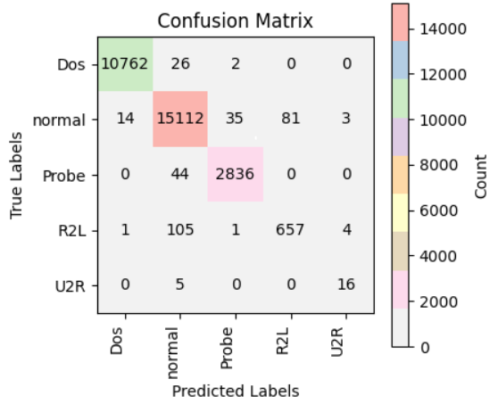
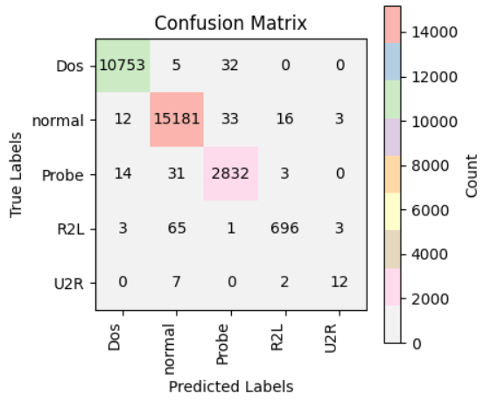
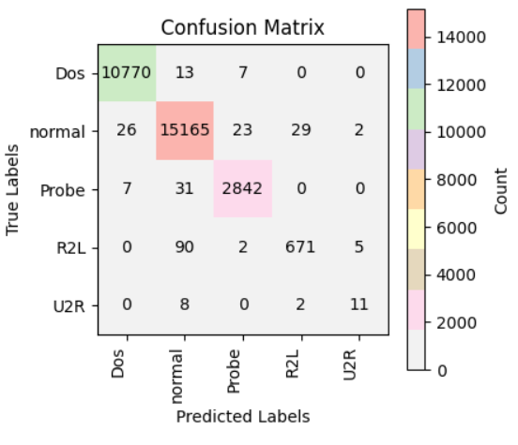
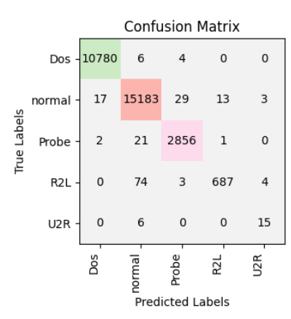
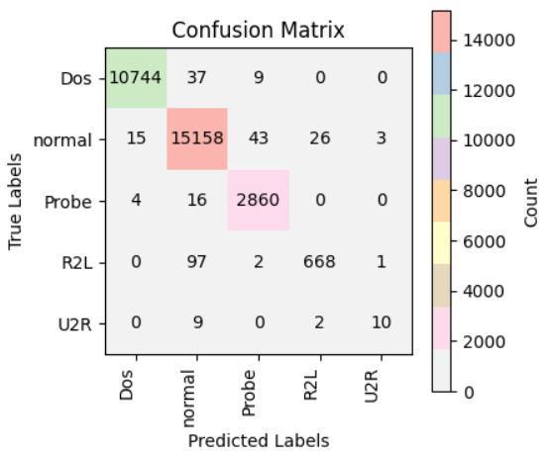
RESULT AND DISCUSSION(Cont...)
a) PCC
b) Chi Square
c) RFE
d) XGBoost
e) Random Forest
Fig-3: Confusion Matrix for the proposed hybrid DL model

Slide 14
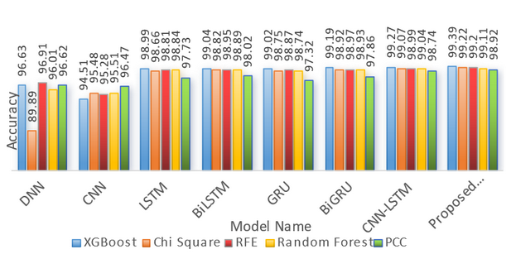
RESULT AND DISCUSSION(Cont...)
Fig-4: Overall Accuracy Comparision of all the adopted deep learning models

Slide 15
RESULT AND DISCUSSION(Cont...)
Performance comparison with other studies
Studies | Year | Method | Accuracy
Amol et al. [7] | 2024 | KNN(RF) | 98.24
Chakrawarti et al. [8] | 2024 | KNN | 98.55
Arun et al. [9] | 2023 | RNN | 98.68
Zhai et al. [10] | 2023 | CNN-GRU-FL | 78.79
Xu et al. [11] | 2023 | CNN-BiLSTM_SelfAttention | 93.26
Proposed model | 2024 | (CNN-BiLSTM-BiGRU_DNN(XGBoost)) | 99.38

Slide 16
IMPACT OF THIS PROJECT ON WIRELESS SYSTEM,
SAFETY AND SECURITY
Impact on Wireless System
Robust Security framework
Improved Real-time threat identification
Increased Computational efficiency and resource’s load balance
Safeguarding data transmission
Safer network ecosystem
Support for edge-based securtity applications
Enhanced security for wireless IoT applications

Slide 17
CONCLUSION & FUTURE WORK
The proposed hybrid deep learning model achieved 99.38% accuracy, demonstrating its effectiveness for intrusion detection in wireless networks.
XGBoost-based feature selection showed optimized performance, highlighting the importance of informative features for accuracy and efficiency.
The proposed system addresses critical challenges in wireless network security, improving reliability and resilience against numerous cyber threats.
For future research, we can focus on adapting real-time intrusion detection scenarios in dynamic and large-scale wireless embedded environments.
We would like to explore explainable AI techniques along with diversifies dataset to ensure more robust and trusted system.

Slide 18
REFERENCE
[1] J. Hussain, V. Hnamte, 2021. Deep learning based intrusion detection system: modern approach: Software Defined Network. 2021 2nd Global Conference for Advancement in Technology (GCAT), 1–6,doi:10.1109/GCAT52182.2021.9587719.
[2] Q. I. Jing, A.V. Vasilakos, J. Wan, J. Lu, D. Qiu, 2014. Security of the Internet of Things: perspectives and challenges. Wireless Netw. 20 (8), 2481–2501.
[3] W. Elmasry, A. Akbulut, A. H. Zaim, 2020. Evolving deep learning architectures for network intrusion detection using a double PSO meta_x0002_heuristic. Comput. Netw. 168, 107042.
[4] M. A. Al-Garadi, A. Mohamed, A. K. Al-Ali, X. Du, I. Ali, M. Guizani, 2020. A survey of machine and deep learning methods for internet of things (iot) security. IEEE Commun. Surv. Tutor. 22 (3), 1646–1685, doi:10.1109/COMST.2020.2988293.
[5] J. Wang, Y. Ma, L. Zhang, R. X. Gao, D. Wu, 2018. Deep learning for smart manufacturing: methods and applications. J. Manuf. Syst. 48,144–156, doi:10.1016/j.jmsy.2018.01.003.
[6] R. Zhao, R. Yan, Z. Chen, K. Mao, P. Wang, R.X. Gao, 2019. Deep learning and its applications to machine health monitoring. Mech. Syst.
Signal Process. 115, 213–237, doi:10.1016/j.ymssp.2018.05.050.
[7] Amol D. Vibhute, Chandrashekhar H. Patil, Arjun V. Mane, Karbhari V. Kale,Towards Detection of Network Anomalies using Machine
Learning Algorithms on the NSL-KDD Benchmark Datasets, Procedia Computer Science,Volume 233,2024,Pages 960-969,ISSN 1877-0509,
https://doi.org/10.1016/j.procs.2024.03.285.
[8] Chakrawarti, A., & Shrivastava, S.S. (2024). Intrusion classification and detection system using machine learning models on NSL-KDD dataset.
In: Devi, B.R., Kumar, K., Raju, M., Raju, K.S., & Sellathurai, M. (Eds.),Proceedings of the Fifth International Conference on Computer and
Communication Technologies (IC3T 2023). Lecture Notes in Networks and Systems, vol. 898. Springer, Singapore. https://doi.org/10.1007/978-981-99-9707-7 8
[9] Silivery, A.K., Kovvur, R.M.R., Solleti, R., Kumar, L.K., & Madhu, B. (2023). A model for multi-attack classification to improve intrusion detection performance using deep learning approaches. Measurement: Sensors, 30, 100924. ISSN 2665-9174. https://doi.org/10.1016/j.measen.2023.100924
[10] Zhai, F., Yang, T., Chen, H., He, B., & Li, S. (2023). Intrusion detection method based on CNN–GRU–FL in a smart grid environment.
Electronics, 12(5), 1164. https://doi.org/10.3390/electronics12051164
[11] H. Xu, L. Sun, G. Fan, W. Li, G. Kuang, 2023. A hierarchical intrusion detection model combining multiple deep learning models
with attention mechanism. IEEE Access, 11, 2023. DOI: 10.1109/ACCESS.2023.3290613.
[12] RUIZHE ZHAO, February 2, 2022, ”NSL-KDD”, IEEE Dataport, doi:https://dx.doi.org/10.21227/8rpg-qt98.

Slide 19
Thank You

