Slide 1

27th International Conference on Computer and Information
Technology (ICCIT 2024)
Paper ID: 122
Performance Exploration of ML and DL Techniques for Malicious URL Detection: A PSO Based Feature Selection Approach
Simina Mannan Trisha
Department of Electronics and Communication Engineering
Khulna University of Engineering & Technology, Khulna-9203
Soyabul Islam
Department of Electronics and Communication Engineering
Khulna University of Engineering & Technology, Khulna-9203
Monir Hossen
Professor,
Department of Electronics and Communication Engineering
Khulna University of Engineering & Technology, Khulna-9203

Slide 2

Outline
Introduction
Background
Problem Statement and Objective
Dataset Description
Proposed Methodology
Result Analysis and Discussion
Conclusion & Future Work
Reference

Slide 3

Introduction
Malicious URL:
Web links that are particularly designed to cause harm by exploiting vulnerabilities in systems or tricking users into taking harmful actions.
Purposes –
Phishing Attacks
Malware Distribution
Download Malware Contents
Instantiate bot to take control

Slide 4

Background
Author | Work | Limitation
Kabakus et al. (2022) | Proposed CNN-based URL categorization. | Only usage of CNN rise question about models reliability, runtime was not discussed.
Malaviya et al. (2023) | Explored various machine learning models and showed Random forest worked better | They didn’t mention about feature extraction , data analysis or runtime.
Alshingiti et al. (2023) | Proposed three deep learning model, CNN, LSTM, and CNN-LSTM based. Used SelectKBest to choose the best features before applying the deep learning classifier. | No mention of total computing time.
S. Afzal et al.(2024) | Combined ANN with Bidirectional Encoder Representations from Transformers (BERT) to extract contextual embeddings. | Transformer based model requires high computational resource and execution time.
Albahadili et al.(2024) | Detected phishing attacks using deep learning, machine learning, and swarm intelligence. Used GAN to Balance the dataset. | Complex architecture cause high computational power and efficiency. No Mention of detection time.
Our Proposed Model | Worked on meta-heuristic algorithm to select best features and proposed an emsemble machine learning model to classify malicious urls which is comapred to customised deep learning and traditional architecture. | Key Features: selected the most optimal features and classified 98.46% harmful urls within 56.98s execution time.

Slide 5
Problem Statement & Objectives
Problem Statement
Traditional URL-classification methods, like static analysis and post-access features, are insufficient to counter evolving hacker strategies.
Existing systems lack the granularity needed for accurate and precise URL categorization.
Implementation of complex model costs high power and time.
Objectives:
To develop a robust machine learning approach to effectively detects malicious URLs.
To build a feature selection algorithm for computationally effective classification and better model’s performance .
To evaluate the proposed scheme’s superiority over deep learning techniques and traditional methods in terms of accuracy and runtime efficiency.

Slide 6

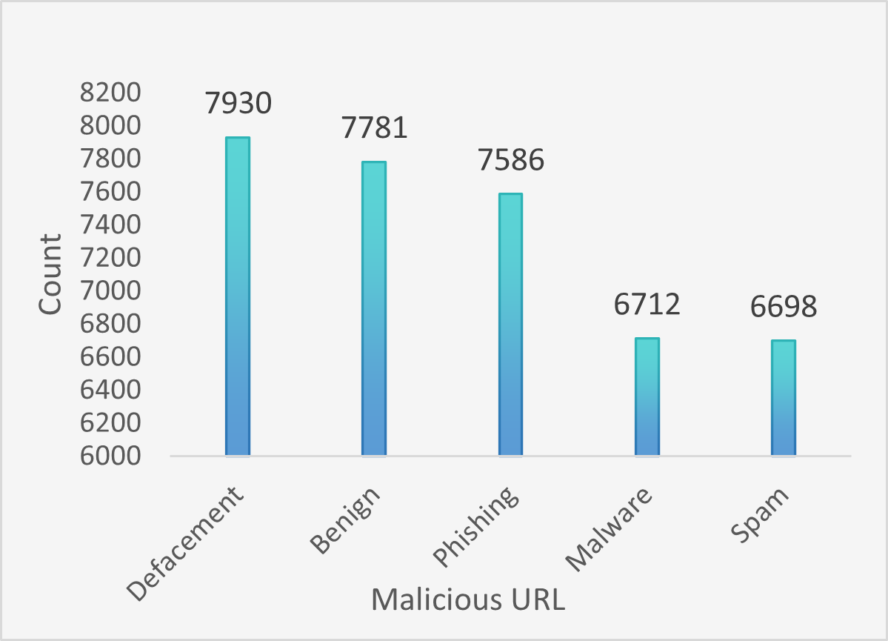
Dataset Description
ISCX-URL2016 dataset Contains total of 36,707 samples
Contains 80 features including . query length, domain token count, path token count, and others
Includes 5 classes: benign, defacement, phishing, malware and spam URLs
Comprehensive details of dataset:
Dataset | Total | Deface-ment | Benign | Phishing | Malware | Spam
Train Set | 29,366 | 6344 | 6225 | 6069 | 5370 | 5358
Test Set | 7341 | 1586 | 1556 | 1517 | 1342 | 1330
Fig. 1: Types of malicious URL and their count in ISCX-URL-
2016

Slide 7

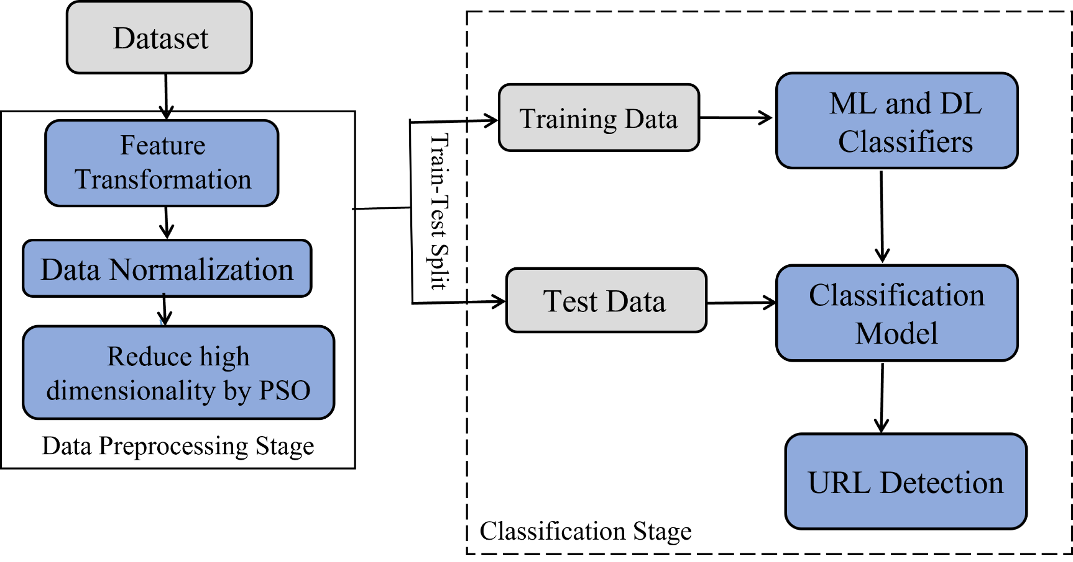
Proposed Methodology
Fig-2: Overall workflow of the proposed scheme

Slide 8
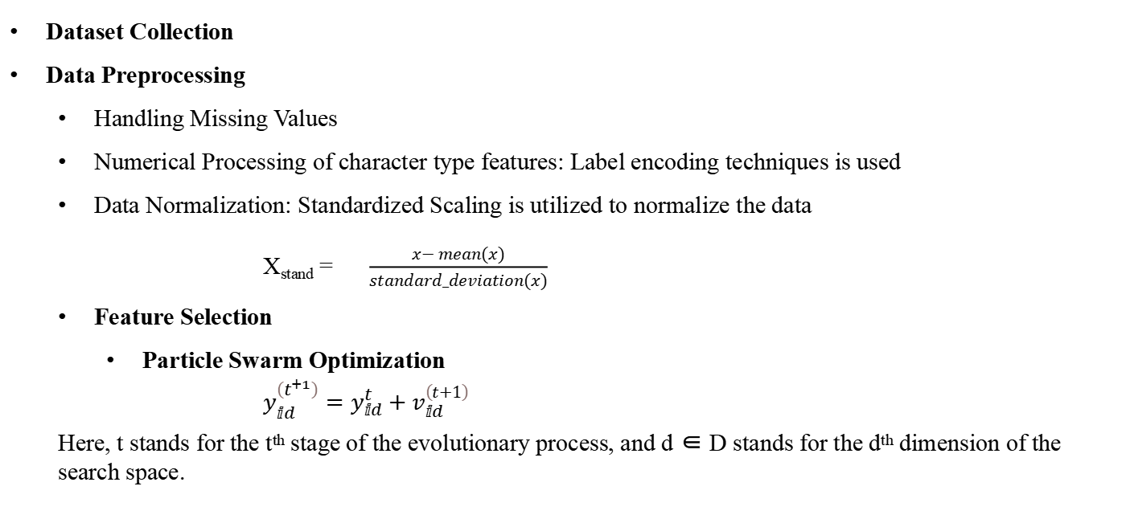
Proposed Methodology(Cont..)
Dataset Collection
Data Preprocessing
Handling Missing Values
Numerical Processing of character type features: Label encoding techniques is used
Data Normalization: Standardized Scaling is utilized to normalize the data
X_{stand} = $\frac{x− mean(x)}{standard_deviation(x)}$
Feature Selection
Particle Swarm Optimization
$y_{ⅈd}^{\left(t^{+1}\right)}=y_{ⅈd}^{t}+v_{ⅈd}^{\left(t+1\right)}$
Here, t stands for the t^{th} stage of the evolutionary process, and d ∈ D stands for the d^{th} dimension of the search space.

Slide 9
Proposed Methodology(Cont..)
Combines Decision Tree, Random Forest, Extra Tree, and XGBoost for improved accuracy and robustness.
Decision Trees: Simple and interpretable models for quick decision-making.
Random Forest & Extra Trees: Reduce overfitting and variance through bagging and feature randomness.
XGBoost: Boosts weak learners and corrects errors, excelling in structured data analysis
Integrates linear, tree-based, and boosting-based methods to diversify learning abilities and optimize performance.
Employs hard voting to aggregate predictions, enhancing classifier reliability.
A hybrid deep learning model is also followed.
The layer description of the followed model is:
Layer Name | Details
Conv 1D | Filters = 64, kernel size = 6, activation = ReLU
LSTM | units = 64, return sequence = false
GRU | units = 64, return sequence = false
DNN(1) | Neurons = 128, activation = ReLU
DNN(2) | Neurons = 5, activation = softmax

Slide 10
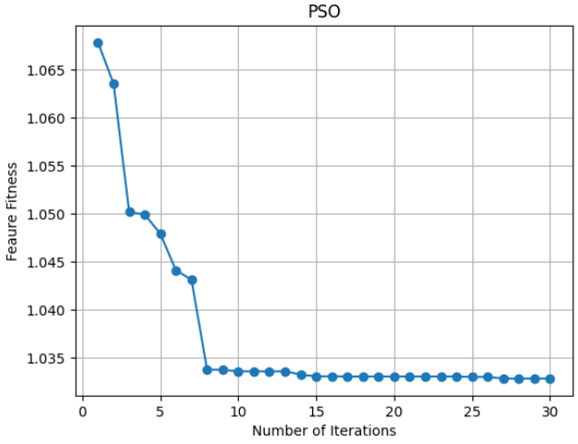
Result and Discussion
Features Selected by PSO of ISCX URL-2016
No of Total Features | Number of Selected Feature | Index of Selected features
80 | 48 | 0, 1, 5, 7, 8, 10, 12, 14, 15, 18, 19, 22, 23, 24, 25, 26, 27, 28, 29, 33, 34, 36, 37, 38, 39, 42,43, 44, 45, 48, 49, 50, 53, 54, 55, 56, 60, 61, 64, 65, 66, 67, 70, 71, 73, 74, 75, 76
Fig. 2: Iteration vs Fitness curve for feature selection by PSO

Slide 11
Result and Discussion
Overall performance of different ML classifiers using all features
Model | Accuracy | Precision | F1-Score | Recall
SVM | 72.38 | 73.60 | 71.40 | 71.40
DT | 95.21 | 95.20 | 95.20 | 95.40
RFC | 97.55 | 97.60 | 97.40 | 97.20
KNN | 92.39 | 92.20 | 92.60 | 92.40
ETC | 97.73 | 97.60 | 97.60 | 97.80
XGB | 98.11 | 98.11 | 98.12 | 98.11
GRADBOOST | 94.36 | 94.40 | 94.20 | 94.20
DT & RF | 96.20 | 96.22 | 96.18 | 96.20
RF & XGB | 98.05 | 98.06 | 98.05 | 98.05
DT & XGB | 98.09 | 98.10 | 98.09 | 98.09
ETC & XGB | 98.11 | 98.12 | 98.11 | 98.11
DT, RF & XGB | 98.00 | 98.00 | 98.00 | 98.00
ETC, RF, XGB | 97.81 | 97.84 | 97.82 | 97.81
DT, RF, ETC, XGB | 98.15 | 98.15 | 98.15 | 98.15

Slide 12
Result and Discussion
Overall performance of different ML classifiers using Selected features
Model | Accuracy | Precision | F1-Score | Recall
SVM | 71.15 | 72.40 | 70.20 | 70.20
DT | 95.71 | 95.60 | 95.80 | 95.80
RFC | 97.81 | 98.00 | 97.60 | 97.80
KNN | 92.22 | 92.40 | 92.20 | 92.40
ETC | 97.92 | 98.20 | 97.60 | 98.00
XGB | 98.20 | 98.20 | 98.20 | 98.20
GRADBOOST | 93.80 | 93.80 | 93.80 | 93.60
DT & RF | 96.25 | 96.28 | 96.23 | 96.25
RF & XGB | 98.09 | 98.10 | 98.09 | 98.09
DT & XGB | 98.16 | 98.16 | 98.16 | 98.16
ETC & XGB | 98.15 | 98.16 | 98.15 | 98.15
DT, RF & XGB | 98.20 | 98.22 | 98.21 | 98.20
ETC, RF, XGB | 98.04 | 98.06 | 98.04 | 98.04
DT, RF, ETC, XGB | 98.46 | 98.46 | 98.46 | 98.46

Slide 13
Result and Discussion
Performance evaluation of Deep Learning Classifier with total and selected features
 | Model | Accuracy | Precision | F1-Score | Recall
All | DNN | 96.48 | 96.47 | 96.47 | 96.48
 | CNN | 96.69 | 96.70 | 96.68 | 96.69
 | LSTM | 95.65 | 95.59 | 95.58 | 95.58
 | BiLSTM | 95.95 | 95.95 | 95.95 | 95.95
 | GRU | 96.10 | 96.13 | 96.10 | 96.10
 | BiGRU | 96.09 | 96.08 | 96.05 | 96.09
 | Hybrid | 96.90 | 96.91 | 96.89 | 96.90
Selected | DNN | 96.48 | 96.48 | 96.48 | 96.48
 | CNN | 96.86 | 96.86 | 96.85 | 96.86
 | LSTM | 96.30 | 96.02 | 96.02 | 96.05
 | BiLSTM | 96.28 | 96.26 | 96.26 | 96.28
 | GRU | 96.62 | 96.53 | 96.54 | 96.55
 | BiGRU | 96.10 | 95.75 | 95.77 | 95.76
 | Hybrid | 97.00 | 97.00 | 97.00 | 97.00

Slide 14
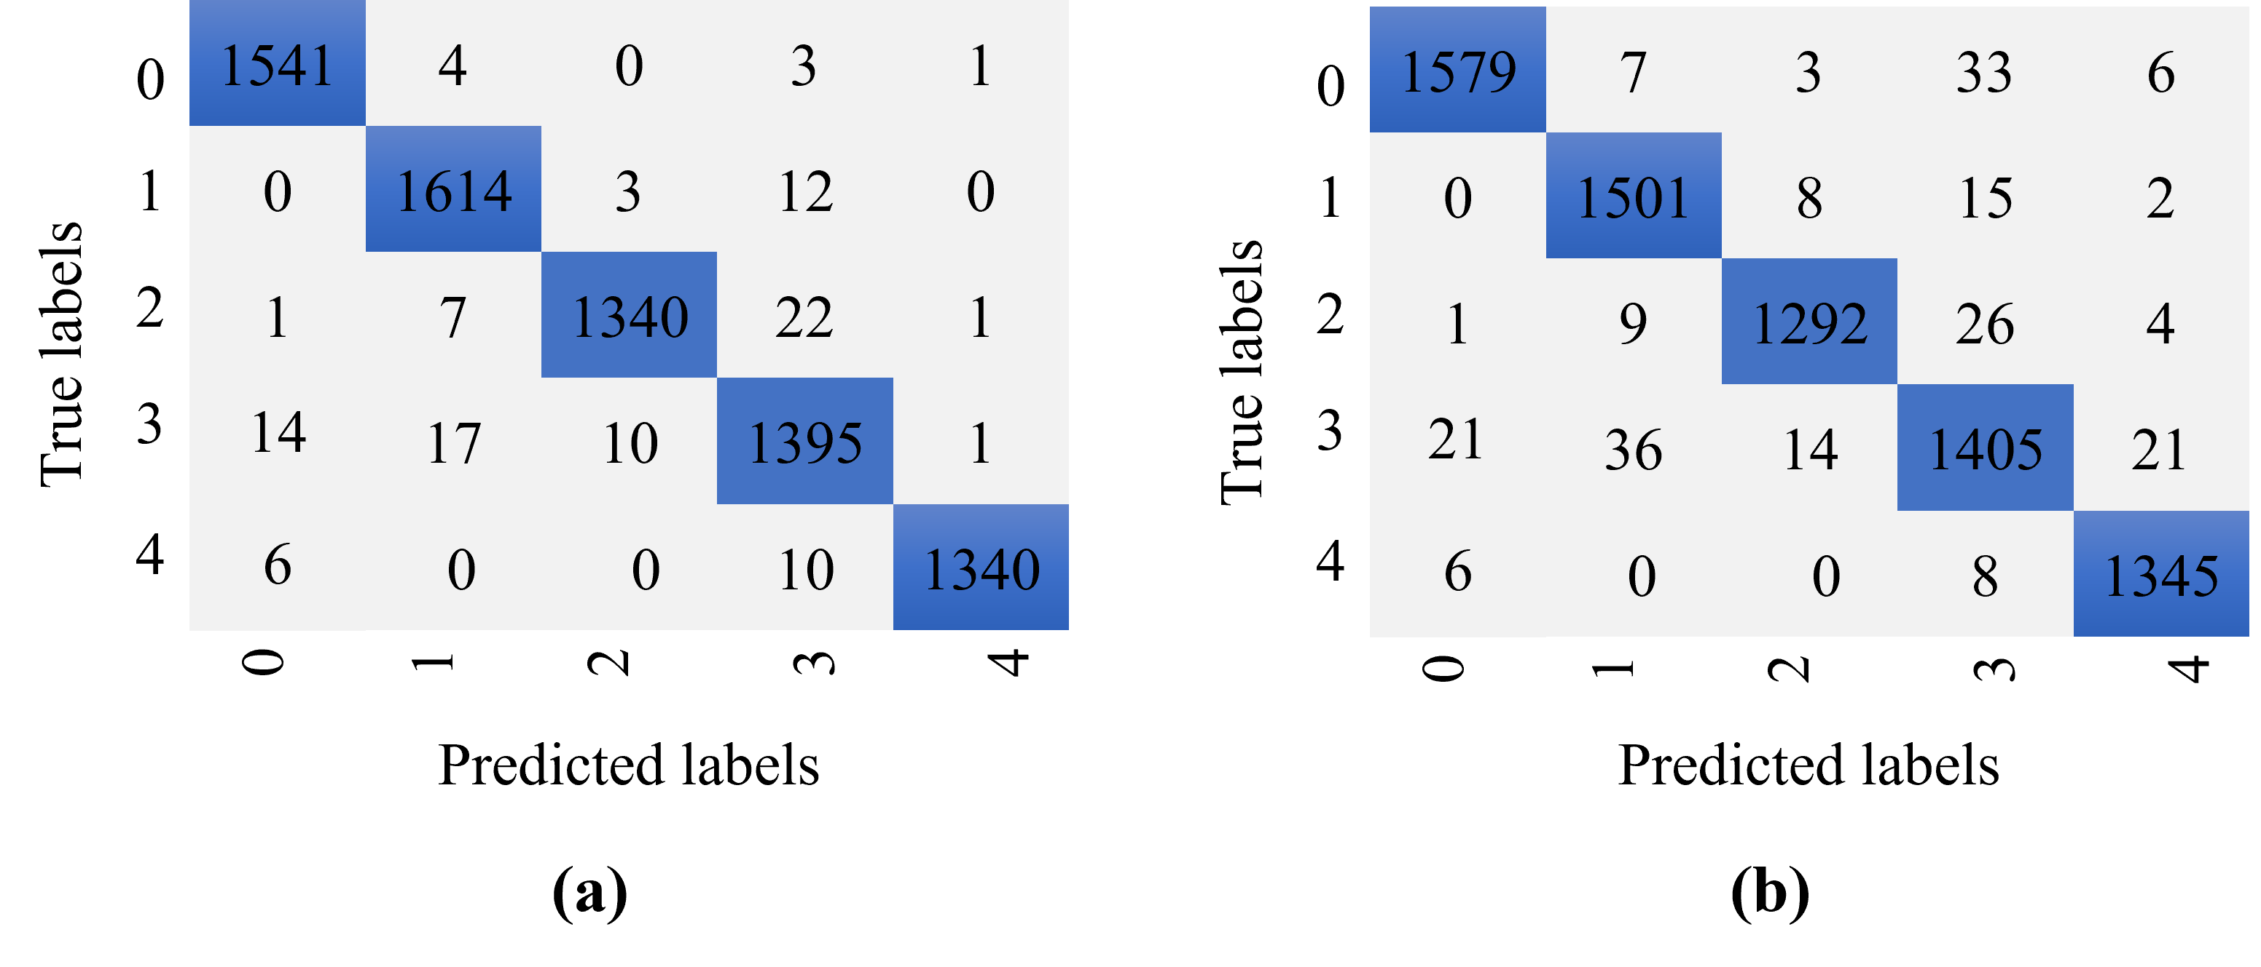
Result and Discussion
Fig. 4 Confusion metrics for (a) proposed ensemble ML (b) hybrid DL classifier

Slide 15
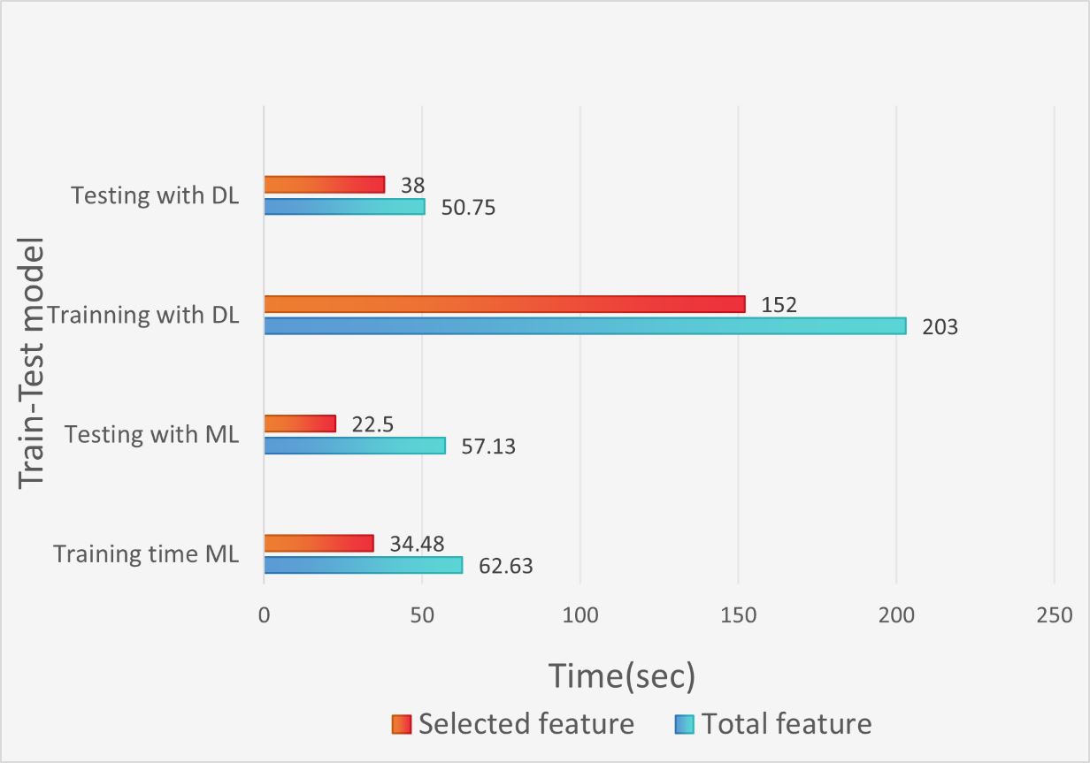
Result and Discussion
Fig. 5 Comparison of Runtime between proposed ensemble ML and hybrid DL

Slide 16
Result and Discussion
Performance comparison with other studies
Studies | Year | Method | Accuracy
Kabakus et al. [2] | 2022 | CNN | 98.10
Alshingiti et al. [3] | 2023 | LSTM | 96.80
Malaviya et al.[5] | 2023 | RandomForest | 96.63
Abu et al. [6] | 2023 | Ensemble_Bagging | 97.92
Albahadili et al.[1] | 2024 | DL+ML+Swarm_Intelligence | 97.94
Afzal et al.[4] | 2024 | ANN+Transformer | 98.00
Proposed | 2024 | DT+RF+ETC+XGBoost | 98.46

Slide 17
Conclusion & Future Studies
Conclusion:
The proposed ensemble model with PSO based hybrid feature selection ensure high detection(98.46%) with a lower execution time(56.98s).
Comparative analysis demonstrates that proposed scheme outperforms deep learning and traditional URL detection strategies.
The system indicates a robust and reliable method for classifying harmful URLs, mitigating cyber-risks .
Future Work
Explore the integration of real-time URL monitoring to further enhance detection speed and applicability in dynamic environments.
Extend the model to include multi-lingual URL datasets and phishing websites targeting non-English users.
Incorporate explainability techniques to make the model’s predictions more interpretable and user-friendly.
Develop a lightweight version of the model for deployment on resource-constrained devices like IoT systems and edge computing platforms.

Slide 18
Reference
[1] Albahadili, A.J.S., Akbas, A. & Rahebi, J. Detection of phishing URLs with deep learning based on GAN-CNN-LSTM network and swarm intelligence algorithms. SIViP 18, 4979–4995 (2024). https://doi.org/10.1007/s11760-024-03204-2
[2] A. T. Kabakus, ”A Novel Robust Convolutional Neural Network for Uniform Resource Locator Classification from the View of Cyber Security,” Concurrency and Computation: Practice and Experience. Nov. 22, 2022. . Available: https://doi.org/10.1002/cpe.7517.
[3] Z. Alshingiti, R. Alaqel, J. Al-Muhtadi, Q. E. Ul Haq, K. Saleem, and M. H. Faheem, ”A Deep Learning-Based Phishing Detection System Using CNN, LSTM, and LSTM-CNN,” Electronics, vol. 12, no. 1, p. 232, 2023. Available: https://doi.org/10.3390/electronics12010232.
[4] S. Afzal, M. Asim, M. O. Beg, T. Baker, A. I. Awad, and N. Shamim, ”Context-aware embeddings for robust multiclass fraudulent URL detection in online social platforms,” Computers and Electrical Engineering, vol. 119, p. 109494, 2024. Available: https://doi.org/10.1016/j.compeleceng.2024.109494.
[5] P. Malaviya, S. Bhadja, V. Gajjar and Y. Kumar, ”Cyber Security and Data Mining: Detecting Malicious URL Using Data Mining Techniques,” 2023 International Conference on Communication, Security and Artificial Intelligence (ICCSAI), Greater Noida, India, 2023, pp. 527-534, doi: 10.1109/ICCSAI59793.2023.10421348.
[6] Abu Al-Haija, Q., Al-Fayoumi, M. An intelligent identification and classification system for malicious uniform resource locators (URLs). Neural Comput & Applic 35, 16995–17011 (2023). https://doi.org/10.1007/s00521-023-08592-z

Slide 19
Thank You

