Slide 1
Margaret R. Starostik (McCoy lab)
Chromosomal abnormalities in early human embryonic development
Joint Genomics Meeting
January 24, 2019
Notes:
My name is Margaret, and I am a first-year graduate student in the Cell, Molecular, Developmental Biology, and Biophysics Program over on Homewood campus. Today I will be presenting the project that I worked on during my rotation in Rajiv McCoy’s lab in the Department of Biology. I applied computational methods to single-cell RNA-seq data in order to detect and better understand chromosomal abnormalities in early human embryonic development.

Slide 2
Human aneuploidies
Major cause of early pregnancy loss and congenital defects
Meiotic aneuploidy
→Mostly during oogenesis
→Affects all embryonic cells
Mitotic aneuploidy
→Occurs after fertilization
→Mosaic embryos
Screening against aneuploidy in pre-implantation embryos
Notes:
Aneuploidy, an abnormal number of chromosomes due to aberrant chromosomal segregation during meiosis or mitosis, is a major cause of early pregnancy loss and congenital defects. Aneuploidy can range from gain or loss of individual chromosomes to more complex aberrations involving many chromosomes.
Meiotic aneuploidy, which occurs mostly during oogenesis, affects all embryonic cells. Mitotic aneuploidies are also a common occurrence but appear after fertilization. These result in mosaic embryos with different cells having different chromosomal signatures.
Whereas meiotic aneuploidies are well considered in the fertility field, mitotic aneuploidies are more controversial in that the existence of mitotic aneuploidies, and thereby mosaicism, is widely debated.
Because of the importance of genetic integrity in human conception and development, screening against aneuploidy in pre-implantation embryos has become a common procedure during in vitro fertilization.

Slide 3
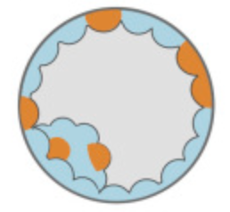
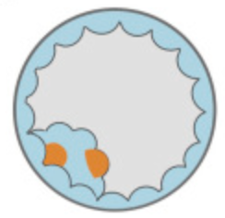
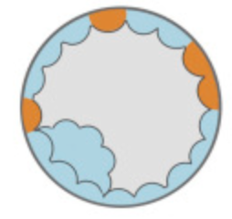
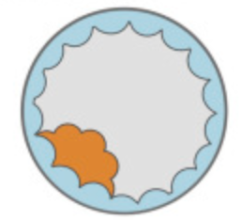
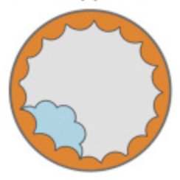
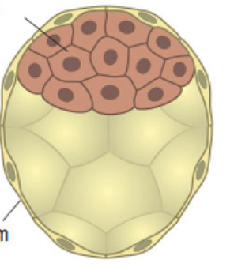



Preimplantation genetic screening
Day-5 multicell biopsy of blastocyst trophectoderm layer
Representative of actual embryo?
Implications for IVF embryo selection?
Inner cell mass
Euploid Mosaic Aneuploid
Trophectoderm
Image adapted from Vera-Rodriguez et al., 2017
Notes:
Currently, day-5 multi-cell biopsies of the outer layer of the blastocyst, the trophectoderm as depicted in the image to the right, is performed. Since only a single biopsy is taken of a specific cell lineage, it is debated whether such a biopsy is representative of the embryo proper, which develops from the inner cell mass. As shown in the 5 embryos with varying aneuploidy patterns, the true aneuploidy and mosaicism of an embryo may be missed during a biopsy simply due to the fact that such cells were not tested to begin with. In addition, since embryos are currently classified into two distinct stages, either aneuploid or euploid, there is widespread disagreement as to whether mosaicism is even a real phenomenon. Since much of the controversy stems from limited technical approaches in which a single biopsy is taken, we leveraged the single-cell approach to look into questions that confound the field. To date, one such data set exists, and it is RNA-seq data.

Slide 4
Can we detect mosaic aneuploidies in scRNA-seq data, and if so, …
…what is the true incidence of chromosomal mosaicism?
…are aneuploid cells disproportionately allocated to the trophectoderm?
Notes:
In my rotation, we asked whether we can detect mosaic aneuploidies in scRNA-seq data, and if so,
… what is the true incidence of chromosomal mosaicism? And
…are aneuploid cells disproportionately allocated to the trophectoderm?

Slide 5
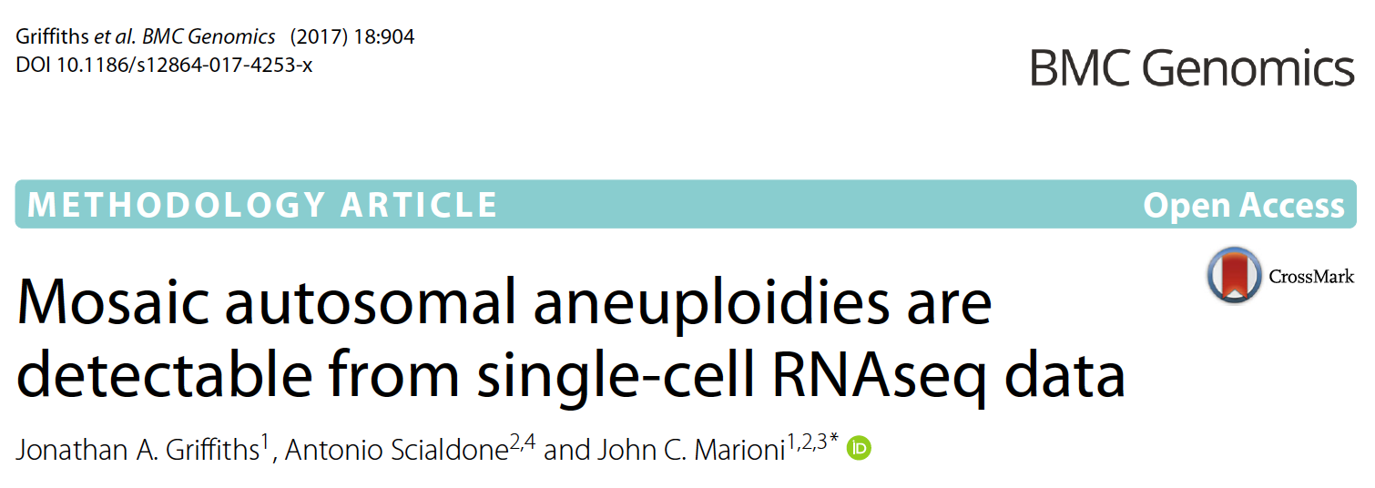
Methodology to detect aneuploidies
Notes:
For the analysis, we used an aneuploidy detection tool that was recently published and tested on several datasets. The Rpackage was developed by the Marioni lab in the European Bioinformatics Institute within the European Molecular Biology Laboratory and is well documented on Github.

Slide 6
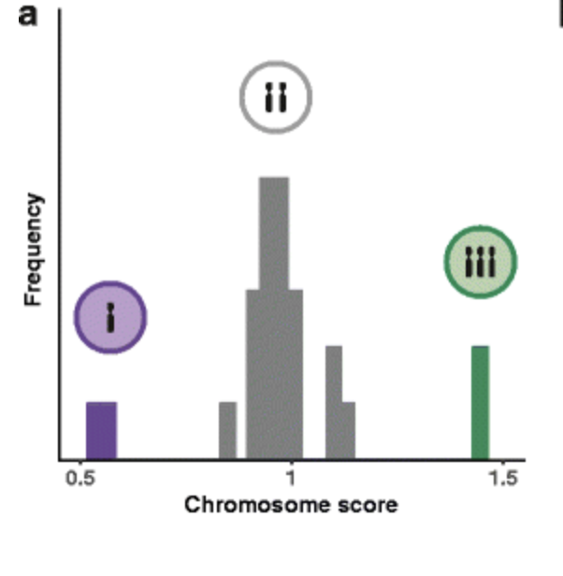
Methodology to detect aneuploidies
For defined group of cells, calculate score for each chromosome-cell pair
Convert scores into p-values to detect significant deviations
Griffiths et al., 2017
Notes:
Overall, this method works by statistically identifying, separately for each cell, chromosomes with genes that show consistently deviant expression compared to the same chromosome in other cells. It is important to initially stratify the dataset and consider only highly expressed genes. For a defined group of cells, a score for each chromosome-cell pair is calculated. These scores are then converted into p-values to detect significant deviations that can be interpreted as aneuploidies.

Slide 7
Methodology to detect aneuploidies
Dataset | Sensitivity (%) | Specificity (%) | Precision (%) | FDR (%)
8-cell stage mouse embryos | 78.0 | 99.5 | 88.6 | 4.9
HCC38-BL cell lines | 15.3 | 98.7 | 15.3 | 90.0
Trisomy 21 iPSC-derived neurons | 0.0 | 99.3 | 0.0 | 100.0
Griffiths et al., 2017
Notes:
To assess the method’s performance, it was applied to 3 genotype-and-transcriptome datasets. In the first dataset, the method performed relatively well with a sensitivity of 78% and FDR of 4.9%. In two additional datasets, the method performed poorly, as the model is confounded by high gene expression variance.

Slide 8
Human embryonic scRNA-seq
 | All |  | Undifferentiated |  | Inner cell mass |  | Trophectoderm |  | Intermediate |  | Epiblast |  | Primitive endoderm
E3 | 78 | (13) | 78 | (13)
E4 | 185 | (16) | 185 | (16)
E5 | 360 | (24) | 67 | (5) | 66 | (12) | 227 | (27)
E6 | 405 | (18) |  |  |  |  | 336 | (17) | 36 | (11) | 25 | (7) | 8 | (4)
E7 | 453 | (17) |  |  |  |  | 379 | (17) | 32 | (8) | 20 | (7) | 22 | (7)
Total | 1,481 | (88) | 330 | (34) | 66 | (12) | 942 | (61) | 68 | (19) | 45 | (14) | 30 | (11)
Petropolous et al., 2016
Stirparo et al., 2018
Notes:
The scRNA-seq data I worked with contains 88 embryos comprising almost 1,500cells. Cell lineages were inferred in another publication from gene expression profiles and tSNE plots.

Slide 9
Variability in gene expression profiles
ME⁻
ME⁺
T21⁻
T21⁺
1000
100
50
20
log₁₀(standard deviation)
100 300 1000 3000
log₁₀(mean)
Notes:
I validated the aneuploidy detection software on two datasets, one that performed well and one that performed poorly due to high variability in gene expression.

Slide 10
Variability in gene expression profiles
10000
1000
100
20
ME⁻
ME⁺
T21⁻
T21⁺
E3
E4
E5
E6
E7
ME⁻
ME⁺
T21⁻
T21⁺
1000
100
50
20
log₁₀(standard deviation)
100 300 1000 3000
100 1000 10000
log₁₀(mean)
Notes:
On the right, I plotted our scRNA-seq data across all embryonic stages and cell lineages. Our data look like the one that performed well, so we predicted that our analysis should work.

Slide 11
t-SNE analysis identifies stage-specific clusters
8
4
0
-4
Stage
E3 E4 E5 E6 E7
Cell Lineage
(2,996 genes; median CPM > 50)
t-SNE 2
Undifferentiated
Inner cell mass
Trophectoderm
Intermediate
Epiblast
Primitive endoderm
-10 -5 0 5 10 15
t-SNE 1
Notes:
t-SNE analysis was performed since cell lineages were inferred by this method, and since data substructure plays an critical role in correctly identifying aneuploidies. If data substructure is not taken into account, the chromosome scores would be driven by differentially expressed genes rather than aneuploidy. Based on almost 3,000 highly expressed genes, we observed stage-specific clusters and different cell lineages in this plot.

Slide 12
t-SNE analysis identifies stage-specific clusters
8
4
0
-4
Stage
E3 E4 E5 E6 E7
Cell Lineage
(2,996 genes; median CPM > 50)
t-SNE 2
Undifferentiated
Inner cell mass
Trophectoderm
Intermediate
Epiblast
Primitive endoderm
-10 -5 0 5 10 15
t-SNE 1
Notes:
T-SNE analysis was performed since cell lineages were inferred by gene expression signatures and tSNE plots, and since data substructure plays an important role in correctly identifying aneuploidies. If data substructure is not taken into account the aneuploidy detection tool would performed differential expression due to differences in cell type rather than perform aneuploidy detection. Based on almost 3,000 highly expressed genes, you can observe stage-specific clusters and different cell lineages in this plot.

Slide 13
t-SNE analysis identifies stage-specific clusters
8
4
0
-4
Stage
E3 E4 E5 E6 E7
Cell Lineage
(2,996 genes; median CPM > 50)
t-SNE 2
Undifferentiated
Inner cell mass
Trophectoderm
Intermediate
Epiblast
Primitive endoderm
-10 -5 0 5 10 15
t-SNE 1
Notes:
T-SNE analysis was performed since cell lineages were inferred by gene expression signatures and tSNE plots, and since data substructure plays an important role in correctly identifying aneuploidies. If data substructure is not taken into account the aneuploidy detection tool would performed differential expression due to differences in cell type rather than perform aneuploidy detection. Based on almost 3,000 highly expressed genes, you can observe stage-specific clusters and different cell lineages in this plot.

Slide 14
t-SNE analysis identifies stage-specific clusters
8
4
0
-4
Stage
E3 E4 E5 E6 E7
Cell Lineage
(2,996 genes; median CPM > 50)
t-SNE 2
Undifferentiated
Inner cell mass
Trophectoderm
Intermediate
Epiblast
Primitive endoderm
-10 -5 0 5 10 15
t-SNE 1
Notes:
T-SNE analysis was performed since cell lineages were inferred by gene expression signatures and tSNE plots, and since data substructure plays an important role in correctly identifying aneuploidies. If data substructure is not taken into account the aneuploidy detection tool would performed differential expression due to differences in cell type rather than perform aneuploidy detection. Based on almost 3,000 highly expressed genes, you can observe stage-specific clusters and different cell lineages in this plot.

Slide 15
t-SNE analysis identifies stage-specific clusters
8
4
0
-4
Stage
E3 E4 E5 E6 E7
Cell Lineage
(2,996 genes; median CPM > 50)
t-SNE 2
Undifferentiated
Inner cell mass
Trophectoderm
Intermediate
Epiblast
Primitive endoderm
-10 -5 0 5 10 15
t-SNE 1
Notes:
T-SNE analysis was performed since cell lineages were inferred by gene expression signatures and tSNE plots, and since data substructure plays an important role in correctly identifying aneuploidies. If data substructure is not taken into account the aneuploidy detection tool would performed differential expression due to differences in cell type rather than perform aneuploidy detection. Based on almost 3,000 highly expressed genes, you can observe stage-specific clusters and different cell lineages in this plot.

Slide 16
Performance metrics
 | Undifferentiated |  |  | Inner cell mass |  |  | Trophectoderm |  |  | Intermediate |  |  | Epiblast
E3
E4
E5
E6
E7
R nG Z
Compared to G&T-seq 8-cell embryos
R = gene-wise variability score
nG = total number of highly expressed genes
Z = fraction of zero counts observed
Good quality
Exercise caution
Poor quality
Notes:
The aneuploidy detection tool outputs 3 performance metrics based on comparisons to the genotype-and transcript dataset that performed well. The metrics include: a gene-wise variability score, that total number of highly expressed genes, and fraction of zero counts observed. For good quality, the gene-wise variability score should be low, the total number of highly expressed genes should be high, and the fraction of zero counts observed should be low. As shown in the figure, most of the analyses we ran yielded good performance metrics.

Slide 17
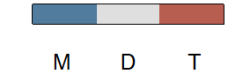
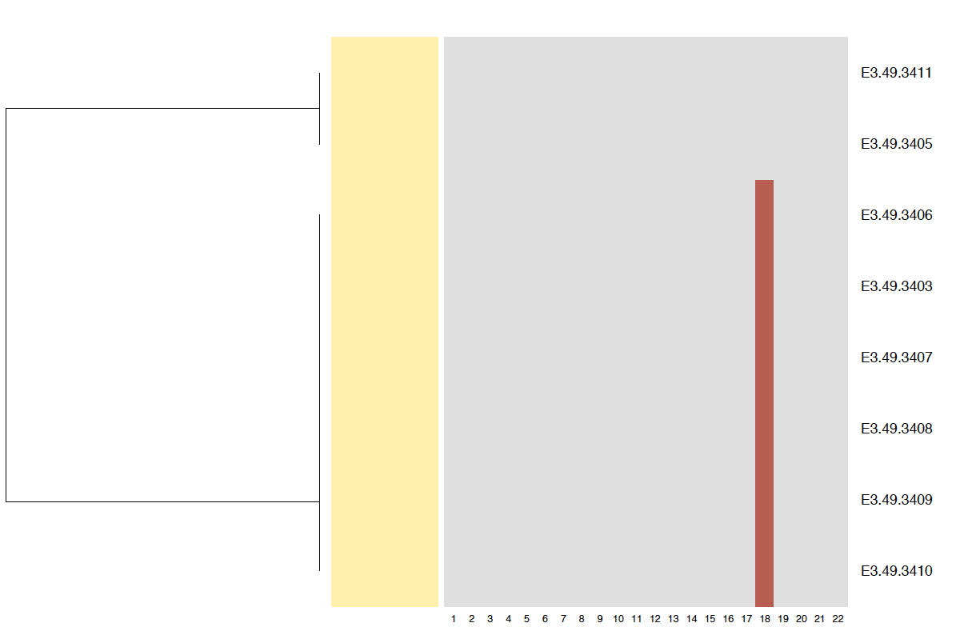
Simple and complex aneuploidy events detected
E3.49
E3.49.3411
E3.49.3405
E3.49.3406
E3.49.3403
E3.49.3407
E3.49.3408
E3.49.3409
E3.49.3410
1 3 5 7 9 11 13 15 17 19 21
2 4 6 8 10 12 14 16 18 20 22
Chromosome
Notes:
The aneuploidy test detected both simple and complex chromosomal aberrations. For the purposes of this talk, I will be showing two examples that show the range of aneuploidies.
As a reference, blue, grey, and red represent monosomy, disomy, and trisomy, respectively. Trisomy of chromosome 18 appears in a majority of the cells tested for this embryoand is suggestive of meiotic aneuploidy.

Slide 18
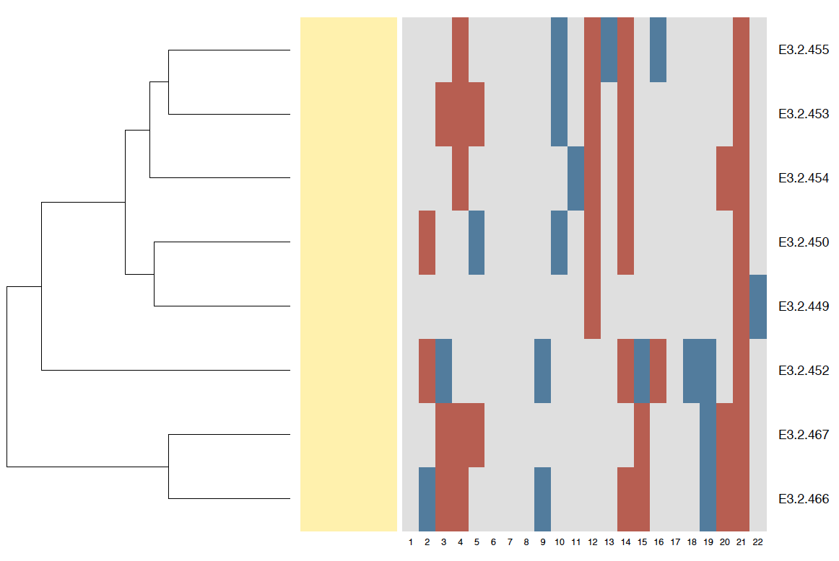
Simple and complex aneuploidy events detected
E3.49
E3.2
E3.49.3411
E3.49.3405
E3.49.3406
E3.49.3403
E3.49.3407
E3.49.3408
E3.49.3409
E3.49.3410
E3.2.455
E3.2.453
E3.2.454
E3.2.450
E3.2.449
E3.2.452
E3.2.467
E3.2.466
1 3 5 7 9 11 13 15 17 19 21
1 3 5 7 9 11 13 15 17 19 21
2 4 6 8 10 12 14 16 18 20 22
2 4 6 8 10 12 14 16 18 20 22
Chromosome
Chromosome
Notes:
The plot to the right depicts a more complicated case with meiotic aneuploidy of chromosome 21 along with several mitotic aneuploidies. In particular, since half or more than half of cells have trisomies of chromosomes 12 and 14, these may be indicative of chromosomal aberrations that occurred early in embryo development.

Slide 19
Overview of aneuploidy events
100
75
50
25
0
Embryos with aneuploid cells (%)
E3 E4 E5 E6 E7
Developmental stage
E3 E4 E5 E6 E7
Notes:
We then looked into the percentage of embryos with aneuploid cells and observed that the vast majority of embryos across all developmental stages have aneuploid cells.

Slide 20
Overview of aneuploidy events
100
75
50
25
0
100
75
50
25
0
Embryos with aneuploid cells (%)
Aneuploid cells per embryo (%)
E3 E4 E5 E6 E7
E3 E4 E5 E6 E7
Developmental stage
Developmental stage
E3 E4 E5 E6 E7
Notes:
Asking a slightly different question, namely the percentage of aneuploid cells per embryo, we observed a wide range across all developmental stages.

Slide 21
Are aneuploid cells disproportionately tolerated in trophectoderm?
Inner cell mass
Euploid Mosaic Aneuploid
Trophectoderm
Notes:
Lastly, we tested whether aneuploid cells are disproportionately tolerated in the trophectoderm, a long-standing question in the fertility field.

Slide 22
Aneuploid cells not disproportionately tolerated in trophectoderm
Inner cell mass
Euploid Mosaic Aneuploid
Trophectoderm
Generalized linear mixed model
y = Xβ + Zu + ε
 | Odds ratio [99.5% CI]
Trophectoderm | 1.196 [0.909 – 1.583]
Notes:
I used a generalized linear mixed model approach with random effects of embryo and in our data, aneuploid cells do not appear to be disproportionately tolerated in the trophectoderm. Given our small sample size, it is possible that this was not adequately explored. Nonetheless, this is the first quantitative attempt to answer this question that has confounded the field.

Slide 23
Conclusions
Computational approach applied at single-cell level to detect aneuploidies works
Every embryo appears to be mosaic
→ Part of normal phenotype
Trophectoderm cells do not disproportionately affect aneuploidy compared to cells of inner cell mass
Notes:
In conclusion, this computational approach applied at the single-cell level to detect aneuploidies appears to work.
Our data suggest that every embryo exhibits mosaicism of some sort, and that is may perhaps be a part of a normal phenotype. This suggestion would dramatically impact the fertility field as the two-classification system, aneuploid or not, must be modified to include mosaicism.
In addition, the single-cell approach could be used to determine that trophectoderm cells do not disproportionately affect aneuploidy, implying that a biopsy of such cells may be representative of the embryo.

Slide 24
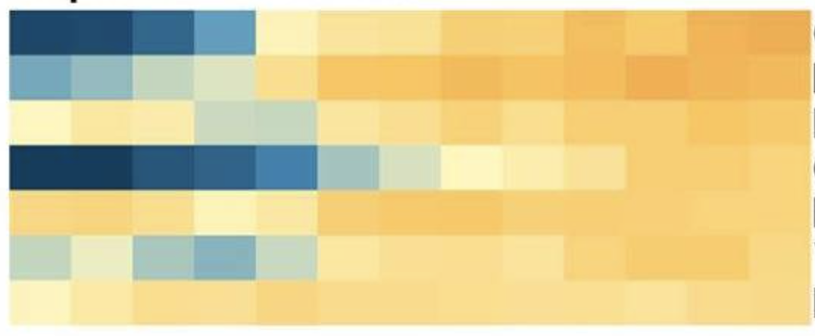
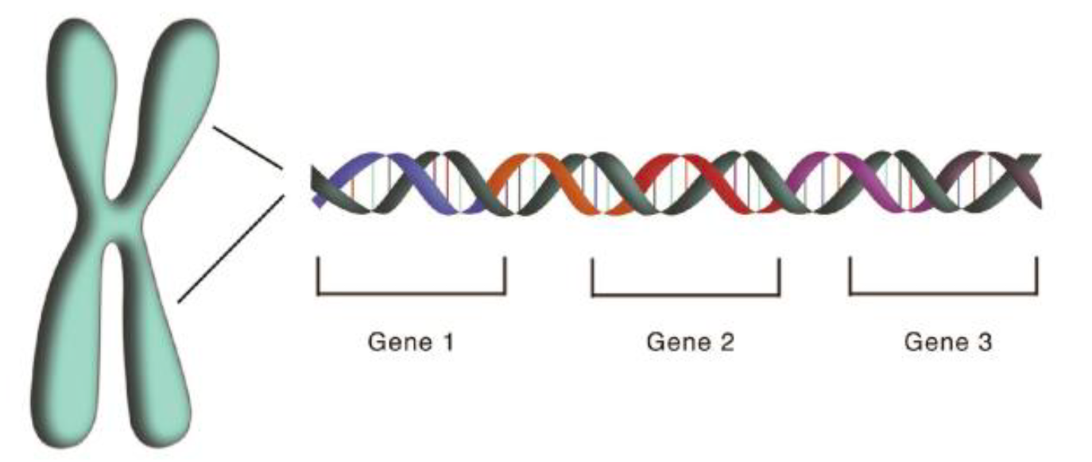


Future directions
Improve method to detect aneuploidies
Extend analysis to additional scRNA-seq datasets
+
Gene 1 Gene 2 Gene 3
Gene expression
Genotype
Notes:
An immediate question of interest is to simulate the process of pre-implantation genetic screening by randomly sampling 5-10 cells from an embryo and asking at what frequency the true aneuploidy status of the embryo is detected.
Future work involves improving the method by which aneuploidies are detected. This work was based purely on gene expression data and summary statistics, but more information can be gained by incorporating genotype data. This would allow us to validate findings from scRNA-seq, and in the long term can be incorporated into a model that may better detect aneuploidies.
In addition, aneuploidy detection may be extended to additional scRNA-seq datasets.

Slide 25


Thank You
Rajiv McCoy, Ph.D.
Arta Seyedian

Slide 26
Distribution of aneuploidy type varies among autosomes
0.08
0.06
0.04
0.02
0
Proportion
Trisomy
Monosomy
1 2 3 4 5 6 7 8 9 10 12 14 16 18 20 22
11 13 15 17 19 21
Chromosome

Slide 27
Detecting aneuploidy events
E3
E4
E5
E6
E7
20
15
10
5
0
Frequency
Embryos
Mitotic Meiotic

