Slide 1
Network Formation and Interaction Patterns in a Statistics Classroom
Presented by: Siming, Su & Yuning, li
Faculty adviser: Dr. Uma Ravat
University of California at Santa-Barbara
Notes:
.

Slide 2

Goal
To understand students’ interactions with peers
using Social Network Analysis(SNA) and Exponential Random Graph Models (ERGMs)

Slide 3
Methodologies
Network Visualization :
Macro-level visualization of interactions in a classroom using igraph, statnet
Network and Node Attributes:
Using graph theory to measure interactions
Hypothesis Testing:
Investigate the potential relationships in the survey dataset
ERGM Modeling:
Explore deeply the formation and relationships within the classroom network

Slide 4
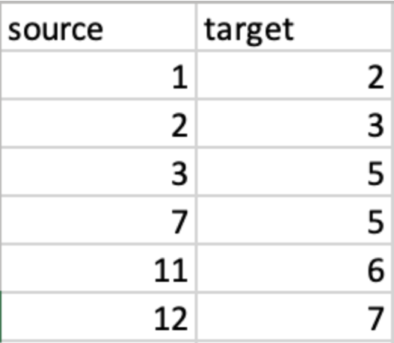
DATA
Cleaned data to get source-target list for
- student interactions
- student perception of strong students

Slide 5
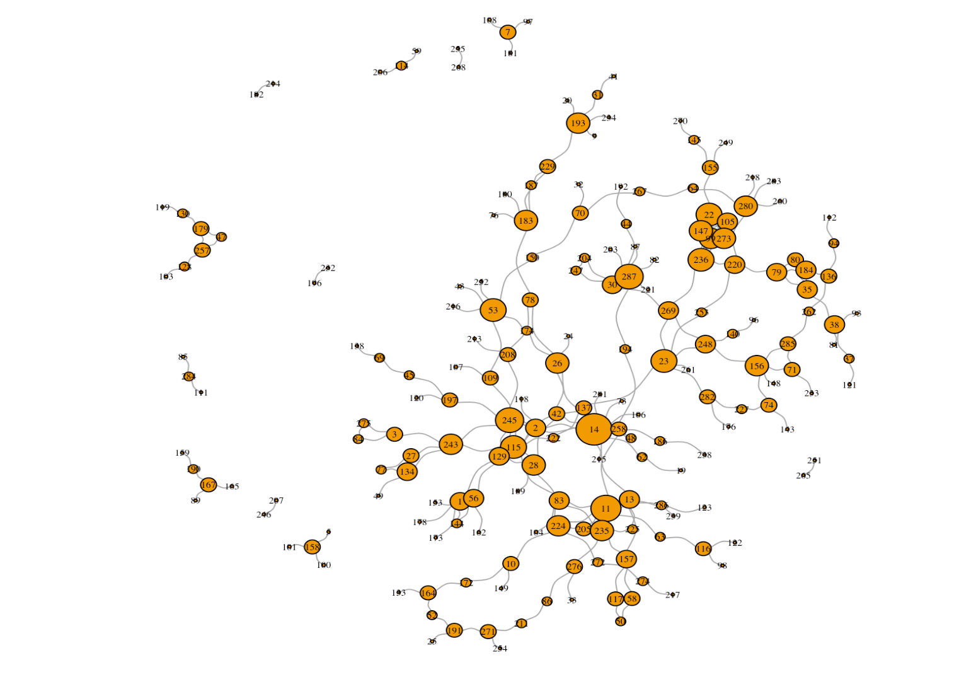
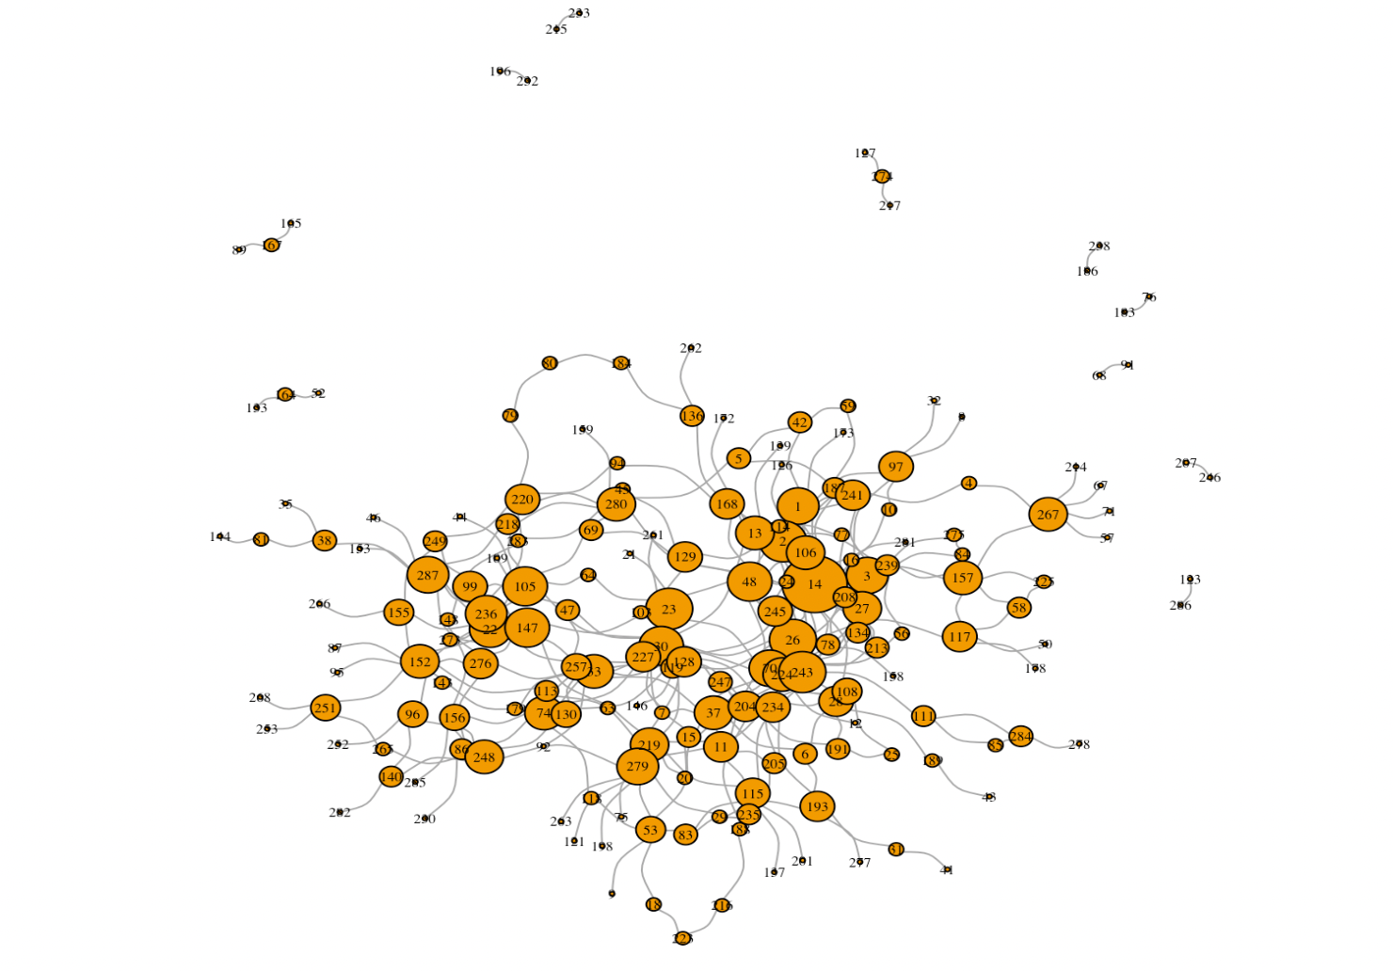
Visualization
Students’ interactions in week 6
Students’ interactions in week 9

Slide 6
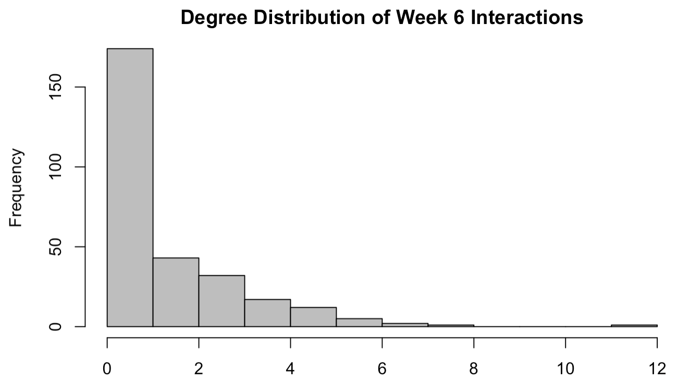
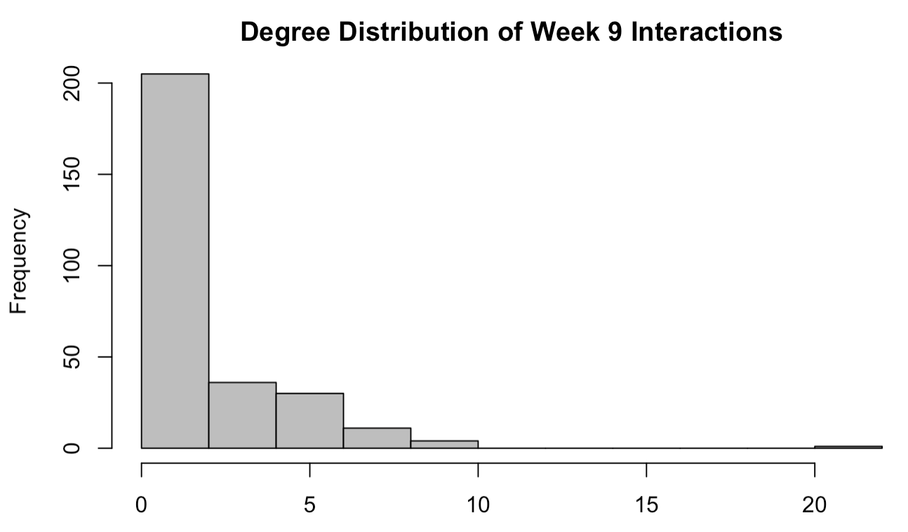
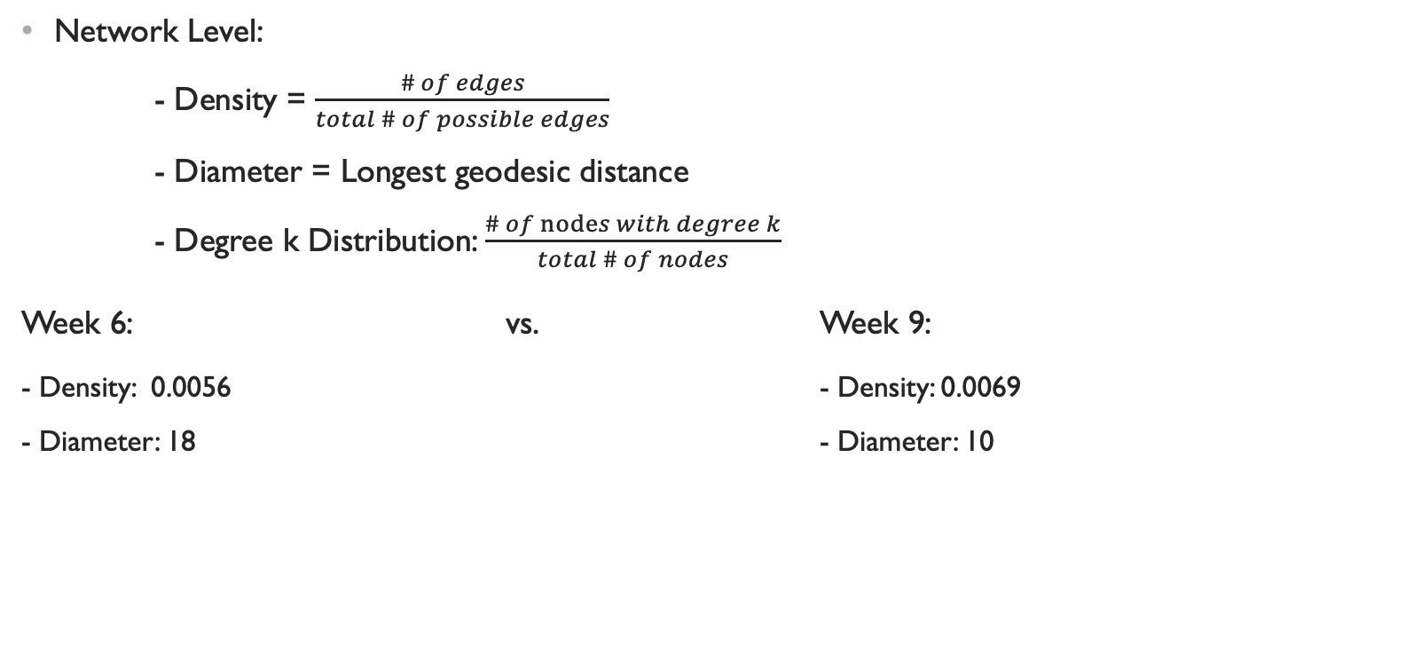
Network attributes
Network Level:
- Density = $\frac{\# of edges}{total \# of possible edges}$
- Diameter = Longest geodesic distance
- Degree k Distribution: $\frac{\# of nodes with degree k}{total \# of nodes}$
Week 6: vs. Week 9:
- Density: 0.0056 - Density: 0.0069
- Diameter: 18 - Diameter: 10

Slide 7
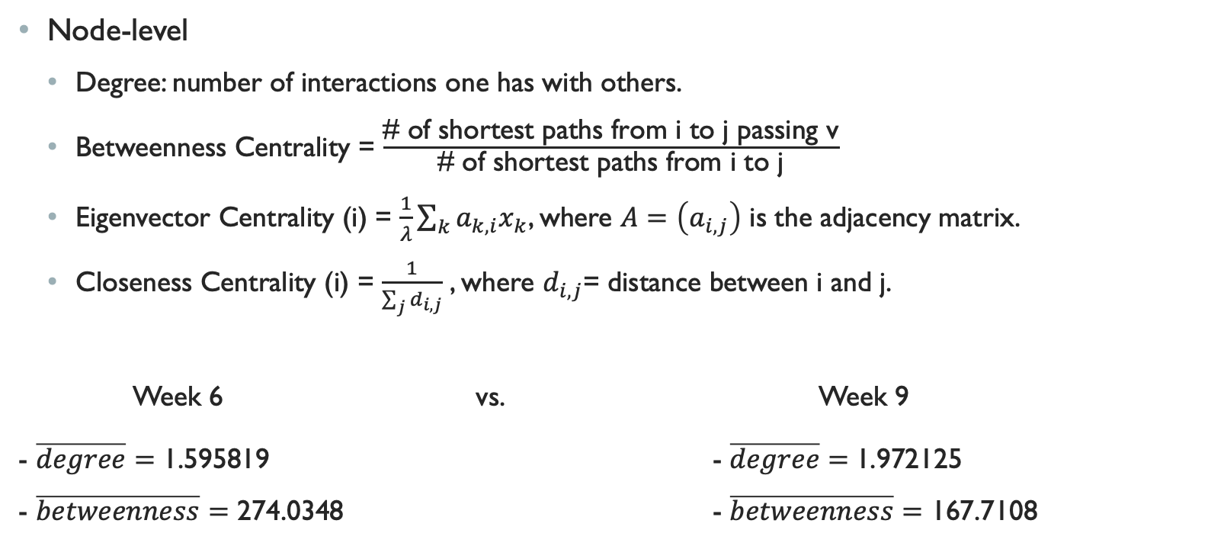
noDE ATTRIBUTE
Node-level
Degree: number of interactions one has with others.
Betweenness Centrality = $\frac{\text{\# }\text{of} \text{shortest} \text{paths} \text{from} \text{i} \text{to} \text{j} \text{passing} \text{v}}{\text{\# }\text{of} \text{shortest} \text{paths} \text{from} \text{i} \text{to} \text{j}}$
Eigenvector Centrality (i) = $\frac{1}{λ}\sum_{k}{a_{k,i}x_{k}}$, where $A=\left(a_{i,j}\right)$ is the adjacency matrix.
Closeness Centrality (i) = $\frac{1}{\sum_{j}{d_{i,j}}}$ , where $d_{i,j}$= distance between i and j.
Week 6 vs. Week 9
- $\overline{degree}=\text{1.595819}$ - $\overline{degree}=$1.972125 - $\overline{betweenness}=\text{274.0348}$ - $\overline{betweenness}=$ 167.7108

Slide 8
Hypothesis TestING
- Strong statistical significance between node degrees of week 6 and week 9 interactions.
- Strong statistical significance between betweenness centrality of week 6 and week 9 interactions.

Slide 9
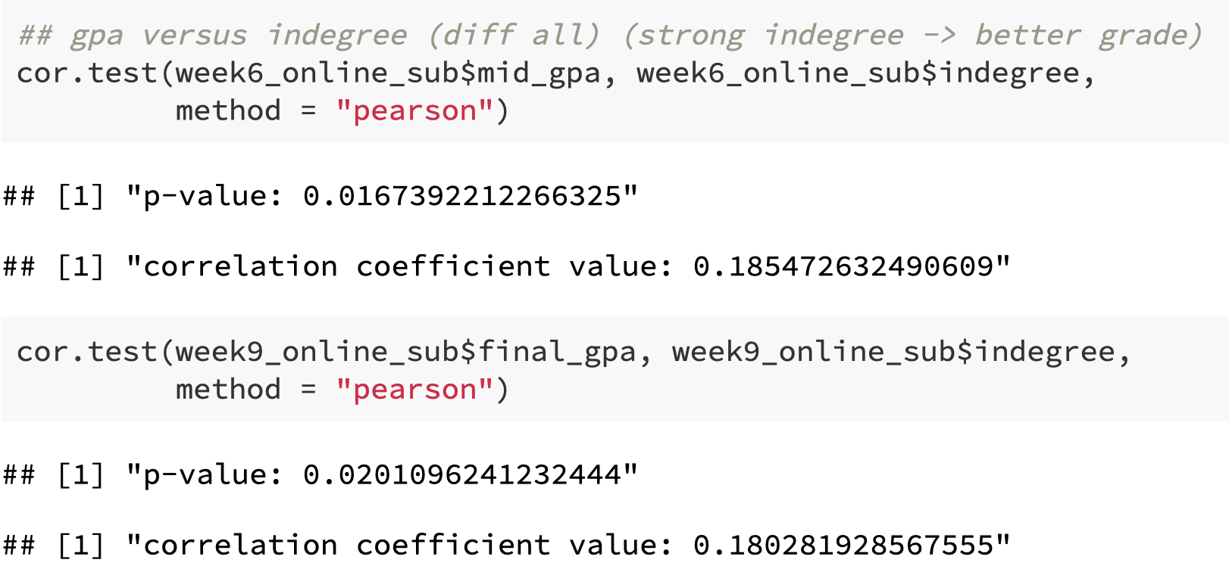


Grade vs. Perception of Strongness from Peers
- Strong statistical significance between midterm grade and the perception from peers.
A
B
Strongness
+ 1
- Strong statistical significance between midterm grade and the perception from peers.

Slide 10

Ergm model
(Exponential Random Graph Model)
Likelyhood of formation of edge i-j
Network statistics like final grade, gender...
(9 total to explore both
differences between node connections
As well as homophily of network patterns )
Parameters to be fitted

Slide 11
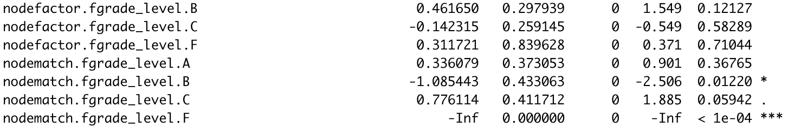
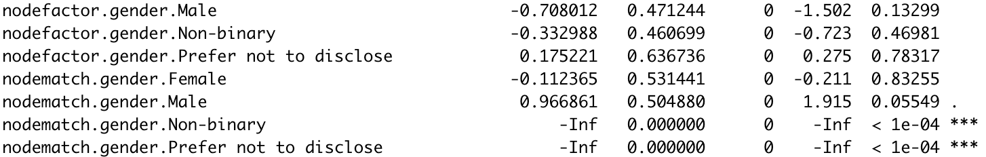
Result
- Edge density of network = exponential of the parameter estimate
- no strong evidence showing that students tend to interact only with students’ with good grade or bad grade.
- Interesting results when looking at homophily
- males are 2.6 times more likely to interact with male students compared to the other gender

Slide 12
Result (continued)
- Students remains as friends from week 6 (exp(2.72) $≈$ 15)
- Students’ interactions are positively correlated with the perception of peers.

Slide 13
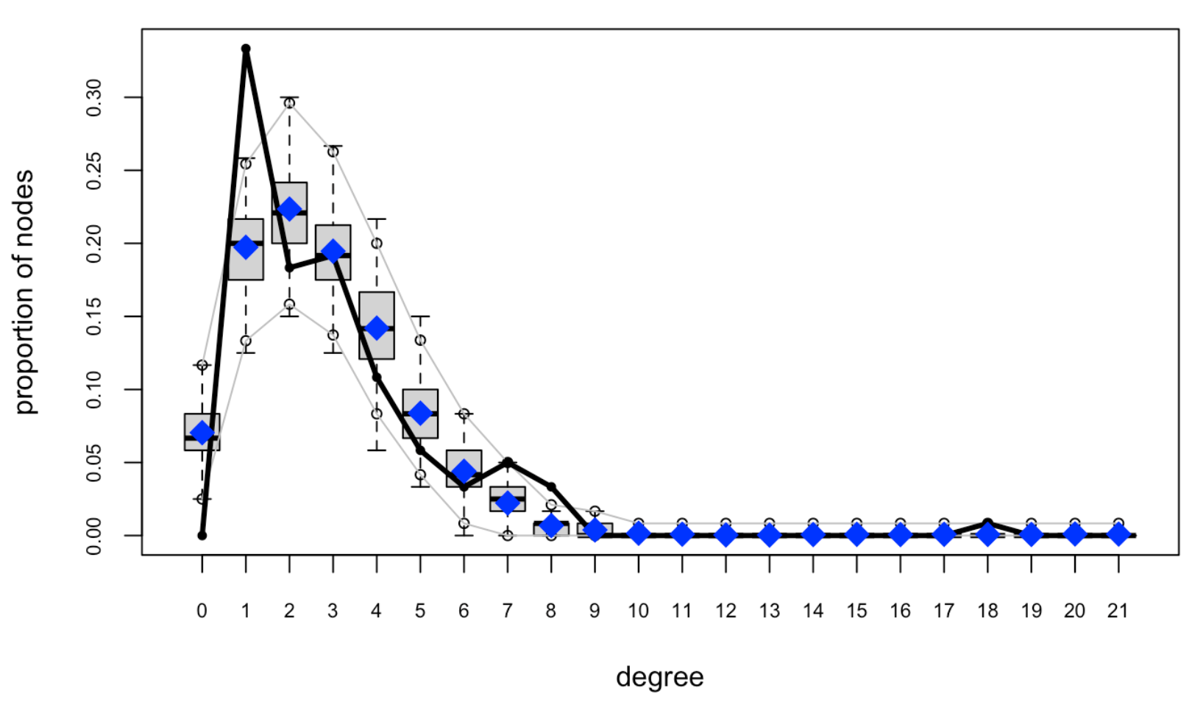
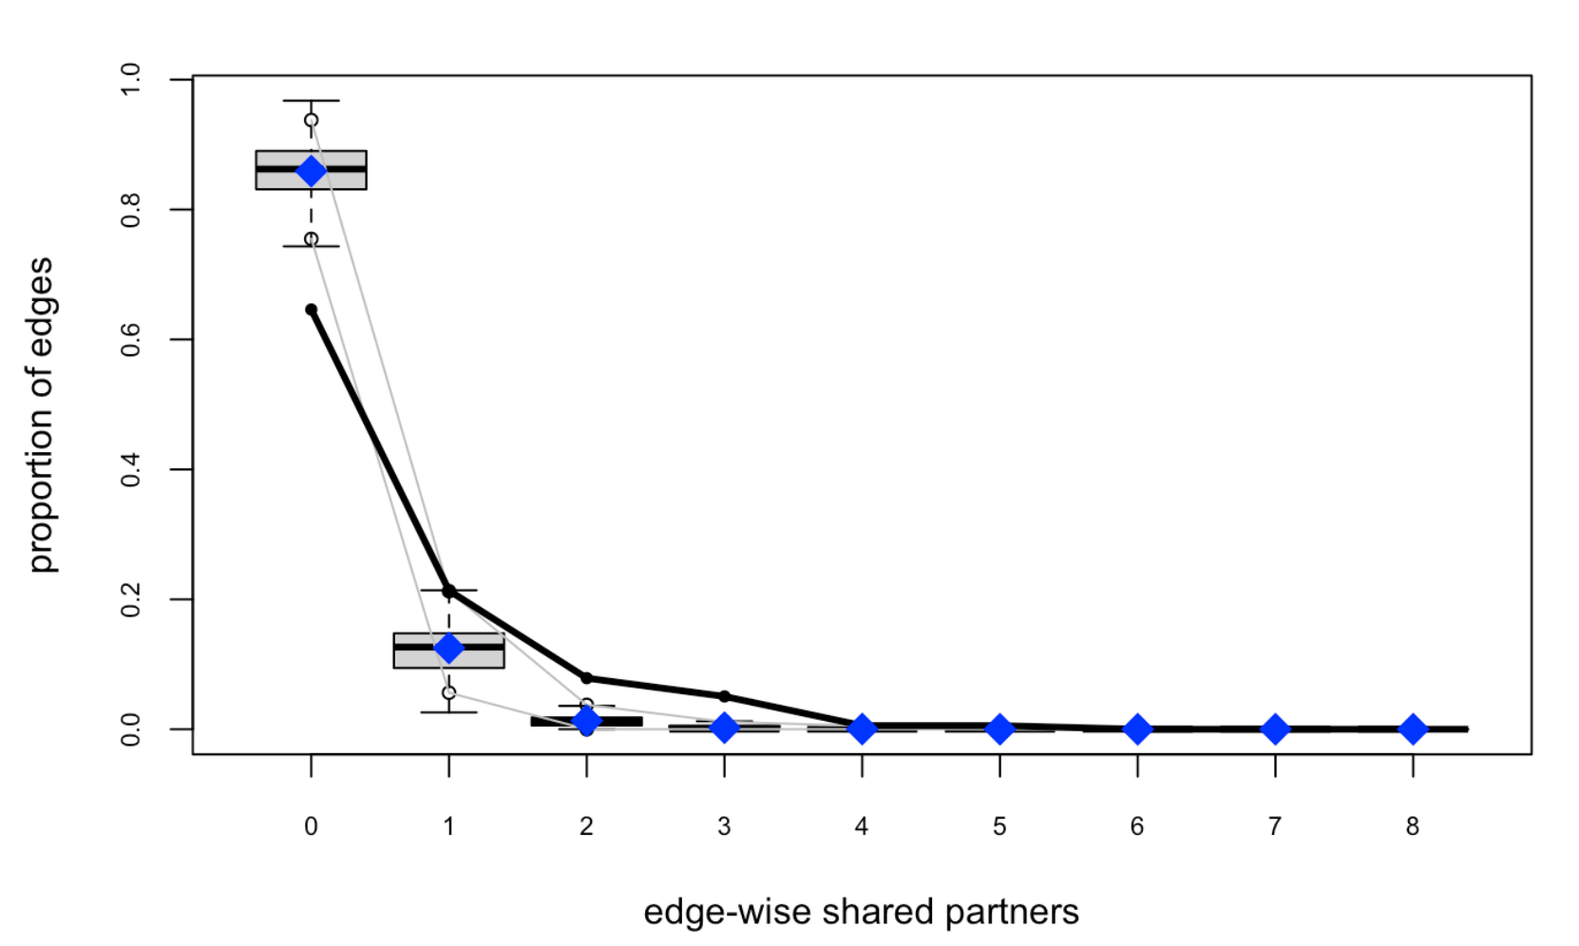
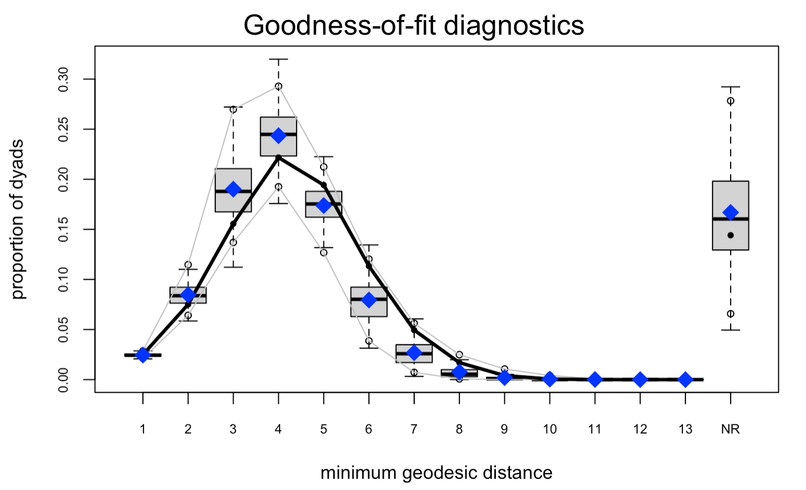

GOODNESS OF FIT
:successfully capture the trends of each parameter
Blue-box plot: Monte Carlo simulations of network generated
using x-axis value as parameter
Black line: observed network statistics from our data

Slide 14
CoNCLUSION
perception of peers plays an important role for both academic performance and student interactions.
- Students’ interactions differ based on gender and their grades.
Students interact more as the term progresses.
Most students don’t change the people they interact with as the term progresses.

