Slide 1


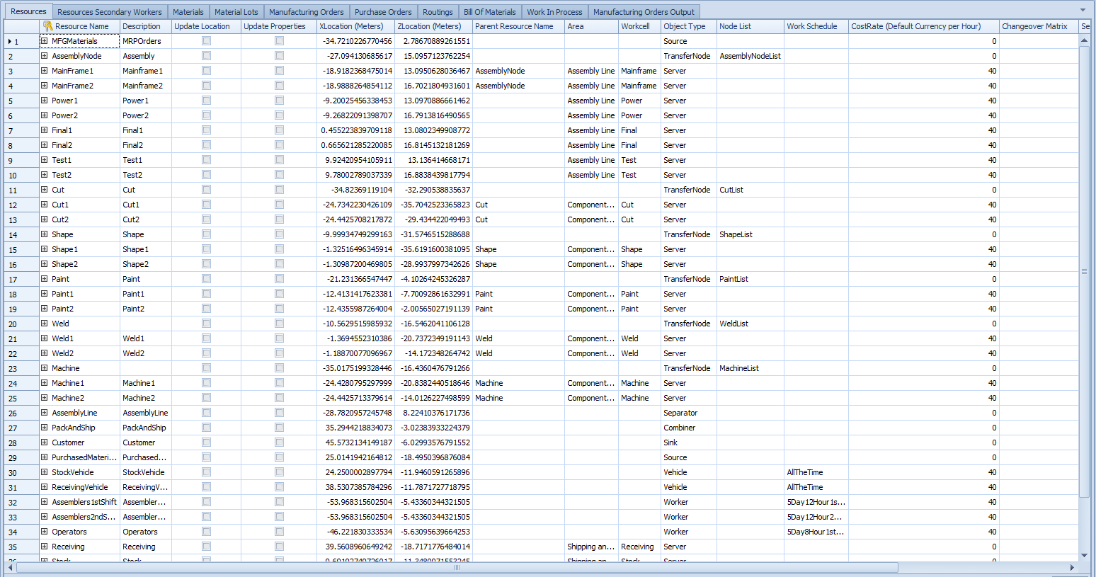
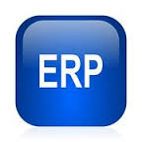
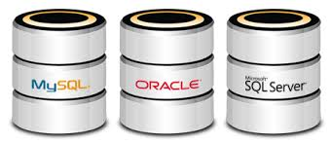


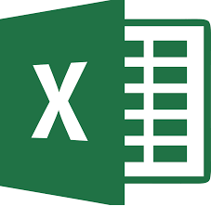
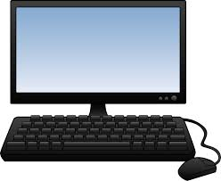
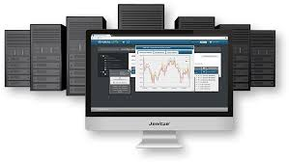
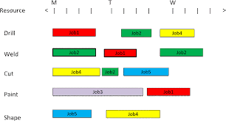

Simio Interoperability
Factory
Digital Twin
Manual data entry
Excel and CSV table binding (Excel)
Database table binding (SQL/Oracle, etc.)
XML transformation (ERP/SAP/Oracle, etc.)
Connecting to Wonderware MES (or others) using the standard API.
Simio Data Tables
Database Systems
ERP Systems
MES
User Systems
Manufacturing Execution Systems

Slide 2
Why do we need a database to begin with?
Necessity to tie together multiple sources of data (ERP, MES, etc)
Starting point / Endpoint for integration brokers (Altova, BizTalk, PI, IBM Message Broker) to enable data transformation/mapping (flattening a hierarchical IDOC)
Allows the easily cleaning of data using views and stored procedures.
Also allows for preserving scheduling dates across runs for exports.
Provides an intermediary because nobody wants us to plug directly into their ERP system
Make moving data from one model to any another very easy (Export \ Import Model Add-In example).

Slide 3
Why are multiple databases needed by Corporate IT??
At a minimum, we have a production and a test/development environment
Before any changes can be made in a production environment they have to be tested first.
IT personal that deploy from dev to test to production will have little knowledge of Simio. They want to change the database connection setting using an external configuration file.

Slide 4
What is the model development workflow that DirectConnect enables??
Open Template and save as a model.
Modify tables based on the customer needs
Exporting Table Structure To Database.
Data Types
Default Values
Transaction Types (need for speed).
Saving Data To Database on Model Save. This can also be trigged using Publish.

Slide 5
API Needs ( custom code that was need for this project)?
Run Import Data Binder / Export Data Binders via API.
Convert Simio Tables to DataSet / DataSet to Simio Table.
Block Import if IDOCs / XML is still currently processing.
Send BAPI Web Service Call.

