Slide 1
DATA ANALYTICS CAPSTONE · GROUP 5
Air Quality Patterns
in African Cities
Client: United Nations Environment Programme (UNEP)
Data source: OpenAQ v3 API · Cities: Nairobi, Kampala, Kigali, Addis Ababa, Johannesburg, Lagos · 2021–present
Team: Samuel Tokoye · Paul Kibet Miningwa · Winnie Odoyo · Gloria Simiyu Wandabwa

Slide 2
OVERVIEW
Agenda
• Project brief & research questions
• Data acquisition & methodology
• Data quality & cleaning decisions
• Statistical techniques applied
• Key visuals (6 charts)
• Findings — answers to the 6 client questions
• Intervention prioritization ranking
• Recommendation for UNEP
Air Quality Patterns in African Cities — Capstone Group 5
1

Slide 3
SECTION 1
Project Brief
Air pollution is an increasing public-health concern across African cities. UNEP commissioned this analysis to evaluate air-quality patterns across six selected cities, to guide future intervention priorities.
Research Questions
• Which city recorded the highest average PM2.5?
• Which pollutants are monitored most frequently?
• Which cities show the greatest seasonal variation in PM2.5?
• How often do PM2.5 readings exceed WHO guidelines?
• Which monitoring stations are most complete & reliable?
• Which cities should be prioritised for intervention, and why?
Air Quality Patterns in African Cities — Capstone Group 5
2

Slide 4
SECTION 2
Data Acquisition
API: OpenAQ v3 · Authentication via X-API-Key header
• GET /v3/locations — identify monitoring stations within a 25km radius of each city center
• GET /v3/sensors/{id}/days — daily-averaged PM2.5 readings, 2021-01-01 to present
• Pollutant scope: full time-series for PM2.5 only; other pollutants catalogued by station frequency (Q2)
• Active sensor = station's last report within 2 years of pull date
• Known limitation: Johannesburg — only 1 of 7 PM2.5 sensors active; monitoring skews to SO2/PM10/CO. Retained with the limitation documented rather than dropped.
Air Quality Patterns in African Cities — Capstone Group 5
3

Slide 5
SECTION 3–4
Data Quality & Cleaning Decisions
• Missing values: 105 physically-impossible readings reclassified as missing (Lagos 72, Kampala 33); genuine gaps ≤3 days interpolated, longer gaps dropped (concentrated in Addis Ababa 2022 & Kampala 2023)
• Duplicates: 0 found via (city, sensor, date) check; drop step kept as a defensive safeguard
• Outliers: statistical (IQR) outliers flagged, not dropped — spikes can reflect real events (fires, dust, traffic) relevant to WHO exceedance analysis
• Completeness: each row carries a coverage_ratio & quality_band, so later questions choose reliability cutoffs
• Consistency: single unit (µg/m³) and single averaging period across all six cities — no standardization needed
Air Quality Patterns in African Cities — Capstone Group 5
4

Slide 6
SECTION 5
Statistical Techniques Applied
Technique
Question(s)
Purpose
Descriptive statistics & ranking
Q1, Q2
Rank cities by mean/median PM2.5 and monitoring intensity
Time-series / seasonal analysis + one-way ANOVA
Q3
Quantify & test significance of monthly variation
Threshold / exceedance-rate analysis
Q4
% of readings above WHO 24-hr and annual guidelines
Composite completeness scoring
Q5
Rank stations by coverage, quality band, flag/interpolation rate
Spearman correlation + weighted composite ranking
Q6
Synthesize Q1–Q5 into an intervention-priority order
Air Quality Patterns in African Cities — Capstone Group 5
5

Slide 7
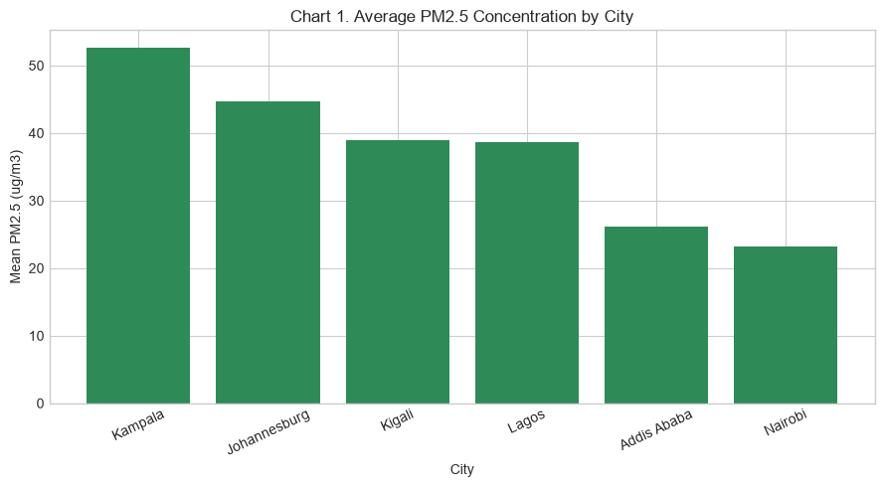
CHART 1
Average PM2.5 Concentration by City
Bar chart chosen for direct ranking comparison across discrete cities.
Air Quality Patterns in African Cities — Capstone Group 5
6

Slide 8
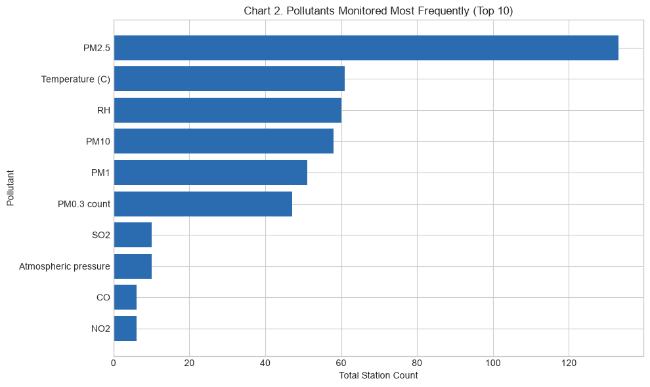
CHART 2
Pollutant Monitoring Frequency
Horizontal bar chosen for comparing many categories with long labels.
Air Quality Patterns in African Cities — Capstone Group 5
7

Slide 9
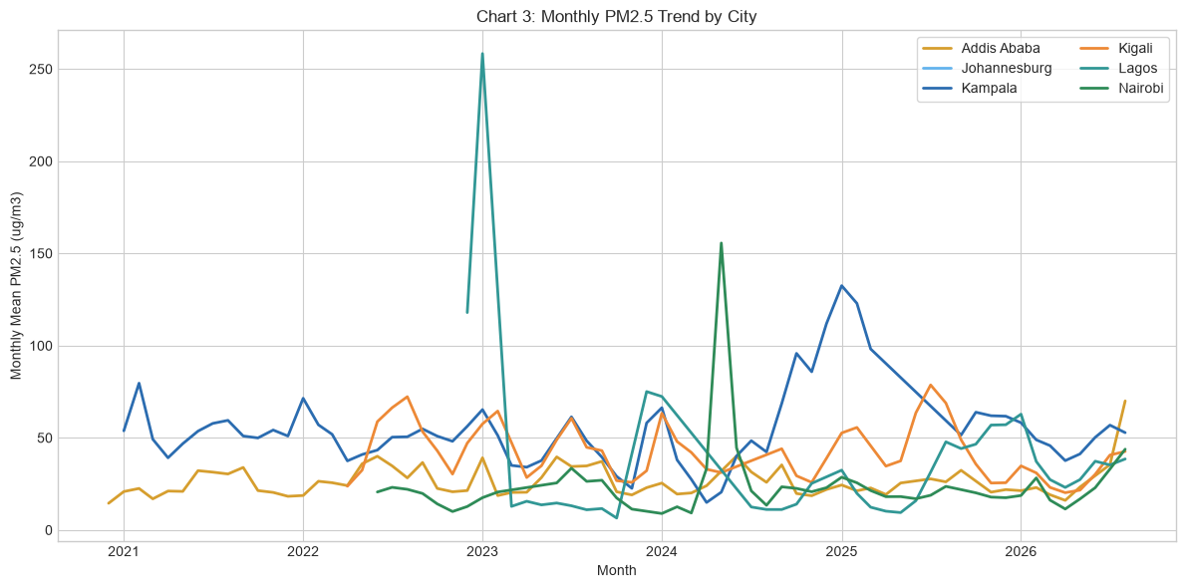
CHART 3
Monthly PM2.5 Trend by City
Line chart chosen to show time patterns and seasonal movement.
Air Quality Patterns in African Cities — Capstone Group 5
8

Slide 10
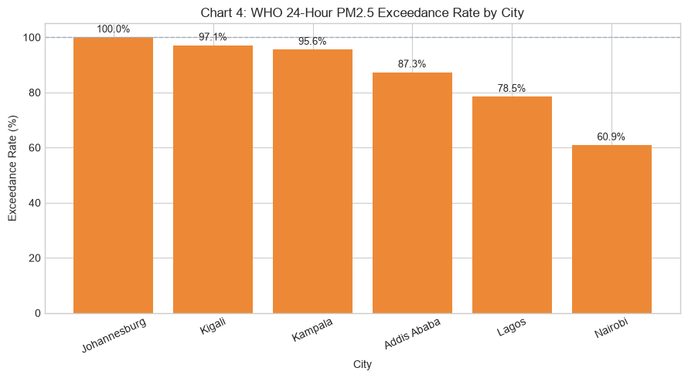
CHART 4
WHO Exceedance Rate by City
Bar chart chosen for clear threshold-compliance comparison.
Air Quality Patterns in African Cities — Capstone Group 5
9

Slide 11
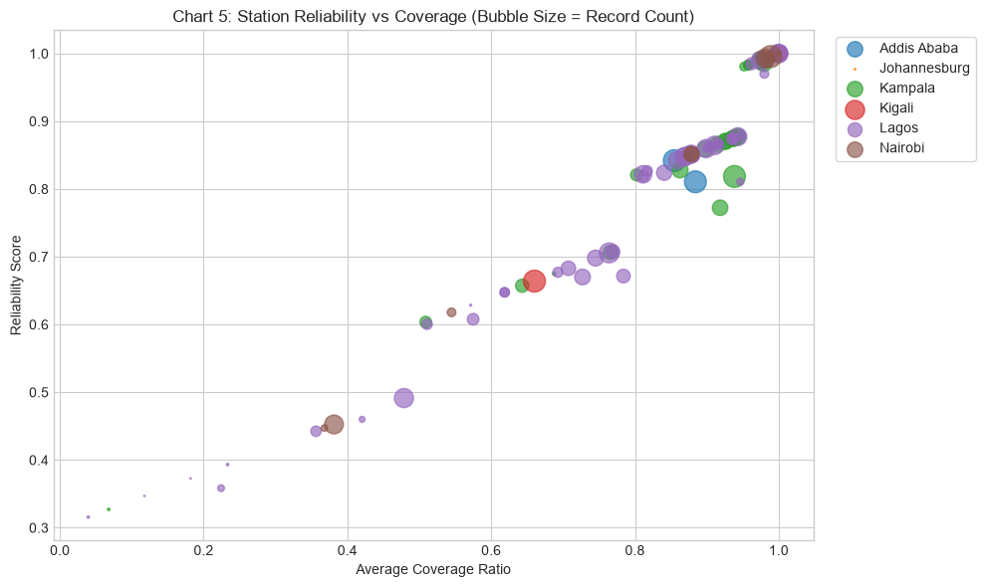
CHART 5
Station Reliability vs. Average PM2.5
Scatter plot chosen to show the relationship between data quality and pollution level.
Air Quality Patterns in African Cities — Capstone Group 5
10

Slide 12
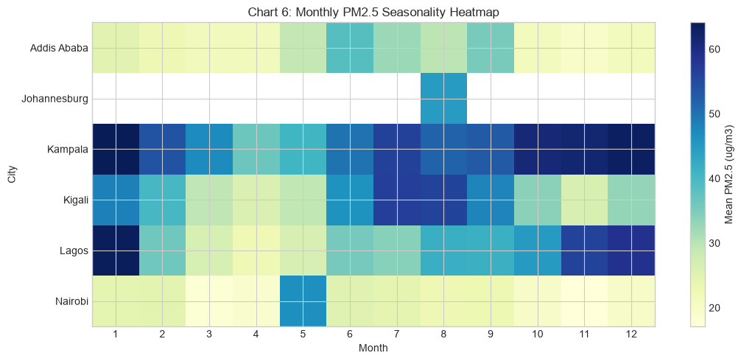
CHART 6
Monthly PM2.5 Seasonality Heatmap
Heatmap chosen to quickly spot seasonal highs/lows by city.
Air Quality Patterns in African Cities — Capstone Group 5
11

Slide 13
SECTION 7.1
Findings — Q1 & Q2
Q1: Highest average PM2.5 concentration?
Kampala: 52.6 µg/m³ mean, n=7,113 readings — the highest of all six cities studied.
Q2: Most frequently monitored pollutant?
PM2.5: 133 station-monitor entries across the six cities — more than any other pollutant.
Air Quality Patterns in African Cities — Capstone Group 5
12

Slide 14
SECTION 7.1
Findings — Q3 & Q4
Q3: Seasonal variation in PM2.5?
Lagos shows the widest seasonal swing (monthly mean range = 41.4 µg/m³). A one-way ANOVA confirms statistically significant month-to-month variation (p<0.05) in 5 of 6 cities (Kampala, Kigali, Lagos, Addis Ababa, Nairobi); Johannesburg's data volume was too low to test.
Q4: How often do readings exceed the WHO guideline?
Kigali exceeds the WHO 24-hour guideline (15 µg/m³) most often among reliably-monitored cities: 97.1% of 1,418 readings. Every city's annual mean PM2.5 sits above the WHO annual guideline (5 µg/m³). Johannesburg shows a nominal 100% rate, but from only 3 readings — not treated as statistically meaningful.
Air Quality Patterns in African Cities — Capstone Group 5
13

Slide 15
SECTION 7.1
Findings — Q5 & Q6
Q5: Most complete & reliable monitoring stations?
"Koshe Test" in Addis Ababa: reliability score 1.00, 100% coverage, "high" quality band.
Q6: Which cities should be prioritised for intervention?
See the prioritization ranking (next slide) — a weighted composite synthesis of the Q1, Q3, Q4 and Q5 findings above.
Air Quality Patterns in African Cities — Capstone Group 5
14

Slide 16
SECTION 7.2
Intervention Prioritization Ranking
1
Kampala
Highest avg PM2.5 among reliably-monitored cities (52.6 µg/m³, 3x+ WHO annual guideline); exceeds 24-hr guideline 96% of the time; large evidence base (n=7,113).
2
Kigali
Highest 24-hr exceedance rate of all reliably-monitored cities (97.1%); large seasonal swing (30.8 µg/m³) suggests a recurring, targetable source (e.g. dry-season burning/dust).
3
Lagos
Largest evidence base (n=9,042) and widest seasonal range (41.4 µg/m³) on an already-high baseline (38.6 µg/m³) — episodic events on top of chronic exposure.
4
Addis Ababa
Moderate average (26.1 µg/m³), still 5x+ WHO annual guideline; hosts the study's most reliable station (Koshe Test) — existing infrastructure to build on.
5
Nairobi
Lowest average PM2.5 (23.2 µg/m³) and lowest exceedance rate (61%) among the five — still above guidelines, but least urgent.
Air Quality Patterns in African Cities — Capstone Group 5
15

Slide 17
SECTION 7.2
Monitoring-Expansion Watchlist
Johannesburg is excluded from the priority ranking — not because its air is clean, but because the study window captured only 3 readings from 1 active sensor, too little to support any severity claim.
Recommendation: fund monitoring-infrastructure expansion here before any pollution-mitigation intervention — no defensible priority ranking is currently possible from this data.
A Spearman correlation test between average PM2.5 and station reliability across the five reliably-monitored cities found no significant relationship (rho=0.10, p=0.873) — this ranking reflects real pollution differences, not an artifact of uneven monitoring quality.
Air Quality Patterns in African Cities — Capstone Group 5
16

Slide 18
RECOMMENDATION FOR UNEP
UNEP should prioritize funding for both air-quality mitigation measures in Kampala, Kigali, and Lagos, and expanded monitoring infrastructure in cities with limited data coverage, such as Johannesburg, to enable more confident future assessment.
Thank you — questions welcome.

