Slide 1
Grocery Delivery Application
Team members and Enrollment numbers
Damini Gadpal (EONFWL629541)
Sravani Simma(EBEON0722627757)
Arunprasath Sivakumar(EBEON0722624976)
KarvinBritto M (EBEON0722626000)
Krishnaraj B(EBEON0722625017)
Guided by Varadarajan A

Slide 2
Grocery Delivery Application
Admin Module (Damini)
Order Module (Sravani)
Customer Details Module (ArunPrasadh)
Delivery Management System(Karvin)
Product Details (Krishnaraj)

Slide 3
Grocery Delivery Application
Order Module
Goals:
How to add product into cart
How to achieve payment process
How to view order status
How to maintain offers and discounts
Submodules:
Cart
Payment
Order details
Offers and discounts

Slide 4
Module 1:Cart
Definition: Shopping cart enables customers to select products , review what they selected , make modifications or add extra items if needed , and purchase the products.
Module interconnection:
when ever customer click on the “add to cart” button . it redirect to the cart this action control by productconroller.java class

Slide 5
Module 2:Payment
Definition: Online payments refer to the electronic exchange of currency through the internet. These payment usually consist of the transfer of monetary funds from a customer’s bank or credit or debit account, into the seller’s bank account
Module interconnection:
This this payment process control by payment controller

Slide 6
Module 3: Order Details
Definition: Order Details consists name of the item ,order number, total price, discount price, order date , order status.
Module interconnection:
In this module customer when ever click on “my order” it redirect to customer/my_account it is control by Orderdetailcontroller.java

Slide 7
Module 4: Offers and Discounts
Definition: The offer which is made to an individual or to a specific group of individual is said to be specific offer
Module interconnection:
Offers and Discounts control by ProductAdmController.java
In this module admin can add product name , product description , and mrp rate, price, product status, product img.
When ever click on submit “/saveProduct” is control by ProductAdminController.java

Slide 8
Project overview
project architecture diagram
Project Architecture
Approved
Customer
Pending
Login
Dashboard
Stock maintenance
Report
Order
checkout

Slide 9
Dataflow diagram
Order Management
Payment Management
Cart Management
Grocery order module
Offers and Discount magement
Checkout Management

Slide 10
Challenging issues
While developing my module I faced errors regarding configuration files and while connection between submodules.
Later I work on errors and fixed errors and finally I got output.

Slide 11
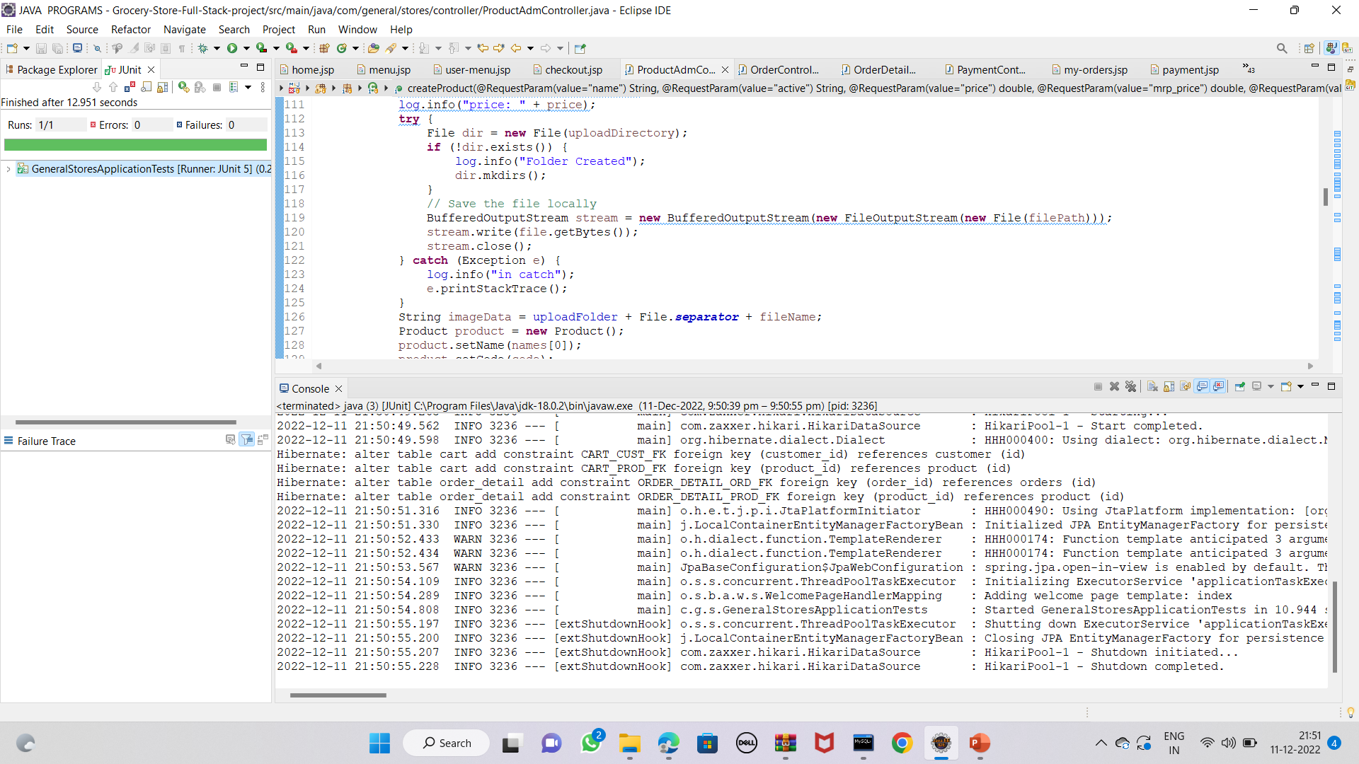
Testing
Tested result
Test tool: JUnit test

Slide 12
Features about the module
In Order module customers can easily can find product using search bar
Customers can easily zoom items images
Customers can easily view the product details
Customers can easily add products into cart
Customers can easily order grocery items by simple steps

Slide 13
Future enhancement
We can give more advance software for grocery delivery application including more facilities.
Create the master and slave database structure to reduce the overload of the database queries
Implement the backup mechanism for taking backup of codebase and database on regular basis on different severs.

Slide 14
Conclusion
Our project is only a humble venture to satisfy the needs of users . Several user friendly coding have also adopted.
User can easily interact with my application and also they can buy products by simple steps.
Finally my project is implemented and tested according to test cases.

