Slide 1

HybridMusicRec: Intelligent Music Recommendation Using Machine Learning
Group No. 22107058
Yash Nalawade 22107058
Prathamesh Babar 21107058
Sidhanath Arolkar 221070
Project Guide
Prof. Richa Singh

Slide 2
Contents
Abstract
Introduction
Motivation
Objectives
Research Gap
Problem Definition
Scope
Technological Stack
Implementation
Conclusion

Slide 3
Abstract
The HybridMusicRec system is a music recommendation application that suggests songs to users based on their listening preferences and audio characteristics of songs. The system uses Collaborative Filtering to find users with similar taste and Content-Based Filtering to analyze audio features such as danceability, energy, tempo, and valence. Cosine similarity is used to identify both similar users and musically similar songs. The model is trained using Python and Scikit-learn on a dataset of 2000 songs and 300 users, and a weighted hybrid formula combines both approaches to generate final recommendations. A web interface built with HTML, CSS, JavaScript, and Flask allows users to discover personalized song recommendations in real time.

Slide 4
Introduction
The HybridMusicRec system is designed to suggest songs to users based on both their rating history and the audio characteristics of songs.
The system uses Collaborative Filtering to identify users with similar music taste and recommend songs that those similar users have liked.
Content-Based Filtering is applied to analyze 9 audio features of each song and find musically similar tracks using cosine similarity on normalized feature vectors.
A hybrid approach combines both methods using the formula: Final Score = α × CF + (1−α) × CB, where alpha is adjustable by the user.
The application integrates a Python Flask backend with an HTML, CSS, and JavaScript frontend to provide real-time song recommendations and evaluation insights to users.

Slide 5
Motivation
Many music listeners find it difficult to discover new songs that match their personal taste from the millions of tracks available on streaming platforms.
Searching for music manually is time-consuming and does not adapt to the user's individual preferences or the actual sound characteristics of songs.
A hybrid recommendation system can help users discover relevant songs accurately by combining user behavior patterns and audio-level song similarities.
Using Collaborative Filtering and Content-Based Filtering together overcomes the cold-start problem and the filter-bubble effect that affect single-approach systems.
The project aims to develop a simple and intelligent system that helps users explore diverse and personalized music recommendations through an easy-to-use web interface.

Slide 6
Objectives
To develop a hybrid music recommendation system that suggests songs based on user preferences and audio characteristics of songs.
To implement Collaborative Filtering using cosine similarity on a user-item rating matrix to identify similar users and recommend songs.
To implement Content-Based Filtering by analyzing audio features such as danceability, energy, tempo, and valence to find musically similar songs.
To combine both approaches using a weighted hybrid formula where the balance between Collaborative and Content-Based filtering is adjustable by the user.
To integrate the trained recommendation model with a Flask backend and a web-based interface using HTML, CSS, and JavaScript for real-time song recommendations.

Slide 7
Research Gap(Limitations of existing systems)
Many existing music platforms rely only on Collaborative Filtering, which fails for new users who have no rating history due to the cold-start problem.
Several systems do not use Content-Based approaches, resulting in less accurate recommendations that do not consider the actual audio characteristics of songs.
Some recommendation systems depend heavily on user ratings or historical data, making it difficult to recommend songs to users with limited interaction history.
Existing systems often fail to combine multiple recommendation approaches, limiting their ability to provide both accurate and diverse song suggestions.
Many platforms lack a simple and interactive interface that allows users to control and tune the recommendation strategy in real time.

Slide 8
Problem Definition
Many users struggle to discover new music that matches their personal taste from the large number of songs available on modern streaming platforms.
Collaborative Filtering alone fails for new users who have no rating history, making it impossible to find similar users and generate recommendations.
Content-Based Filtering alone keeps recommending songs that are too similar to what the user already knows, limiting music discovery and variety.
There is a need for a system that can analyze both user behavior and audio characteristics of songs together to generate accurate and diverse recommendations.
Therefore this project aims to develop a hybrid music recommendation system that combines both approaches using a weighted formula and provides results through a simple interactive web interface.

Slide 9
Scope
The system can recommend songs based on user rating history and audio features including danceability, energy, tempo, valence, acousticness, and loudness.
It can be integrated with web applications or mobile platforms to provide real-time personalized song recommendations to users.
The model can be extended by incorporating the real Spotify Tracks Dataset and additional features such as album art, track previews, and playlist creation.
Future improvements may include personalized recommendations based on implicit feedback such as play counts and skip rates, or advanced models like Matrix Factorization.
The system can be further enhanced by deploying on cloud platforms and integrating with live music APIs for real-world recommendation at scale.

Slide 10
Technological Stack
Frontend: HTML, CSS, JavaScript
Backend: Python, Flask
Machine Learning: Collaborative Filtering and Content-Based Filtering
Recommendation Method: Hybrid Approach (Weighted Combination)
Similarity Algorithm: Cosine Similarity
Data Processing: Pandas, NumPy, MinMaxScaler(Scikit-learn)
Model Training Environment: Google Colab
Model Storage: In-memory similarity matrices precomputed at server startup
API Communication: REST API using Flask and Fetch API (JavaScript)
Visualization: Chart.js for bar charts and radar charts

Slide 11
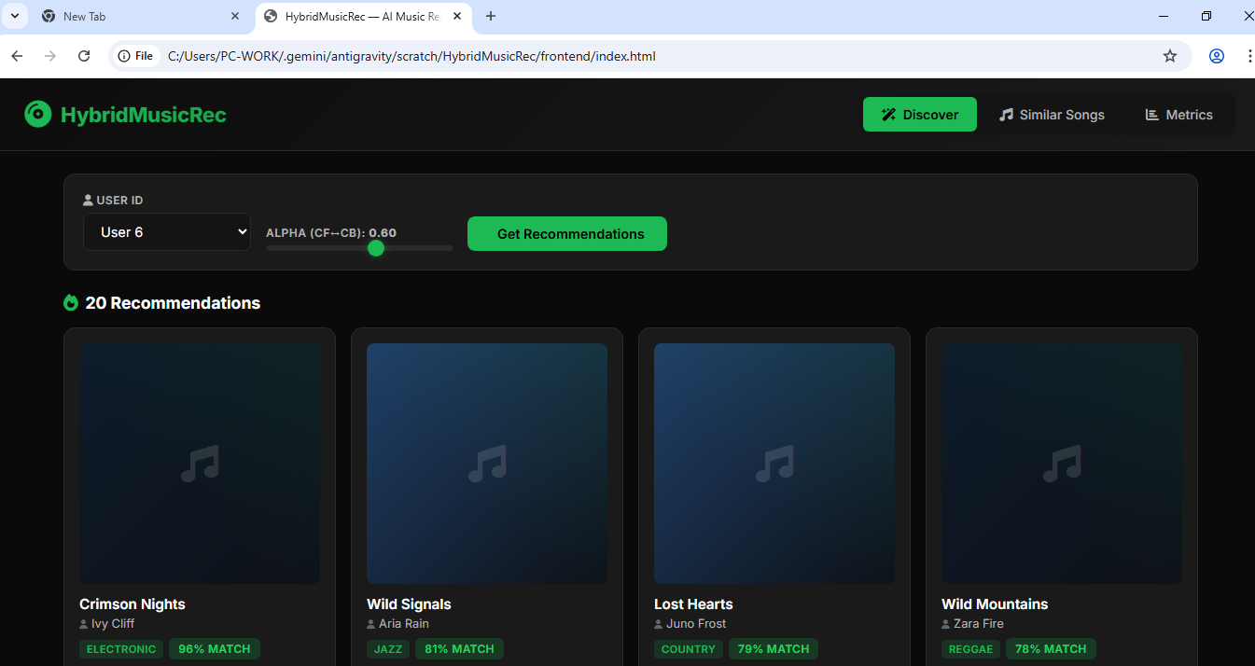
Implementation
Figure 1. Discover Page

Slide 12
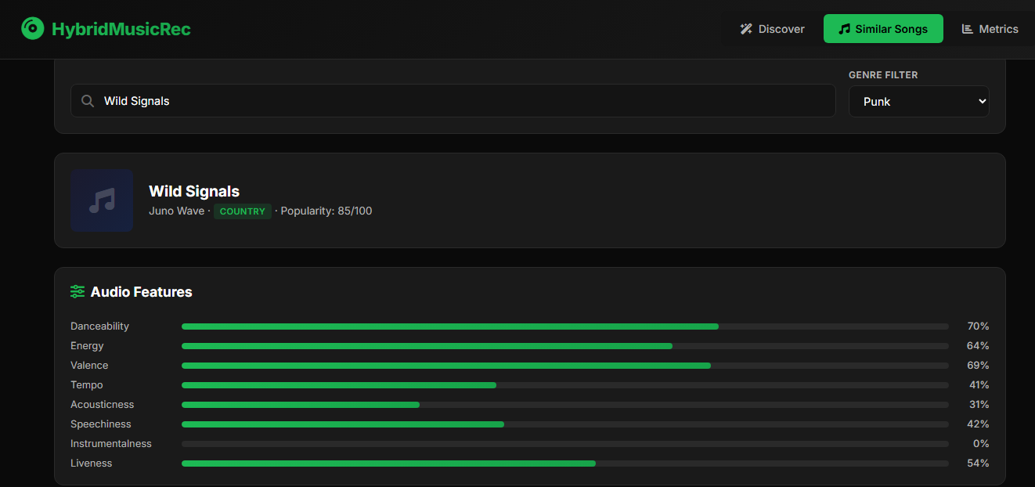
Implementation
Figure 2. Similar Songs Page

Slide 13
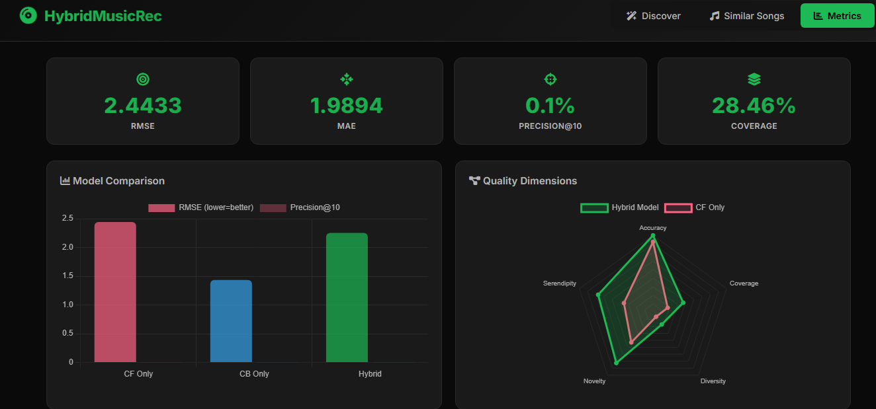
Implementation
Figure 3. Metrics Page

Slide 14
Conclusion
The HybridMusicRec system successfully demonstrates how machine learning techniques can be used to build an effective and personalized music recommendation application. By combining Collaborative Filtering and Content-Based Filtering using cosine similarity and a weighted hybrid formula, the system analyzes both user behavior and audio characteristics to suggest relevant songs to users. The integration of a Flask-based backend with an HTML, CSS, and JavaScript frontend allows users to easily interact with the system and receive real-time recommendations. The inclusion of a metrics dashboard further enhances the project by visualizing evaluation results through interactive charts. Overall, the project shows how hybrid recommendation systems can help users discover diverse and personalized music in a practical and efficient manner.

Slide 15
Thank You...!!

