Slide 1
Cartographer: Using Python to Create Maps of Curved Spacetime and Differential Scattering Cross-sections of Low-Mass Objects about a Schwarzschild Black Hole Progress Report
Thomas Knudson
Department of Physics, OSU
Advisor: Dr. Kathryn Hadley
14 November 2021

Slide 2
Context: What are you doing?
Creating maps of curved spacetime geometries
Geodesics
Velocity vector fields
Differential Scattering Cross sections
A toolset that is extendable with manageable complexity
Now: python 3.10
Numpy
Matplotlib
Pyyaml

Slide 3
Background: Recap and Beyond PH 335
Special Relativity
General Relativity
Spacetime
Measure time in meters
Straight Worldlines
Non-Euclidean distance
Only two invariant quantities
Proper time and Proper distance
Length contraction and time dilation between observers
Reference frames at rest with respect to events
very useful but also abundant
Spacetime but curved
Locally: straight worldlines
Globally: curved paths
Still non-Euclidean
Geometric vs Physical distance
Still invariant measurements
Proper time and Proper distance
But now gravity causes another set of Length contraction, time dilation!
Resting Reference frames
Very limited

Slide 4
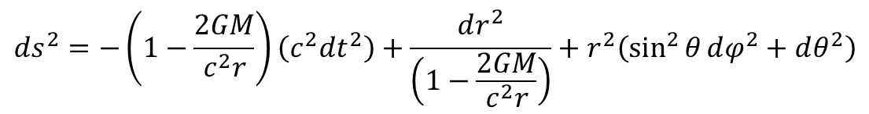

Background: Schwarzschild Geometry
$$ds^{2}=−\left(1−\frac{2GM}{c^{2}r}\right)\left(c^{2}dt^{2}\right)+\frac{dr^{2}}{\left(1−\frac{2GM}{c^{2}r}\right)}+r^{2}\left(\sin^{2}{θ}dφ^{2}+dθ^{2}\right)$$
Simplest solution to Einstein’s Field Equations
Empty universe
Single Massive Object
Non-rotating
Uncharged
Spherically symmetric
Shell observers are the only “rest” frames
$r$ is not a radius!

Slide 5
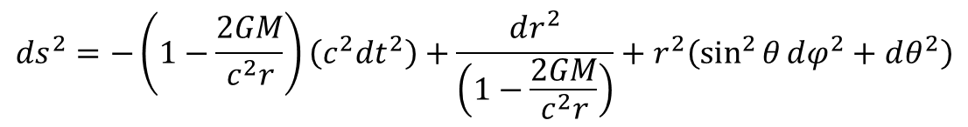
Progress: Python is Weird (How it started)
Emphasis on Polymorphism
Class variables vs Instance variables
Inheritance and overriding behaviour
Not great for abstracting mathematical expressions
Can’t store unassigned variables
Can’t store a call to another function
$$ds^{2}=−\left(1−\frac{2GM}{c^{2}r}\right)\left(c^{2}dt^{2}\right)+\frac{dr^{2}}{\left(1−\frac{2GM}{c^{2}r}\right)}+r^{2}\left(\sin^{2}{θ}dφ^{2}+dθ^{2}\right)$$

Slide 6
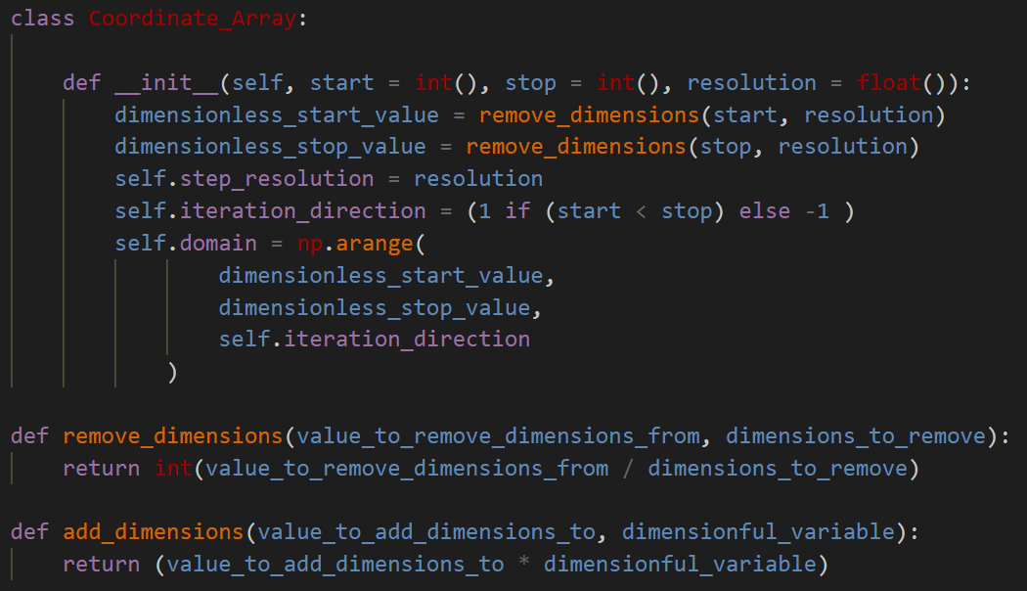
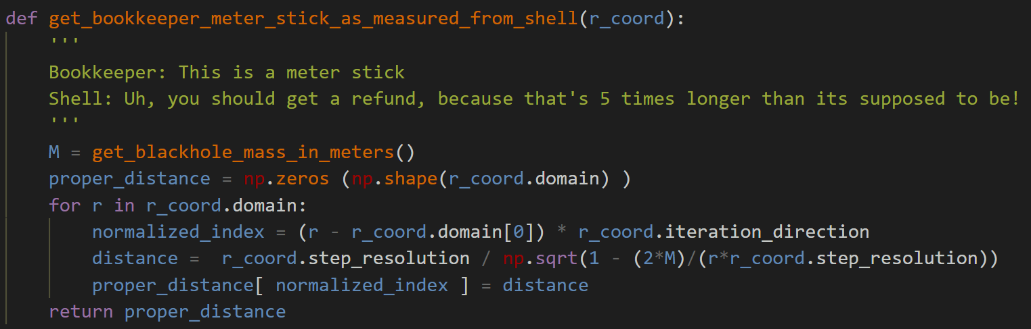

Progress: Accounting for dimensions
Math trick for solving ODEs
Works great for computation
Coordinate axes
Dictates the number of steps to take for the request intervals
$N$ steps for $x∈\left[a,b\right]$
Indices for elements
dimensionless
intensive
Allows for more sanity checks:
Names implying dimensions better have them
Unit analysis on functions

Slide 7
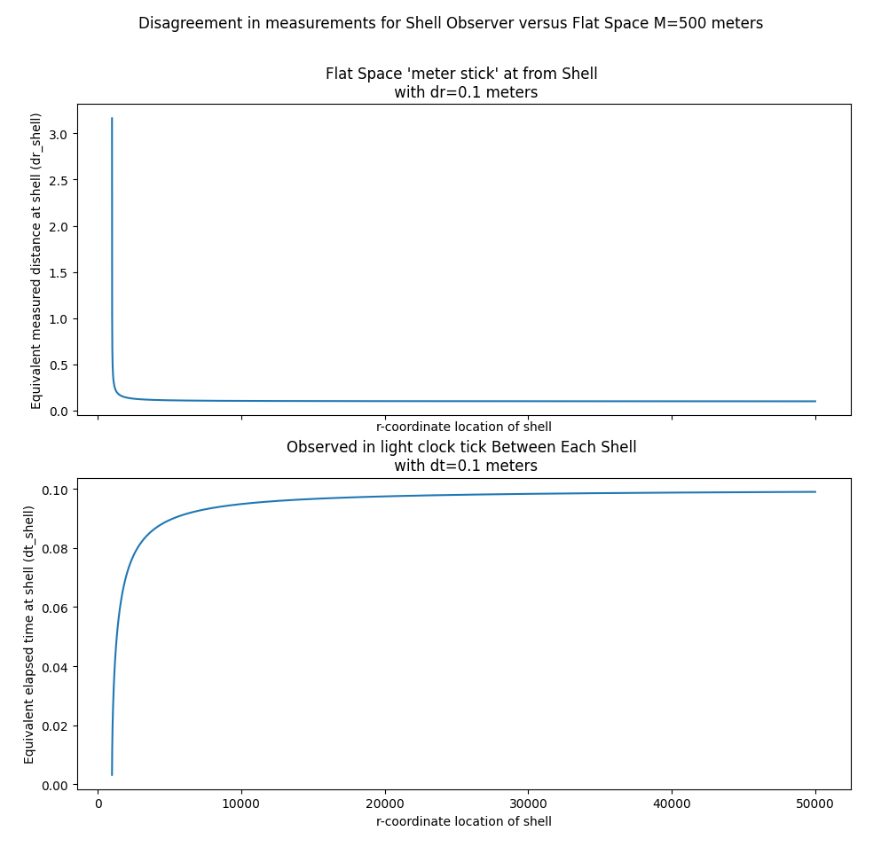
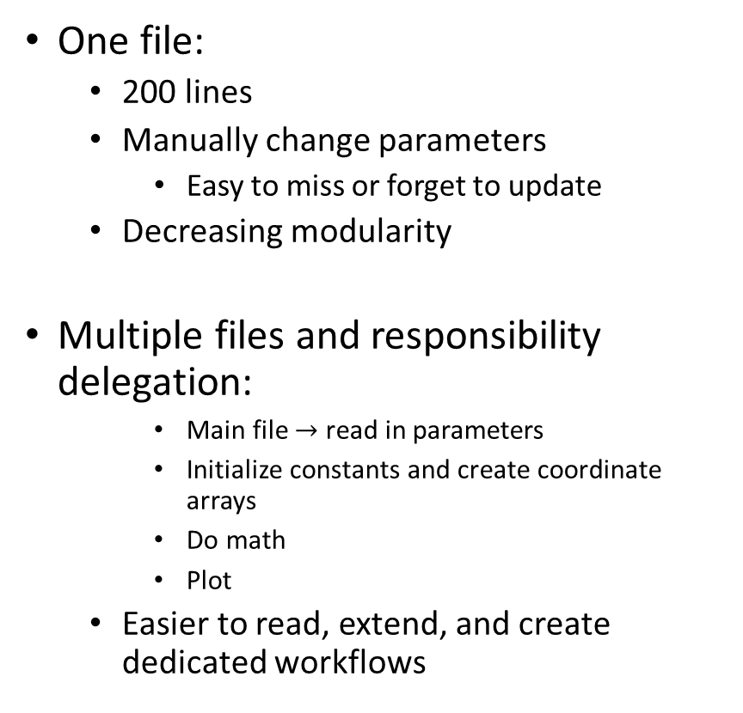
Progress: Breaking Monoliths
One file:
200 lines
Manually change parameters
Easy to miss or forget to update
Decreasing modularity
Multiple files and responsibility delegation:
Main file $→$ read in parameters
Initialize constants and create coordinate arrays
Do math
Plot
Easier to read, extend, and create dedicated workflows

Slide 8
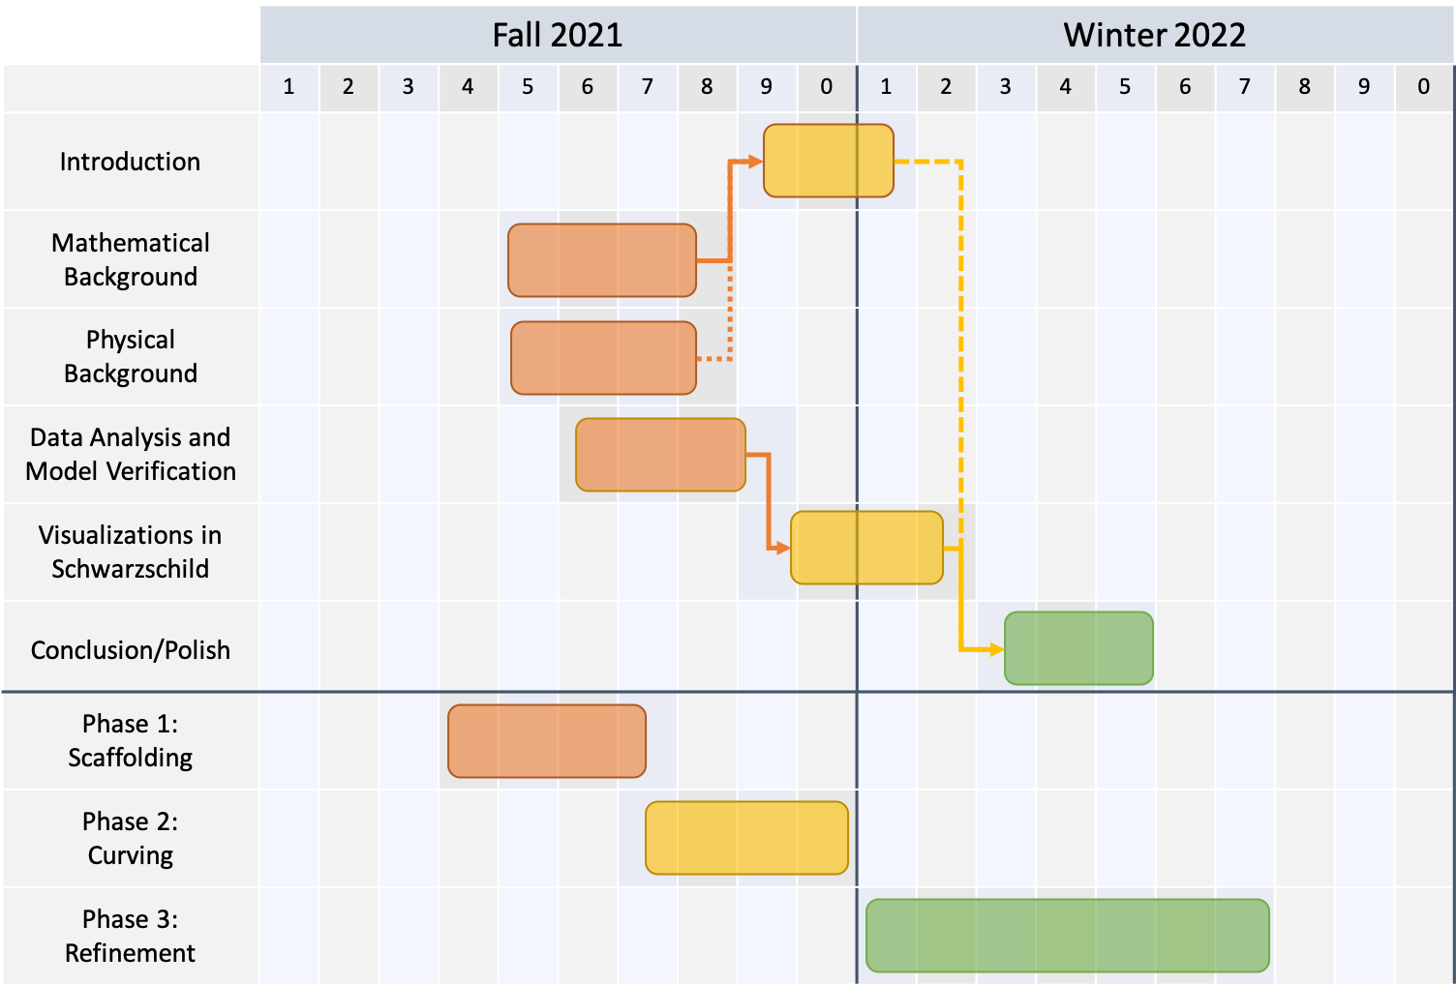
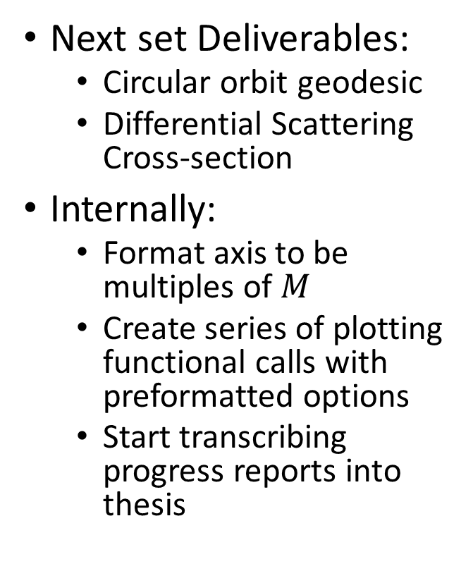
Outlook
Next set Deliverables:
Circular orbit geodesic
Differential Scattering Cross-section
Internally:
Format axis to be multiples of $M$
Create series of plotting functional calls with preformatted options
Start transcribing progress reports into thesis

