Slide 2
Math
Today:
Polynomials
Binomials
Problem Solving

Slide 3
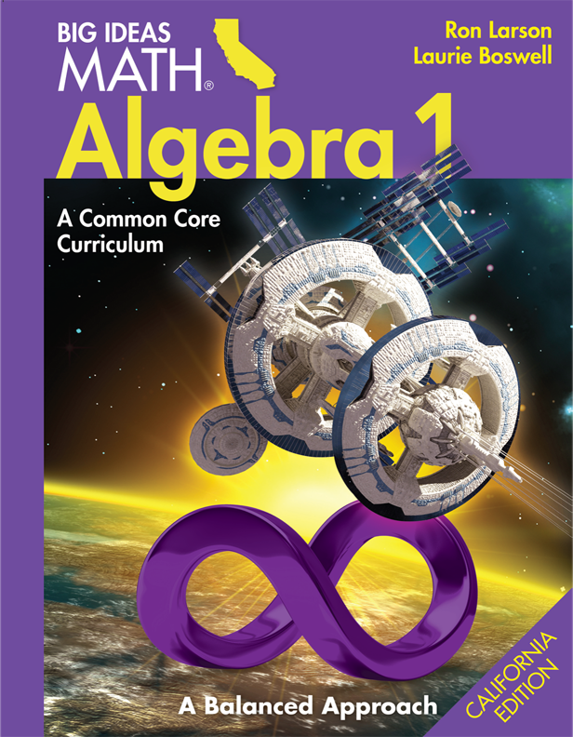
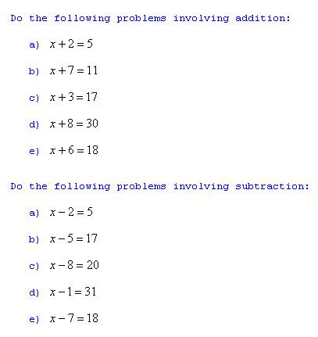
Questions:
Practice

