Slide 1

Seasonal Agriculture Performance Analysis
Simmy Kumari
Indira Gandhi Delhi Technical University for Women
AICTE Student ID : STU63c3cafa16af61673775866
VOIS for Tech – AICTE Internship | Batch 1, 2026–27 | Data Analytics

Slide 2

PROBLEM STATEMENT
Agricultural activity is shaped by seasonal variation in environmental conditions, farming practices, resource availability and market prices. As a result, performance differs from one season to another.
Raw agricultural data, on its own, does not explain how performance changes across seasons or which patterns hold under different seasonal conditions.
The problem is to analyse a 4,000-farm seasonal agriculture dataset and investigate how performance differs across Kharif, Rabi and Zaid — identifying meaningful patterns, trends, relationships and variations within the available data.

Slide 3
Project Description
An end-to-end exploratory data analysis of seasonal agricultural performance across 8 Indian states, built in Python.
▪ The dataset 4,000 farm records × 28 attributes covering environment, soil, inputs, irrigation, output and economics across 3 seasons (Kharif, Rabi, Zaid), 8 crops and 8 states.
▪ Data preparation Profiled structure and data types, quantified missing values in Rainfall, Soil Moisture and Yield, imputed them with the median, confirmed zero duplicates and reviewed outliers.
▪ Analysis performed Season-wise aggregation of yield, production, profit, water use and pest risk; crop × season and state × season pivot heatmaps; irrigation comparison; correlation analysis; and a one-way ANOVA on yield across seasons.
▪ Visualisation 22+ charts built with Matplotlib and Seaborn — histograms, box plots, bar charts, scatter plots and annotated heatmaps.
▪ Deliverable A documented Jupyter Notebook ending in evidence-based insights and recommendations for seasonal agricultural planning.

Slide 4

WHO ARE THE END USERS?
Anyone whose decisions change with the season.
▪ Farmers and farmer producer organisations — choosing which crop, season and irrigation method gives the best return on their land.
▪ Agricultural officers and extension services — targeting seasonal advisories, pest alerts and input support where the data shows they are needed.
▪ State agriculture departments and policy planners — allocating subsidies, water and price support across Kharif, Rabi and Zaid.
▪ Agri-input and irrigation companies — planning seasonal demand for fertiliser, pesticide and drip / sprinkler systems.
▪ Agri-finance, insurance and lending institutions — pricing seasonal risk using yield variability, pest risk and profitability evidence.
▪ Researchers and data-analytics students — as a reproducible template for seasonal agricultural analysis.

Slide 5

Technology Used
Python 3
Core language for the entire analysis
Pandas
Loading, cleaning, grouping, pivot tables, aggregation
NumPy
Numerical operations and dtype selection
Matplotlib
Figure creation, axes, titles and layout control
Seaborn
Histograms, box plots, bar plots, scatter plots, heatmaps
SciPy (stats)
One-way ANOVA test for seasonal yield differences
Jupyter / Google Colab
Interactive notebook environment
Git & GitHub
Version control and project hosting

Slide 6
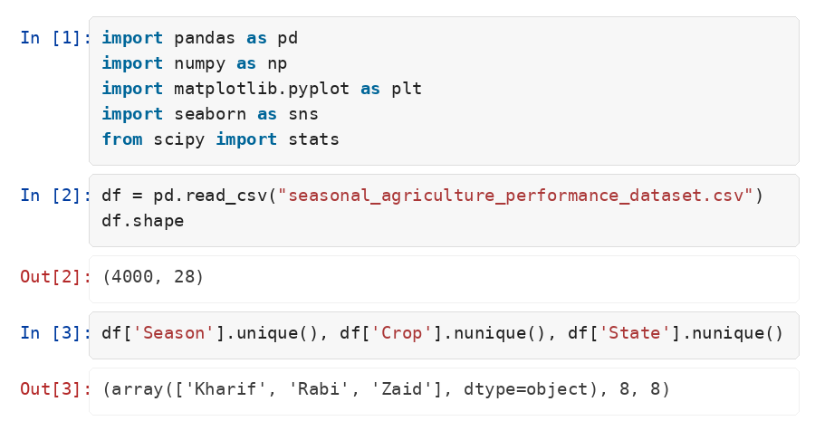
RESULTS
1. Loading the dataset and understanding its structure
Insight: 4,000 farm records across 28 attributes — 3 seasons, 8 crops and 8 states. Season counts are uneven (Kharif 1,779, Rabi 1,627, Zaid 594), which matters when comparing them.

Slide 7
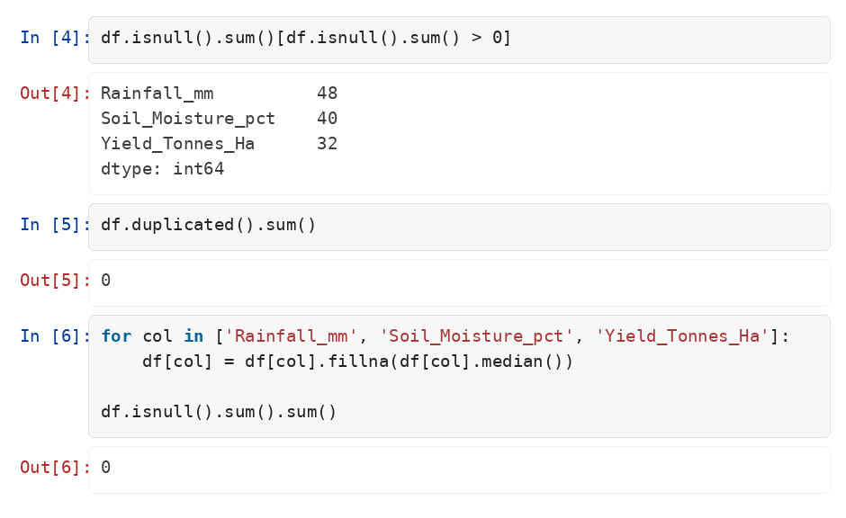
RESULTS
2. Data quality check and cleaning
Insight: Only 120 missing values (3.0% of rows) in three columns, and zero duplicates. The median was used rather than the mean because yield is heavily right-skewed.

Slide 8
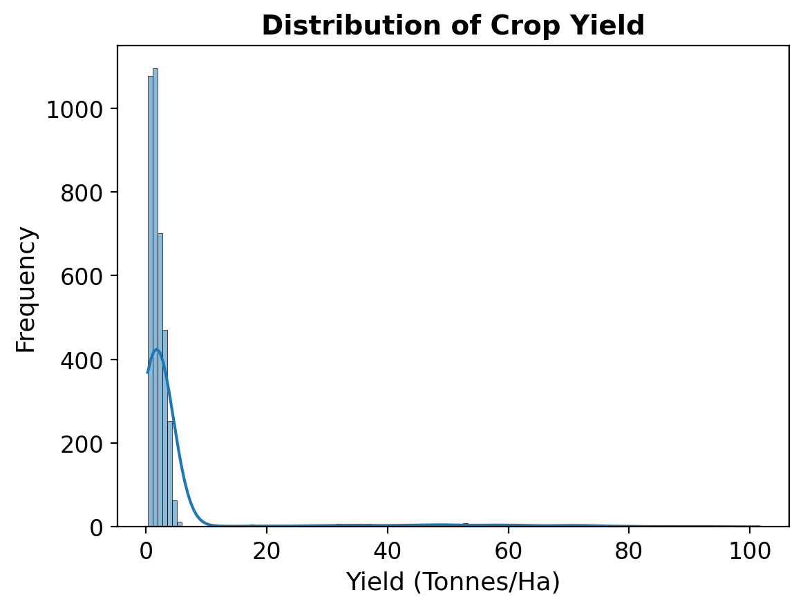
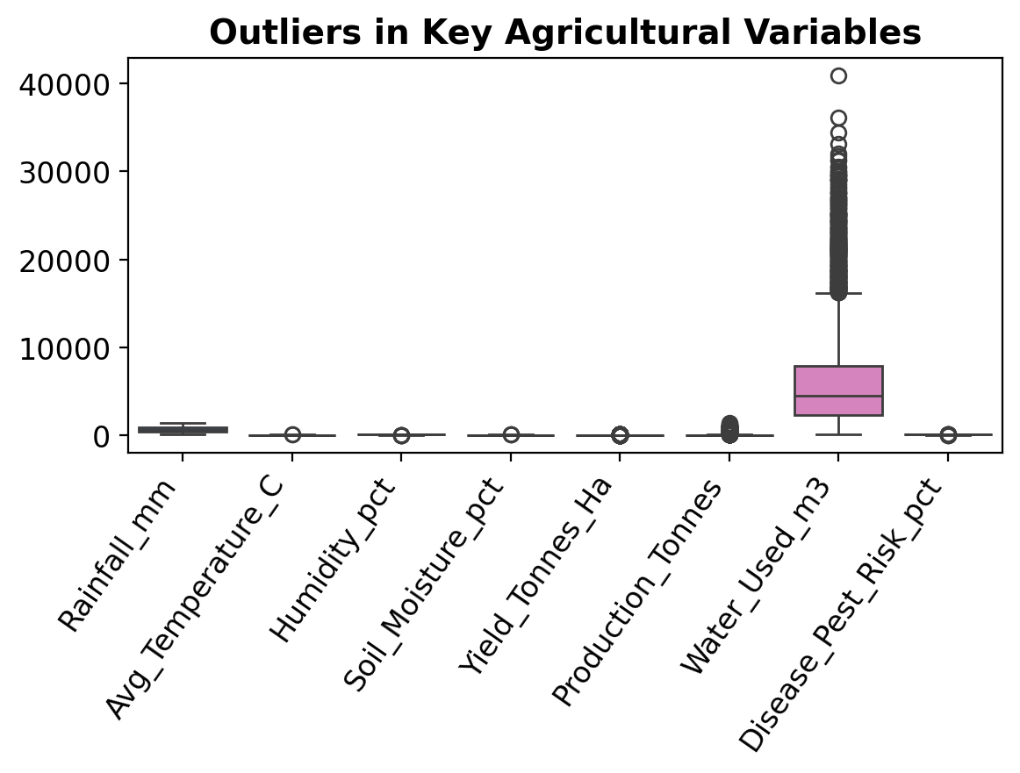
RESULTS
3. Distribution and outlier review of key variables
Insight: Yield is strongly right-skewed (median 1.74 vs mean 5.27 t/ha) because sugarcane averages 46.6 t/ha against 1–3 t/ha for every other crop — so those high values are a real crop effect, not bad data.

Slide 9
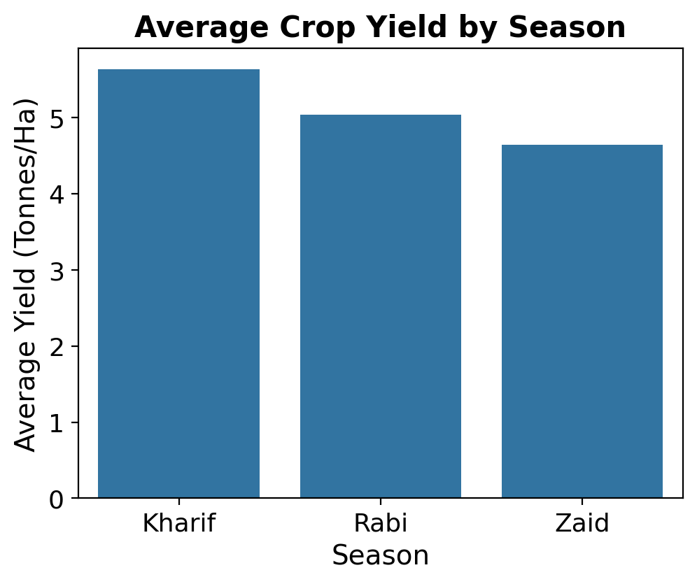
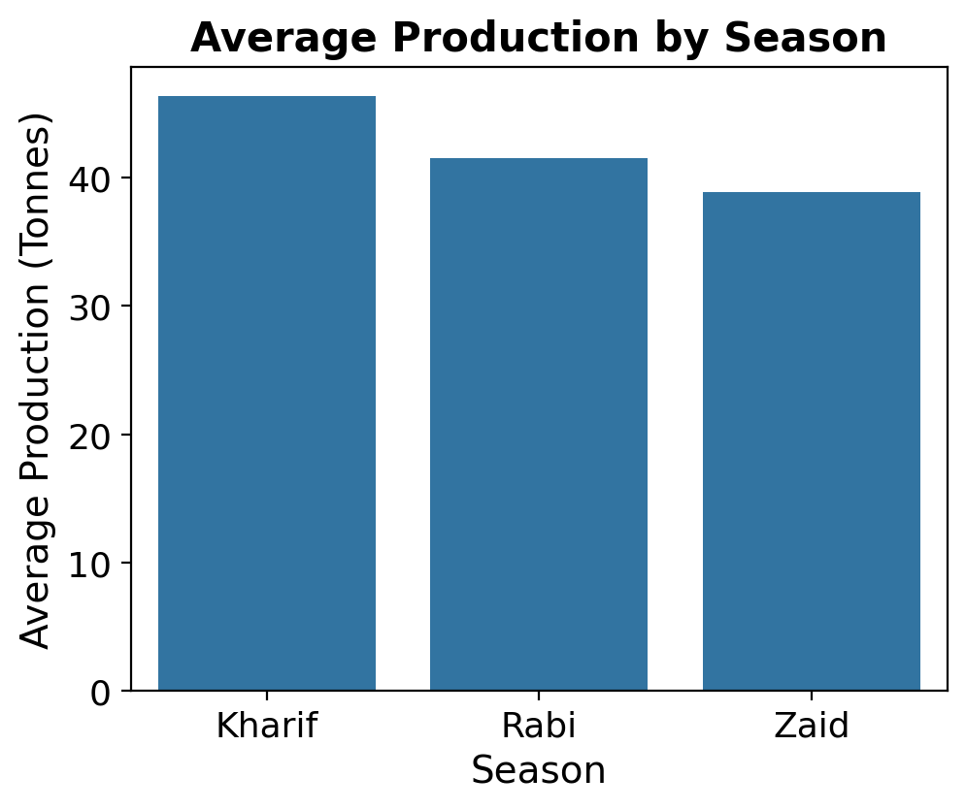
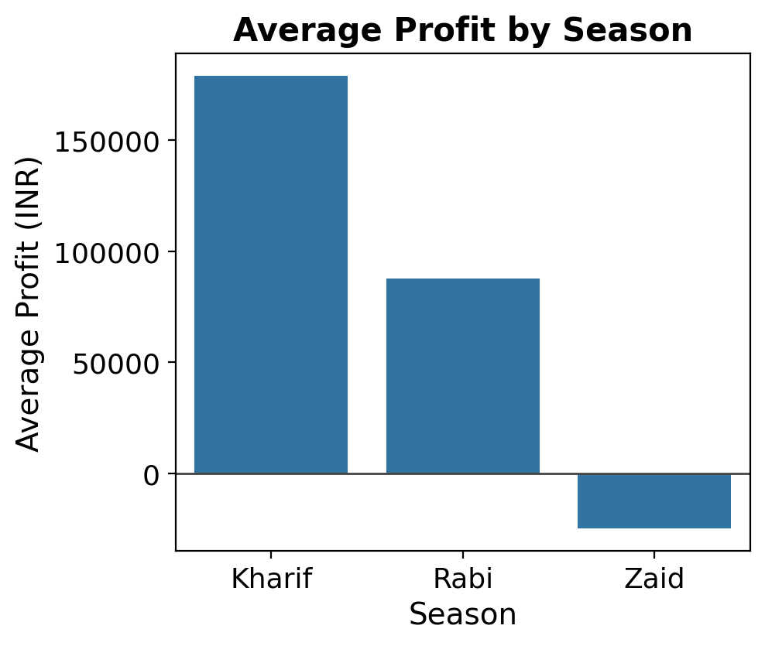
RESULTS
4. Seasonal performance — yield, production and profit
Insight: Kharif leads on all three measures. The profit gap is the striking one: ₹1.79 lakh average profit in Kharif against an average loss of ₹24,805 in Zaid.

Slide 10
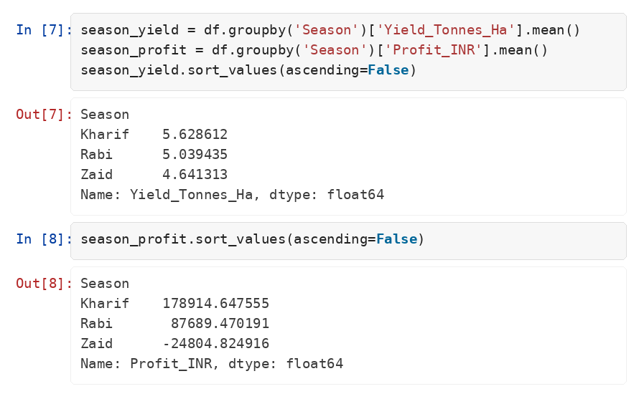
RESULTS
5. The season-wise aggregation behind those charts
Insight: Kharif yields 5.63 t/ha against Zaid's 4.64 — a 21% gap — but profit swings from +₹1.79 lakh to −₹24,805, so cost and price matter far more than yield alone.

Slide 11
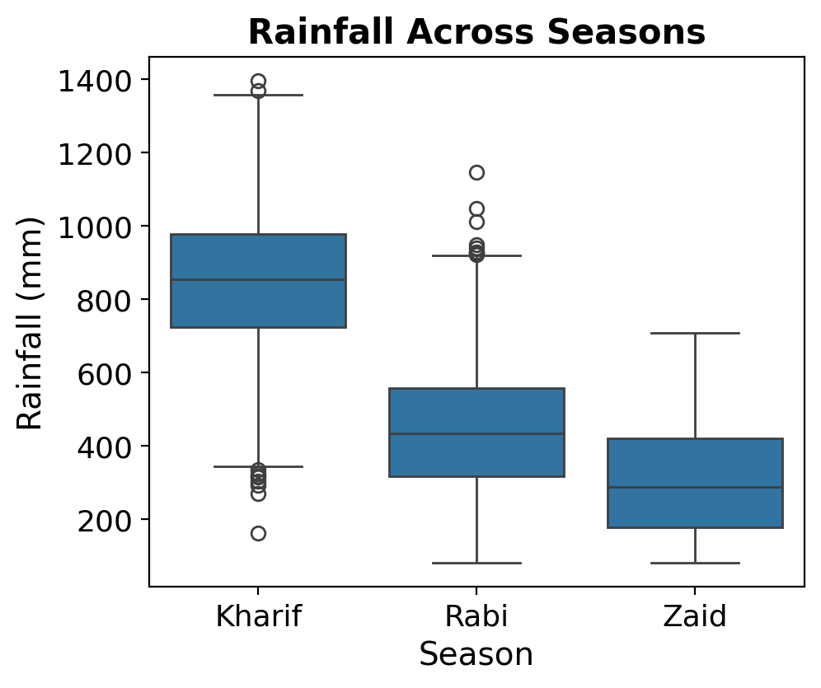
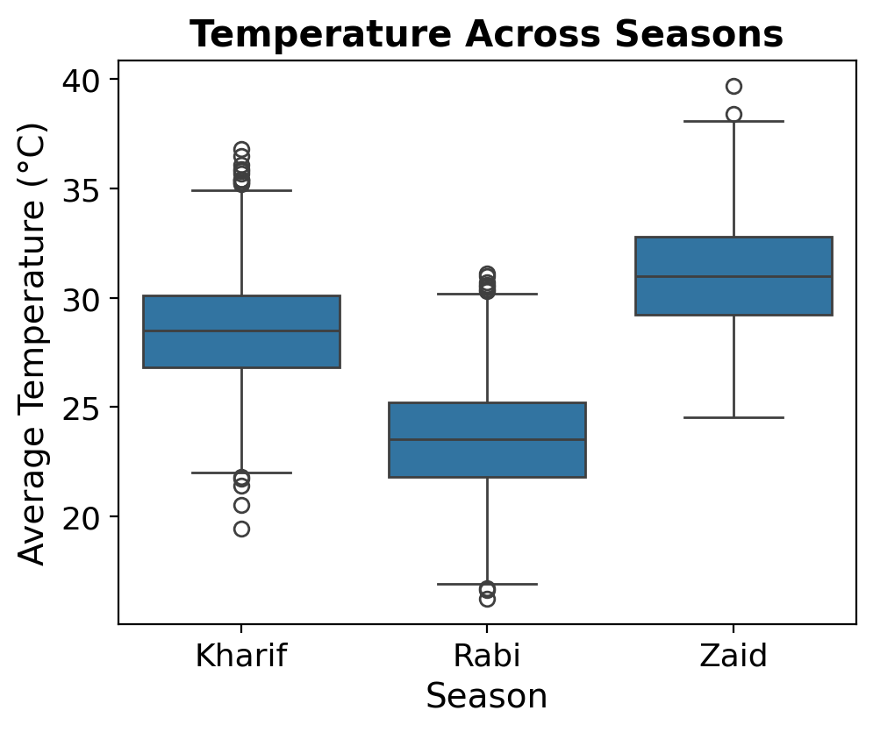
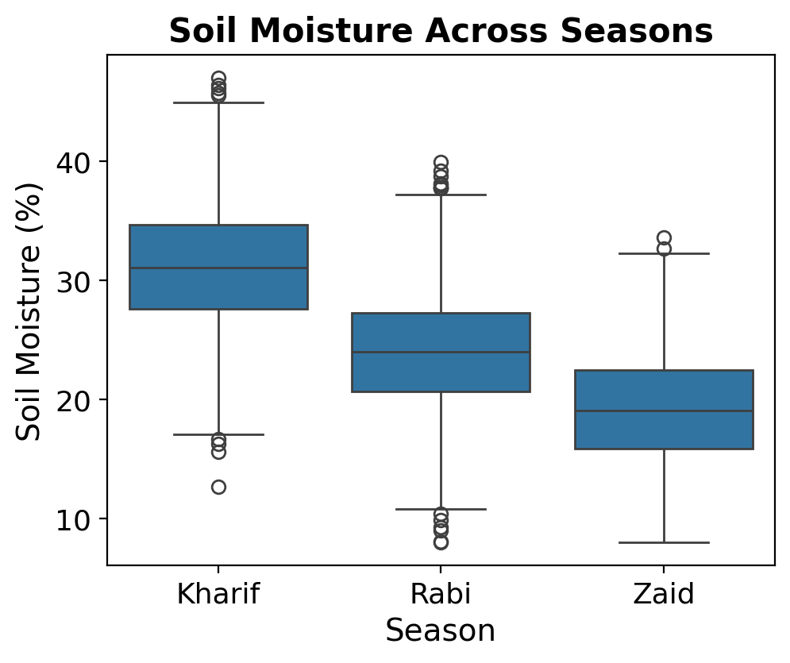
RESULTS
6. Environmental conditions across the three seasons
Insight: The seasons are genuinely distinct: Kharif averages 849 mm rainfall and 31% soil moisture, while Zaid gets only 305 mm and 19% and runs hottest at 31°C — the driest, hottest season.

Slide 12
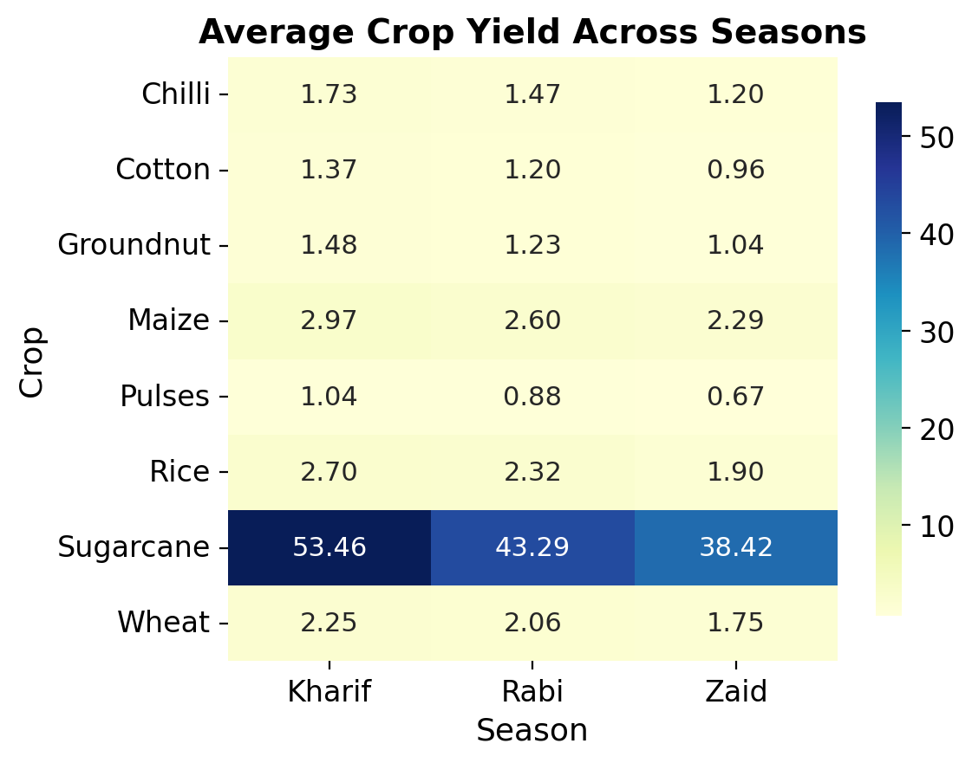
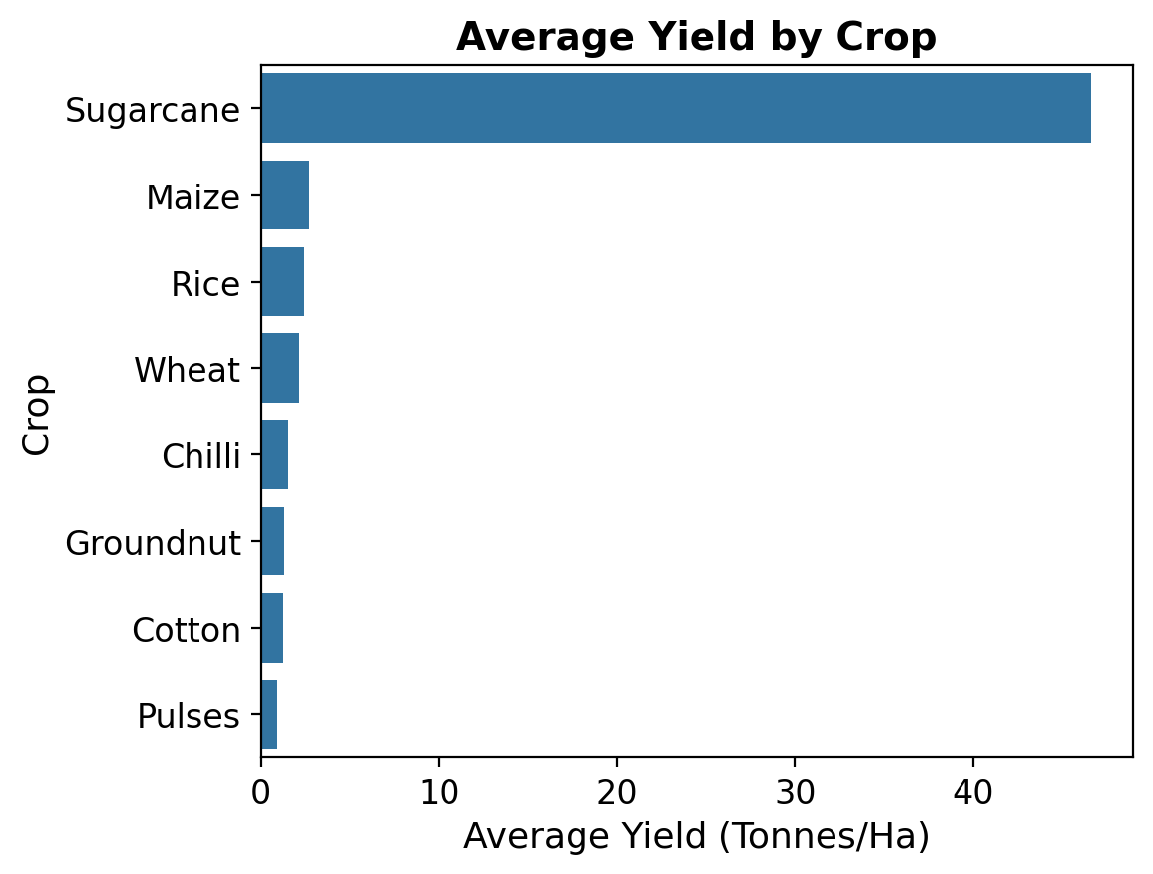
RESULTS
7. Crop-level patterns and the crop × season yield heatmap
Insight: Kharif is the best season for all 8 crops without exception. But the spread between crops (sugarcane 46.6 t/ha vs pulses 0.92) is far wider than the spread between seasons — crop choice outweighs season.

Slide 13
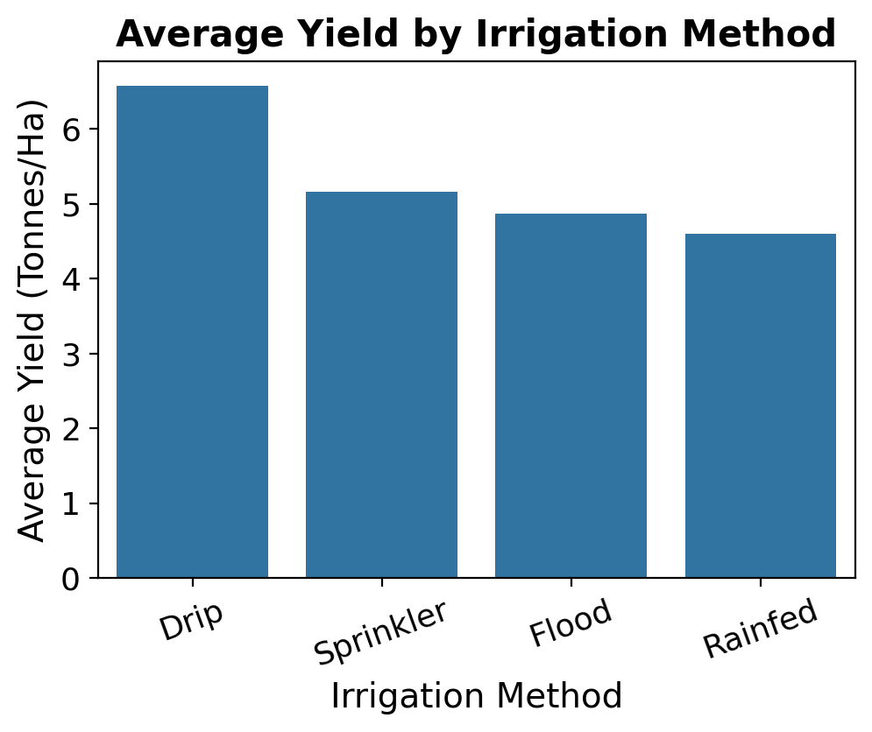
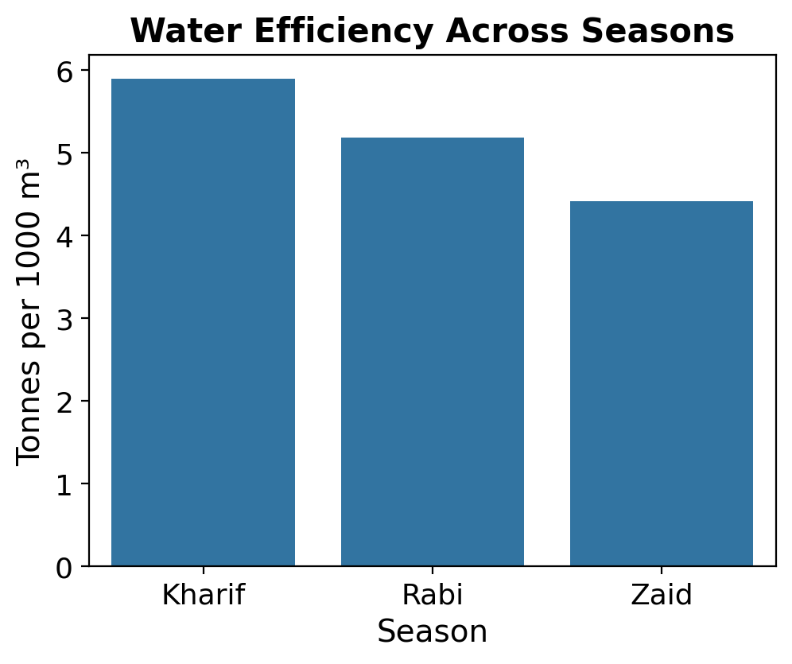
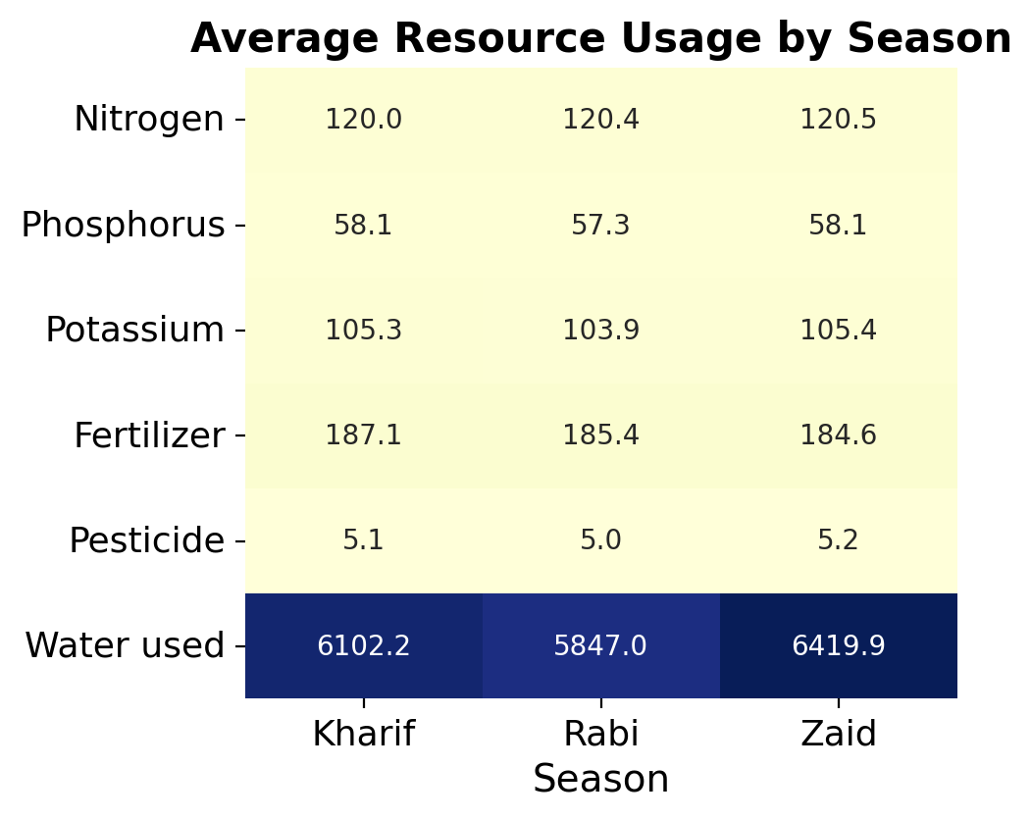
RESULTS
8. Resource usage, irrigation method and water efficiency
Insight: Drip irrigation averages 6.58 t/ha against 4.60 for rainfed — a 43% advantage. Input levels are near-identical across seasons, yet Zaid uses the most water (6,420 m³) for the lowest efficiency (4.41 t / 1000 m³).

Slide 14
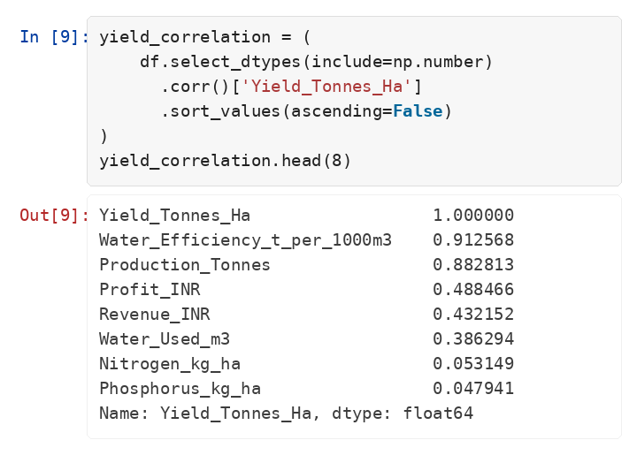
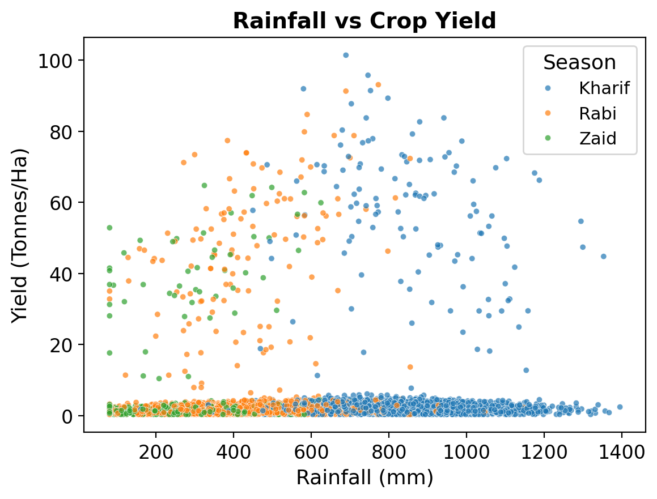
RESULTS
9. Which factors actually move yield? Correlation analysis
Insight: Water efficiency (r = 0.91) and production (r = 0.88) dominate, while fertiliser, rainfall and soil pH sit near zero. Market price is negatively correlated (r = −0.38) — high-volume sugarcane sells at ₹3,490/tonne against ₹1.03 lakh for chilli.

Slide 15
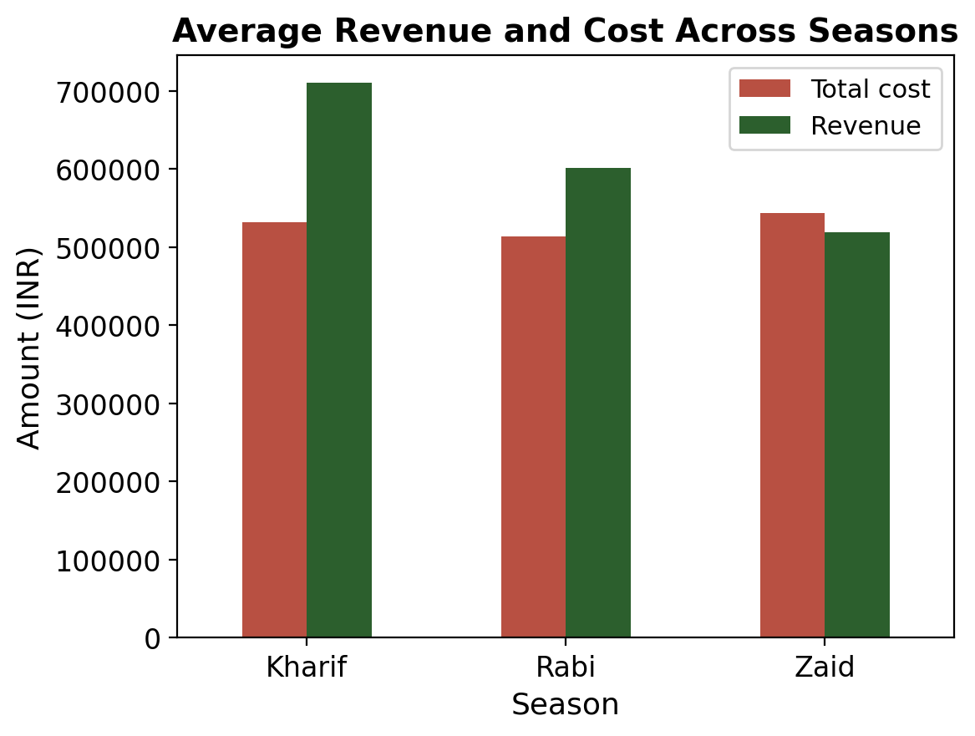
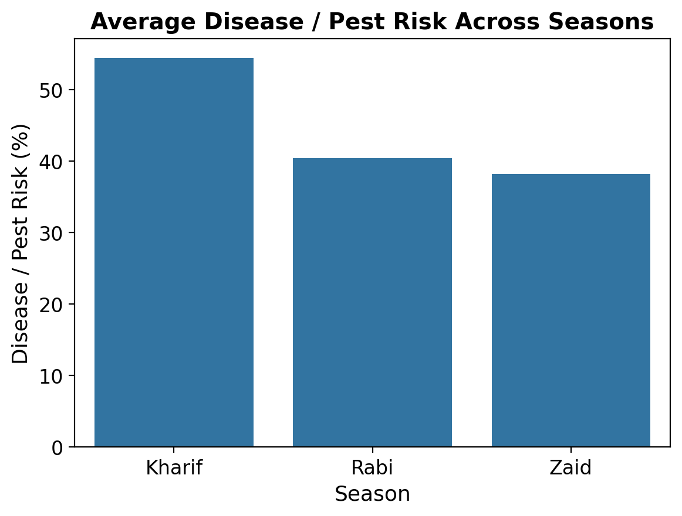
RESULTS
10. Economic performance and pest risk by season
Insight: Zaid is the only season where average cost (₹5.44 lakh) exceeds revenue (₹5.19 lakh). Kharif carries the highest pest risk at 54.5%, so its higher returns come with higher exposure.

Slide 16
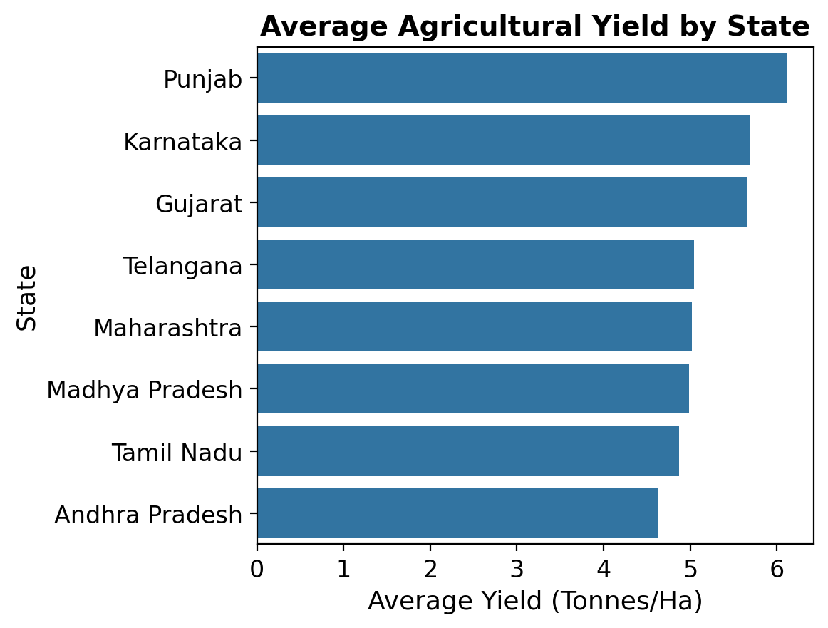
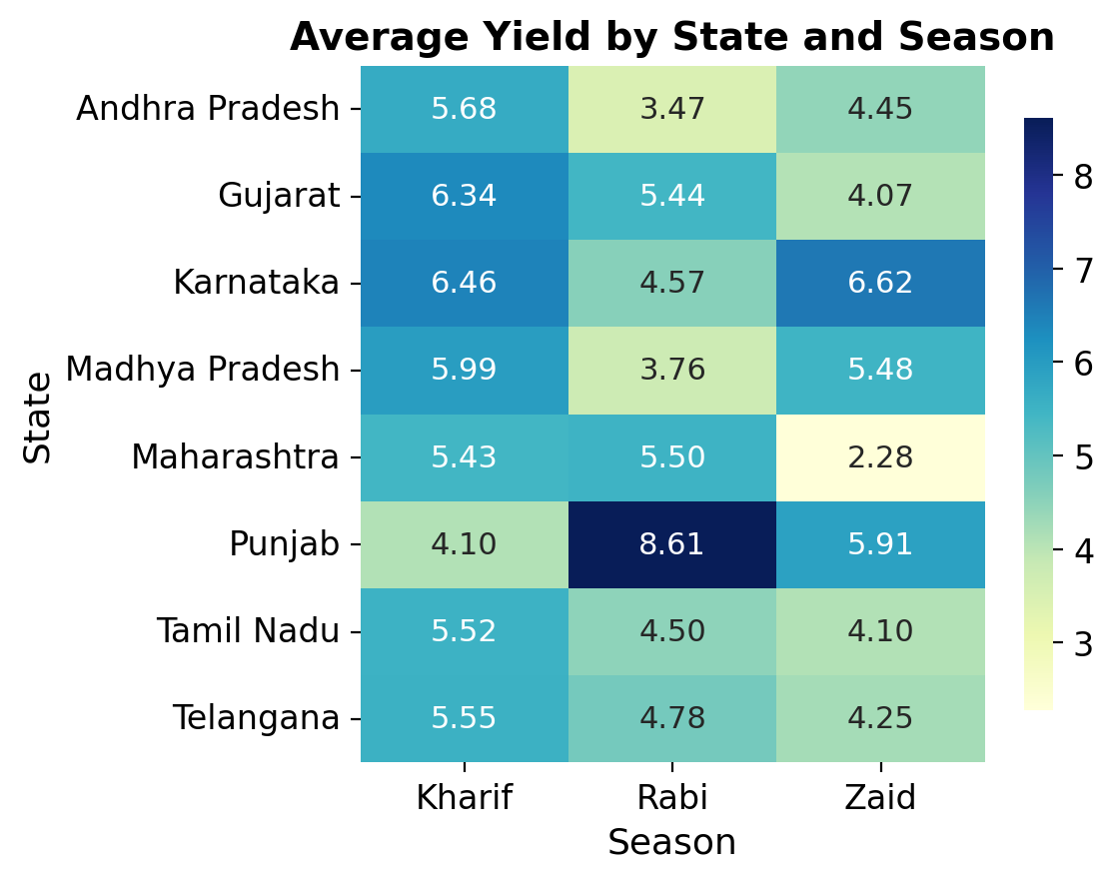
RESULTS
11. State-wise variation and the state × season heatmap
Insight: Punjab leads overall at 6.12 t/ha. The best season varies by state — Kharif wins in 5 of 8 states, while Punjab and Maharashtra peak in Rabi and Karnataka in Zaid.

Slide 17
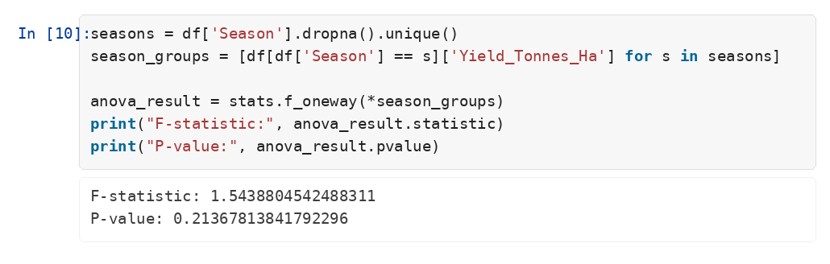
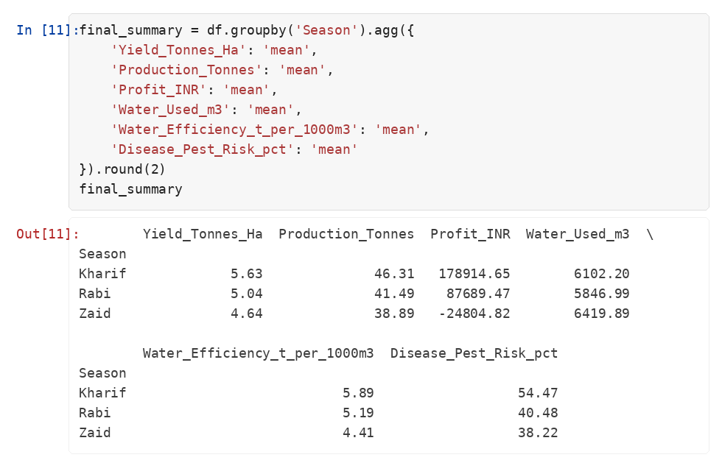
Statistical Validation & Conclusion
One-way ANOVA on yield across seasons, and the consolidated season summary
▪ p = 0.214 > 0.05 The ANOVA on raw yield is not significant — the sugarcane tail inflates within-season variance enough to mask the seasonal effect.
▪ Yet the ordering is perfectly consistent. Within every one of the 8 crops, Kharif > Rabi > Zaid. The effect is real but must be compared crop by crop.
▪ The economics separate clearly. Kharif earns ₹1.79 lakh average profit; Zaid loses ₹24,805 — driven by cost and price, not yield alone.
▪ Efficiency is the lever worth pulling. Water efficiency correlates with yield at r = 0.91, and drip beats rainfed by 43%.

Slide 18
Future Scope
Where this analysis can go next
▪ Predictive modelling Train regression models (Random Forest, XGBoost) to forecast yield and profit from environmental and input variables before the season begins.
▪ Profitability classification Build a classifier that flags farm-season combinations at risk of running a loss, as Zaid does on average here.
▪ Crop-wise statistical testing Run ANOVA and post-hoc tests within each crop, or on log-transformed yield, so the sugarcane tail no longer masks the seasonal effect.
▪ Multi-year and live data Extend to multi-year records and real sources — IMD weather, soil health cards, eNAM mandi prices — so trends can be tracked over time rather than in a single snapshot.
▪ Water-optimisation module Recommend the irrigation method and water budget that maximises efficiency per crop, season and state.
▪ Interactive dashboard Deploy the season, crop and state views as a Streamlit or Power BI dashboard so officers can explore without code.

Slide 19
GitHub Link
https://github.com/SimmyKumari12/VOIS-Major-Project
▪ VOISMajorProject.ipynb The complete documented analysis — cleaning, EDA, 22+ visualisations, ANOVA and the final season summary.
▪ seasonal_agriculture_performance_dataset.csv The raw 4,000-record dataset used throughout.
▪ README.md Project overview, objective, methodology and key findings.
Submitted for the VOIS for Tech – AICTE Major Project, Batch 1 (2026–27).

Slide 20

VOIS Course Completion Certificate — Data Visualization

Slide 21
Thank you
Simmy Kumari
Indira Gandhi Delhi Technical University for Women
AICTE Student ID : STU63c3cafa16af61673775866
github.com/SimmyKumari12/VOIS-Major-Project

