Slide 1
Distributed
Systems

Slide 2
Introduction
There are drawbacks associated with conventional stand-alone computers.
For example, a person who is responsible for maintaining software on a group of stand-alone machines has the following difficulties.
  Distributing software to multiple users means separate installations on multiple machines
  Change and version management requires updating multiple copies of the same program

Slide 3

Introduction (cont’d.)
What are the alternatives to having stand-alone
programs running on multiple machines?
Example solutions are discussed in the following slides.

Slide 4
Solutions
  Installations on multi-user multi-tasking server machines such as Unix systems and mainframes are possible. Although change management is easier,
    scaling to large networks is difficult
    significant investment in systems management is needed and competent people are scarce

Slide 5
Solutions (cont'd.)
  File servers can store all software in one place.
  However, this solution leads to
    heavy network traffic
    little scope for heterogeneous platforms
  Client-server architectures are often the best choice. This solution is discussed below.

Slide 6
Outline
Distributed Systems
Client-Server Architectures
WWW Distributed Applications

Slide 7
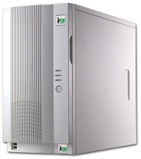
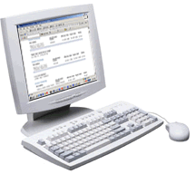
Client-Server Approach
The Client-Server (C/S) approach involves decomposing the total application functionality into two distinct components, client and server. These components are connected over a network
Server
Request
Request
Response
Client
Client

Slide 8
Definitions
Client – A process that requests a service from the server over the network. Clients are active initiators.
Server – A process that receives requests from clients and provides the corresponding service. Servers are passive listeners.

Slide 9
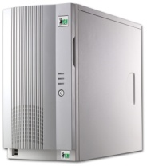
Definitions (cont'd.)
Middleware – A software component that sits between the client and the server. This component is intended to improve the quality of interactions.
Client
Middleware
Server

Slide 10
Importance of Engineer Participation
Certain options work only on limited platforms. Porting to different platforms may require complete redevelopment.
Middleware products based on protocols thus have functionality limits. For example, stateless protocols make it difficult to enforce security.
For this reason, engineers should actively participate in order to choose middleware that is the most appropriate for their application.

Slide 11
Characteristics of C/S Systems
The two most important features are:
  Asymmetric protocol – Clients, almost always, initiate interactions.
  Message-based mechanism – A message consisting of a certain sequence of bytes is sent as a request. The response is also a message. Communication protocols are defined to understand messages.

Slide 12
Examples of C/S Systems
  File Servers – enable manipulation of file systems through remote machines
  FTP Servers – send and receive files (no file system manipulations)
  Database Servers – supply requested data and modify data upon request

Slide 13
Examples C/S Systems (cont'd.)
  Groupware Servers – enable exchange of data as well as unstructured information such as mail, documents, etc.
  Object Servers – enable communication between distributed objects
  Display Servers – display text and graphics upon request from remote machines

Slide 14
Examples of C/S Systems (cont'd.)
  Operating System Servers – allow remote user logins
  Web Servers – process HTTP requests and supply documents
  Application Servers – perform application specific computations such as numerical simulations

Slide 15
Importance of Protocols
Client-Service architecture has led to open systems in many domains. People and enterprises are launching services that are potentially accessible to everyone. However, protocols are required in order to achieve this accessibility.
A poorly designed protocol limits the capabilities of an application. Therefore, it is important to choose an appropriate protocol for an application.

Slide 16
Common C/S Architectures
  GUI program at the “front-end” running on a PC (Client)
  Database Server at the “backend” running on a mainframe or Unix system
The client program
      interacts with the user
      sends requests to a database system at the back-end
The server program supplies data and modifies the data base.

Slide 17
C/S Communication: Example
The following steps are taken when communication objects called “sockets” are employed for information transfer.
  The server program creates a socket and binds it to its local address (at a free port – a port is a software object)
  It then listens for requests from clients through this socket
  The client program creates a socket and connects to the server's address

Slide 18
C/S Communication: Example (cont’d.)
  The server accepts the connection
  The client writes a request to the socket
  The server reads the request, services the request and sends the response
  The client closes the connection
  The server continues to listen

Slide 19
Application Partitioning
Load balancing – Create neither a fat client, nor a fat server
Data management – always on the server side
Reduce network traffic – In the near future, networks could be overloaded. The network should not become a bottleneck.

Slide 20
Outline
Distributed Systems
Client/Server Architectures
WWW Distributed Applications

Slide 21
C/S Applications for the Web
Objectives
This section is included for the following reasons.
To illustrate how the client-server model works when applied to the World Wide Web.
2. List options that are currently available for
developing distributed applications on the Web.

Slide 22
Advantages of C/S for WWW
Main advantages are
  Manageability
  Interoperability (heterogeneous platforms)
  Scalability
  Accessibility
Example: You would like to make project information and programs available to other project partners on the internet.

Slide 23
Example of C/S for WWW
Product models
GUI Client
User data
Cost computation server
Govt. rates
Cost
Contracting services

Slide 24
Differences between WWW and the Internet
The Internet is a network of computer networks.
WWW is a service (application) hosted on the internet
(HTTP is a basic example of middleware).
  It began as a networked information project at CERN, Geneva (original idea by Tim Berners-Lee)
  It contains the information that is accessible on the network
  A network of web-servers allows easy access to information

Slide 25
HTTP
HTTP (HyperText Transfer Protocol) is an
application-level protocol for distributed, collaborative,
hypermedia information systems.
HTTP defines
  how to make connections
  the format for addresses (URL)
  the messaging format (the syntax of the structured sequence of bytes) for communication

Slide 26
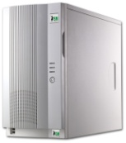
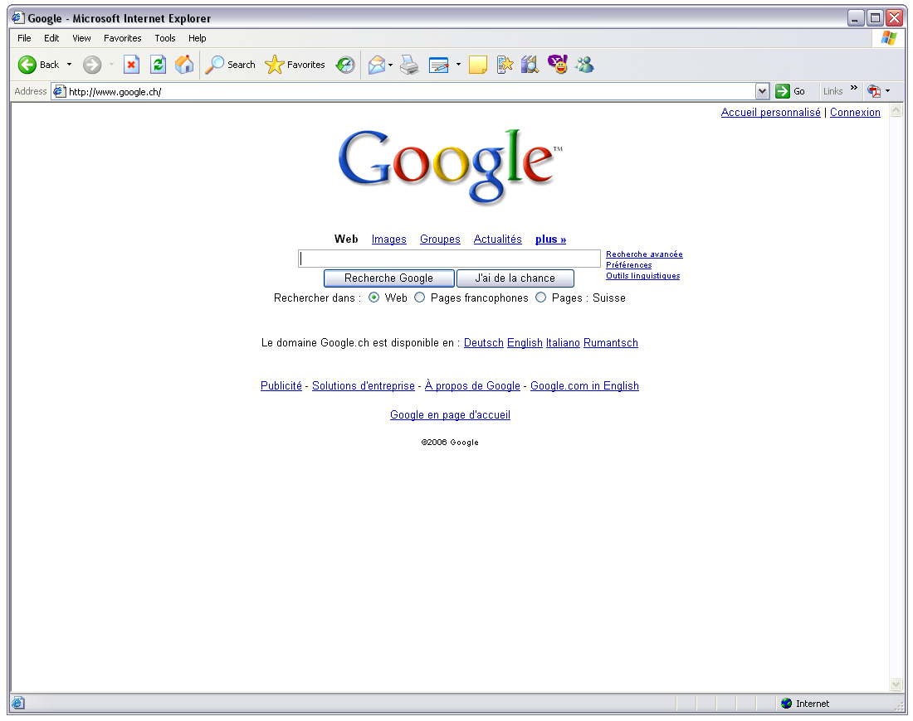

Access via HTTP
Browser
Web Server
GET index.html
HTTP/1.0
index.html
index.html

Slide 27
URL
A URL (Uniform Resource Locator) is a reference (an
address) to a resource on the Internet.
Example: http://java.sun.com/products/index.html
Components of a URL :
  Protocol identifier.
  For example, http, ftp, file, gopher, news are identifiers
  Resource name.
  For example, Host Name, Port Number, Reference, Filename are parts of resource names

Slide 28
HTML
HTML (HyperText Markup Language) consists of tags that are embedded in the text of a document.
A Web browser (Internet Explorer, Netscape Navigator, etc.) interprets these tags to format and display the document.

Slide 29
HTML: Example
<HTML>
<HEAD>
<TITLE>Title of the webpage</TITLE>
</HEAD>
<BODY>
An example of a simple <B>web</B> page.
</BODY>
</HTML>

Slide 30
HTML: Limitations
  Only static information can be shown
  User queries cannot be accommodated
Many extensions and alternatives to using plain HTML now exist.
Some of these are XML, CGI, and Java Applets.
The last two are described next.

Slide 31
Common Gateway Interface (CGI)
CGI (Common Gateway Interface) is a standard for interfacing external applications with Web servers.
An introduction to CGI can be accessed at
http://hoohoo.ncsa.uiuc.edu/cgi/intro.html
A CGI program is
  written in any language
  stored at specific locations within a website
  executed by the web server when the URL is accessed

Slide 32

CGI (cont'd.)
CGI defines the mechanism for
  reading in data from remote users
  outputting data to be sent over the network
Browser
Web Server
GET test.cgi HTTP/1.0
test.cgi
Result of test.cgi

Slide 33
Example
Cost estimation program on the WWW.
Client – An HTML form displayed by the browser
Server – A CGI program for cost estimation
Middleware – HTTP, TCP/IP.

Slide 34
Drawbacks
Drawbacks of the CGI model are:
  Fat server – All computations are performed on the server
  Heavy network traffic – All requests are sent to the server
  Stateless – No concept of a session or transaction. Connection from the client to the server is made whenever necessary, and the server does not record details of previous connections. This makes it difficult to enforce security.

Slide 35
Java Applet: An alternative to CGI
Applets are miniature programs written in Java and reside on the server. Typically, applets contain data as well as procedures.
Applets are often downloaded along with the web pages (HTML files). They are executed on the client machine (by local Java software).
Applets display text and graphics in the applet area within a web page.

Slide 36
C/S with Java
Following are C/S characteristics of Java-based applications
  Fat-clients are created
  The presentation layer is split between the client and the server
  Application logic and data management are bundled together

Slide 37
C/S with Java: Advantages
The advantages of Java Applets are listed below.
  Small server (all the calculations are done by the client machines)
  Platform independent
  High-level accessibility

Slide 38
C/S with Java: Disadvantages
The drawbacks of Java Applets are the following.
  Cannot store data on local machines (cannot save states) for security reasons
  Tend to be slow (while running under a browser)
  Higher network traffic (for big applets)

Slide 39
Java: Server Side
This method involves use of Java servlets that reside on the server machine.
  Servlets are invoked by Java applets running on remote machines
  Java enabled web-servers execute them
  Output from servlets are sent to clients
Server-side Java is an alternative to CGI.

Slide 40
Review Quiz
Why are protocols important?
Why should engineers actively participate in choosing the middleware for their client-server application?

Slide 41
Answers to Review Quiz
Why are protocols important?
C/S architecture has lead to open systems in many domains. People and enterprises are launching services that are potentially accessible to everyone. However, protocols are required in order to achieve this accessibility.
A poorly designed protocol limits the capabilities of an application.

Slide 42
Answers to Review Quiz
Why should engineers actively participate in choosing the middleware for their client-server application?
Certain options work only on limited platforms. Porting to different platforms may require complete redevelopment.
Protocols limit functionality. Middleware products based on protocols thus have functionality limits. For example, stateless protocols make it difficult to enforce security.
These are two reasons why engineers should be active in choosing the most appropriate middleware.

Slide 43
Outline
Distributed Systems
Client-Server Architectures
WWW Distributed Applications
Complexity

Slide 44
Complexity of distributed systems
With the growing amount of “Cloud computing” applica-tions, the interest in distributed systems is growing.
Among the advantages, there is the possiblity of increasing performance. Will there be a speed-up? It depends …
Consider an algorithm that has polynomial complexity O(n^{k}). With a number of processors, p
Parallel programming (memory sharing)
O(n^{k}/p + coordination)
Distributed programming (no memory sharing)
O(n^{k}/p + coordination + network)

Slide 45
Complexity estimations for parallel computing are usually optimistic for distributed computing.
Example: Following deformation measurements of sliding earth on a slope there are 600,000 data points. We would like to erase all zero measurements (sensor failures) as well as very large values (outliers) and then find the minimum value of the entire data set. We have a computer with 100 processors.
Stage 1: Create 100 sets of 6000 data points. Filter the zeros and the large values, find the minimum of each set.
Stage 2: Compare pairs to find the global minimum.

Slide 46
The complexity of this example is
O(n/p + log p)
Coordination is often log p or more generally,
(log p)^{d} – polylogarithmic
(d is a positive integer that depends on the algorithm)
For algorithms of polynomial complexity without parallel programming, the parallel application is often
O(n^{k}/p + (log p)^{d})
If p = n^{k} (a massively parallel situation), the computational complexity is
O( (log n)^{d} )
Note: Even for a massively parallel situation, exponential complexity remains exponential.
O(2^{n} / n^{k} ) = O(2^{n})

Slide 47
Summary
  The motivation for distributed systems stems from difficulties with distribution and version management of software on several computers.
  In a client-server architecture, clients request data and services; servers supply data and perform computations to service the requests.
  The HTTP protocol and the HTML language make it possible to create distributed applications on the web. Java Applets add a dynamic aspect.
  Distributed computing may reduce execution times of polynomial (or better) algorithms.
  Distributed computing may not lower execution times of exponential (or worse) algorithms when they are applied to full-scale tasks.

