Slide 1
Electron gun vacuum system control
Project in Embedded Systems

Slide 2
Outline
Purpose and project specifications
Work
Results and summary
Demonstration

Slide 3
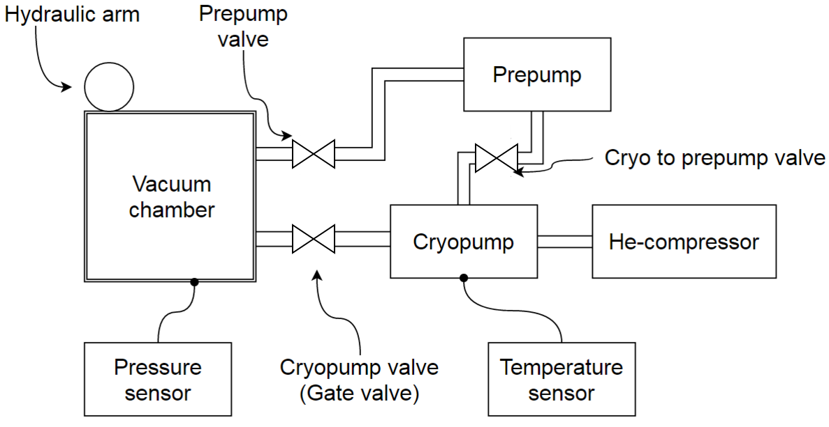
Purpose
Control system for vacuum system

Slide 4
Specifications
Milestones
Prototype on breadboard with working touch screen and digital I/O
Prototype on breadboard with working universal PID-controller
Finished PCB with working universal PID-controller

Slide 5
Development tools
AtmelStudio 7.0
Sublime Text
Git
AVRDUDESS
KiCad

Slide 6
Work
Software
Microcontroller
Touch screen display
Touch screen touch interface
Polling
GUI
Controls
Binary search
PID-controller

Slide 7
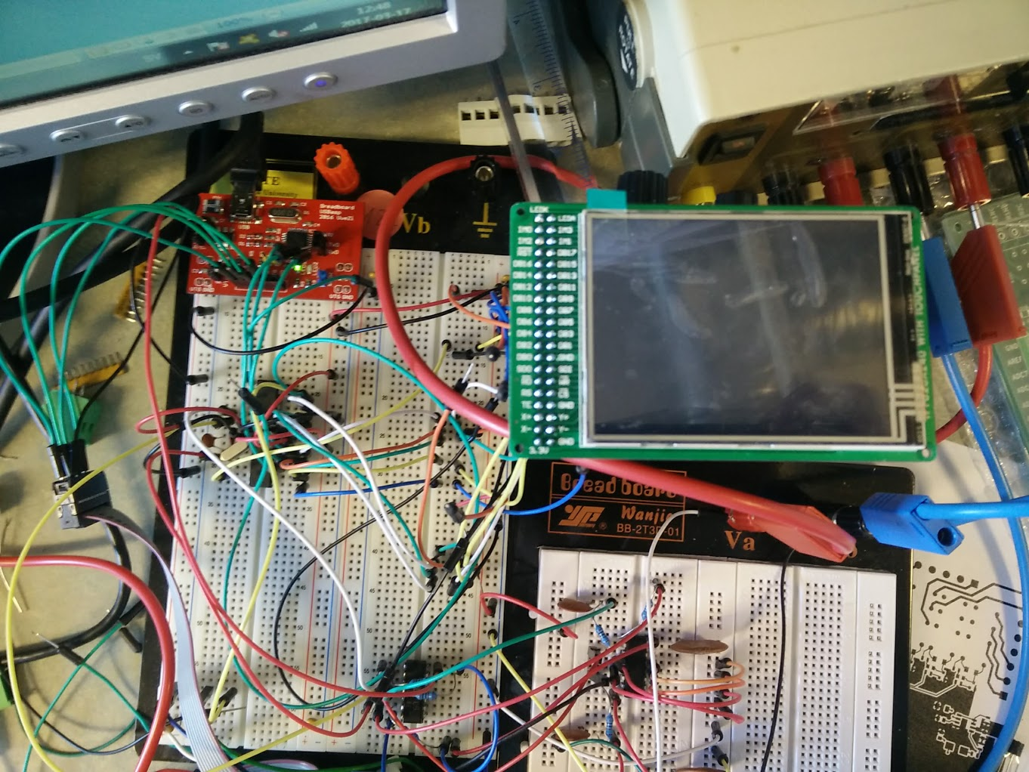
Work
Prototype

Slide 8
Work
PCB design
Datasheets
Footprints
KiCad

Slide 9
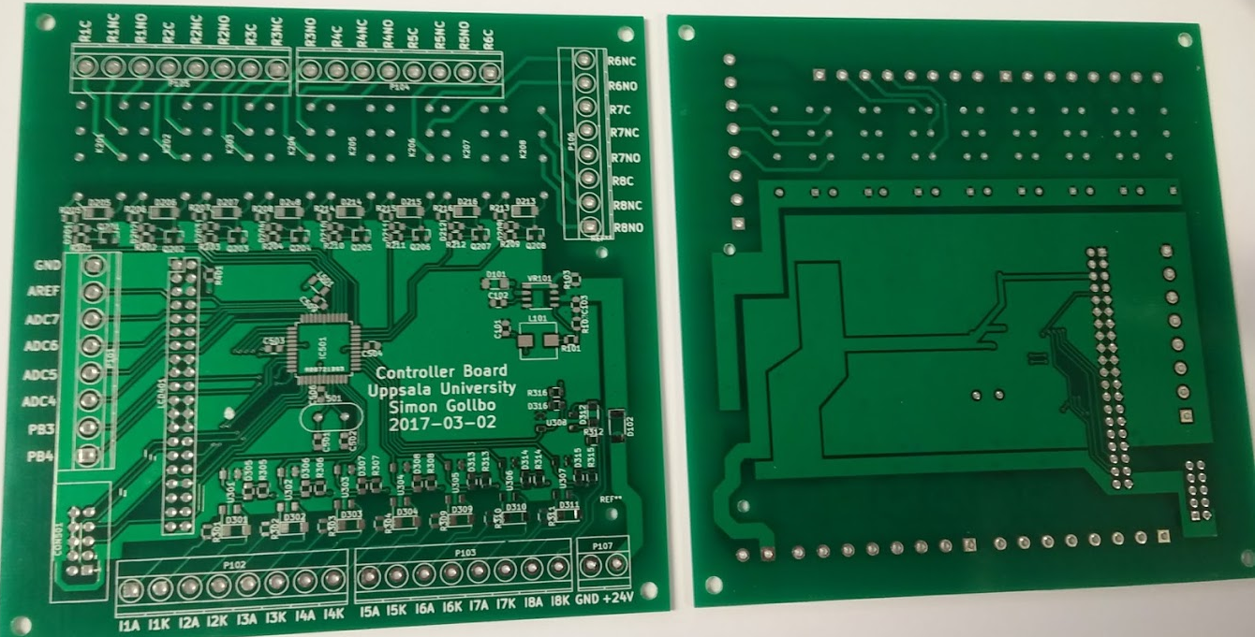
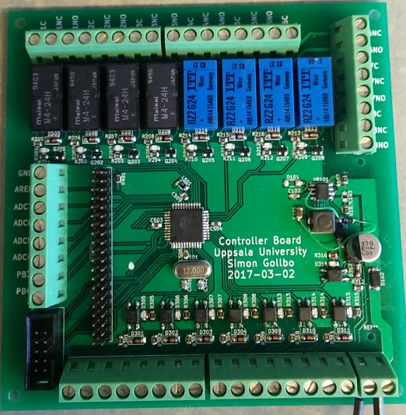
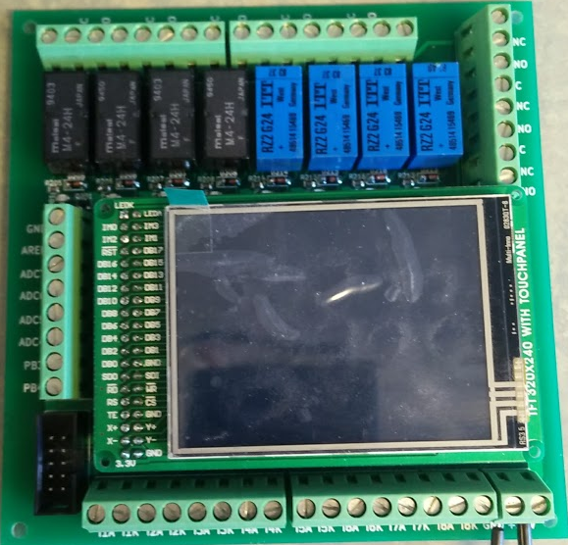
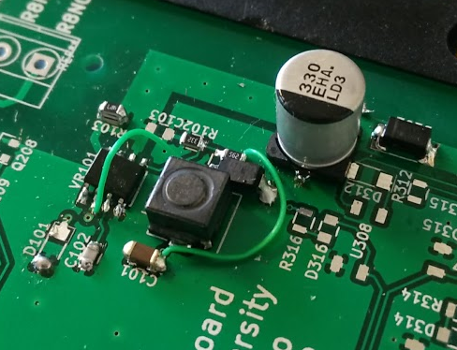
Work
PCB

Slide 10
Results
Working PCB
GUI for vacuum system
GUI for PID-controller

Slide 11
Summary
Prototype and test
PCB design
PCB test

Slide 12
Demonstration

