Slide 1
Natural Language Processing
B.M.Drury

Slide 2
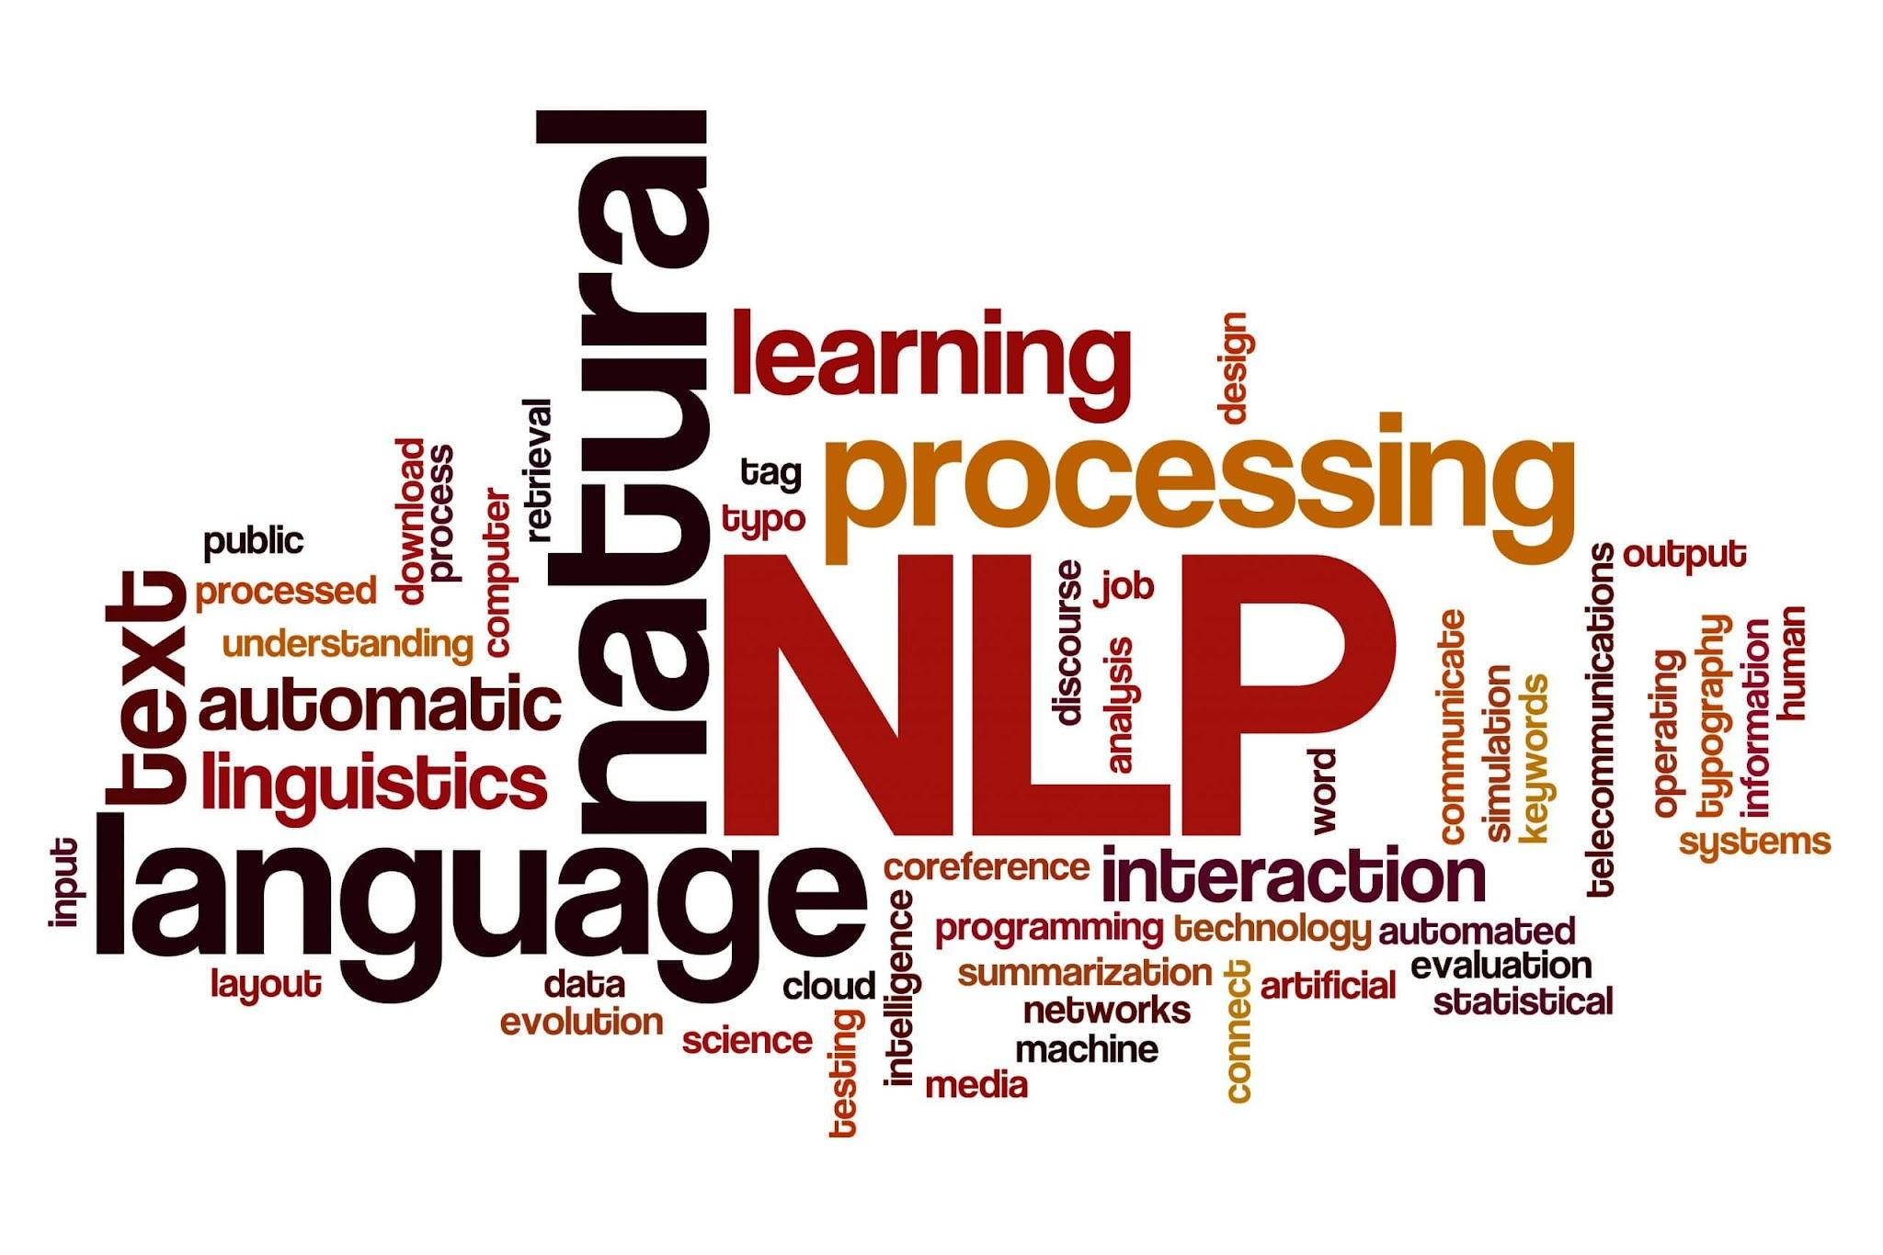
Why NLP?

Slide 3
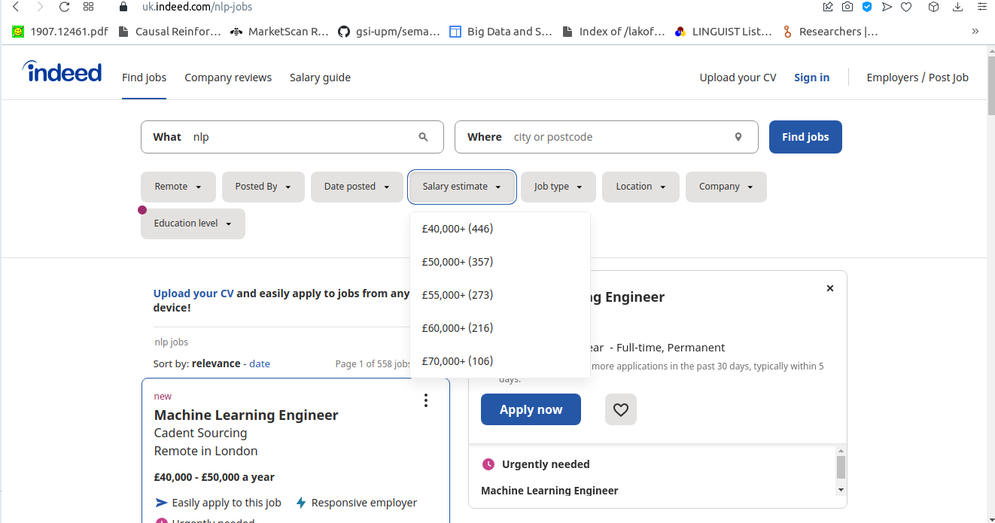
Why NLP?

Slide 4
Basic NLP Terms
Stemming: Reducing words to their root, for example going -> go
Unigram: Single word
Bigram: Sequence of two words
N-Grams: Sequence of word of N-Length
Stop-Words: Very frequent words (of, the)
Sentiment / Opinion Analysis: Detection of subjective information in text
Dependency parsing: is the process to analyze the grammatical structure in a sentence and find out related words

Slide 5
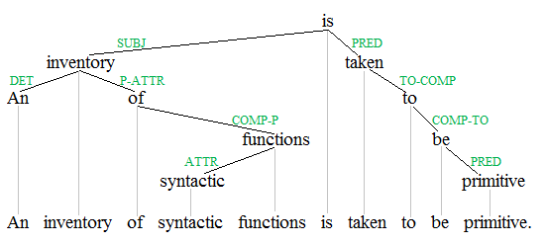
Dependency Trees
Dependency grammar (DG) is a class of modern grammatical theories that are all based on the dependency relations
Dependency is the notion that linguistic units, e.g. words, are connected to each other by directed links.
(source: wikipedia)

Slide 6
Dependency Parsing
What is used for?
Information Extraction: is a series of techniques used to extract information from natural language.
Relation Extraction: Extraction of a relation (sequence of words) from text where the sequence has some sort of meaning or theme
Temporal Relations: A relation involving time, (The patient underwent the surgery on Tuesday)
Causal Relation: A relation where an effect has a dependency on the cause (Smoking causes cancer)

Slide 7
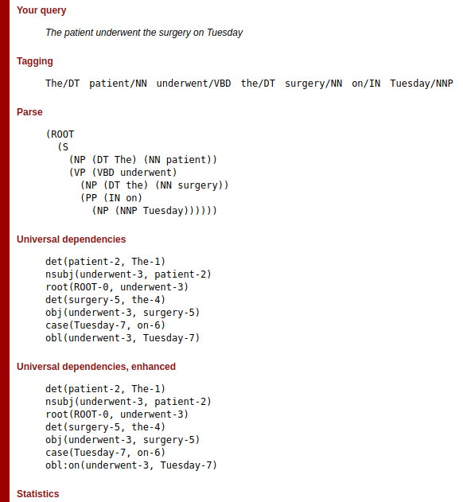
Dependency Parser

Slide 8
Tools
Stanford Parser: https://nlp.stanford.edu/software/lex-parser.shtml
Tregex: Tregex is a utility for matching patterns in trees, based on tree relationships and regular expression matches on nodes (the name is short for "tree regular expressions").
Example: NP < NN would return patient and surgery from the previous example. The expression returns a singular noun from a noun-phrase
TSurgeon: Tsurgeon provides a way of editing trees based on a set of operations that are applied to tree locations matching a tregex pattern

Slide 9
Graph Neural Networks
Graph Neural Networks (GNNs) are a class of deep learning methods designed to perform inference on data described by graphs.
GNNs are neural networks that can be directly applied to graphs, and provide an easy way to do node-level, edge-level, and graph-level prediction tasks.
GNNs can do what Convolutional Neural Networks (CNNs) failed to do.
Dependency trees are graphs
Source: neptune.ai

Slide 10
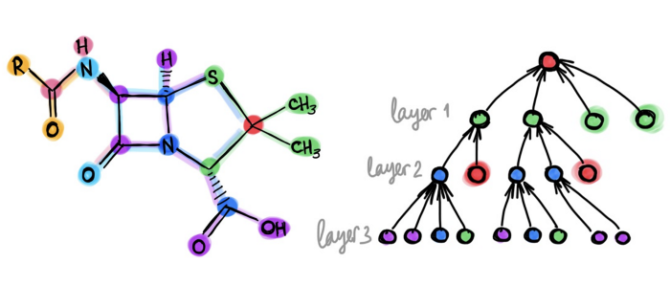
Graph Neural Networks
Text Classification
Question Answering
Information Extraction
Text Generation
Abnormal Text Detection
Source: towardsdatascience.com

Slide 11
Part of Speech Tagging
POS Tagging
POS Tagging applies a Part of Speech Tag to words. The main of part of speech tags are Noun, Adjective, Adverb, and Verb. There are other tags such as determiner (the).
Brown Cropus
Tag | Definition
CC | coordinating conjunction (and, or)
CD | cardinal numeral (one, two, 2, etc.)
CS | subordinating conjunction (if, although)
EX | existential there
JJ | adjective

Slide 12
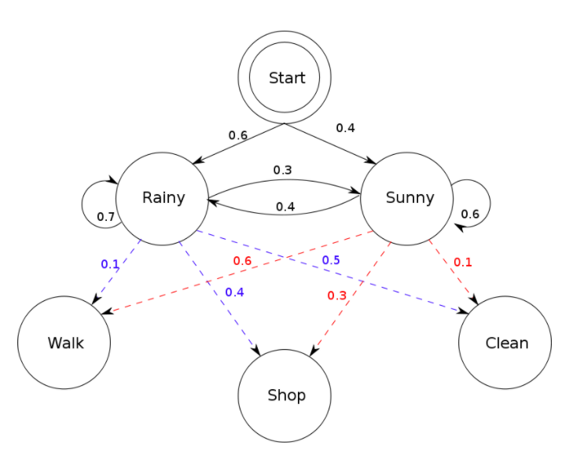
Compute POS Tags
Hidden Markov Models: “The transition probability is the likelihood of a particular sequence for example, how likely is that a noun is followed by a model and a model by a verb and a verb by a noun. This probability is known as Transition probability. It should be high for a particular sequence to be correct.” (source:mygreatlearning.com)
Verbti Algorithm: dynamic programming algorithm that computes the most likely sequence in a series of observations.

Slide 13
Application of POS Tags
Features: POS tags can be used as features in a machine learning algorithm. As these are the type of word, rather than a word, it may offer better generalisation abilities
Lexical Bundles: these are used to identify common speech patterns. Typically we use words, but we can generalise speech patterns.
Information Extraction: NN-NN and Proper Nouns for Named Entities
Input for Noun Phrase Chunkers: return phrases which are called noun-phrases, where the subject must be a noun. Used for more complex IE. NP-V-NP (causal relations)
Sentiment Analysis: sentiwordnet based on wordnet and synsets. POS tags are used in the look up and word sense detection. See Lesk Algorithm

Slide 14
Document Representation
Bag of Words: Split text into individual words. Remove stop-words. Loses semantic relationships between words and phrases
Bigrams / Trigrams: Sequences of two or three words. Such as Computer Science, and Bag of Words
Dependency Trees: Sequences of words that have dependencies
Word Vectors: BOW where words are represented as vectors
Document Vectors: Represent whole document as a vector words or as a vector of vectors (tensors)

Slide 15
Applications of NLP
Text Classification: Classifying text document into a pre-defined category. For example a news story could be classified into sports, politics or technology
Approaches:
1. Supervised, train a learner such as Naïve Bayes
2. Unsupervised: topic modelling and clustering
Topic Modelling:
An unsupervised method for finding associated words, and grouping them under topics
Choose number of topics in advance
LDA one of the most common
Clustering:
Can use words or topics to cluster related documents

Slide 16
Sentiment Analysis
Detect subjectivity in text. Typically used for opinion analysis
For example, “I really liked the camera it is the best I have ever used “ -> positive
Rule based: look at sentiment lexicons: “I really liked the camera it is the best I have ever used”
Supervised Learning: features typically words, so will pick up the same features
Aspects: Properties of an object. For example: shutter speed of a camera, for example, “the shutter speed of the camera is really good”

Slide 17
Emotion Analysis
Similar to emotion analysis but instead of positive, negative and neutral we use emotions
Classify documents into emotion categories such as: anger, fear and joy
“I hate this camera”
Techniques such as supervised learning and rules with an emotion lexicon

Slide 18
Issues
Negation: the negative of the intended emotion .
For example: “her performance was not good”
Intensifiers: “her performance was very good”
Moderators: “her performance was fairly good”
Spelling errors, slang and unique grammars. “She is a wicked dancer”

Slide 19
Out of Training Documents
This happens because there are words or phrases that are rare or are invented (neologisms) or a spelling error. This is typical in social media.
Word vectors where we are learning from a whole corpus and all word vectors are an embedding layer in a neural network. (remember this from the meta-learning lecture)
Language Models: Full neural networks learnt from massive corpora such as the common crawl
Character Vectors: Similar to word vectors, but each character has a vector. Generalises really well and can handle novel words

Slide 20
Practical Applications of Text Classification
News Analytics : Using information in news to trade. This technique plots sentiment or emotion in news on a time series graph and uses that to predict stock prices. This is because the stock market tends to overreact to news events. Therefore, news can contain alpha, which is useful trading information
Social Media: Stock market is driven by animal spirits, i.e. it is driven by emotion and irrationality where is no practical information. Sampling social media is equivalent to sampling millions of people to get the “emotional temperature” of a country or region
Social Media: Automated crime. Can use text classification and account profiling to identify “suckers” that can be exploited by other techniques such as language generation

Slide 21
Practical Applications of Text Classification
Inferred Mental States: From an individual’s writings it is possible to infer mental states. This can be from the amount of writing , type of writing style and content. Depression for example reduces the amount of writing
Mass-Scale Health Surveillance: Social media has been used to infer country wide mental states from monitoring tweets from a single country
Now-Casting Food Prices: Monitoring of trends of supermarket prices from supermarket web pages.

Slide 22
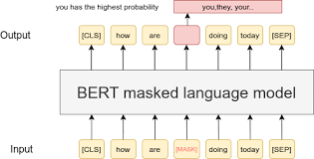
Language Models
Large fully trained Neural Networks
Unsupervised learning from very large corpora
Capture relationships between words and phrases
Apple has a relationship with the word tree
Apple fell from the tree
Apple grew on a tree
Ship is unlikely to have a relationship with the word tree

Slide 23
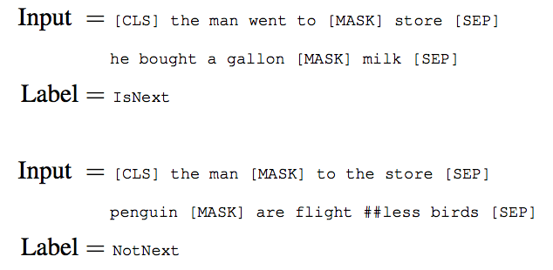
Language Models
Masked Sentence Training
Source: medium.com

Slide 24
BERT
BERT (Bidirectional Encoder Representations from Transformers) is a frequently used language model
Developed by Google in 2018 and is used in the Google Search Engine
Masked Training using the bookcorpus., (around 74M sentences and 1G words) from 11038 Books
Holds vectors for each word sense of each word
Bidirectional: identifies relationships in both directions
Apple and tree, the examples given on the previous slide also builds a relationship between tree and apple

Slide 25
BERT
Has been pretrained for other areas.
FinBERT: is a pre-trained NLP model to analyze sentiment of financial text. (source:github). Trained on a large number of financial texts. Scored state of the art on FiQA sentiment scoring
and Financial PhraseBank.
PetroBERT released in 2022. A BERT model for Portuguese and trained on petro-chemical texts.
Causal-BERT, the masked training is between cause and effect.

Slide 26
Other Language Models
GPT-3:
Dataset | # Tokens | Weight in Training Mix
Common Crawl | 410 billion | 60%
WebText2 | 19 billion | 22%
Books1 | 12 billion | 8%
Books2 | 55 billion | 8%
Wikipedia | 3 billion | 3%
XLM: A cross language model that uses BERT type masked training

Slide 27
Cross Lingual Text Classification
It is possible to train a model in one language and have it predict values in many other languages
Laser Embeddings (Facebook / Meta) 93 Languages Supported: Its approach that it has embeddings for all languages in the training phase, but it generalises well for other languages
Multi-BERT: (Google) supports 104 languages in the training phase. Masked training as per usual BERT
MultiFit: (FAST-AI): Cross-lingual model as the teacher, weakly supervised learning, requires 100 labelled examples to get state of the art results
Laser and Multi-Bert use Zero-shot learning , so there is unlabelled examples in the training phrase, but not many of them

Slide 28
Transfer Learning in NLP
Pretraining: All the language models that have been covered, as well as embeddings such as ELMO, Glove
However, large pretrained models (e.g. BERT-Large) are prone to degenerate performance when fine-tuned on tasks with small training sets (source: ruder.io)
Sequential adaptation If related tasks are available, we can fine-tune our model first on a related task with more data before fine-tuning it on the target task
Multi-task fine-tuning Alternatively, we can also fine-tune the model jointly on related tasks together with the target task.

Slide 29
Attention Networks
Attention is the cognitive process of selectively concentrating on one or a few things while ignoring others (source: analyticsvidhya.com)
Attention in NLP is choosing the relevant words that are important in the task, and ignoring the words that are not important
Attention Networks searches for set of positions that contain the most information
These positions are in the encoder of the RNN

Slide 30
Attention Networks
Why is this important?
Sequential classifiers such as RNN suffering from what is called exploding gradient problem for long sequences
Exploding gradient: “Exploding gradients are a problem where large error gradients accumulate and result in very large updates to neural network model weights during training. This has the effect of your model being unstable and unable to learn from your training data.” (source: https://machinelearningmastery.com)
BERT has maximum sequence lengths that are available during training time

Slide 31
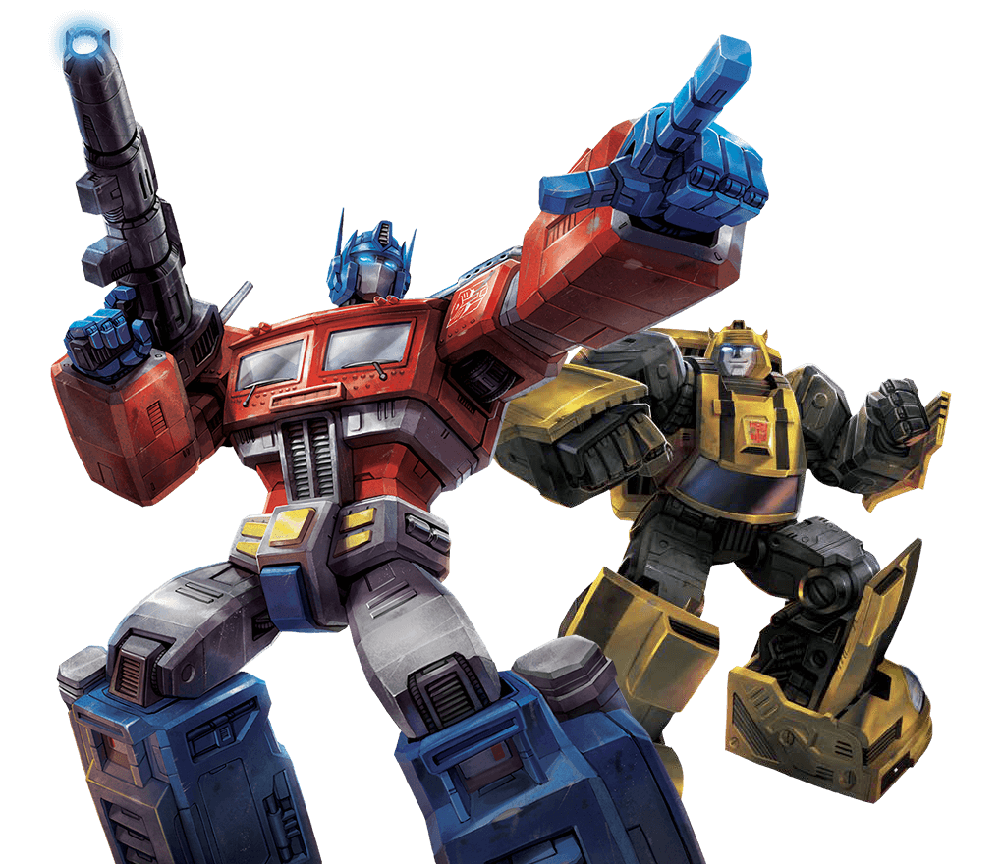
Transformers
“The Transformer in NLP is a novel architecture that aims to solve sequence-to-sequence tasks while handling long-range dependencies with ease.” (source: towardsdatascience.com)
“It relies entirely on self-attention to compute representations of its input and output WITHOUT using sequence-aligned RNNs or convolution” (source: towardsdatascience.com)
Source: transformers.hasbro.com

Slide 32
Transformers
“Self attention, sometimes called intra-attention is an attention mechanism relating different positions of a single sequence in order to compute a representation of the sequence.” (source: towardsdatascience.com)
“self attention helps us create similar connections but within the same sentence. “(source: towardsdatascience.com)
Types of attention:
Encoder-Decoder Attention: Attention between the input sequence and the output sequence
Self attention in the input sequence: Attends to all the words in the input sequence
Self attention in the output sequence: The scope of self attention is limited to the words that occur before a given word. This prevents any information leaks during the training of the model.
(source: towardsdatascience.com)

Slide 33
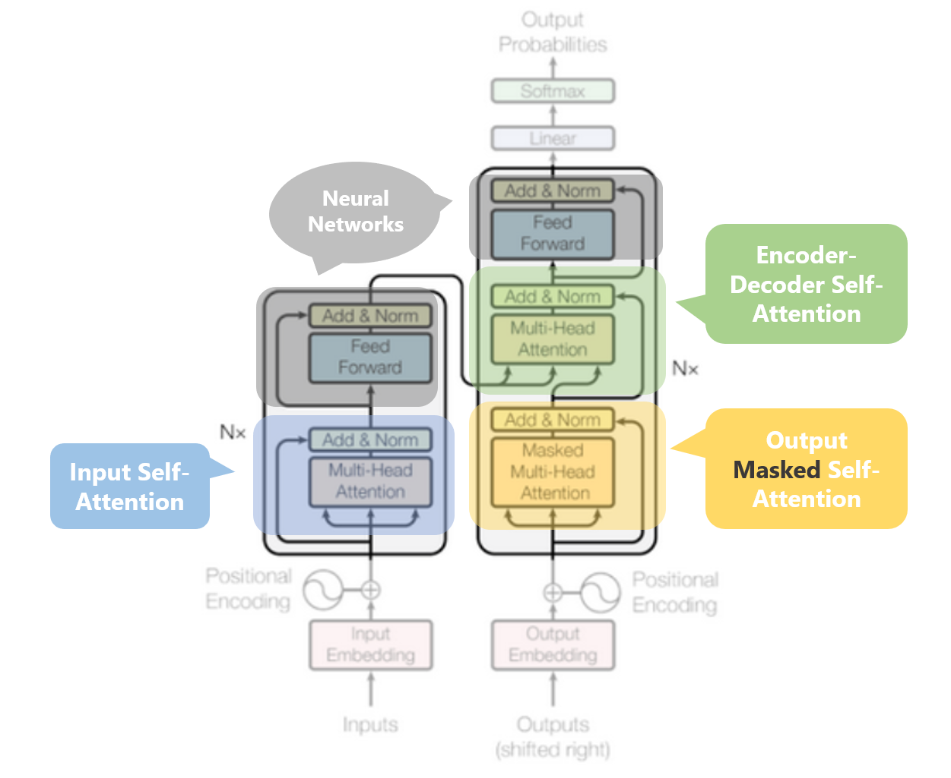
Transformers
(source: towardsdatascience.com)

Slide 34
Transformers - Advantages
Can deal with longer sequences (sentences) with out the exploding gradient problem
Can train in parallel
Massive language models would almost be impossible or would need huge amounts of compute time
State of the art of performance on many sequential tagging tasks

Slide 35
Information Retrieval
Text retrieval is used in many applications. The most common application that most people have come across is web search
Based on two things: similarity and authority (plus several secret other things)
Authority: graph-based measures such as page rank and in degree centrality
Similarity: A similarity between the query and the target text

Slide 36
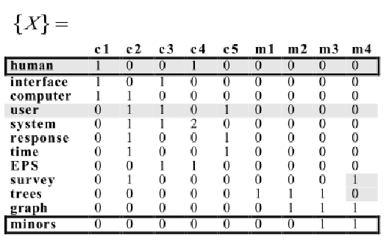
Text Similarity
Term Frequency: The frequency of the search terms in the target document. Favours longer documents
Normalised term-frequency: normalise term frequency by document length or by the maximum term frequency
Inverse document frequency: The inverse document frequency is a measure of whether a term is common or rare in a given document corpus
Source: researchgate

Slide 37
Text Similarity
Computing inverse document frequency:
Number of documents in a log(corpus / number of documents) with the term
Low number of documents with the term the higher the IDF
Tf –IDF = term_frequency * inverse document frequency
Worked Example:
The word “cat” appears in a document twelve times with a hundred words.
Cat appears in 30 documents in a corpus of a 100
Tf IDF = 12 / 100 * log(100 / 30)
0.12 * 0.52 = 0.06
Tf-IDF = 0.06 for cat

Slide 38
Ontology Information Retrieval
Ontology is a representation of words or phrases in a domain
Can often represent relationships, for example: Steve jobs worked for apple
Can be used to computed weights for terms in a domain search
Magellan: An adaptive ontology driven “breaking financial news” recommender (Drury, Almeida, and Morais)
Dynamic Ontologies representing companies. A central entity was assumed (based on graph measures). Other terms weighting based upon shortest path and the probability of the link between entities

Slide 39
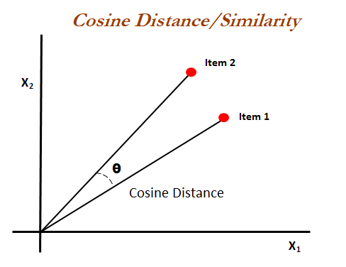
Cosine Similarity

Slide 40
Why study NLP
Very high demand in industry and lack of skilled staff (salaries of 100k plus not uncommon)
Very fast-moving field in the last few years
Many applications of the subject (only a few applications shown here)
Cross-over with other domains (medicine, history, law, agriculture and finance)

