Slide 1
Database Coursework Presentation
Mohammed Chaudry, Iradat Asif, Zak Chaudhry

Slide 2
The scenario
Firstly, as a group, we got together to read through the Ace Training brief to see what Ace Training was asking for and what they needed. We came to a conclusion that they needed a database that stores the information of new students, tutors, courses and course resources.
We then decided on a set of business rules and business operations for the database.

Slide 3
Business Operations
Tutor
BO1 | Add a new student record
BO2 | Update a student record
BO3 | View student record
BO4 | Add a new course record
BO5 | Update a course record
BO6 | View course record
BO7 | Add a new quiz record
BO8 | Update a quiz record
BO9 | View quiz record
BO10 | Add a new resource record
BO11 | Update a resource record
BO12 | View a resource record
Student
BO13 | Add a new student record
BO14 | Update a student record
BO15 | View a student record
BO16 | Add a new student course record
BO17 | View a student course record
BO18 | View course resources record
BO19 | View quiz resources record
BO20 | View quiz results record
BO21 | Add international record
BO22 | Update international record
BO23 | View international record
BO24 | View course record
Admin
BO25 | Add a new course record
BO26 | Update course record
BO27 | View course record
BO28 | Delete course record
BO29 | Add a new tutor record
BO30 | Update a tutor record
BO31 | View tutor record
BO32 | Delete tutor record
BO33 | Add a new student record
BO34 | Update a student record
BO35 | View student record
BO36 | Delete student record
BO37 | Add a new course record
BO38 | Update a course record
BO39 | View course record
BO40 | Add a new quiz record
BO41 | Update a quiz record
BO42 | View quiz record
BO43 | Delete quiz record
BO44 | Add a new resource record
BO45 | Update a resource record
BO46 | View a resource record
BO47 | Delete resource record
BO48 | Add new fees record
BO49 | Update fees record
BO50 | View fees record
BO51 | Delete fees record

Slide 4
Business Rules
Tutor
BR1 | Not Update student id, Name, Address, Next Of Kin, fees paid, dob, email for Student
BR2 | Not delete a Student details
BR | Not view fees paid, dob on Student
BR3 | Not view admin details
BR4 | Not delete admin details
BR5 | Not add admin details
BR6 | Not update admin details
BR7 | Not view International details
BR8 | Not delete International details
BR9 | Not add International details
BR10 | Not update International details
BR11 | Not view Address, Next of kin, dob, national insurance on Tutor details
BR12 | Not delete Tutor details
BR13 | Not add Tutor details
BR14 | Not update Quiz results details
BR16 | Not delete Quiz results details
Student
BR17 | Not Update student id, Name, fees paid, dob, for Student
BR18 | Not delete a Student details
BR19 | Not view admin details
BR20 | Not delete admin details
BR21 | Not add admin details
BR22 | Not update admin details
BR23 | Not delete International details
BR24 | Not update StudentID for International
BR25 | Not view Address, Next of kin, dob, national insurance on Tutor details
BR23 | Not add Tutor details
BR27 | Not update Tutor details
BR28 | Not delete Tutor details
BR29 | Not view QuizID on Quiz results
BR30 | Not delete Quiz results details
BR31 | Not add Quiz results details
BR32 | Not update Quiz results details
BR33 | Not view national insurance , on Course details
BR34 | Not delete Course details
BR35 | Not add Course details
BR36 | Not update Course details
BR37 | Not view QuizID Quiz Resources details
BR38 | Not delete Quiz Resources details
BR39 | Not add Quiz Resources details
BR40 | Not update Quiz Resources details
BR41 | Not view national insurance on Course resources

Slide 5
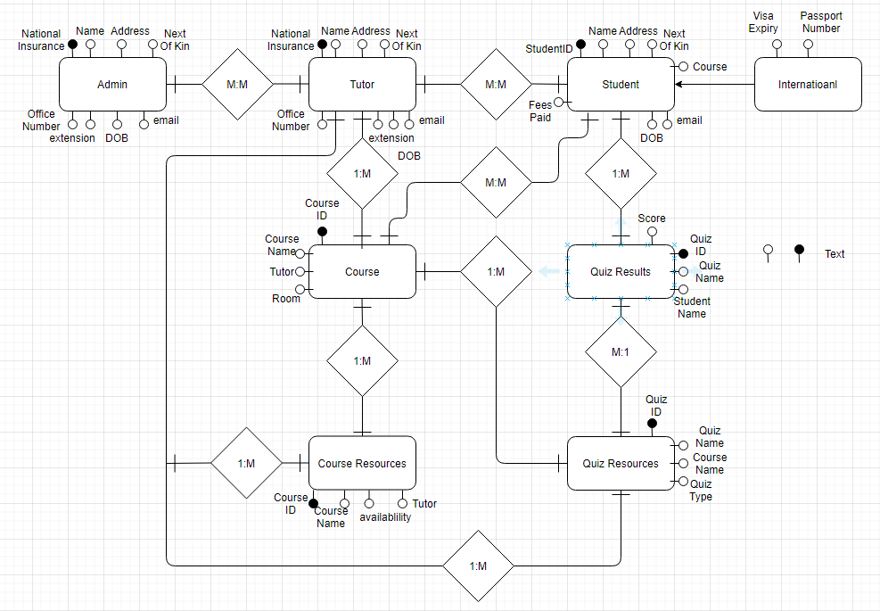
Conceptual Design
We decided that Zak should create the conceptual design for the database and the associated diagram script.
Entity | Attributes | Relationships
Student | Student ID, Name, Address, Next Of Kin, course(s), fees paid, dob, email | Quiz Scores, Tutor, Course, international
international | visa expiry, passport number. | student
Tutor | Name, Address, Next of kin, Office number, extension, dob, email, national insurance. | Admin, Student, Course, Course Resources, Quiz resources
Admin | Name, Address, Next of kin, Office number, extension, dob, email, national insurance. | Tutor
Course | Course ID, Course name, tutor, room, | Tutor, Student, Quiz Resources, Course Resources
Course resources | Course ID, Course name, availability, tutor, | Tutor, Course
Quiz Resources | Quiz ID, Quiz name, Course name, quiz type, | Tutor, Course, Quiz Scores
Quiz Results | Quiz ID, Quiz name, Student name, score. | Student, Quiz Resource

Slide 6
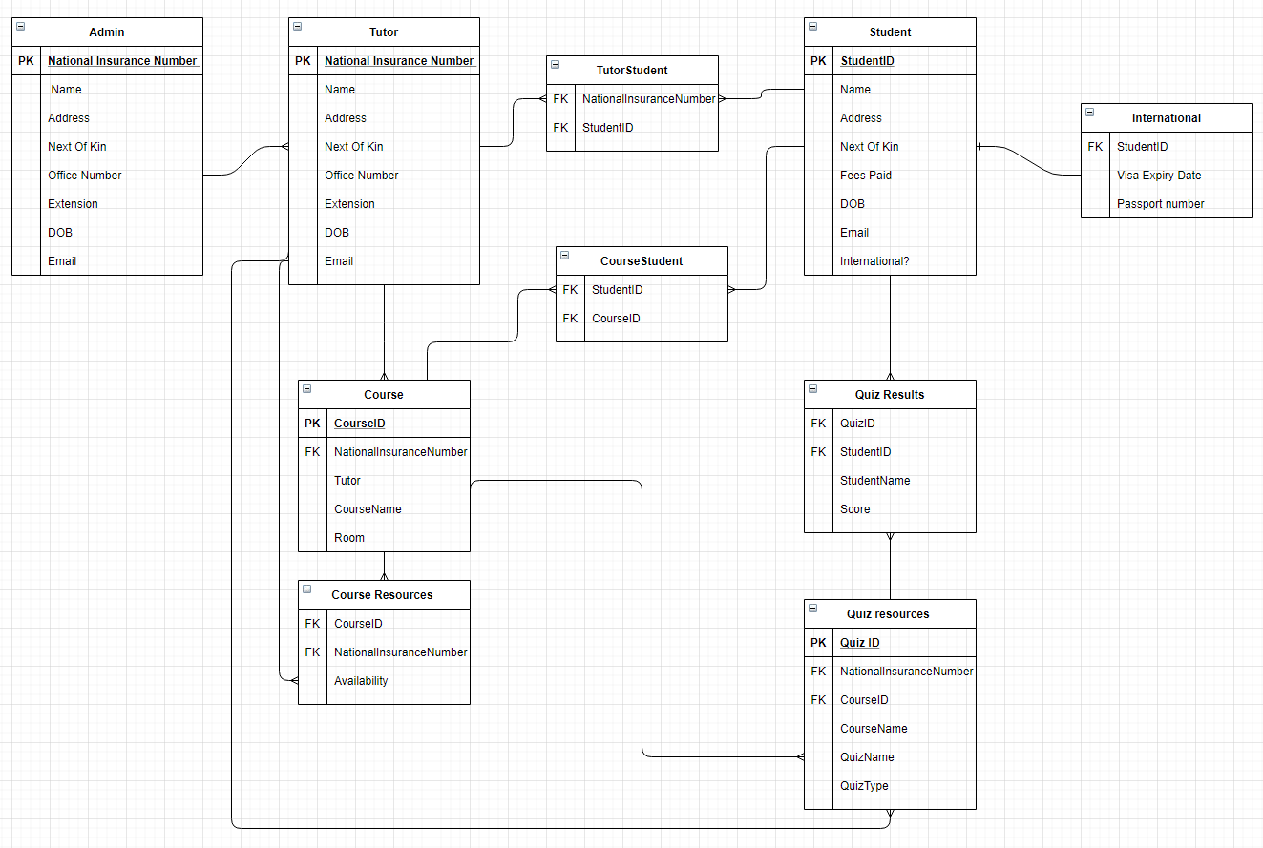
Logical Design
Iradat went on to create the logical design and to write up the DDL for the logical design.

Slide 7
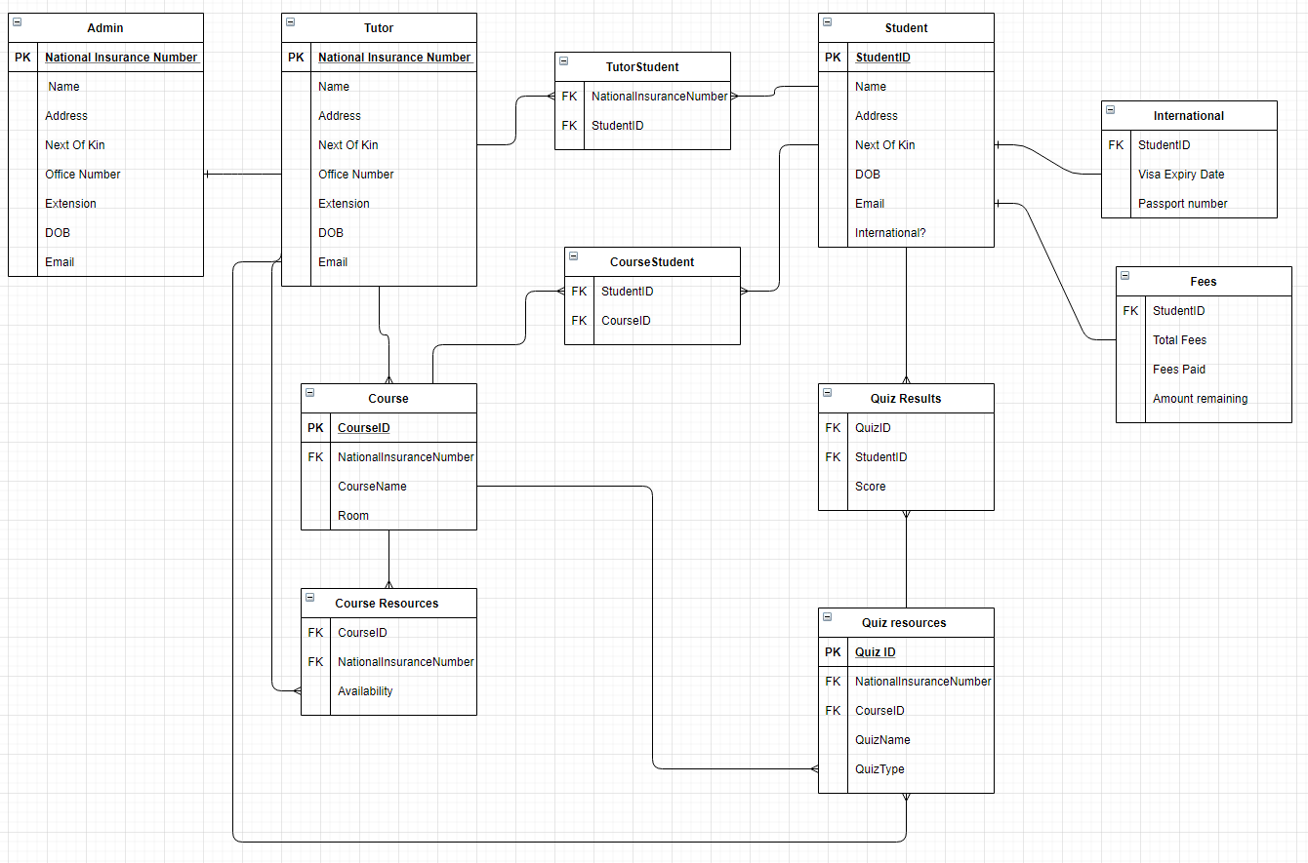
Normalisation
Simnaan then normalized the logical design that iradat created and wrote up the physical design of the database.

Slide 8
Implementation
For implementing the database, Simnaan used the physical design he created to code the database using MySQL. He created the database, the tables and the attributes for each table.
Iradat then implemented the security into the database. He also created the users that can access the database.
Zak created the GUI for the database. He decided that a website would be best suited for this and as a team we agreed to this. He implemented the SQL that Simnaan and Iradat had wrote to his website gui.

Slide 9
SQL Implementation
CREATE DATABASE databaseCoursework;
SHOW DATABASES;
USE databaseCoursework;
CREATE TABLE tblAdmin (
nationalInsuranceNumber varchar(9) not null,
name varchar(30) not null,
address varchar(30) not null,
nextOfKin Varchar(30) not null,
officeNumber Varchar(30) not null,
extension Integer(15) not null,
dob Date(15) not null,
email varchar(30) not null,
phone integer(15) not null,
primary key (NationalInsuranceNumber)
);

Slide 10
CREATE TABLE tblTutor (
nationalInsuranceNumber varchar(9) not null,
name varchar(30) not null,
address varchar(30) not null,
nextOfKin Varchar(30) not null,
officeNumber Varchar(30) not null,
extension Integer(15) not null,
dob Date(15) not null,
email varchar(30) not null,
phone integer(15) not null,
primary key (NationalInsuranceNumber)
);

Slide 11
CREATE TABLE tblStudent (
studentID varchar(30) auto_increment not null,
name varchar(30) not null,
address varchar(30) not null,
nextOfKin Varchar(30) not null,
international Integer(1) not null,
dob Date(15) not null,
email varchar(30) not null,
primary key (StudentID)
);
CREATE TABLE tblInternational (
studentID varchar(30) not null,
visaExpiryDate Date(10) not null,
passportNumber Integer(10) not null,
foreign key(studentID) references tblStudent(studentID)
);

Slide 12
CREATE TABLE tblFees (
studentID varchar(30) not null,
totalFees Integer(10) not null,
feesPaid Integer(10) not null,
amountRemaining Integer(10) not null,
foreign key(studentID) references tblStudent(studentID)
);
CREATE TABLE tblTutorStudent(
studentID varchar(30) not null,
nationalInsuranceNumber varchar(9) not null,
foreign key(studentID) references tblStudent(studentID)
foreign key (nationalInsuranceNumber) references tblTutor(nationalInsuranceNumber)
);

Slide 13
CREATE TABLE tblCourse(
courseID varchar(30) not null,
nationalInsuranceNumber varchar(9) not null,
CourseName varchar(30) not null,
room varchar(30) not null,
foreign key (nationalInsuranceNumber) references tblTutor(nationalInsuranceNumber)
);
CREATE TABLE tblCourseStudent(
courseID varchar(30) not null,
studentID varchar(30) not null,
foreign key(studentID) references tblStudent(studentID)
foreign key(courseID) references tblCourse (courseID)
);

Slide 14
CREATE TABLE tblCourseResources(
courseID varchar(30) not null,
nationalInsuranceNumber varchar(9) not null,
Availability varchar(30) not null,
foreign key(courseID) references tblCourse (courseID)
foreign key (nationalInsuranceNumber) references tblTutor(nationalInsuranceNumber)
);
CREATE TABLE tblQuizResources(
quizID varchar(30) not null,
courseID varchar(30) not null,
nationalInsuranceNumber varchar(9) not null,
quizName varchar(30) not null,
quizType varchar(30) not null,
primary key (quizID)
foreign key(courseID) references tblCourse (courseID)
foreign key (nationalInsuranceNumber) references tblTutor(nationalInsuranceNumber)
);

Slide 15
CREATE TABLE tblQuizResults(
quizID varchar(30) not null,
studentID varchar(30) not null,
scores varchar(30) not null,
foreign key(studentID) references tblStudent(studentID)
foreign key(quizID) references tblQuizResources (quizID)
);

Slide 16
Database Security
GRANT SELECT, INSERT, UPDATE, DELETE ON databaseCoursework.tblTutorStudent TO 'Admin'@'localhost';
GRANT SELECT, INSERT, UPDATE, DELETE ON databaseCoursework.tblAdmin TO 'Admin'@'localhost';
GRANT SELECT, INSERT, UPDATE, DELETE ON databaseCoursework.tblTutor TO 'Admin'@'localhost';
GRANT SELECT, INSERT, UPDATE, DELETE ON databaseCoursework.tblCourse TO 'Admin'@'localhost';
GRANT SELECT, INSERT, UPDATE, DELETE ON databaseCoursework.tblCourseStudent TO 'Admin'@'localhost';
GRANT SELECT, INSERT, UPDATE, DELETE ON databaseCoursework.tblCourseResources TO 'Admin'@'localhost';
GRANT SELECT, INSERT, UPDATE, DELETE ON databaseCoursework.tblQuizResources TO 'Admin'@'localhost';
GRANT SELECT, INSERT, UPDATE, DELETE ON databaseCoursework.tblQuizResults TO 'Admin'@'localhost';
GRANT SELECT, INSERT, UPDATE, DELETE ON databaseCoursework.tblInternational TO 'Admin'@'localhost';
CREATE USER 'Student'@'localhost' IDENTIFIED BY 'StudentPassword';
CREATE USER 'Tutor'@'localhost' IDENTIFIED BY 'TutorPassword';
CREATE USER 'Admin'@'localhost' IDENTIFIED BY 'AdminPassword';
GRANT SELECT, INSERT, UPDATE(address,nextOfKin,email) ON databaseCoursework.tblStudent TO 'Student'@'localhost';
GRANT SELECT, INSERT, UPDATE(visaExpiryDate,passportNumber) ON databaseCoursework.tblInternational TO 'Student'@'localhost';
GRANT SELECT, INSERT, UPDATE ON databaseCoursework.tblTutor TO 'Tutor'@'localhost';
GRANT SELECT, INSERT, databaseCoursework.tblStudent TO 'Tutor'@'localhost';
GRANT SELECT, INSERT, UPDATE ON databaseCoursework.tblTutorStudent TO 'Tutor'@'localhost';
GRANT SELECT, INSERT, UPDATE ON databaseCoursework.tblCourse TO 'Tutor'@'localhost';
GRANT SELECT, INSERT, UPDATE, DELETE ON databaseCoursework.tblCourseResources TO 'Tutor'@'localhost';
GRANT SELECT, INSERT, UPDATE, DELETE ON databaseCoursework.tblQuizResources TO 'Tutor'@'localhost';
GRANT SELECT, INSERT, UPDATE, DELETE ON databaseCoursework.tblStudent TO 'Admin'@'localhost';
GRANT SELECT, INSERT, UPDATE, DELETE ON databaseCoursework.tblFees TO 'Admin'@'localhost';

Slide 17
Final thoughts
We decided to design our database the way we did because we wanted it to be easy to follow and easy to read so it will be easier to pick up and easier to make changes to it, if needed. By doing the database this way, we also made it easier to secure.

