Slide 1
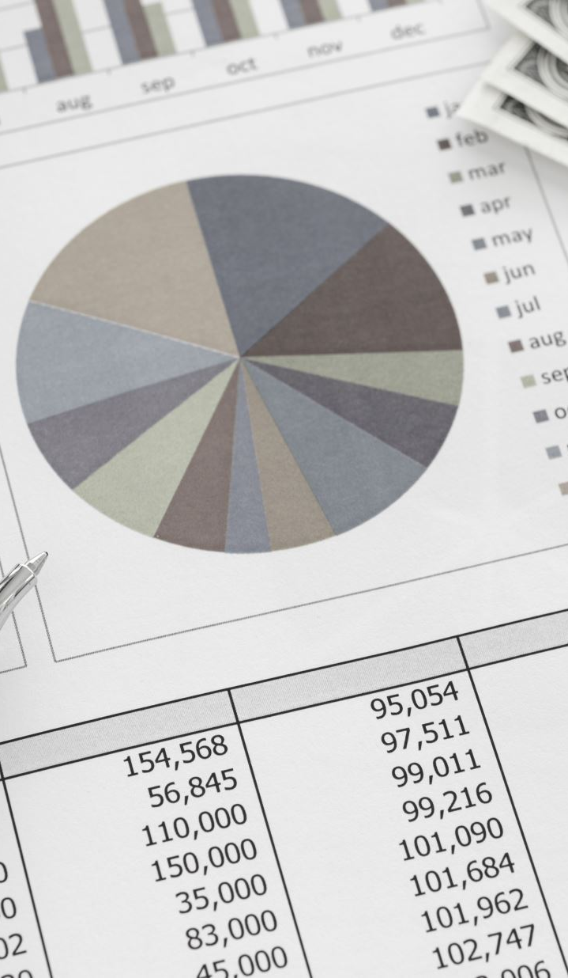
Predicting Strategic Financial Decisions
A Data-Driven Approach to Allocation Decisions Using Financial Ratios
Presented by: Sami Bsata

Slide 2
Problem Statement
- Companies make critical decisions: Repay Debt, Retain Cash, Increase R&D, Expand CapEx
- These actions are difficult to observe without insider info
- Manual analysis is slow and error-prone

Slide 3
Project Objective
- Predict capital allocation using financial ratios
1
- Learn from real quarterly changes
2
- Deliver transparent, scalable predictions
3

Slide 4
Data Pipeline
- TSX-listed tickers scraped via yfinance
- Used Balance Sheet, Income Statement, Cash Flow
- Binary targets from comparing current vs. previous quarter:
• Repaid Debt
• Retained Cash
• Increased CapEx
• Increased R&D

Slide 5
Data Pipeline
Input Features:
P/E Ratio
Debt to Equity
Current Ratio
ROE
ROA
Revenue Growth
Market Cap
Labels:
Repaid Debt
Retained Cash
Increased CapEx
Increased R&D

Slide 6
Data Sample
Sample Scaled Input:
Sample Output:

Slide 7
Model Architecture
- MultiOutputClassifier + GradientBoostingClassifier
- StandardScaler for features
- Dropped labels with only 1 unique class
- Train/Test split = 80/20

Slide 8
Results — Repaid Debt
- Accuracy: 72%
- Precision (1): 58%
- Recall (1): 18%
- Imbalanced data: 38/127 (~30%)

Slide 9
Results — Retained Cash
- Accuracy: 73%
- Precision (1): 41%
- Recall (1): 33%
Sensitive to small changes

Slide 10
Results — R&D
- Accuracy: 94% (but misleading)
- Precision (1): 40%, Recall: 33%
- Very rare class: only 6/127 companies increased R&D

Slide 11
Key Insights
- Financial ratios do hint at corporate strategy
- Model identifies patterns in short-term actions
- Class imbalance limits some prediction power

Slide 12
Next Steps
Add sentiment analysis from CEO letters/filings
Forecast M&A, dividends, layoffs
Build a real-time dashboard

Slide 13

Thank You
Questions?

