Slide 1
CHIP-SEQ ANALYSIS OF ATF5

Slide 2
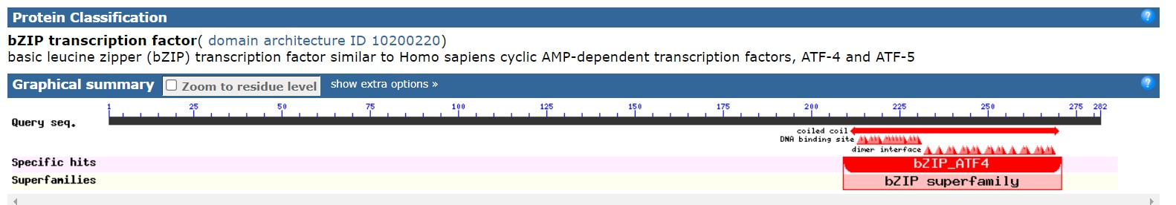
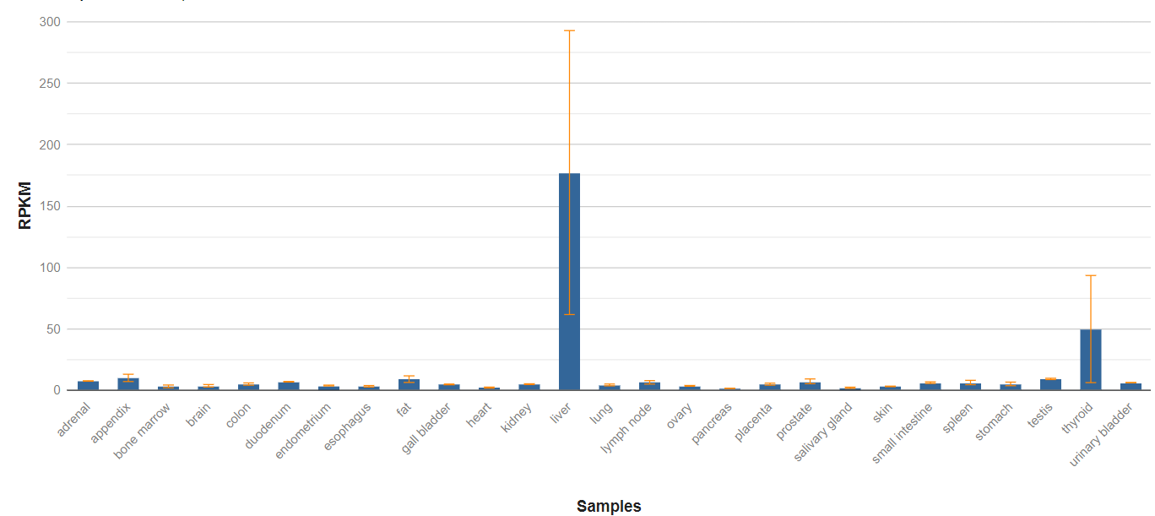
ATF5
ATF5 consists of 282 aa with MW of 31 kDa
ATF5 is a member of basic-region leucine zipper (bZIP) proteins family
ATF5 transcripts and protein are expressed in a wide variety of tissues, in particular, high expression of transcripts in liver
ATF5 is suggested to readily hetero- and homodimerize with transcription factors and is perceived to be quite promiscuous in its binding capabilities
NCBI,gene

Slide 3
Quality Control
replicate | Original n of reads | N of reads after removing multimapping | % uniquely mapping reads(with pcr amplicons) | number of reads after discarding pcr amplicons | Redundant rate | Fragment size (in bp)
REP 1 | 42651469 | 33088099 | 78 | 27306556 | 17 | 122
REP 2 | 34577115 | 27859576 | 81 | 23427153 | 16 | 127
CONTROL | 47230616 | 43420654 | 92 | 36813756 | 15 | NA

Slide 4
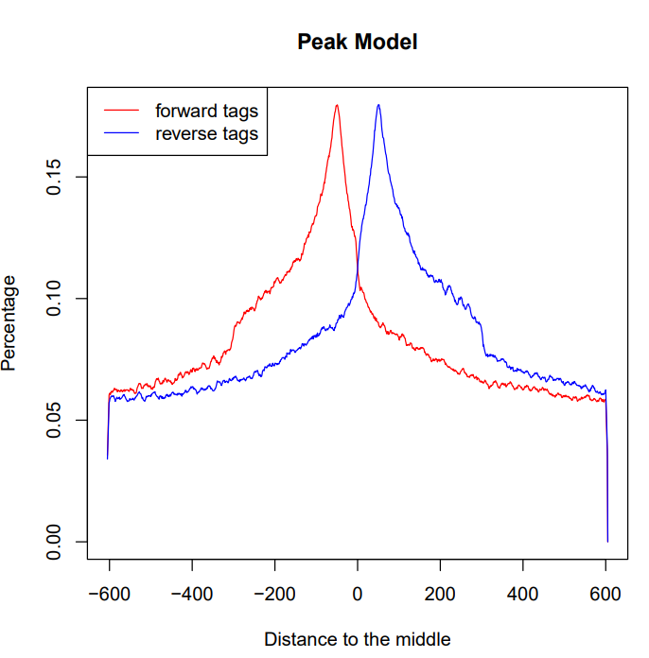
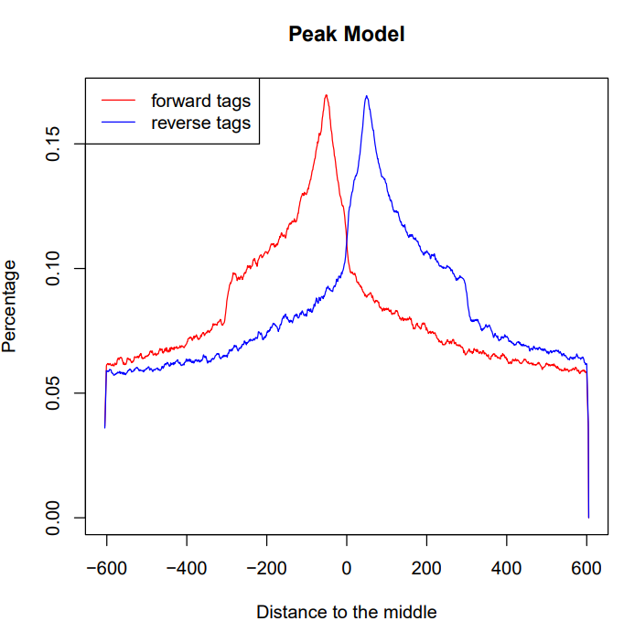
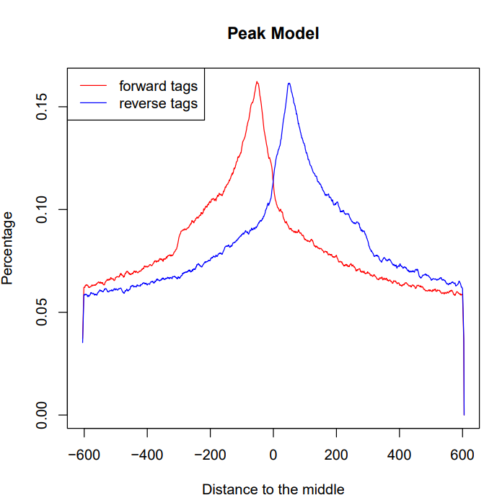
Fragment size estimation
REP 1
REP 2
MERGED

Slide 5
Number of Peaks
Replicate | Before removing non canonical chr | After removing non canonical chr | % of discarded peaks | After removing peaks in black list | % of discarded peaks
REP1 | 3666 | 3580 | 2.3 | 3483 | 2.7
REP2 | 3235 | 3189 | 1.4 | 3114 | 2.3
MERGED | 4190 | 4148 | 1 | 4116 | 0.7

Slide 6
My Peaks vs ENCODE results
Criteria | REP1 intersect REP2 | REP1 vs ENCODE | REP2 vs ENCODE | MERGED VS ENCODE | Intersection(rep1,rep2) vs ENCODE
Peak-overlapping | 1539 | 1390 | 1277 | 1636 | 850
Summit proximity | 1266 | 1128 | 1020 | 1344 | 838

Slide 7
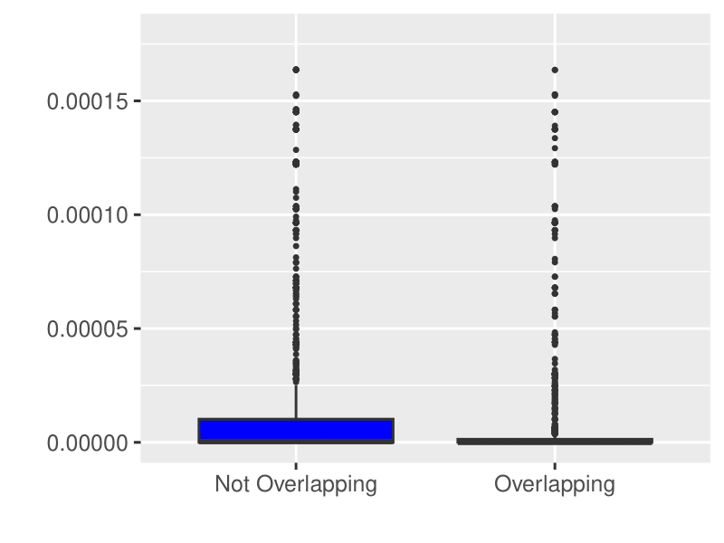
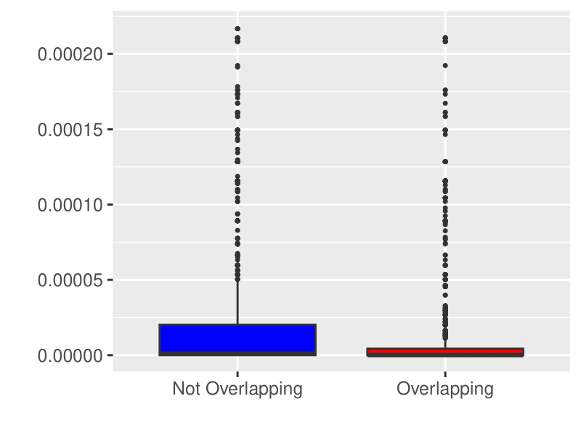
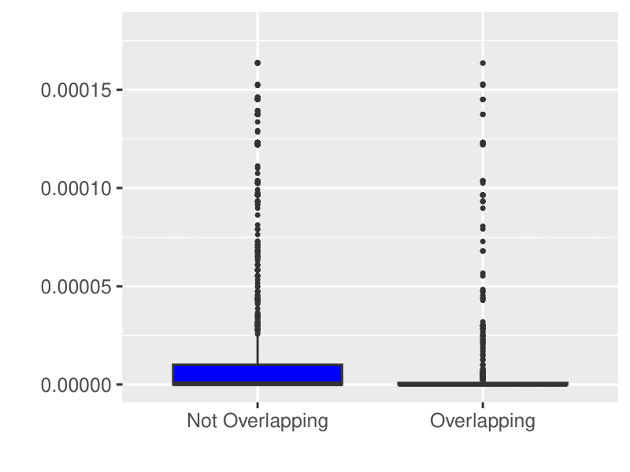
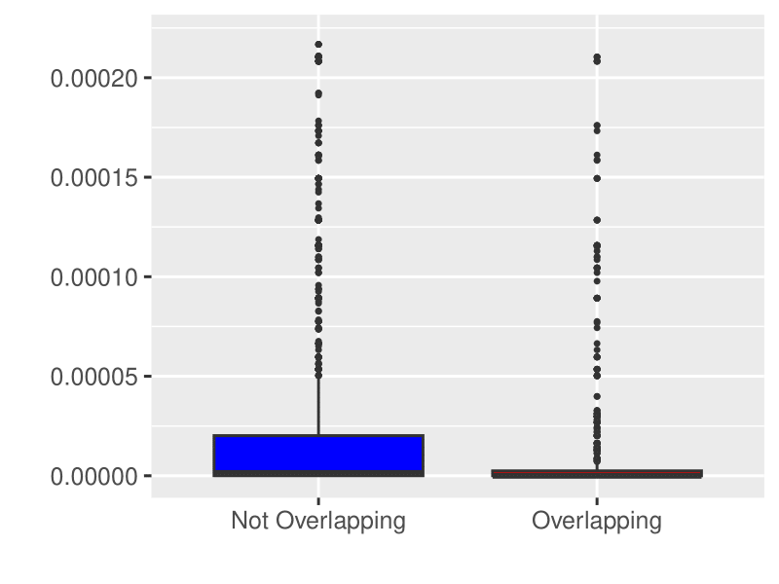
Q-values distribution in my peaks
REP1 vs ENCODE
REP2 vs ENCODE
peak overlapping
peak overlapping
Summit proximity
Summit proximity

Slide 8
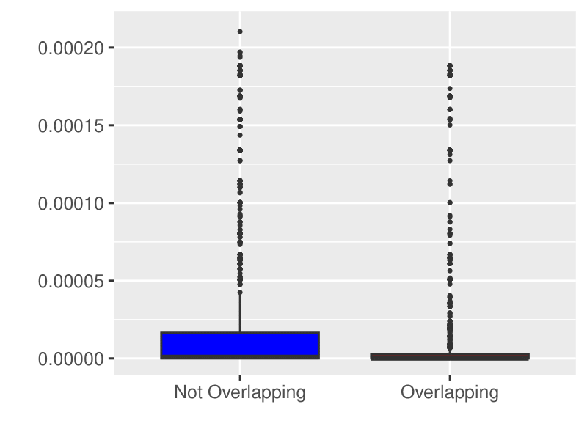
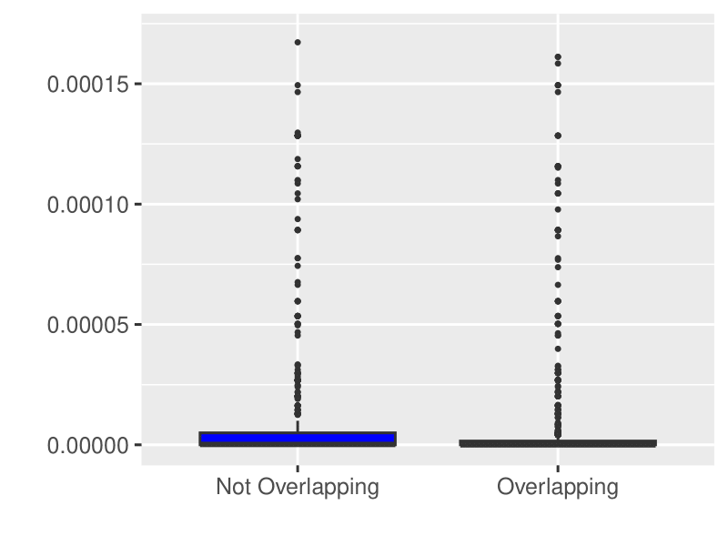
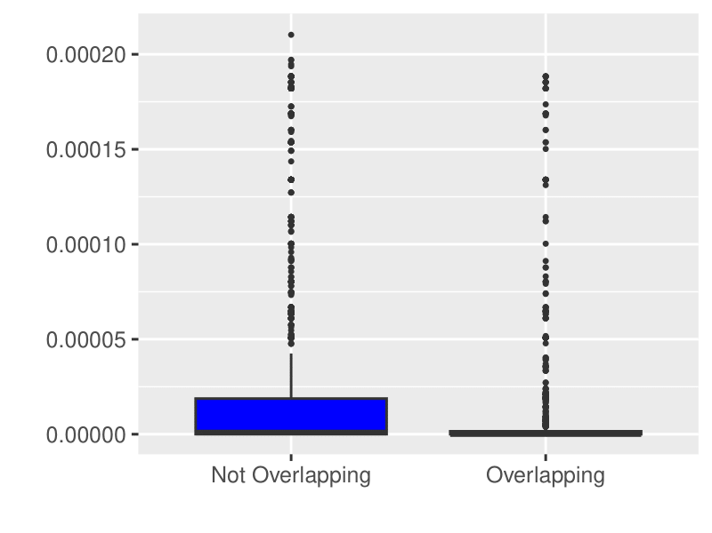
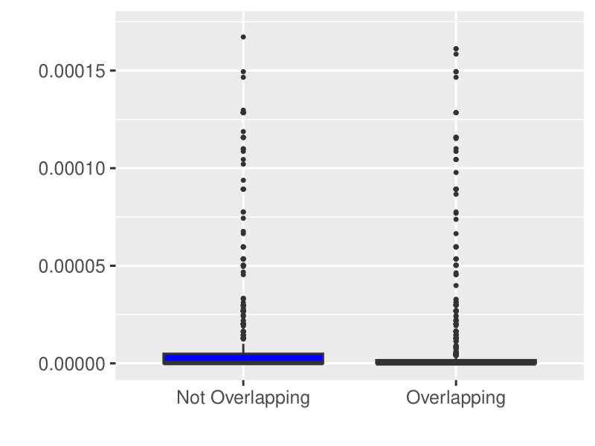
Q-values distribution in my peaks
ERGED vs ENCODE
peak overlapping
summit proximity
summit proximity
MERGED vs ENCODE
REP1REP2 vs ENCODE
peak overlapping
peak overlapping
summit proximity
summit proximity

Slide 9
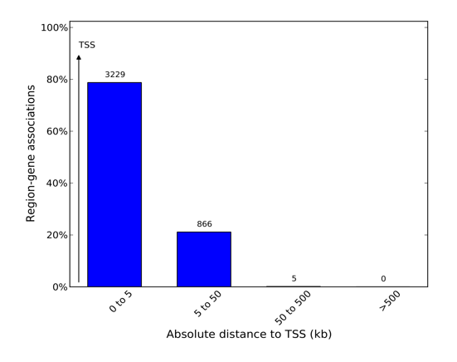
Gene-peak association
1 kbp | 1-5 kbp | 5-50 kbp | 50-500 kbp
3186 | 43 | 866 | 5

Slide 10
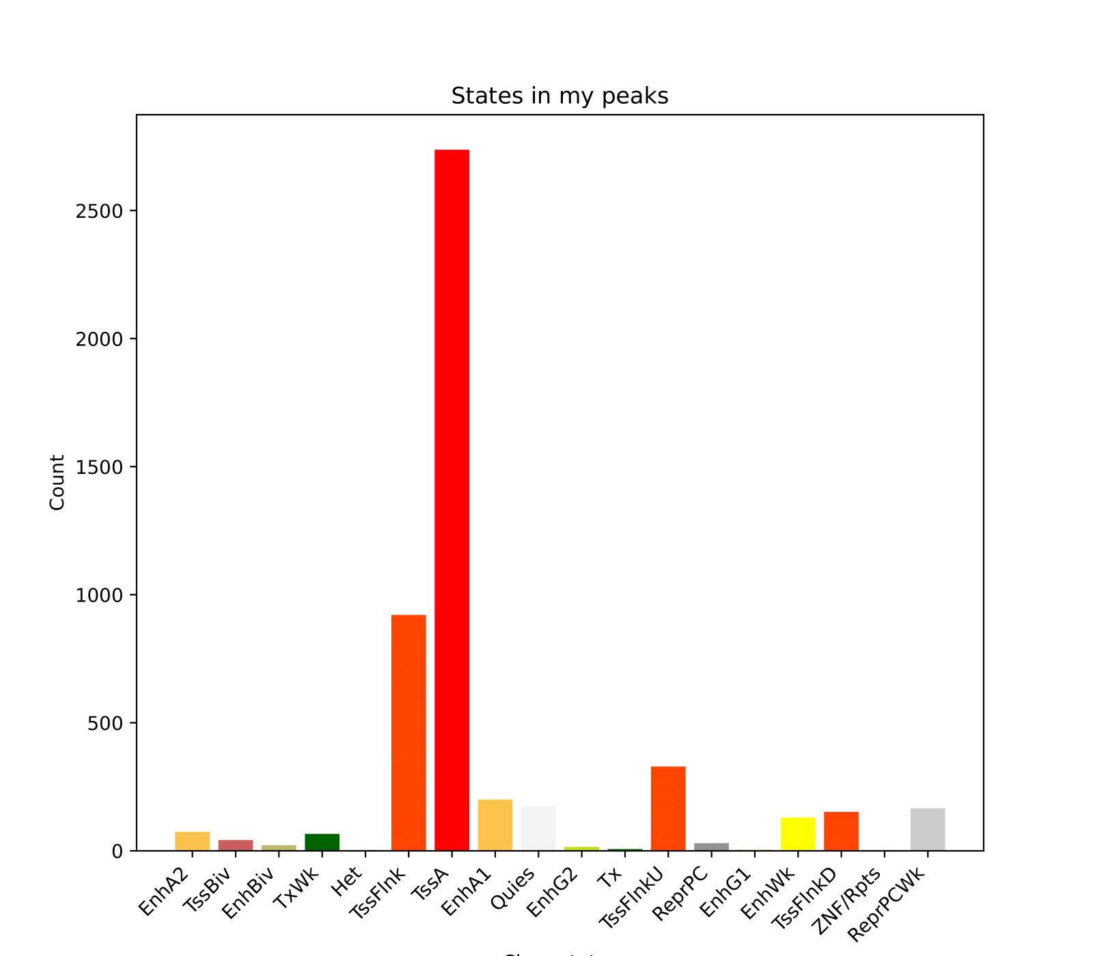
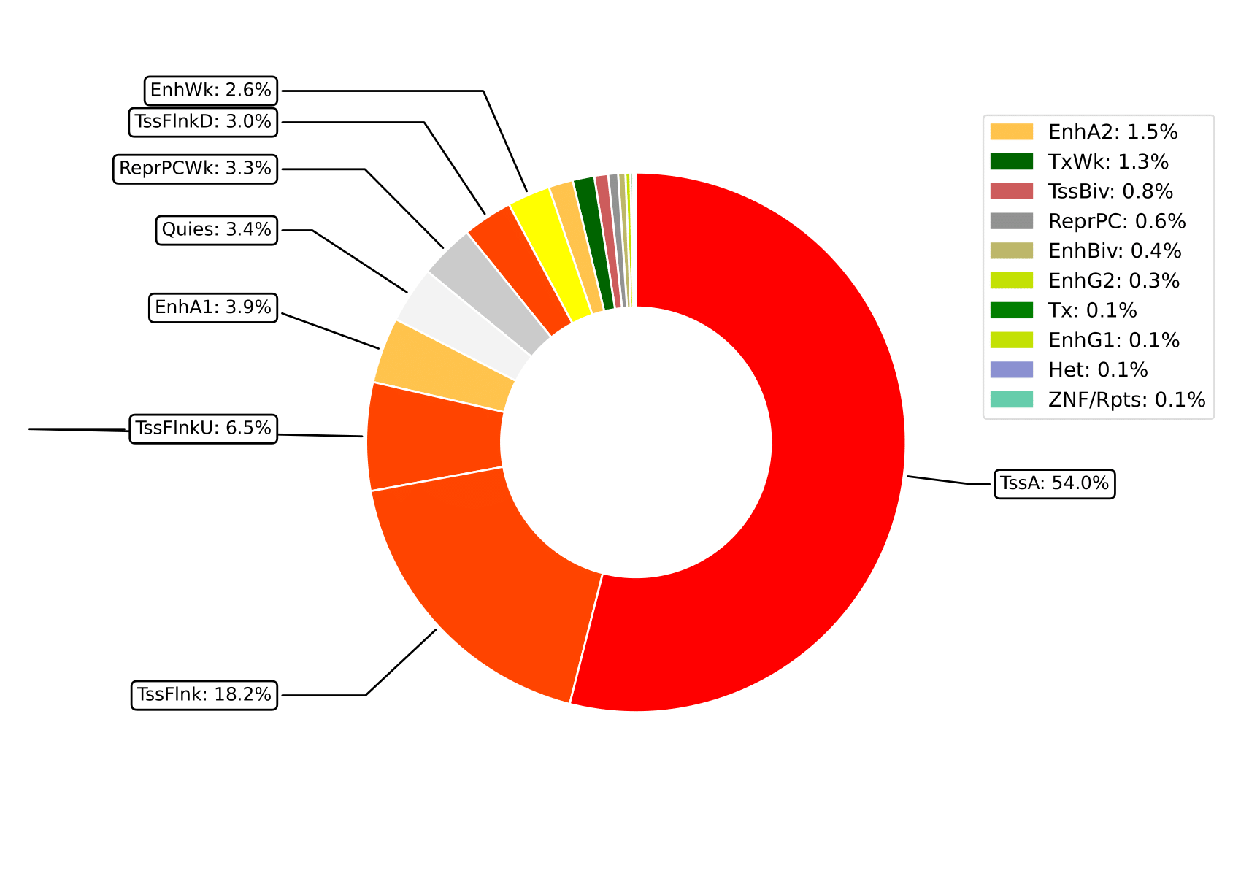
Chromatin states under my peaks
Comparison | J Index
Merged | 0.104767
Rep1Rep2 | 0.0615417

Slide 11
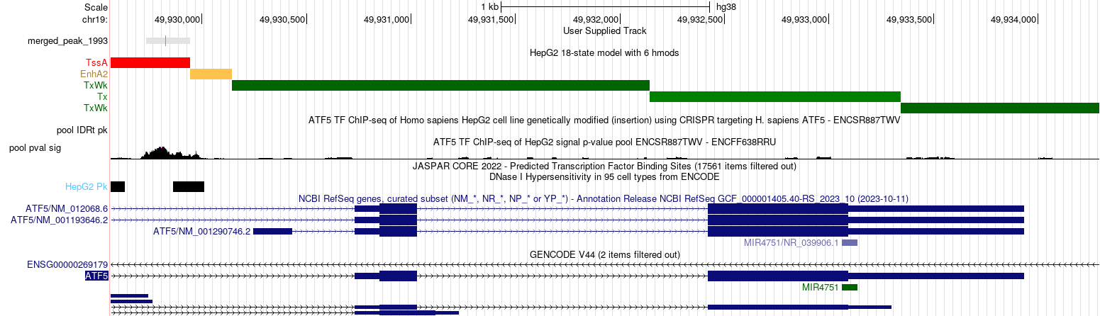
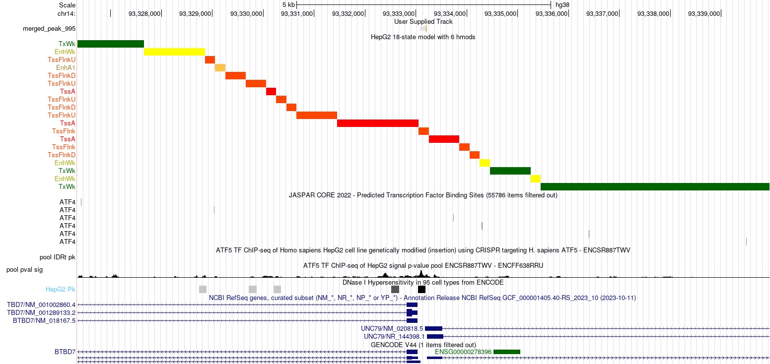
UCSC visualization
Auto regulation of ATF5
ATF4 binding site under my peaks

Slide 12
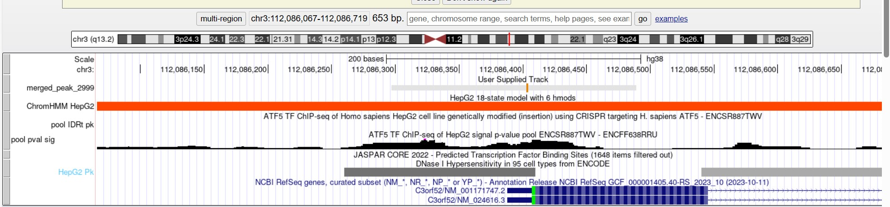
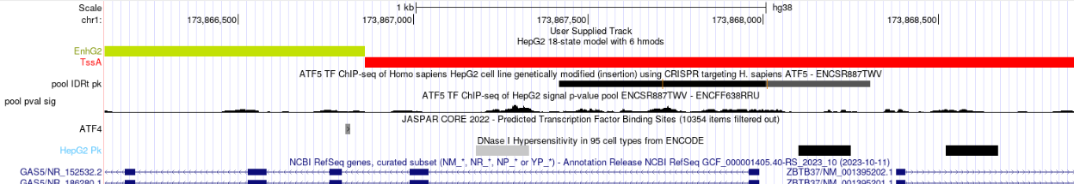
UCSC visualization
My peaks not in encode
Encode peaks not in my results

Slide 13
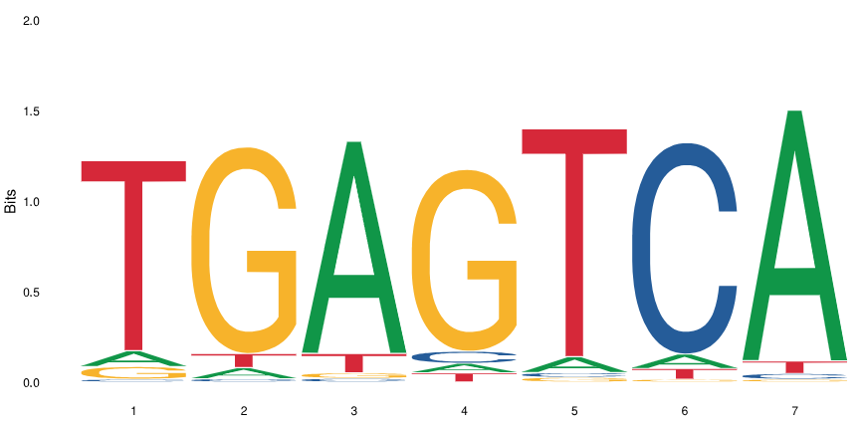
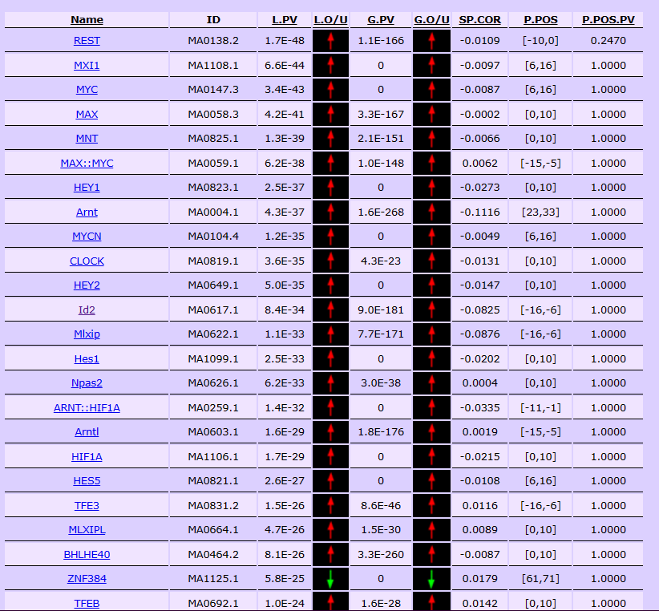
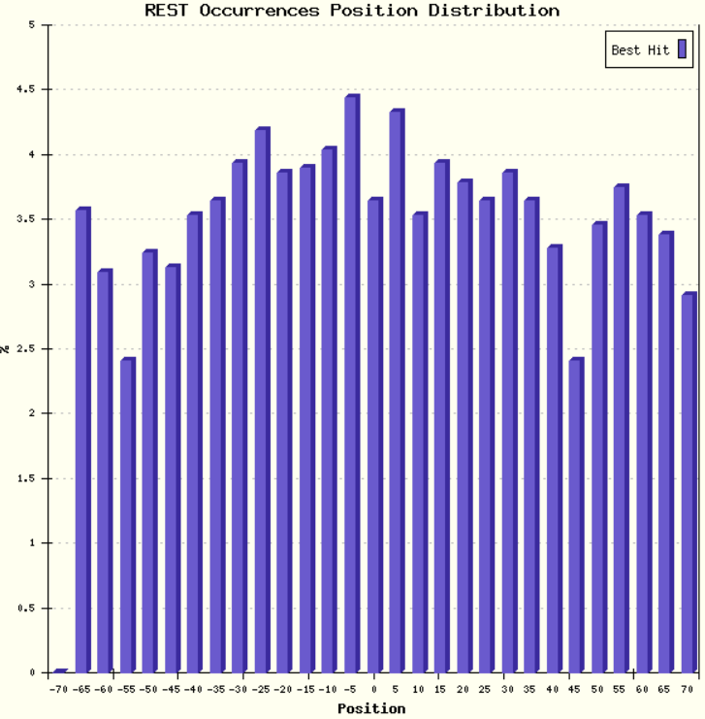
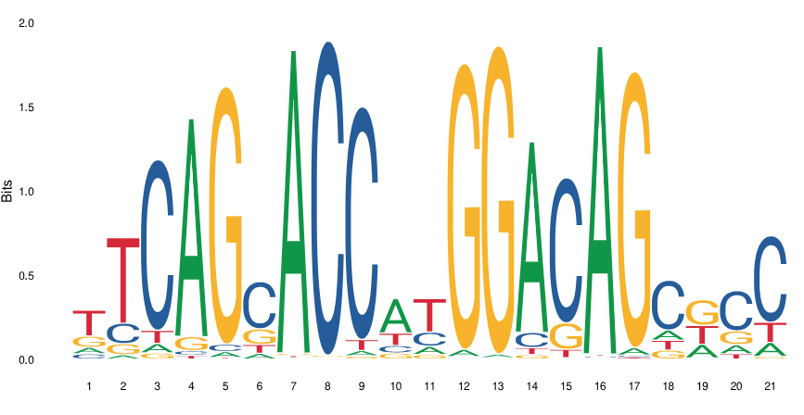
Motif Enrichment Analysis

Slide 14
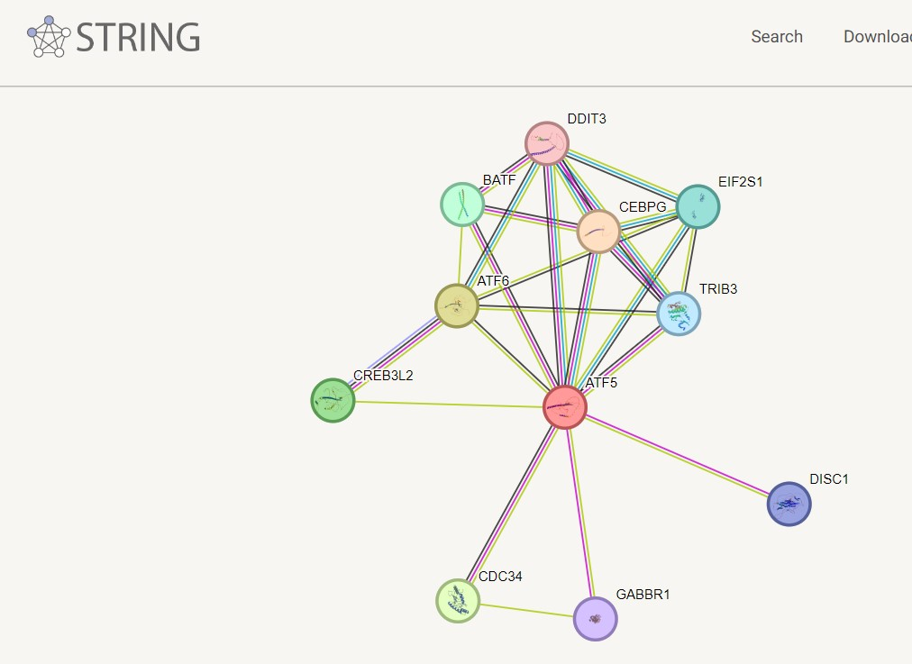
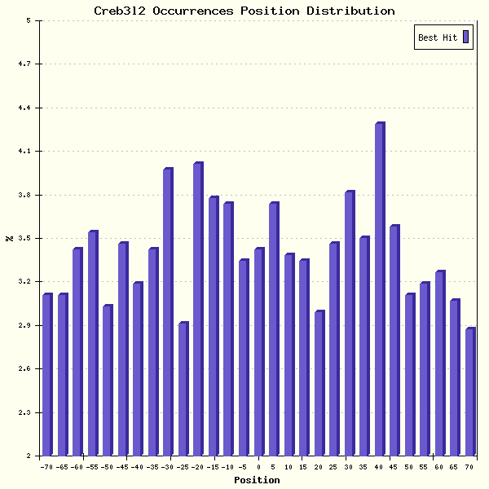
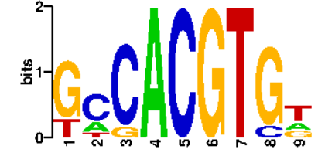
Motif enrichment analysis

