Slide 1
Single cell RNA-SEQ ANALYSIS
Detection of different cell types in spinal cord sample

Slide 2
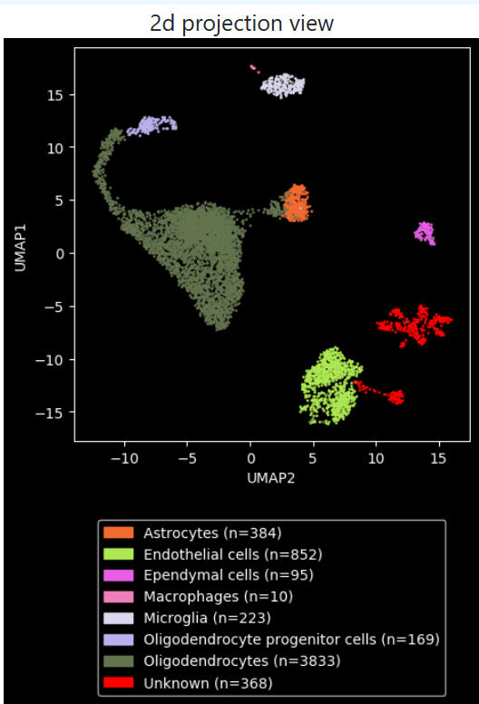
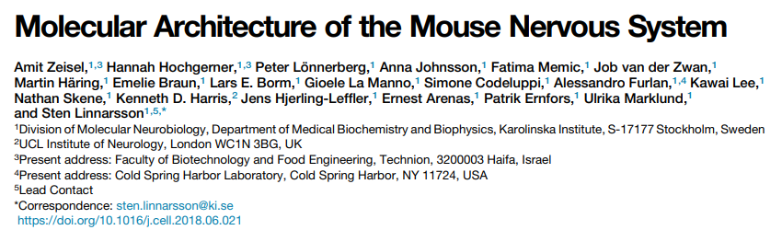
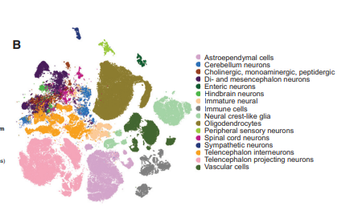
Reference experiment
CELL TYPE | MARKER
oligodendrocyte | Opalin
Oligo-precursor | Pdgfra
Astrocyte | Ctss
Microglia | Aqp4
Ependima cells | Dynlrb2
Neuron | Hoxb8
Endotelial cells | Cldn5

Slide 3
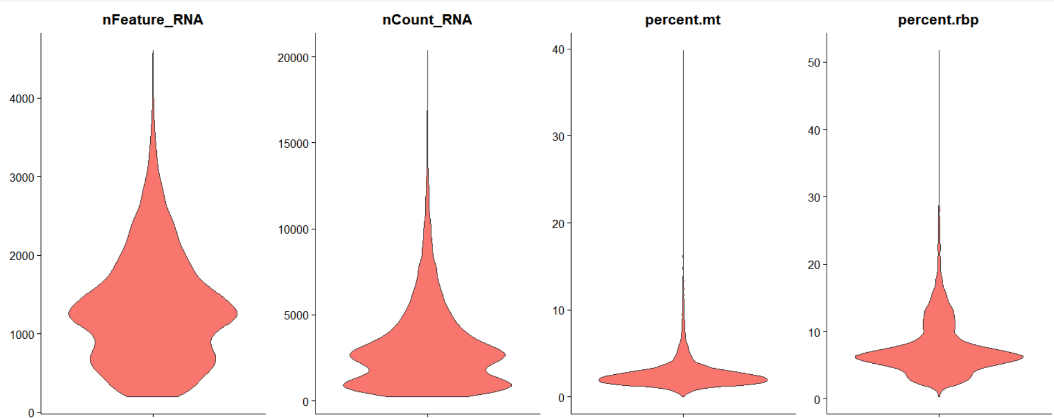
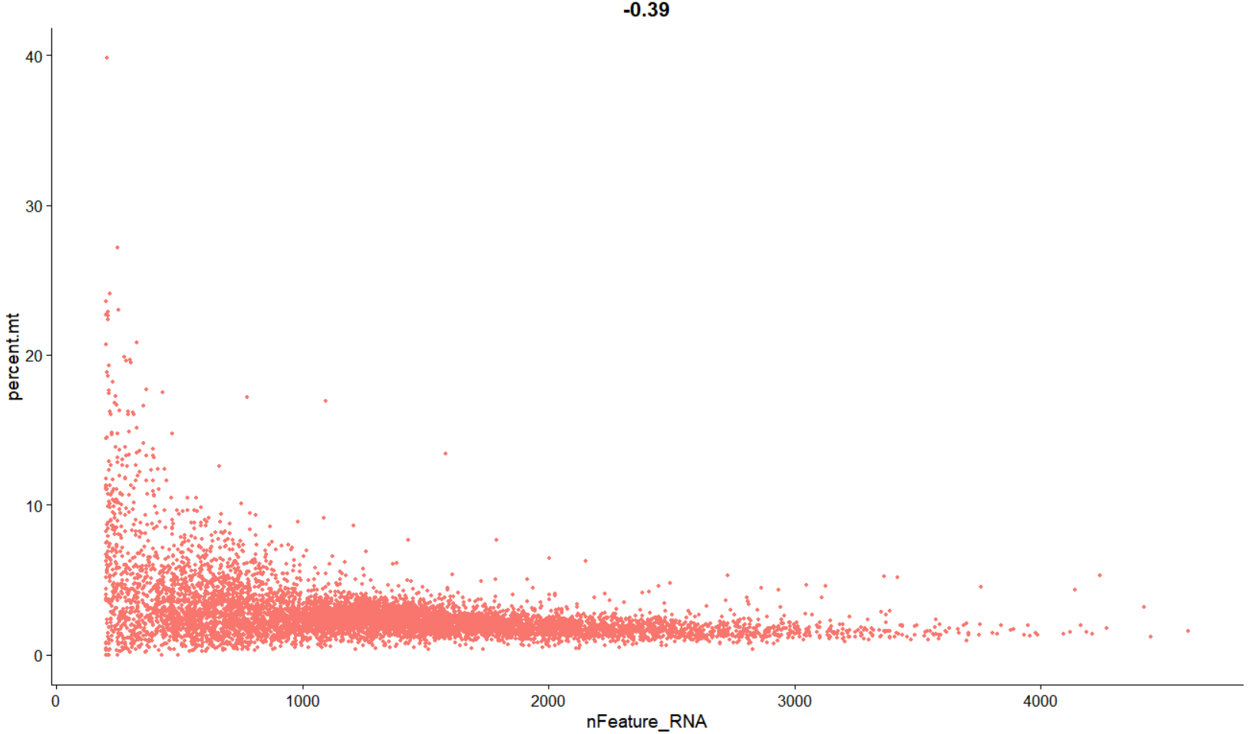
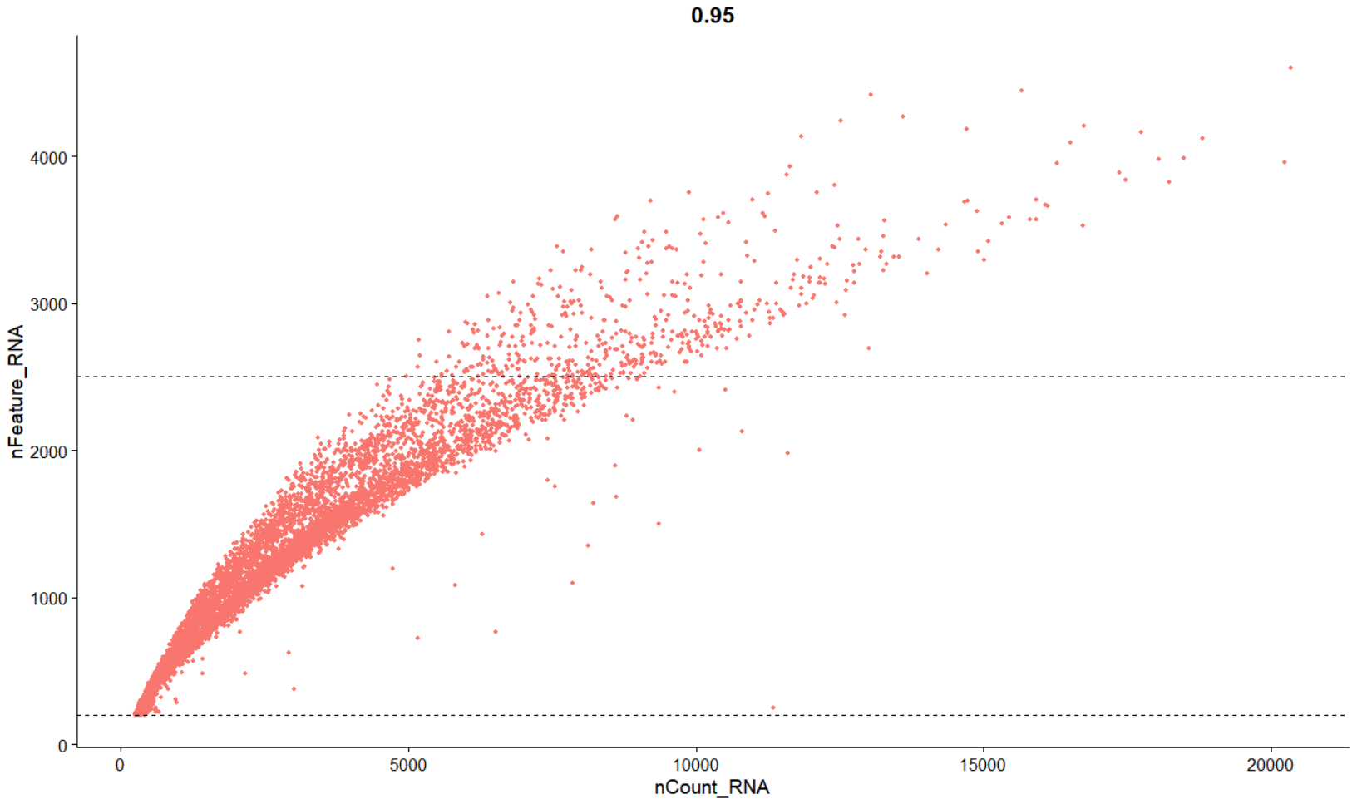
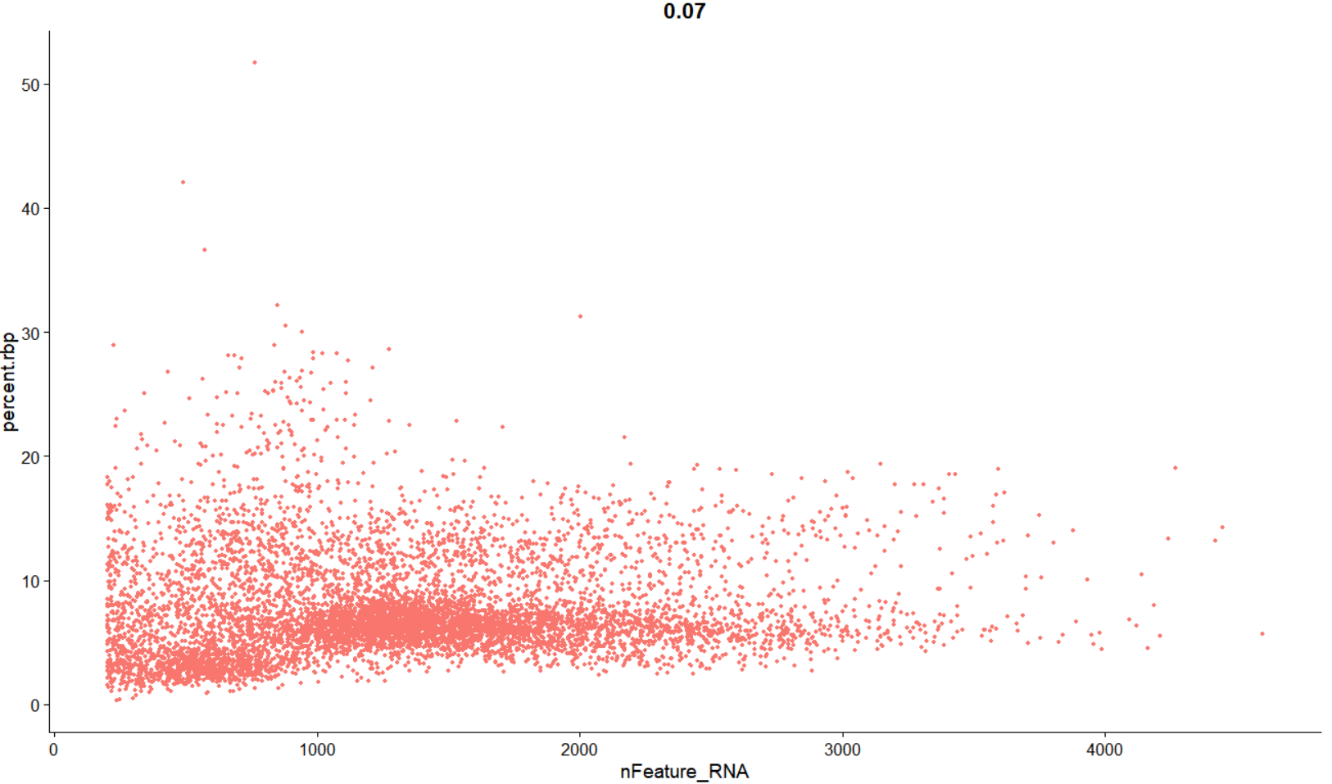
Quality Control

Slide 4
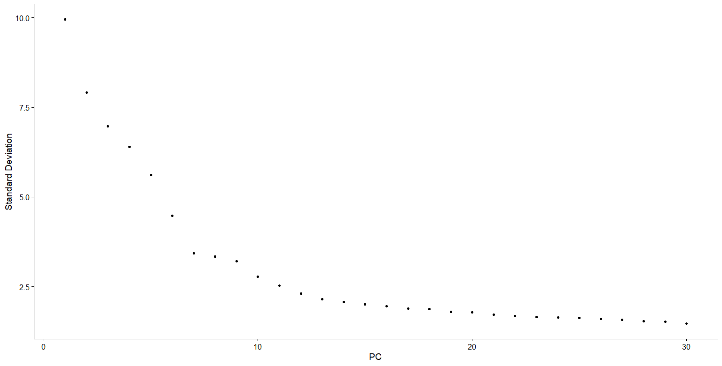
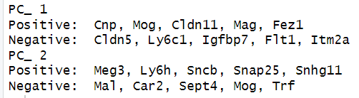
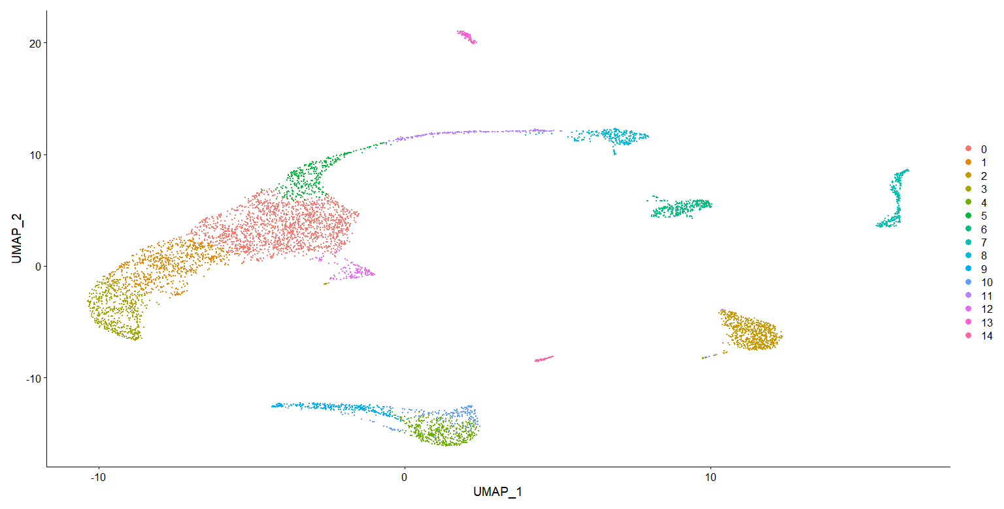
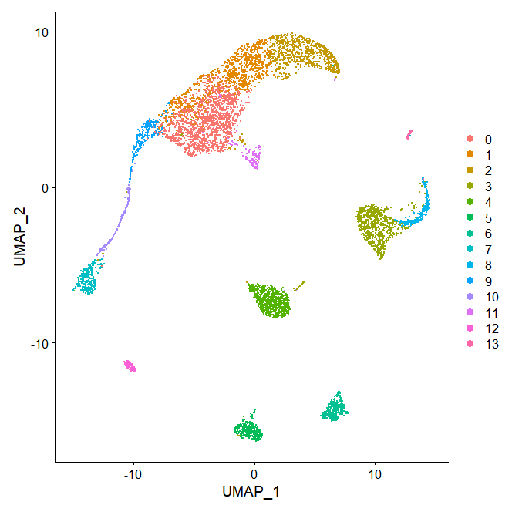
PCA
Elbow plot
Most variable genes for first two PC
UMAP with 10 PC
UMAP with 18 PC

Slide 5
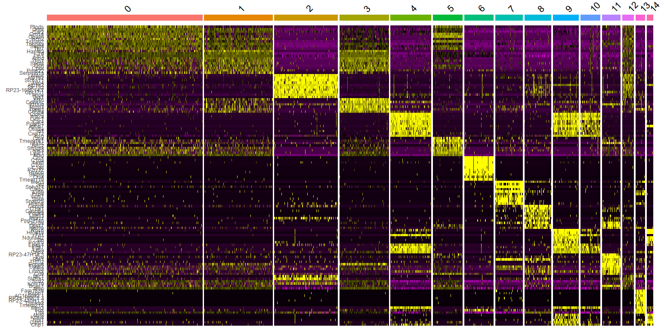
Cluster analysis

Slide 6
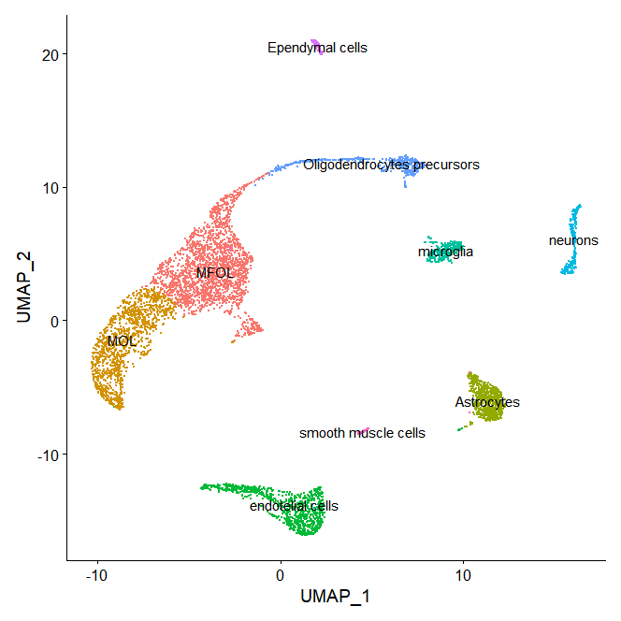
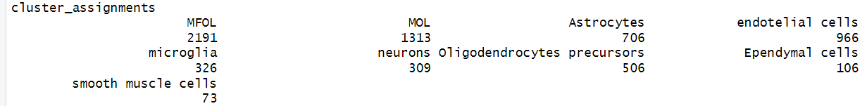
Results

Slide 7
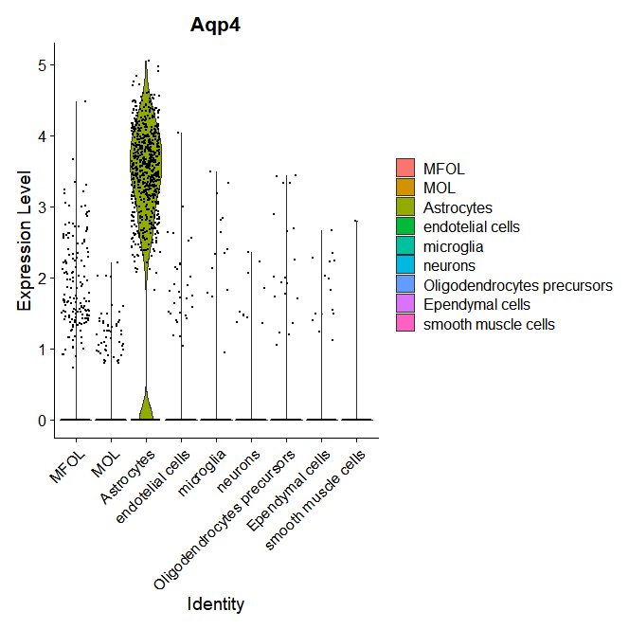
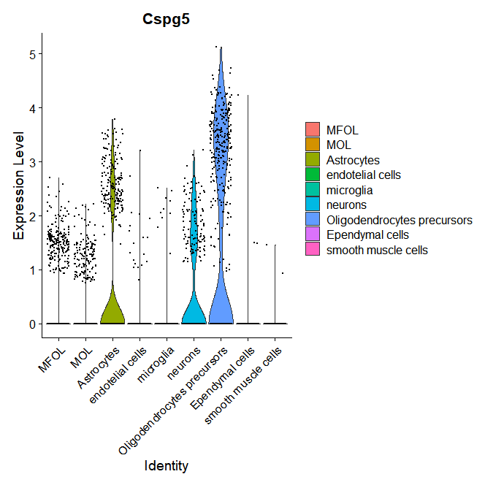
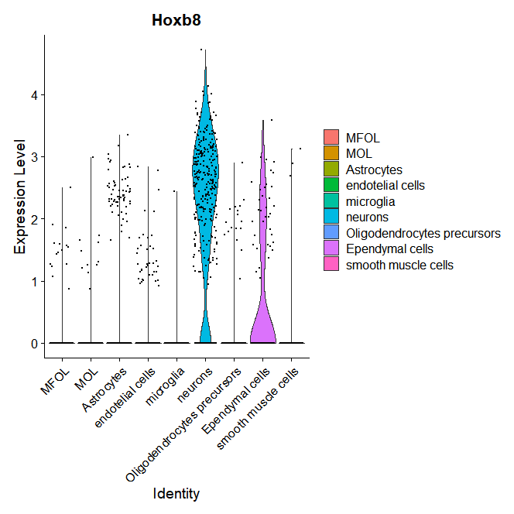
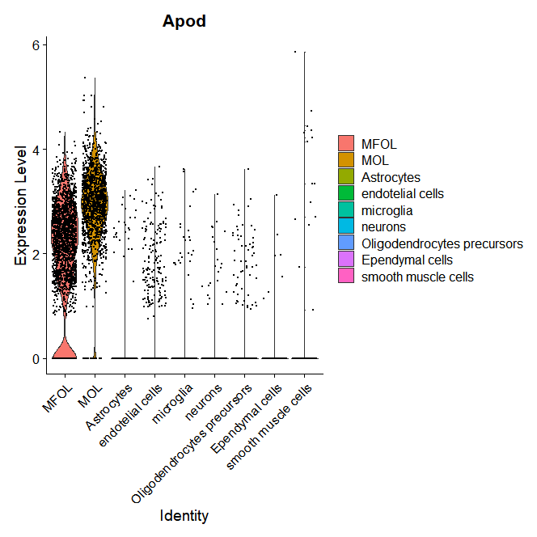
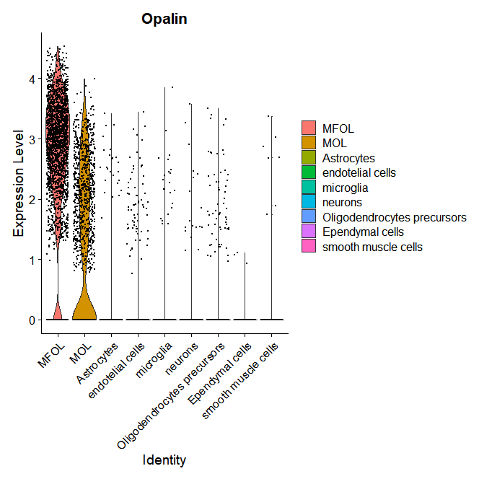
Gene markers in my cell types

Slide 8
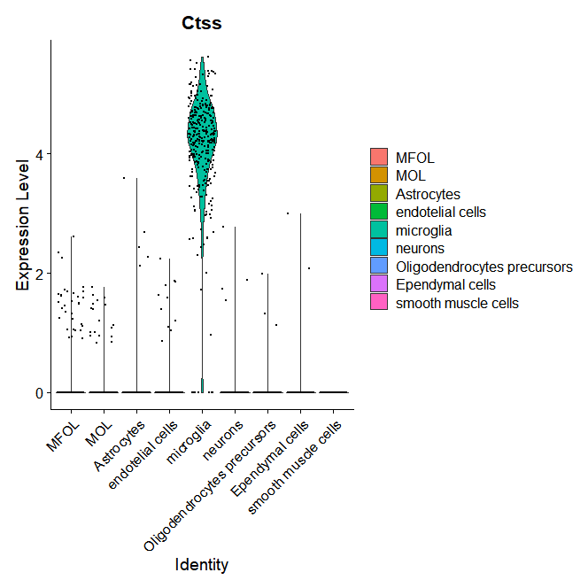
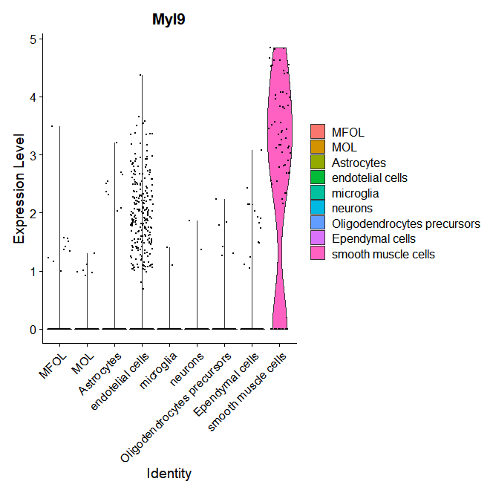
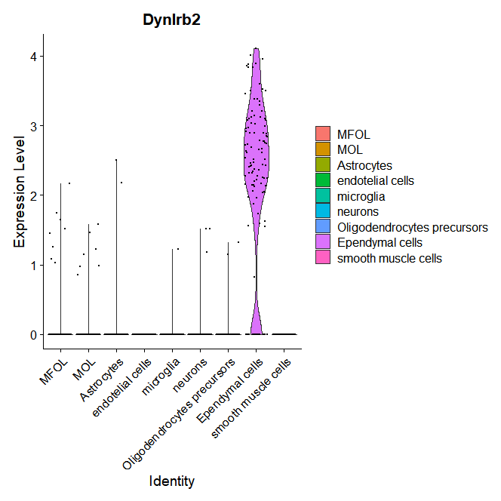
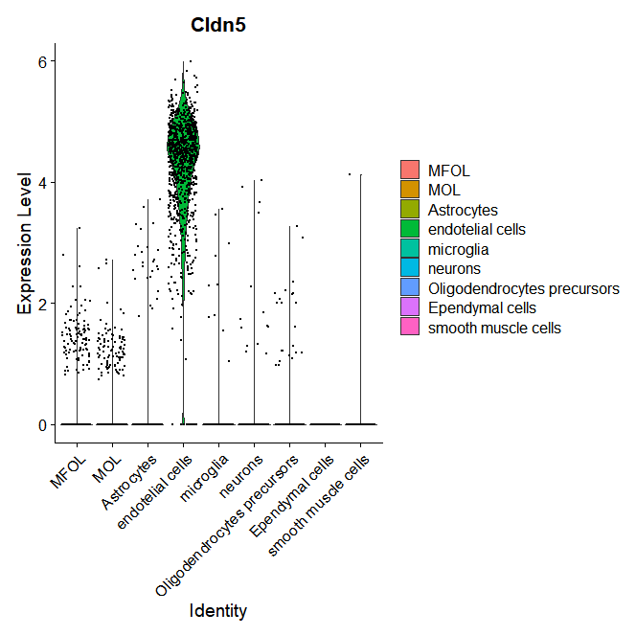
Gene markers in my cell types

Slide 9
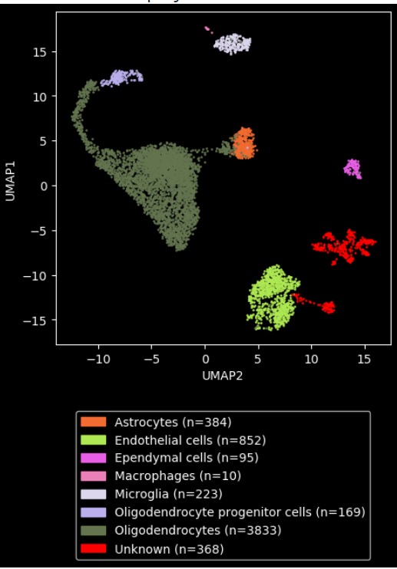
Summary
I was able to identify all the cell types found in the article,given the fact that was a broad study with more than half a million cells sequenced.
Regarding PanglaoDB, i found 7 out of 8 cell types of the automated analysis in my clustering results.I was not able to identify the macrophages.
This is due to the fact that microglia are resident macrophages of SNC,
and there’s not much difference between them.
I was able to identify two cell types not found in PanglaoDB analysis: neurons and smooth muscle cells.

Slide 10
BIBLIOGRAPHY
Zeisel A, Hochgerner H, Lönnerberg P, Johnsson A, Memic F, van der Zwan J, Häring M, Braun E, Borm LE, La Manno G, Codeluppi S, Furlan A, Lee K, Skene N, Harris KD, Hjerling-Leffler J, Arenas E, Ernfors P, Marklund U, Linnarsson S. Molecular Architecture of the Mouse Nervous System. Cell. 2018 Aug 9;174(4):999-1014.e22. doi: 10.1016/j.cell.2018.06.021. PMID: 30096314; PMCID: PMC6086934.
Morimoto J, Matsumoto M, Miyazawa R, Oya T, Tsuneyama K, Matsumoto M. No Major Impact of Two Homologous Proteins Ly6C1 and Ly6C2 on Immune Homeostasis. Immunohorizons. 2022 Mar 9;6(3):202-210. doi: 10.4049/immunohorizons.2100114. PMID: 35264373.
Xie L, Zhang S, Huang L, Peng Z, Lu H, He Q, Chen R, Hu L, Wang B, Sun B, Yang Q, Xie Q. Single-cell RNA sequencing of peripheral blood reveals that monocytes with high cathepsin S expression aggravate cerebral ischemia-reperfusion injury. Brain Behav Immun. 2023 Jan;107:330-344. doi: 10.1016/j.bbi.2022.11.001. Epub 2022 Nov 9. PMID: 36371010.
Marques S, Zeisel A, Codeluppi S, van Bruggen D, Mendanha Falcão A, Xiao L, Li H, Häring M, Hochgerner H, Romanov RA, Gyllborg D, Muñoz Manchado A, La Manno G, Lönnerberg P, Floriddia EM, Rezayee F, Ernfors P, Arenas E, Hjerling-Leffler J, Harkany T, Richardson WD, Linnarsson S, Castelo-Branco G. Oligodendrocyte heterogeneity in the mouse juvenile and adult central nervous system. Science. 2016 Jun 10;352(6291):1326-1329. doi: 10.1126/science.aaf6463. PMID: 27284195; PMCID: PMC5221728.

