Slide 1
BULK RNA-SEQ ANALYSIS
Detection of DE genes in brain ,colon and kidney samples

Slide 2
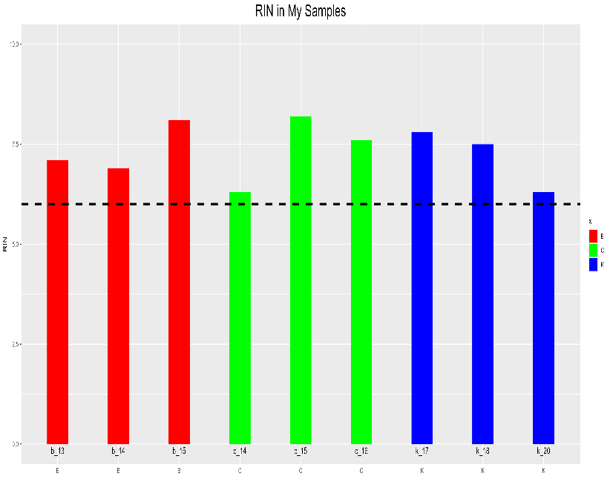
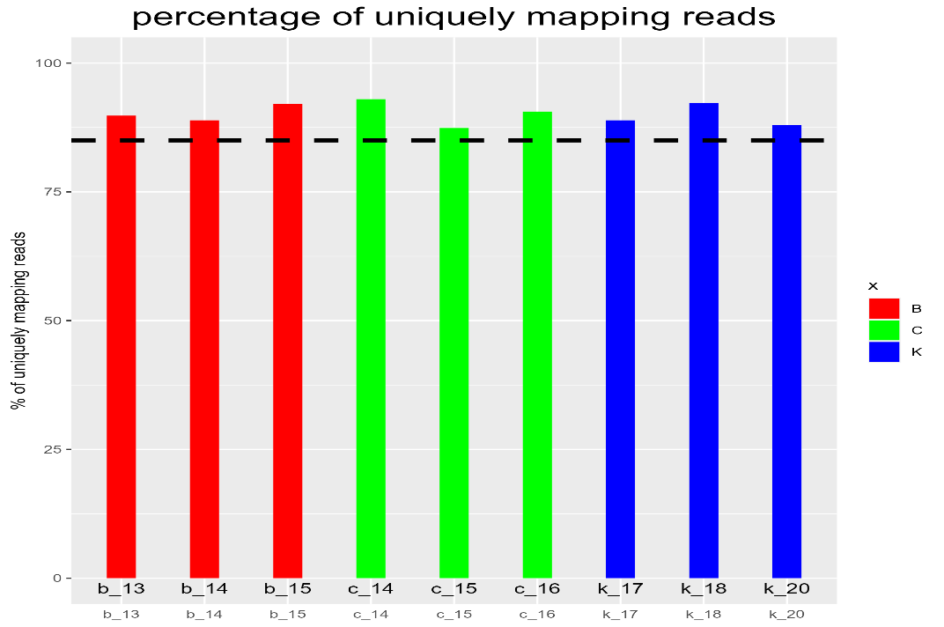
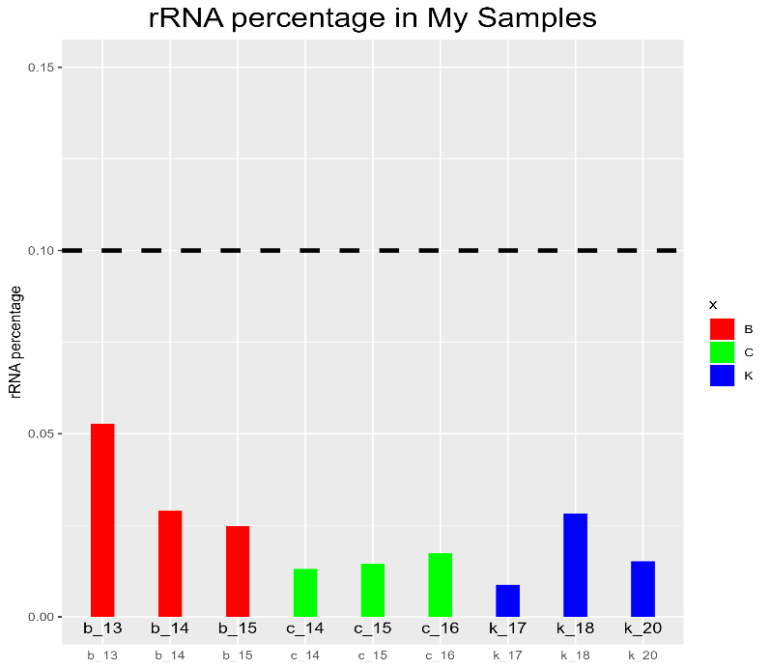
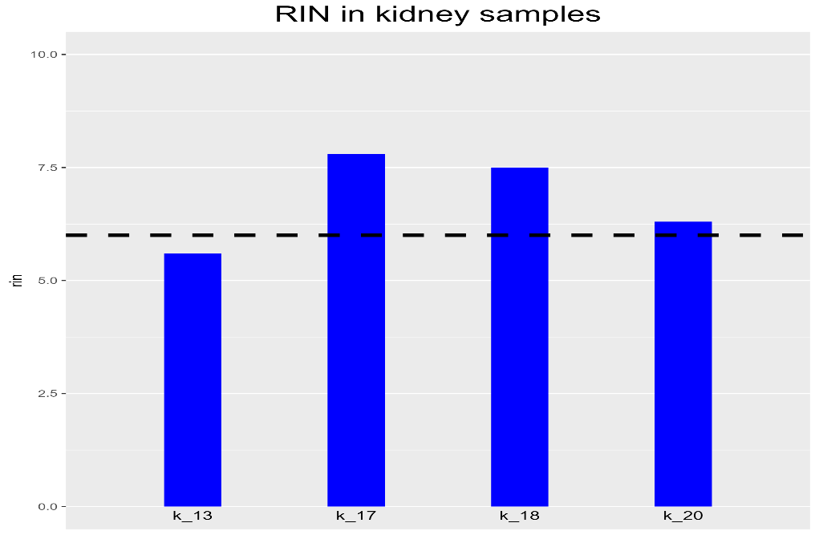
QUALITY CONTROL

Slide 3
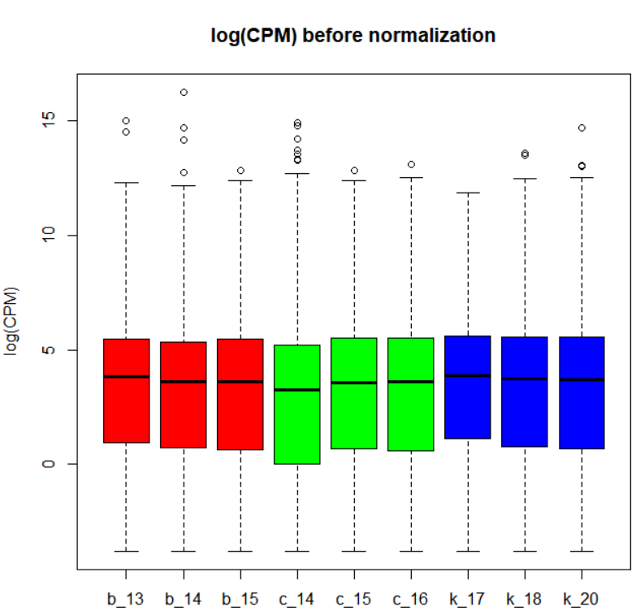
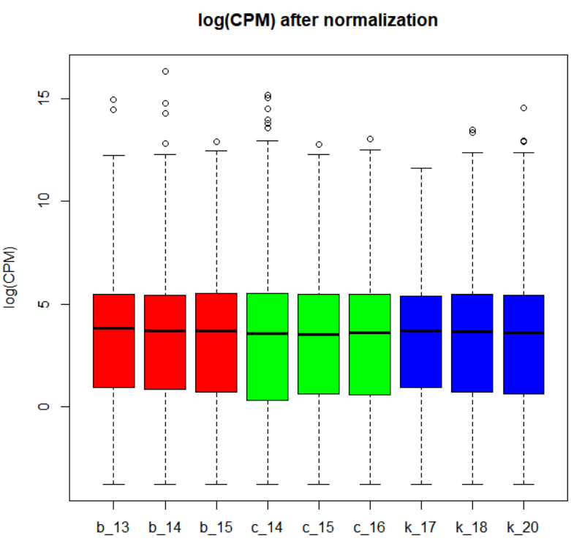
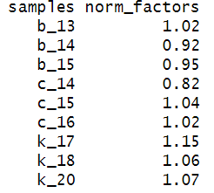
NORMALIZATION

Slide 4
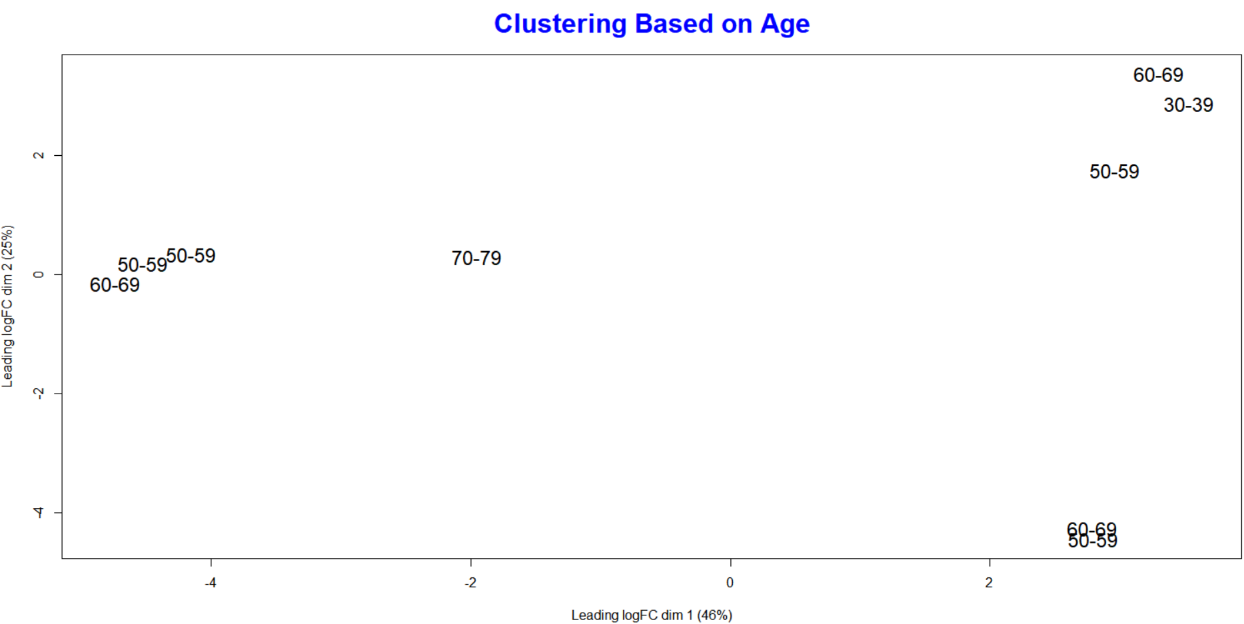
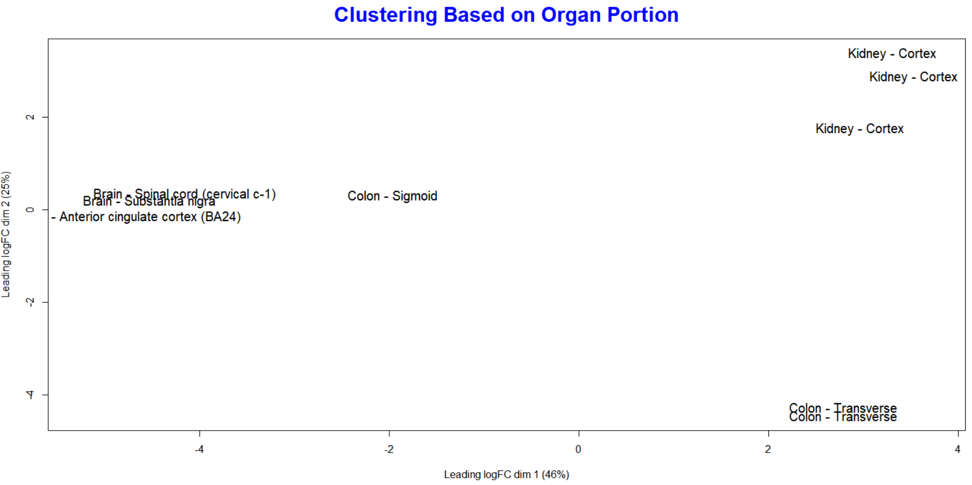
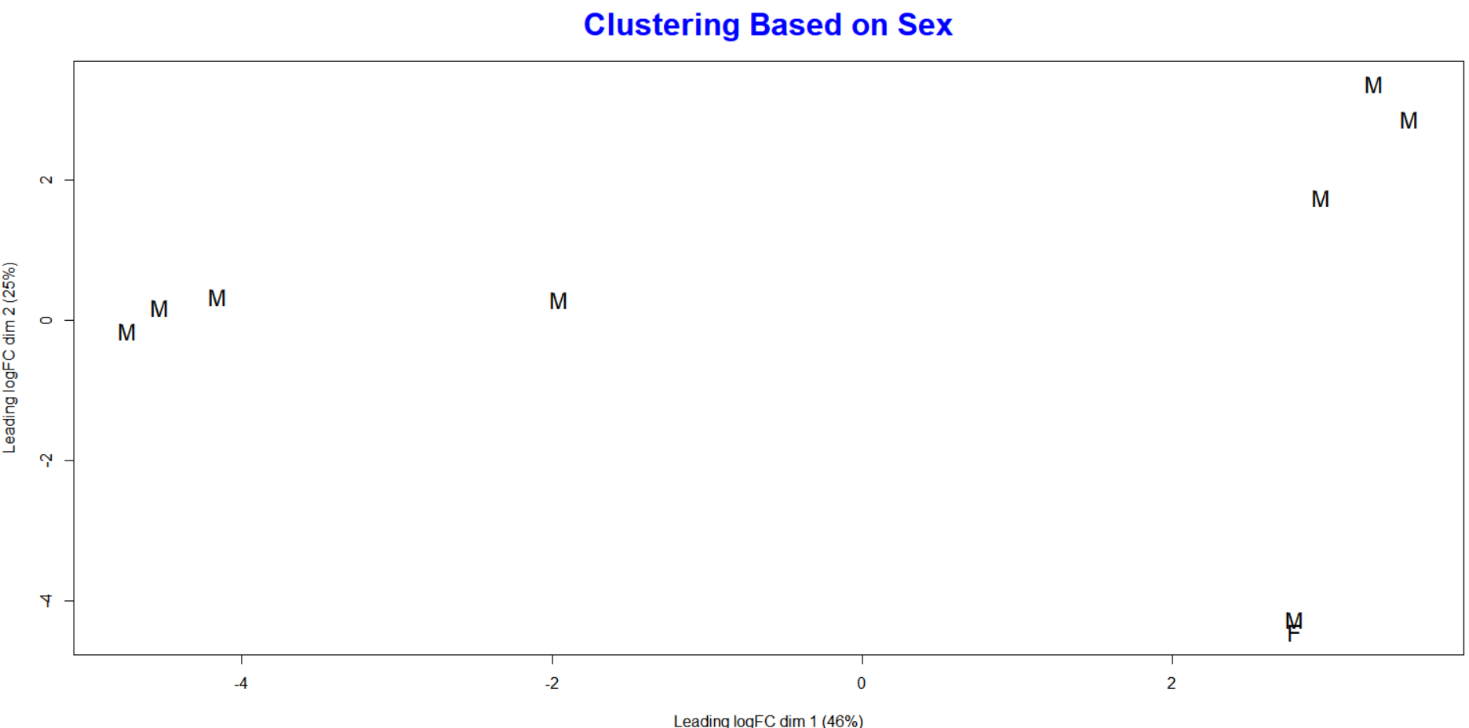
SAMPLES CLUSTERING

Slide 5
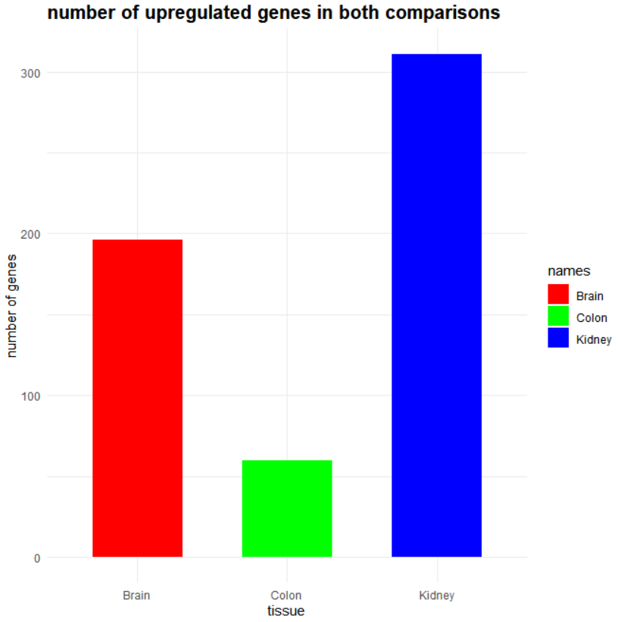
DE genes in my samples
Comparison | FDR | lfc | upregulated | downregulated
Colon vs brain | 0.01 | 0 | 265 | 669
Kidney vs brain | 0.0075 | 0 | 562 | 763
Kidney vs colon | 0.05 | 0 | 919 | 428

Slide 6
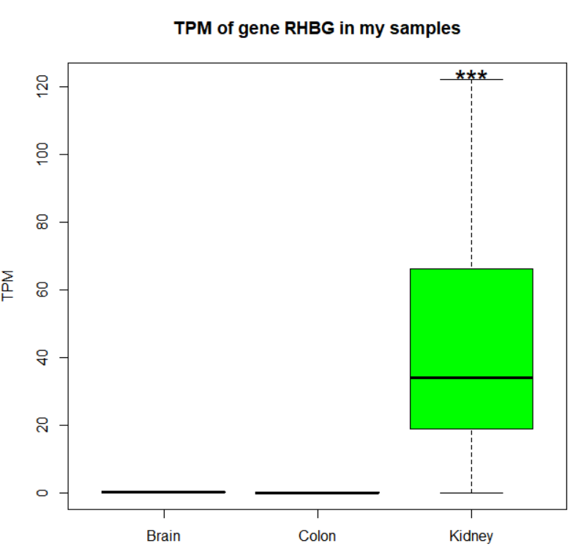
ANALYSIS OF GENE RHBG (kidney biomarker)

Slide 7
GENE MARKERS IN MY SAMPLES
Gene OLIG1 in brain:
Specific oligodentrocytes TF
It is required for late embryonic development of oligodendrocytes
Gene RHBG in kidney:
Ammonium transporter that takes part in the maintenance of acid-base homeostasis
transports ammonium and its related derivative methylammonium across the basolateral plasma membrane of epithelial cells likely contributing to renal transepithelial ammonia transport and ammonia metabolism
Gene GALNT12:
It catalyzes the first reaction in the biosynthesis of mucyne, which is a glycoproteine with protective function of the intestinal epitelium
Its expression is downregulated in colon cancer
Mutations in GALNT12 have been found in individuals and families with a history of colorectal polyps and colorectal cancer

Slide 8
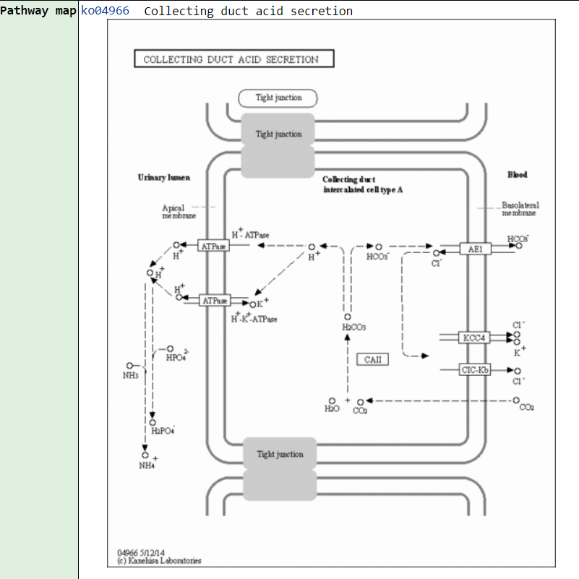
FUNCTIONAL ENRICHMENT ANALYSIS
SAMPLE | TYPE OF ONTOLOGY | NAME OF ONTOLOGY | TERM | Adj P value
BRAIN | Pathways | Reactome 2022 | Trasmission across chemical synapsys | 4.29e-07
BRAIN | Ontologies | GO Cellular Component 2023 | Postsynaptic Density | 4.119e-7
KIDNEY | Pathways | KEGG 2021 Human | Collecting duct acid secretion | 0.00048
KIDNEY | Ontologies | Human Phenotype Ontology | Nephrocalcinosis | 1.920e-9
COLON | Pathways | Human Cyc 2016 | phospholipases | 0.02902
COLON | Ontologies | GO Biological Process 2023 | cGMP-mediated Signaling | 0.00850

Slide 9
BIBLIOGRAPHY
Lorca V, Rueda D, Martín-Morales L, Poves C, Fernández-Aceñero MJ, Ruiz-Ponte C, et al. (2017) Role of GALNT12 in the genetic predisposition to attenuated adenomatous polyposis syndrome. PLoS ONE 12(11): e0187312. https://doi.org/10.1371/journal.pone.0187312
Evans DR, Venkitachalam S, Revoredo L, Dohey AT, Clarke E, Pennell JJ, Powell AE, Quinn E, Ravi L, Gerken TA, Green JS, Woods MO, Guda K. Evidence for GALNT12 as a moderate penetrance gene for colorectal cancer. Hum Mutat. 2018 Aug;39(8):1092-1101. doi: 10.1002/humu.23549.
Gary A. Piazza, Xi Chen, Antonio Ward, Alex Coley, Gang Zhou, Donald J. Buchsbaum, Yulia Maxuitenko, Adam B. Keeton.Targeting cGMP/PKG signaling for the treatment or prevention of colorectal cancer with novel sulindac derivatives lacking cyclooxygenase inhibitory activity.Oncology Signaling,Volume 3,2020,Pages 1-6,SSN 2542-5633,https://doi.org/10.1016/j.onsig.2020.04.001.
Guo, Jian-Ming, Zhang, Yan, Cheng, Lamei, Iwasaki, Hiroko, Wang, Han, Kubota, Tomomi, Tachibana, Kouichi and Narimatsu, Hisashi(2002), Molecular cloning and characterization of a novel member of the UDP-GalNAc:polypeptide N-acetylgalactosaminyltransferase family, pp-GalNAc-T12¹ , FEBS Letters, 524, doi: 10.1016/S0014-5793(02)03007-7
Nakhoul NL, Abdulnour-Nakhoul SM, Boulpaep EL, Rabon E, Schmidt E, Hamm LL. Substrate specificity of Rhbg: ammonium and methyl ammonium transport. Am J Physiol Cell Physiol. 2010 Sep;299(3):C695-705. doi: 10.1152/ajpcell.00019.2010. Epub 2010 Jun 30. PMID: 20592240; PMCID: PMC2944323
Gong X, Lin T, Sun Z, Fu M, Zuo H, Xie Z. Olig1 is downregulated in oligodendrocyte progenitor cell differentiation. Neuroreport. 2008 Aug 6;19(12):1203-7. doi: 10.1097/WNR.0b013e328308b322. PMID: 18628665

Slide 10
Behind the heterogeneity of colon
I decide to perform the analysis considering only colon samples, grouped according to organ portion taken for the analysis. DE genes were checked in human protein atlas to know in which cell types where expressed.
Sample | Type of ontology | Name of ontology | Term | Adj P-value
Sigmoid | Ontologies | GO Biological process | Central Nervous System Myelination | 0.001252
Sigmoid | Pathways | BioPlanet2019 | BDNF signaling pathway | 6.753e-10
Traverse | Pathways | KEGG 2021 Human | Protein digestion and absorption | 0.00003039
Traverse | Ontologies | MGI mammalian Phenotype | abnormal intestine physiology | 0.000002040
Upregulated gene in traverse colon
Upregulated gene in sigmoid colon
Marker gene | Function | Cell type
GCNT3 | Mucine biosynthesis | Colon enterocyte
FUT3 | Glycoprotein biosynthesis | Colon enterocyte
HMGCS2 | Lipid Metabolism | Colon enterocyte
Marker gene | Function | Cell type
NRXN1 | Synaptic formation | Enteric glia,astrocytes
KCNN3 | Potassium channel | Smooth muscle,enteric glia
NRXN1 | Synaptic development | Enteric glia, oligodendrocyte

Slide 11
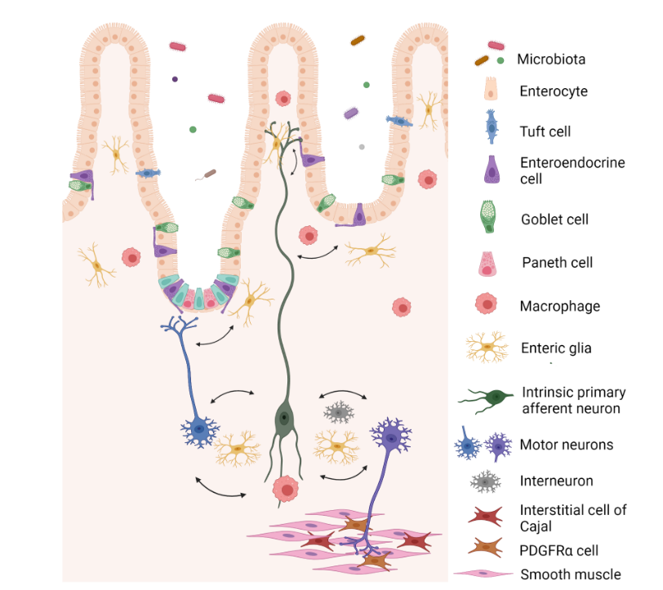
NEURON LIKE CELLS in the intestin
Enteric nervous system (it is estimated to have more neurons than the spinal cord)
It consists of cells located at varying intervals along the digestive tract
There are different types of neurons in the enteric nervous system:
Cholinergic neurons intestinal motility stimulus
Adrenergic neurons intestinal motility inhibition
Serotonergic neurons modulation of cholinergic/adrenergic neurons
Purinergic neurons intestinal smooth muscle inhibition
Paracrine endocrine system (series of cells that release hormons in the digestive tract)
At colon level,EC1 cells release serotonin as a modulator of intestinal peristalsis
Spencer, N.J., Hu, H. Enteric nervous system: sensory transduction, neural circuits and gastrointestinal motility. Nat Rev Gastroenterol Hepatol 17, 338–351 (2020). https://doi.org/10.1038/s41575-020-0271-2
Istologia di Monesi (settima edizione)

