Slide 1

Genomics of Gene Regulation: Concepts and Techniques
Ana Azambuja
Senior Research Associate
Pathology Department - Boston Children’s Hospital

Slide 2
Genomics of Gene Regulation: Concepts and Techniques
Chromatin Conformation
Enhancer activation
Ana Azambuja
Senior Research Associate
Pathology Department - Boston Children’s Hospital

Slide 3

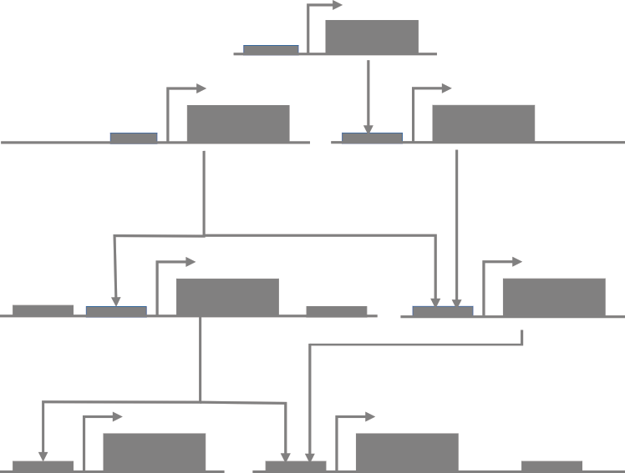
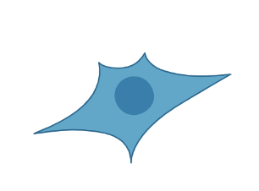
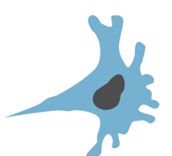
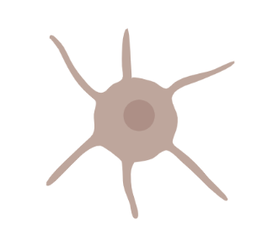
Cellular transitions are controlled by GENE REGULATORY NETWORKS

Slide 4
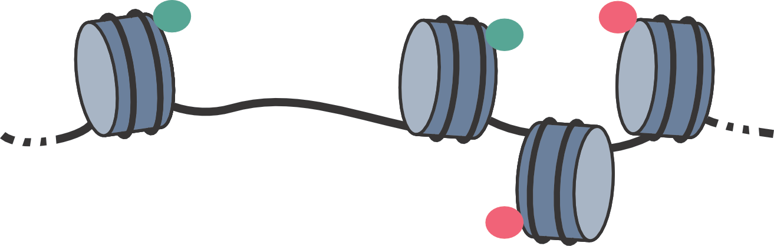
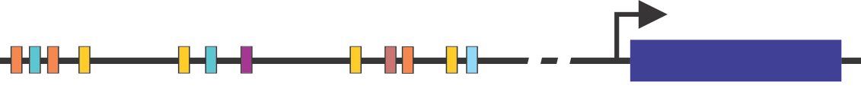
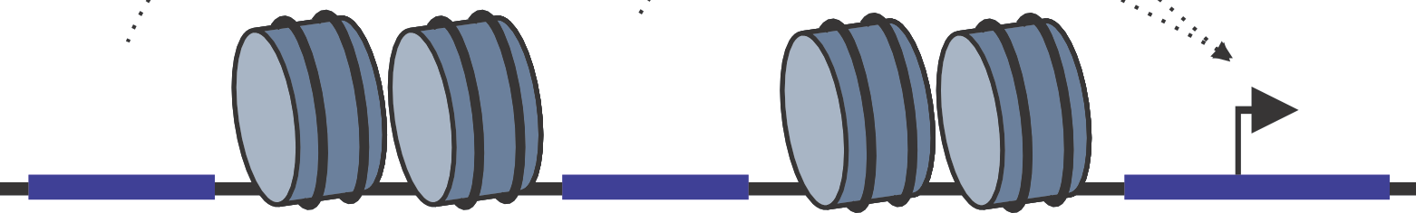
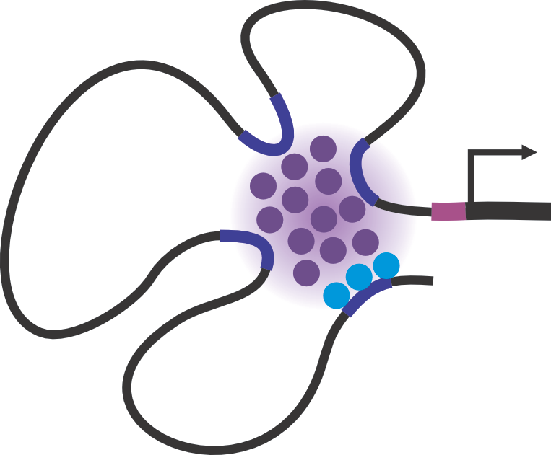
Cis-regulatory features and how to identify them
DNase-seq
DNase I hypersensitive sites sequencing
ATACseq
Assay for Transposase-Accessible Chromatin
DNA accessibility and active histone marks
ChIPseq
Chromatin Immunoprecipitation
CUT&RUN
Cleavage Under Targets & Release Using Nuclease
Tissue specific transcription factor binding
PROseq / GROseq
“nascent” RNA sequencing
Poll II
Enhancer activation and transcription
HiC
map chromatin contacts genome-wide
Enhancer-promoter interaction

Slide 5
Cellular transitions are controlled by GENE REGULATORY NETWORKS

Slide 6
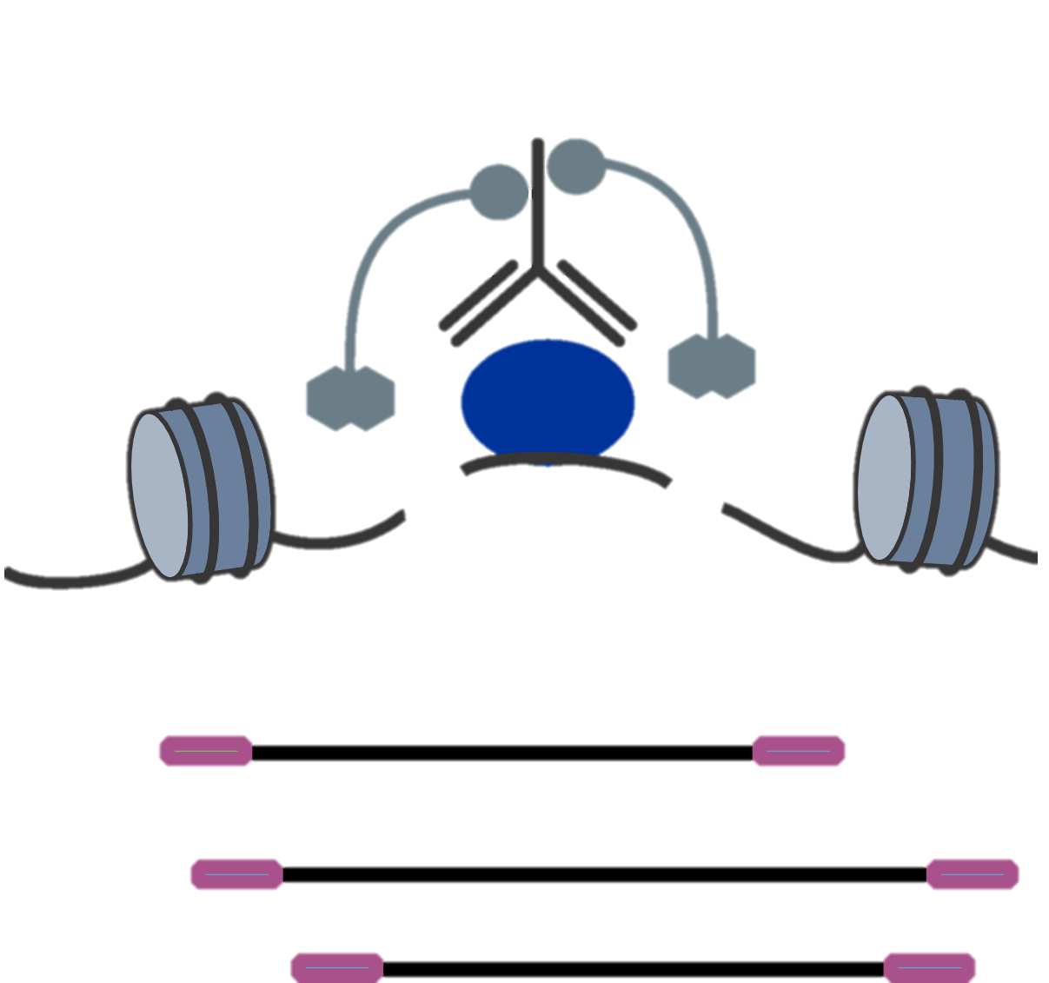
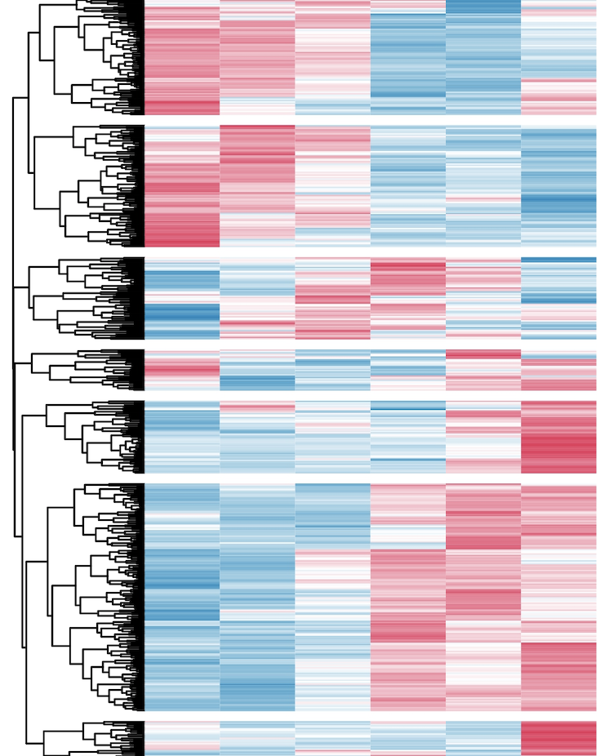
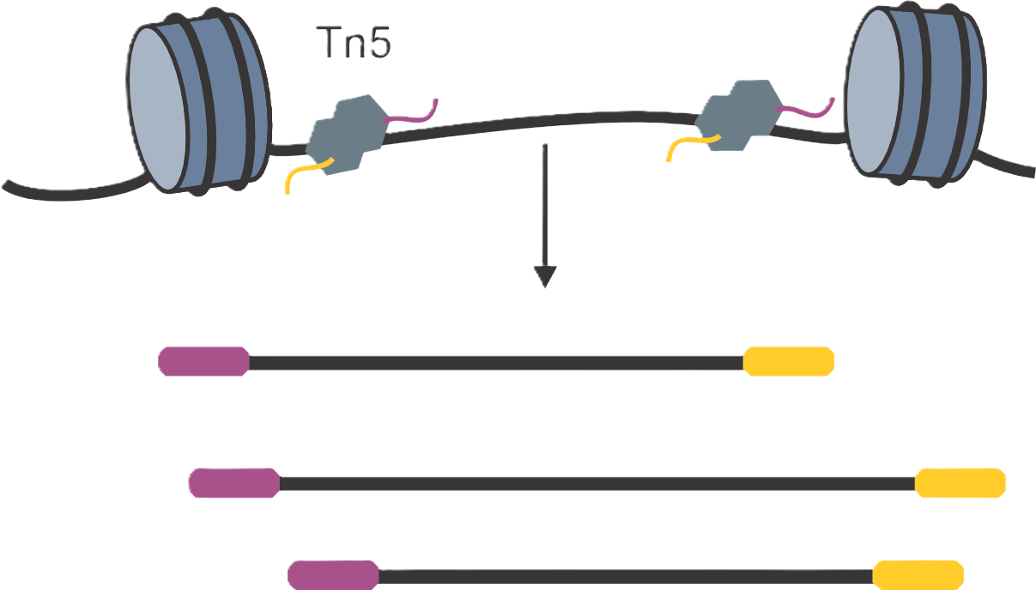
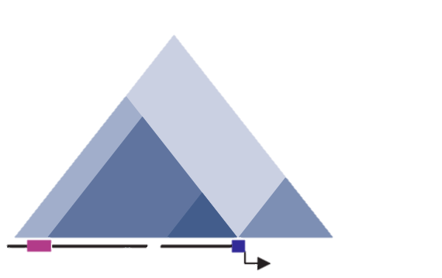
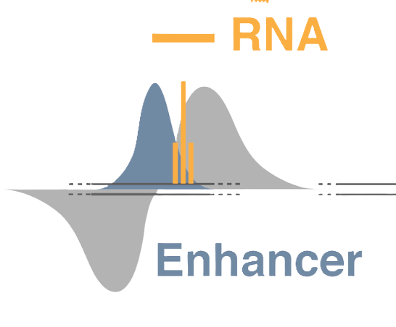
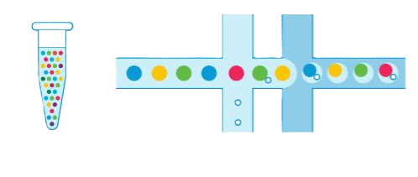
Topics to be covered - Techniques
GENE EXPRESSION
EPIGENOMIC REGULATION
DNA-PROTEIN BINDING
RNAseq
ATACseq
ChIPseq CUT&RUN CUT&TAG
Spatial transcriptomics
GENOME ORGANIZATION
ENHANCER ACTIVITY
SINGLE-CELL TECHNOLOGIES
3D genome organization - HiC
eRNA mapping
Transcriptomics / Multiome

Slide 7
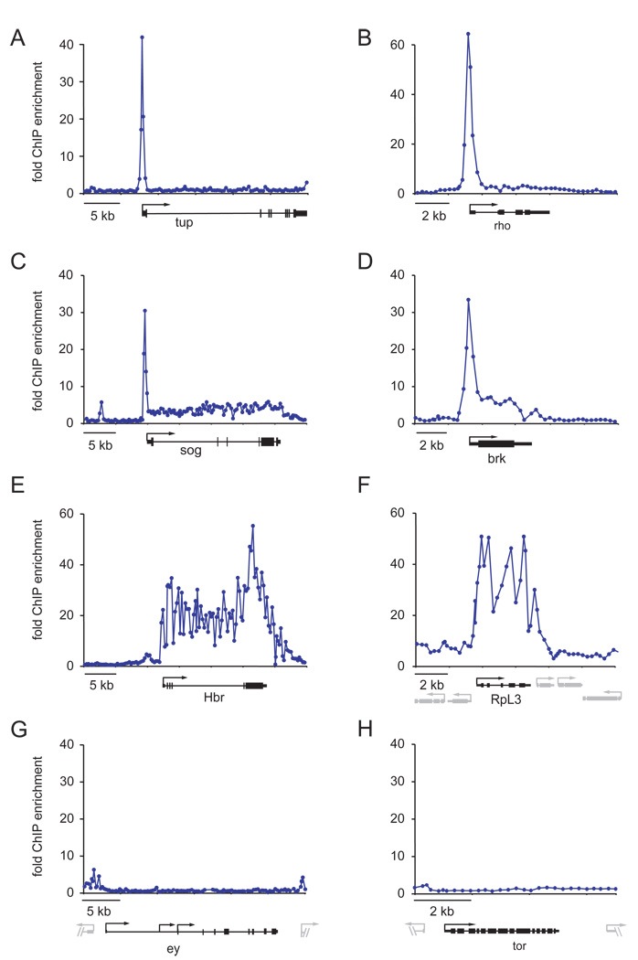
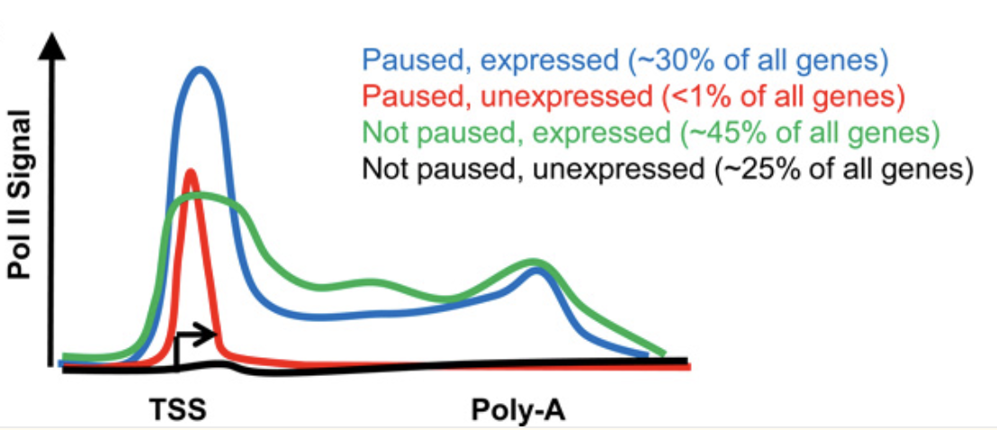
Mapping active transcription
Active
Non-active
Paused
Zeitlinger, et al. 2007. Nat Gen.
For review: Adelman, Lis. 2012. Nat Rev Genet.
Notes:
Recent years have witnessed a sea change in our understanding of transcription regulation: whereas traditional models focused solely on the events that brought RNA polymerase II (Pol II) to a gene promoter to initiate RNA synthesis, emerging evidence points to the pausing of Pol II during early elongation as a widespread regulatory mechanism in higher eukaryotes. Current data indicate that pausing is particularly enriched at genes in signal-responsive pathways. Here the evidence for pausing of Pol II from recent high-throughput studies will be discussed, as well as the potential interconnected functions of promoter-proximally paused Pol II.

Slide 8
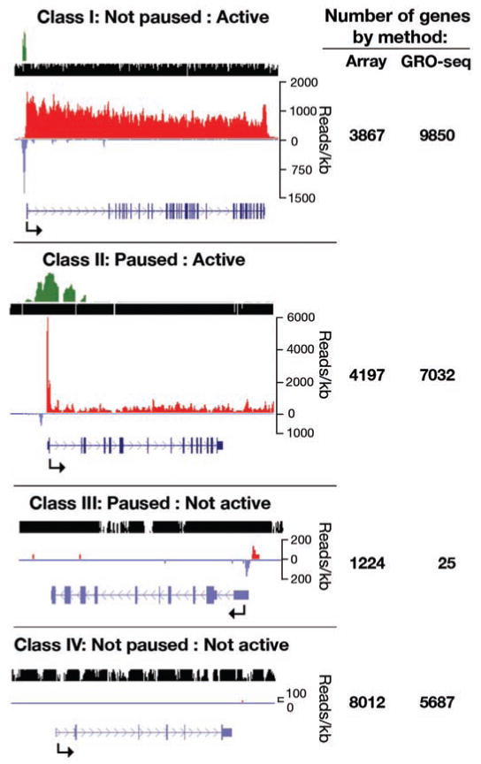
Mapping active transcription
Nascent RNA sequencing (run-on assays)
Active
Non-active
Paused
Zeitlinger, et al. 2007. Nat Gen.
For review: Adelman, Lis. 2012. Nat Rev Genet.
Notes:
Recent years have witnessed a sea change in our understanding of transcription regulation: whereas traditional models focused solely on the events that brought RNA polymerase II (Pol II) to a gene promoter to initiate RNA synthesis, emerging evidence points to the pausing of Pol II during early elongation as a widespread regulatory mechanism in higher eukaryotes. Current data indicate that pausing is particularly enriched at genes in signal-responsive pathways. Here the evidence for pausing of Pol II from recent high-throughput studies will be discussed, as well as the potential interconnected functions of promoter-proximally paused Pol II.

Slide 9
Mapping active transcription and unstable RNA GRO-seq - global run-on sequencing
Pros:
Maps position of transcriptionally engaged RNA polymerases
Determines relative activity of transcription sites
Detects transcription anywhere on the genome
No prior knowledge of transcription sites is needed
Cons:
Limited to cell cultures and other artificial systems, due to the requirement for incubation in the presence of labeled nucleotides
Resolution is only 30–100 nt
Illumina
Core, Waterfall, Lis. 2008. Science
Notes:
Recent years have witnessed a sea change in our understanding of transcription regulation: whereas traditional models focused solely on the events that brought RNA polymerase II (Pol II) to a gene promoter to initiate RNA synthesis, emerging evidence points to the pausing of Pol II during early elongation as a widespread regulatory mechanism in higher eukaryotes. Current data indicate that pausing is particularly enriched at genes in signal-responsive pathways. Here the evidence for pausing of Pol II from recent high-throughput studies will be discussed, as well as the potential interconnected functions of promoter-proximally paused Pol II.

Slide 10
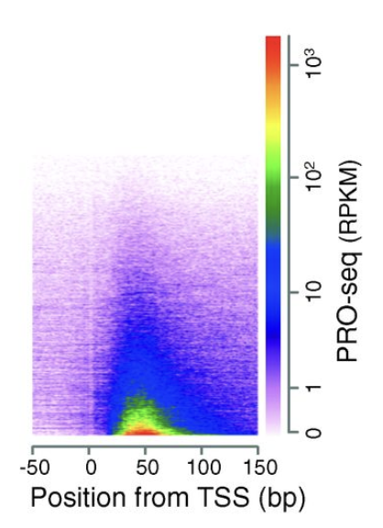
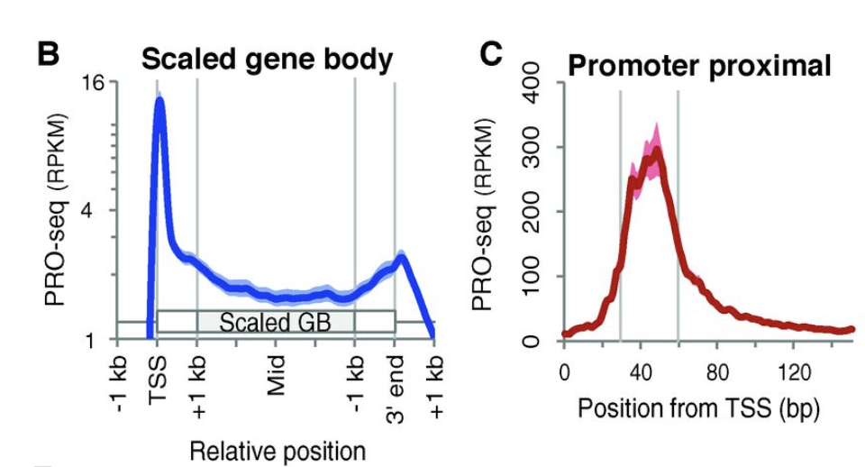
Mapping active transcription PRO-Seq - Precision nuclear run-on sequencing
Illumina Kawak, et al. 2013. Science Mahat, et al. 2016. Nat Prot

Slide 11
Mapping active transcription PRO-Seq - Precision nuclear run-on sequencing
Single nucleotide resolution of engaged and active RNAP across the genome
Analysis of polymerase pausing and productive elongation
Sensitive measurement of differential gene expression
Identification of enhancers
Illumina Kawak, et al. 2013. Science Mahat, et al. 2016. Nat Prot

Slide 12
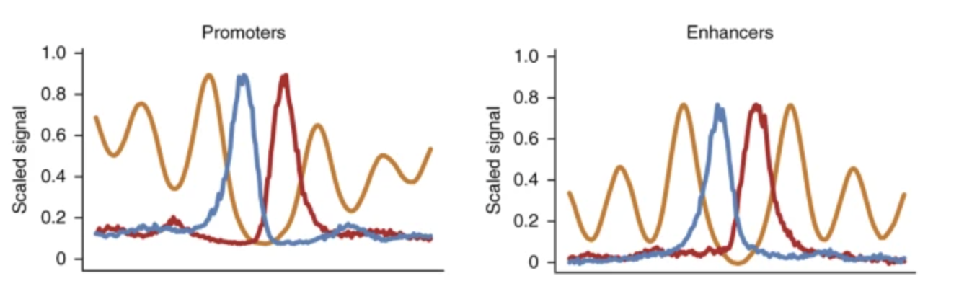
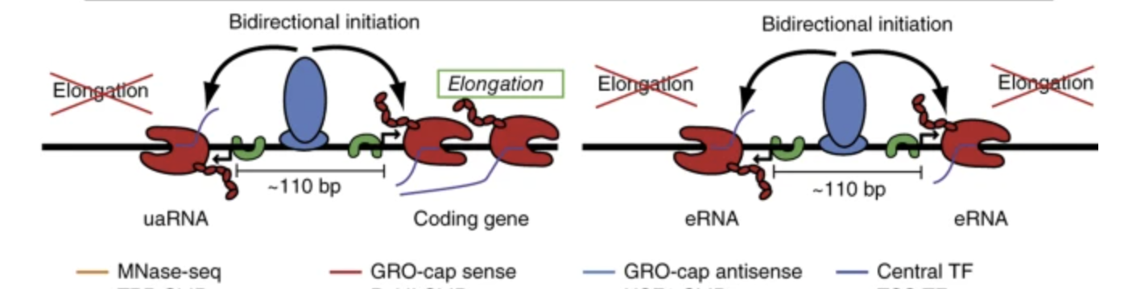
Mapping active transcription Promoters and enhancers share similar transcription initiation mechanisms
Core, et al. 2014. Nat Gen
Notes:
established that promoters and enhancers share remarkably similar transcription initiation mechanisms.

Slide 13
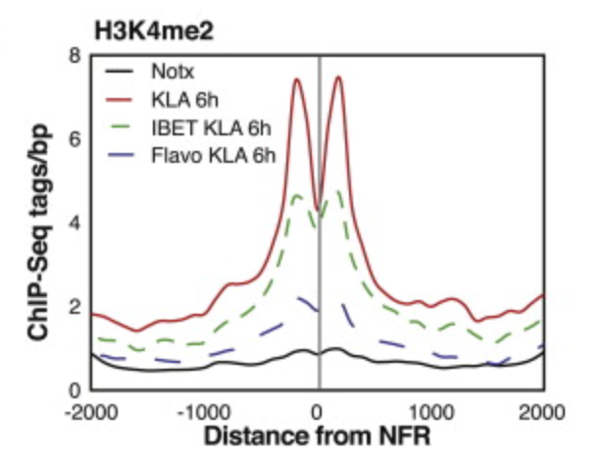
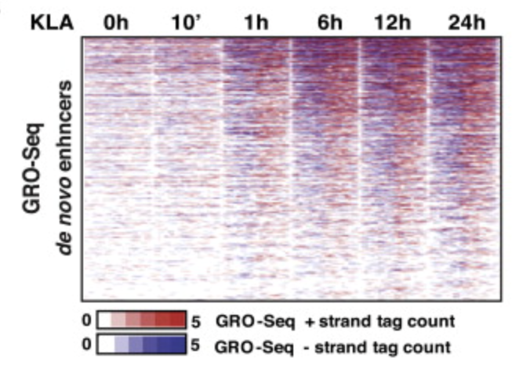
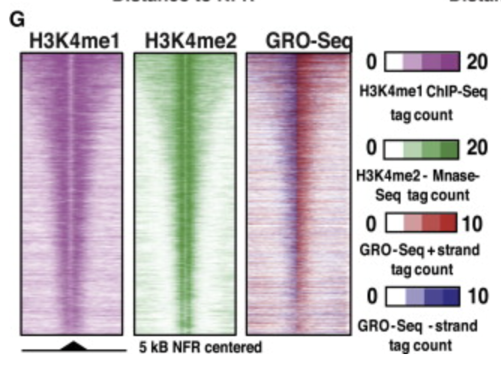
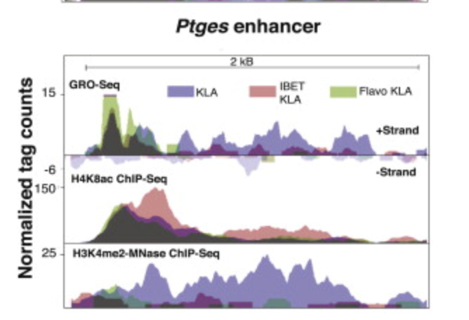
Mapping active transcription Promoters and enhancers share similar transcription initiation mechanisms
Kaikkonen , et al. 2013. Mol Cell
Notes:
established that promoters and enhancers share remarkably similar transcription initiation mechanisms.

Slide 14
Cis-regulatory features and how to identify them
DNase-seq
DNase I hypersensitive sites sequencing
ATACseq
Assay for Transposase-Accessible Chromatin
DNA accessibility and active histone marks
ChIPseq
Chromatin Immunoprecipitation
CUT&RUN
Cleavage Under Targets & Release Using Nuclease
Tissue specific transcription factor binding
PROseq / GROseq
“nascent”RNA sequencing
Poll II
Enhancer activation and transcription
HiC
map chromatin contacts genome-wide
Enhancer-promoter interaction

Slide 15
Cellular transitions are controlled by GENE REGULATORY NETWORKS
Genome conformation

Slide 16
Topics to be covered - Techniques
GENE EXPRESSION
EPIGENOMIC REGULATION
DNA-PROTEIN BINDING
RNAseq
ATACseq
ChIPseq CUT&RUN CUT&TAG
Spatial transcriptomics
GENOME ORGANIZATION
ENHANCER ACTIVITY
SINGLE-CELL TECHNOLOGIES
3D genome organization - HiC
eRNA mapping
Transcriptomics / Multiome

Slide 17
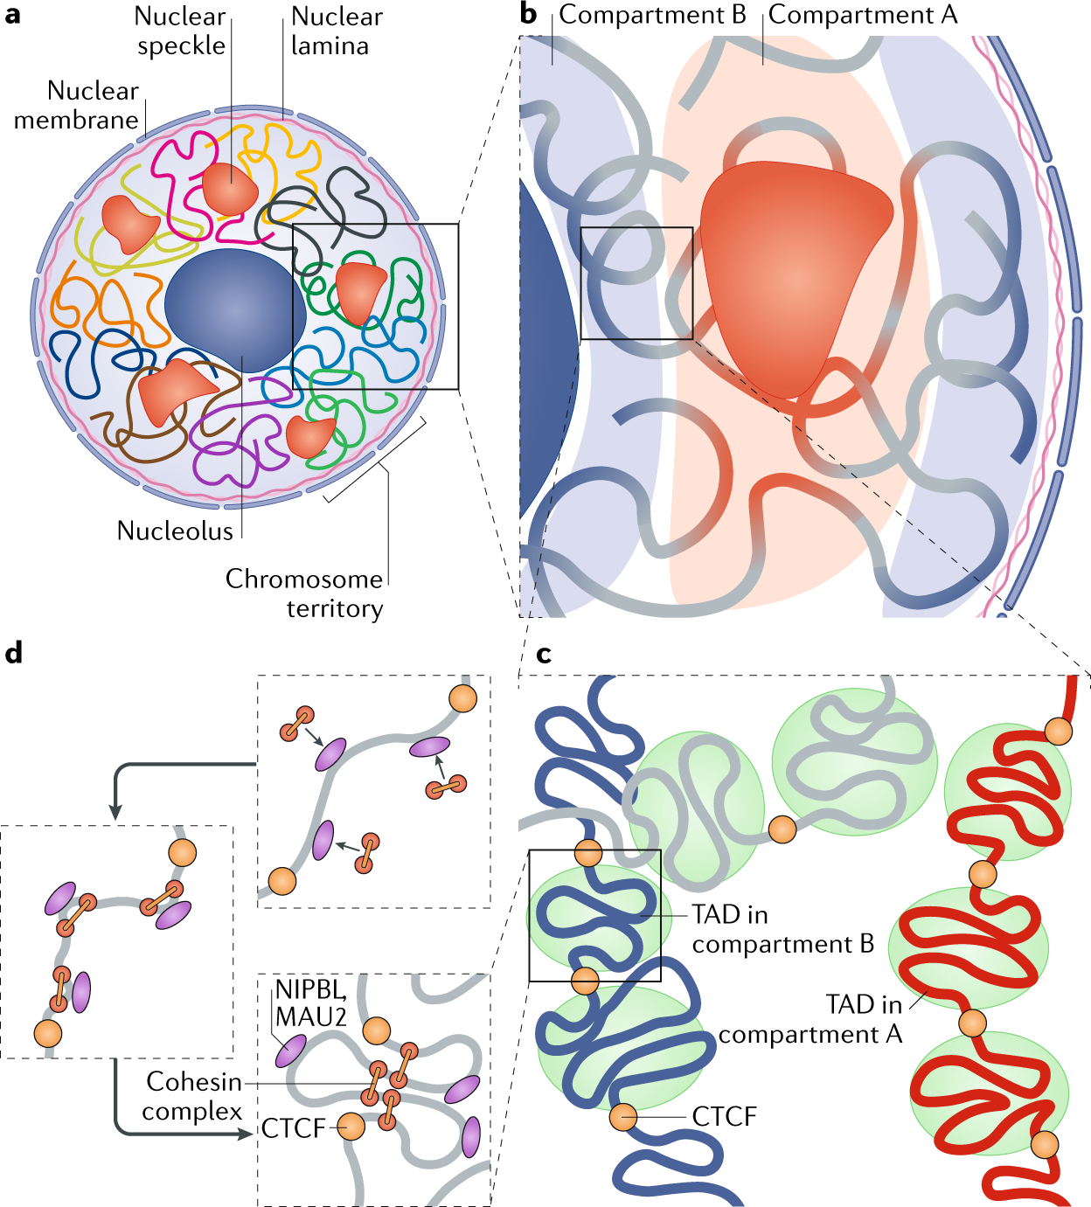
The hierarchical organization of the 3D genome
Zheng and Xie, 2019. Nat Rev

Slide 18
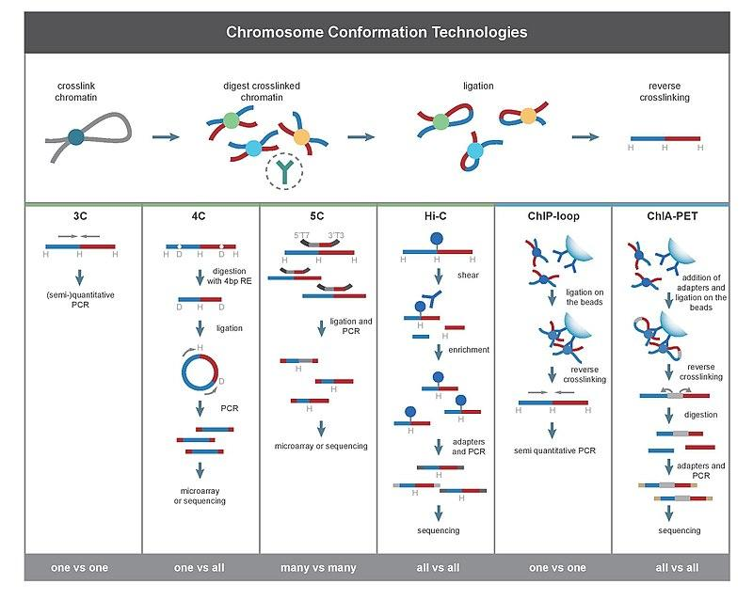
Chromatin Conformation Capture Techniques

Slide 19
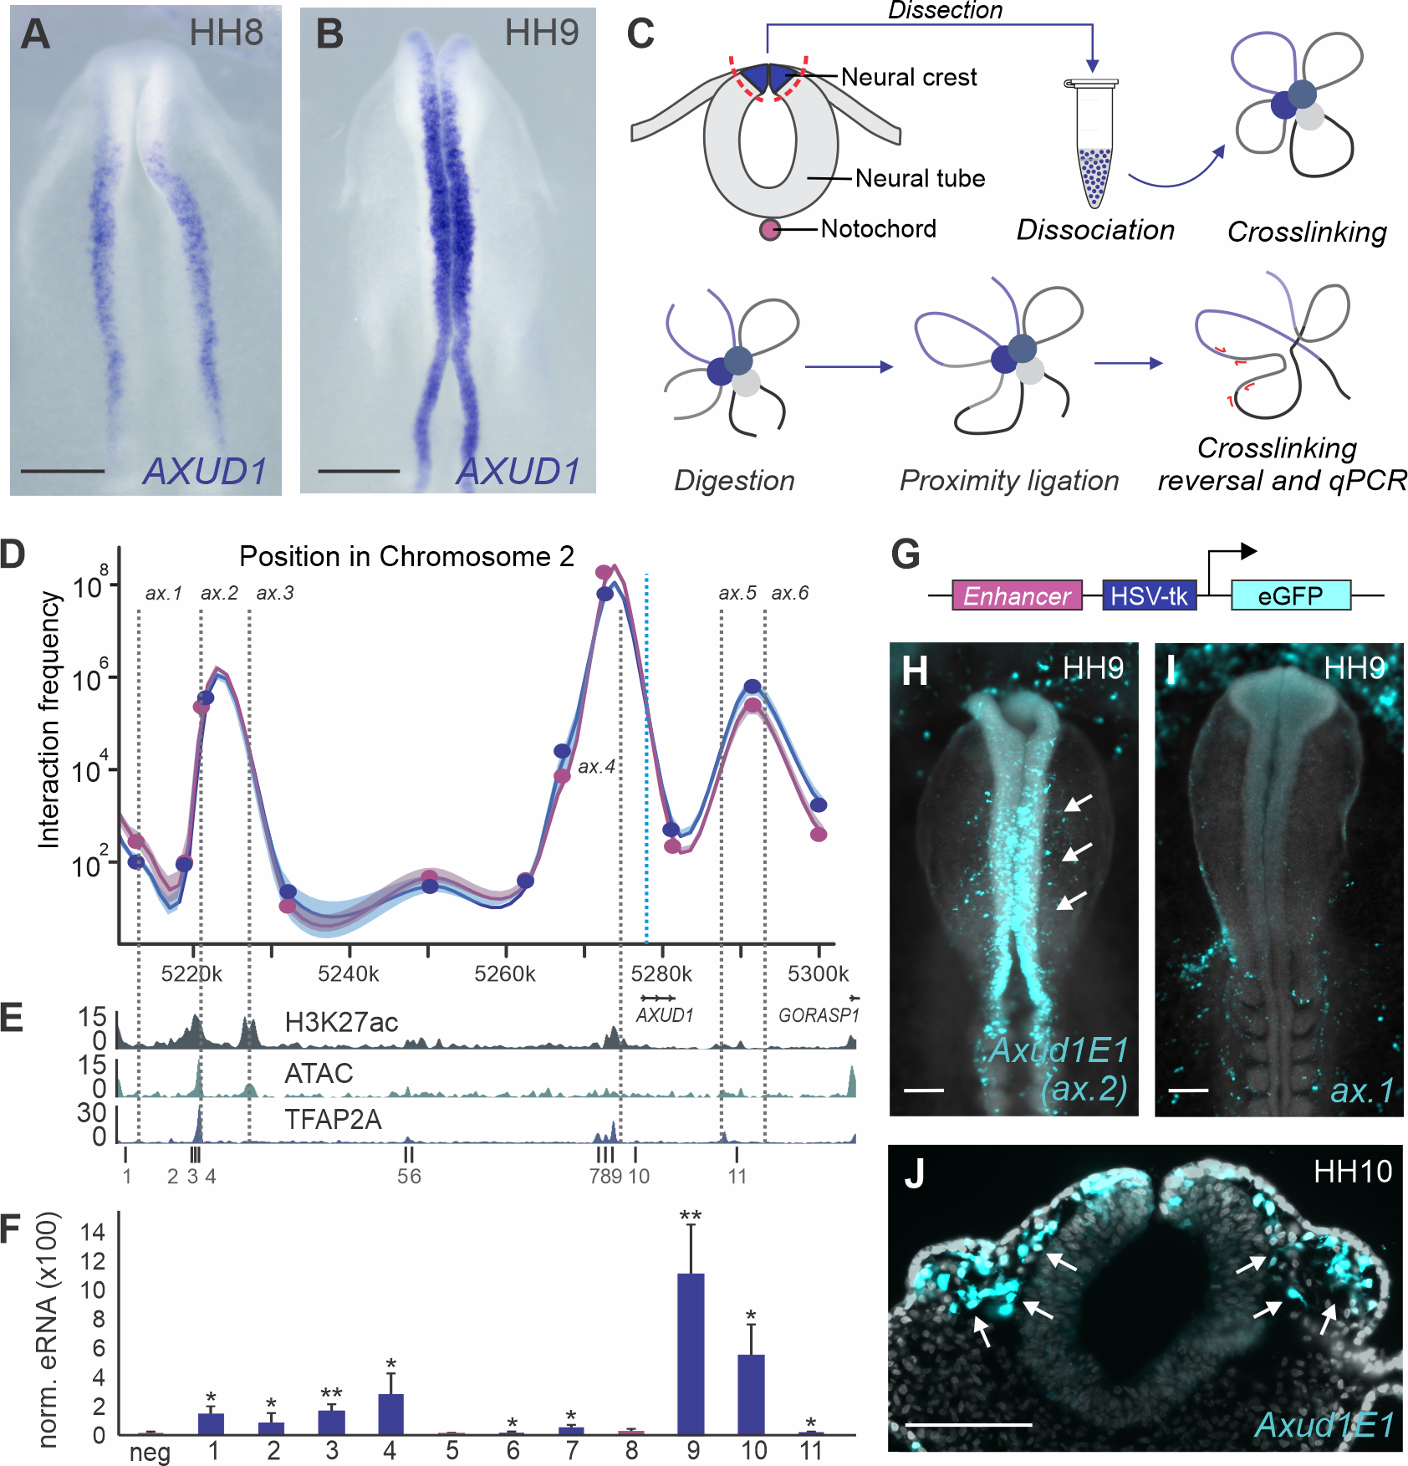
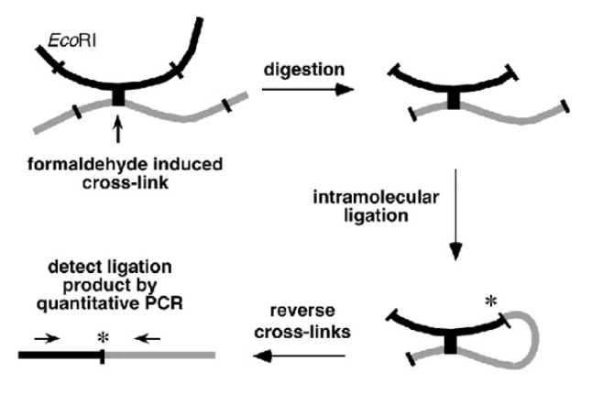
Chromatin Conformation Capture Techniques
Dekker, et al. 2002. Science
Azambuja and Simoes-Costa. 2021. PLOS gen

Slide 20
Chromatin Conformation Capture Techniques

Slide 21
HiCPRO pipeline
Servant, et al. Genome Biology (2015)

Slide 22
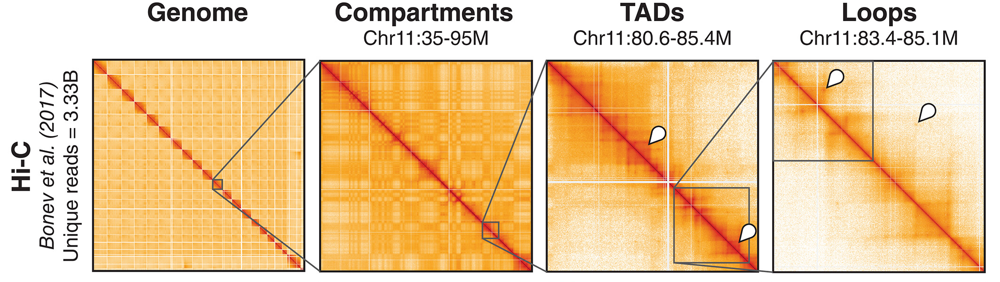
HiC

Slide 23
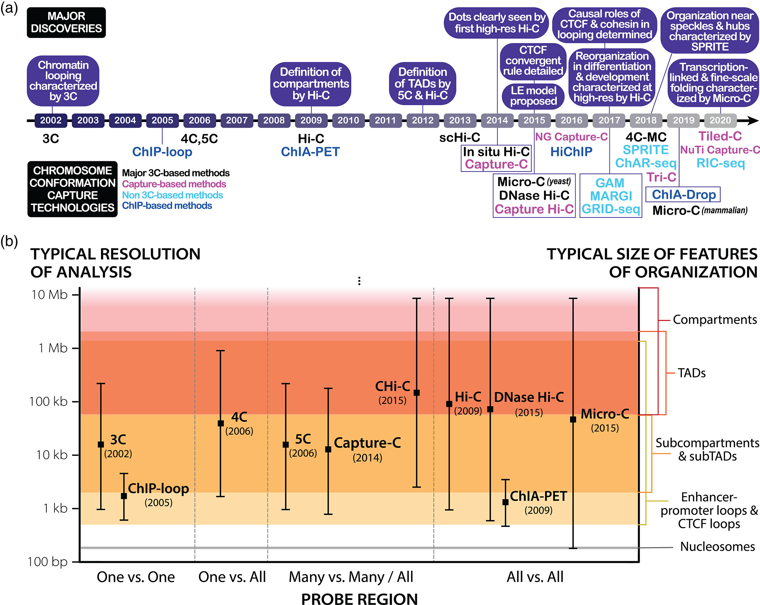
Chromatin Conformation Capture Techniques
Goel and Hansen. 2020. WIRE Dev Bio

Slide 24
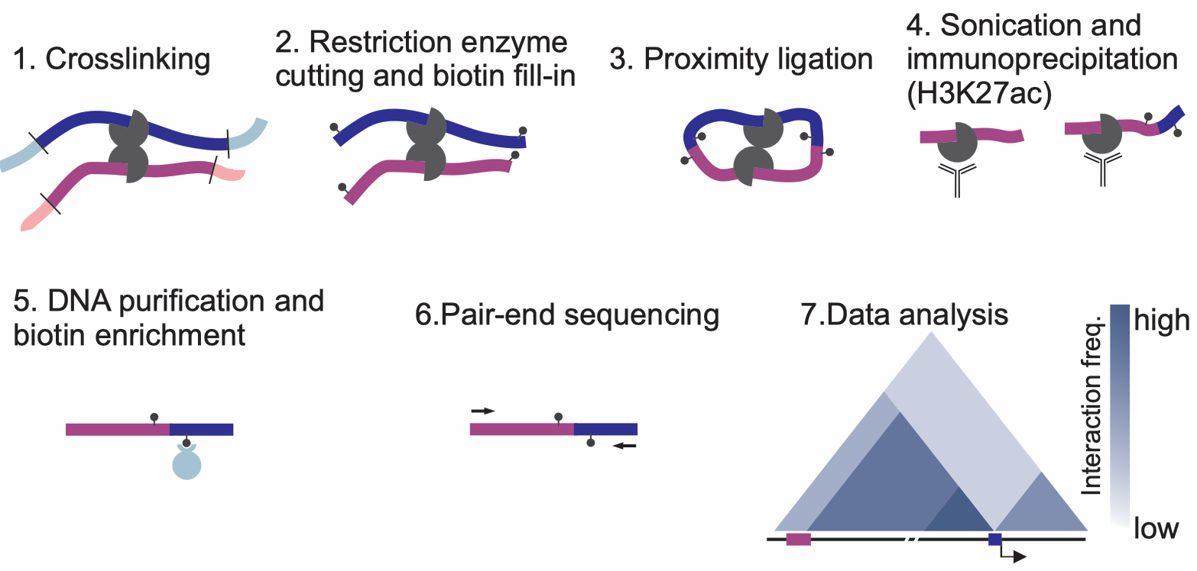
HiChip overview
Mumbach, et al. Nature Methods (2016)

Slide 25
HiCPRO pipeline
Servant, et al. Genome Biology (2015)

Slide 26
HiCPRO QC

Slide 27
HiCPRO QC

Slide 28
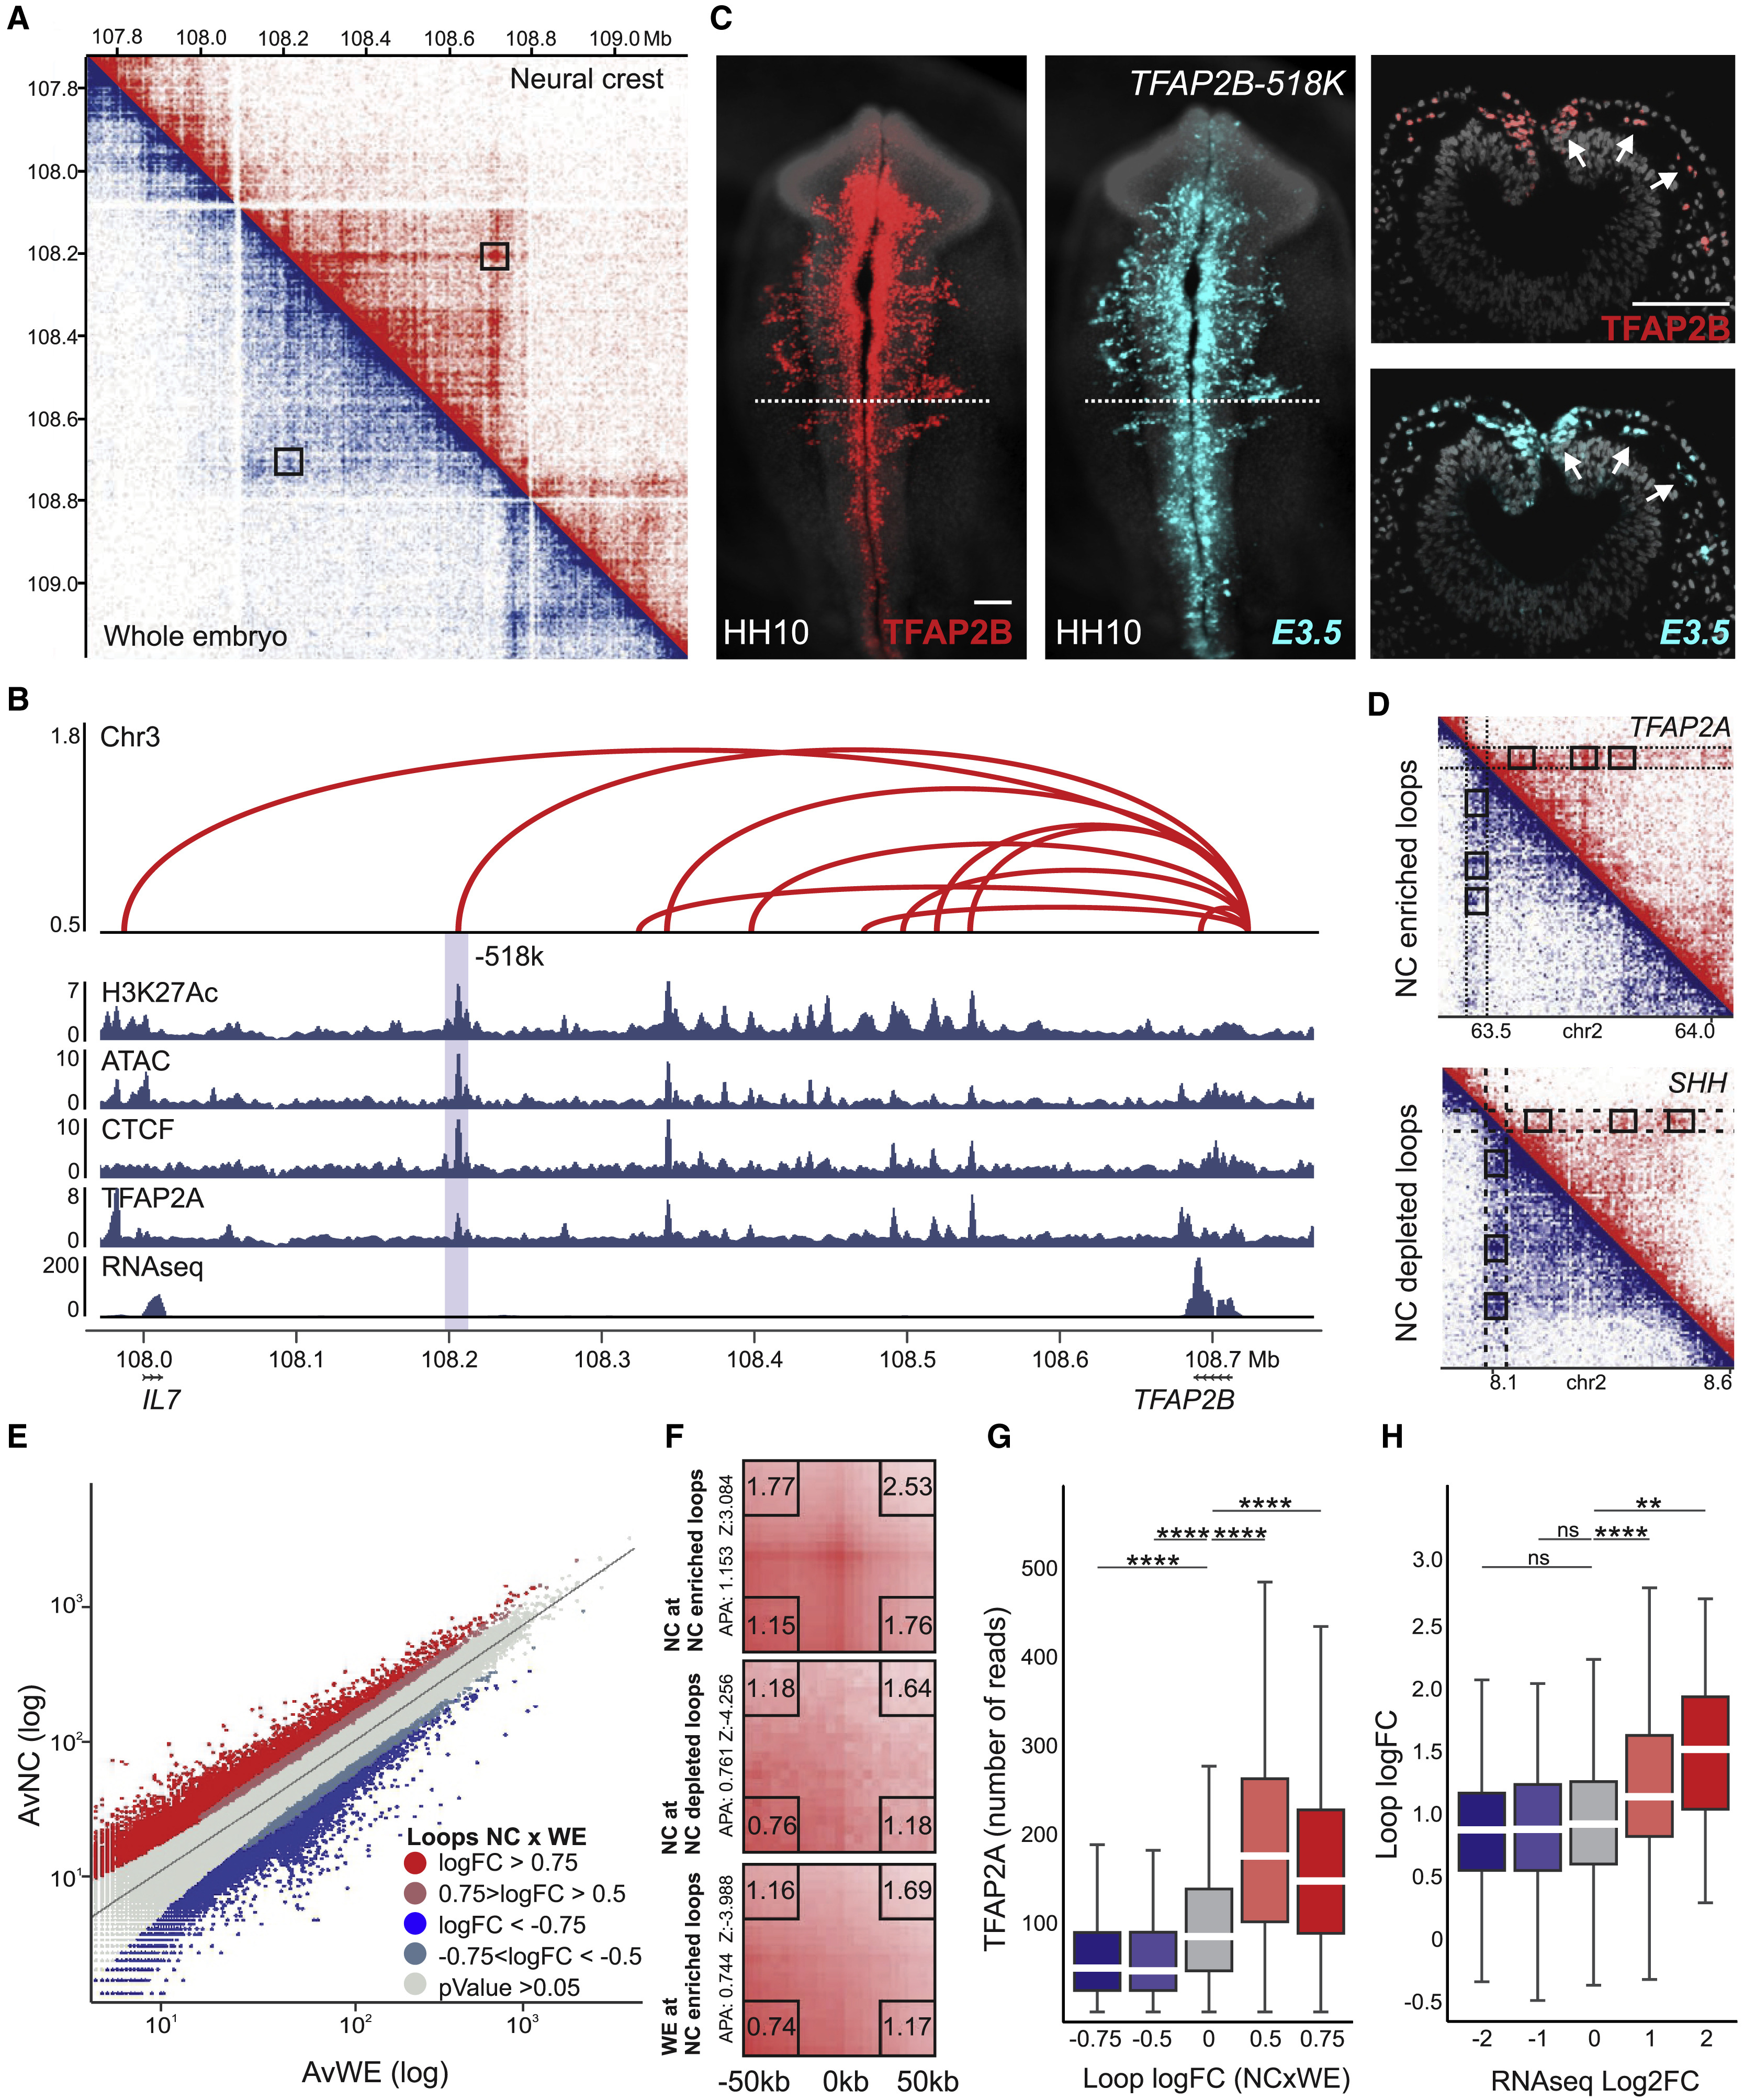
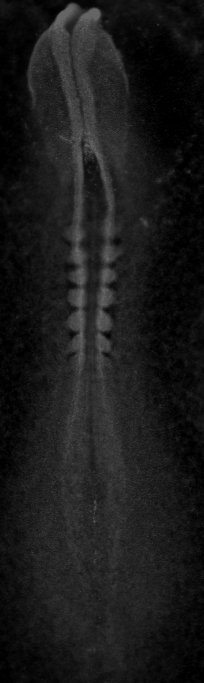
Mapping of tissue-specific enhancer-promoter contacts
Azambuja and Simoes-Costa, 2021. Dev Cell

Slide 29
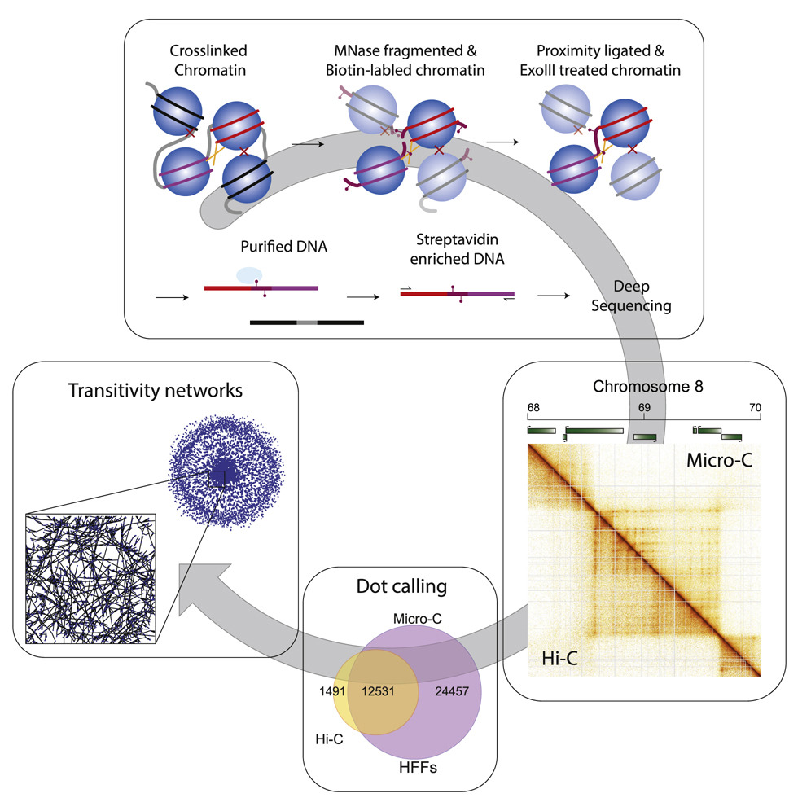
Ultrastructural Details of Chromosome Architecture
MicroC
Krietenstein, 2020. Mol Cell

Slide 30
Ultrastructural Details of Chromosome Architecture
MicroC
H3K27ac - HiChIP
Micro-C

Slide 31
Topics covered - Techniques
GENE EXPRESSION
EPIGENOMIC REGULATION
DNA-PROTEIN BINDING
RNAseq
ATACseq
ChIPseq CUT&RUN CUT&TAG
Spatial transcriptomics
GENOME ORGANIZATION
ENHANCER ACTIVITY
SINGLE-CELL TECHNOLOGIES
3D genome organization - HiC
eRNA mapping
Transcriptomics / Multiome

