Slide 1
Circuit Model for a microring modulator
Simon Bélanger-de Villers
2020

Slide 2
Notes and future works
Vary the ring radius in order to find the optimal value;
Instead of using the analytical model, use the TMM model;
Use the time domain model by B.E. Little for simple yet more accurate time domain/ large signal analysis;

Slide 3

Circuit model of a MRM
Waveguide cross section
h
sh
w
Input parameters (scalars)
R : Ring radius [µm];
w : Waveguide’s ridge width [nm];
h : Waveguide’s ridge thickness [nm];
sh : Waveguide’s slab thickness [nm];
g : Bus-Ring gap width [nm];
pnC : PN Junction coverage [%];
MRM top view
R
g
E_{in}
E_{out}

Slide 4
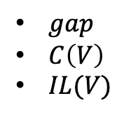

OOP function block diagram
Components
Circuits (or Devices)
Waveguide
MRR
Directionnal Coupler
MRR AP
MRR AD
$gap$
$C\left(V\right)$
$IL(V)$
pnC
MRM
PhaseShifter
$LPN$
${∆n}_{eff}\left(V\right)$
$∆α\left(V\right)$
MRR : general microring resonator
MRR AP : all-pass type microring resonator
MRR AD : add-drop type microring resonator
MRM : microring modulator (all-pass)
Relations arrows
Inherits
Instantiates in

Slide 5
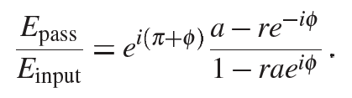







Circuits attributes and methods
MRR
Attributes
radius
roundtripLength
roundtripPhase
roundtripLoss
effectiveIndex
groupIndex
FSR
Qfactor
Methods
getRoundtripLength
getRoundtripPhase
getRoundtripLoss
MRR AD
Attributes
fdsf
Methods
fds
MRM
Attributes
fdsf
Methods
fds
$k^{2}$: power cross-coupling coefficient
$r^{2}$: power thru-coupling coefficient
$r^{2}+k^{2 }=1$ (lossless)
$α$: power attenuation coefficient [1/m]
$a$: single-pass amplitude transmission

Slide 6
Components attributes and methods
Waveguide
Attributes
ridgeWidth
ridgeThickness
slabThickness
Materials
length
bendingRadius
centralWavelength
effectiveIndex
groupIndex
intrinsicLoss
Methods
getPropagationMatrix

Slide 7
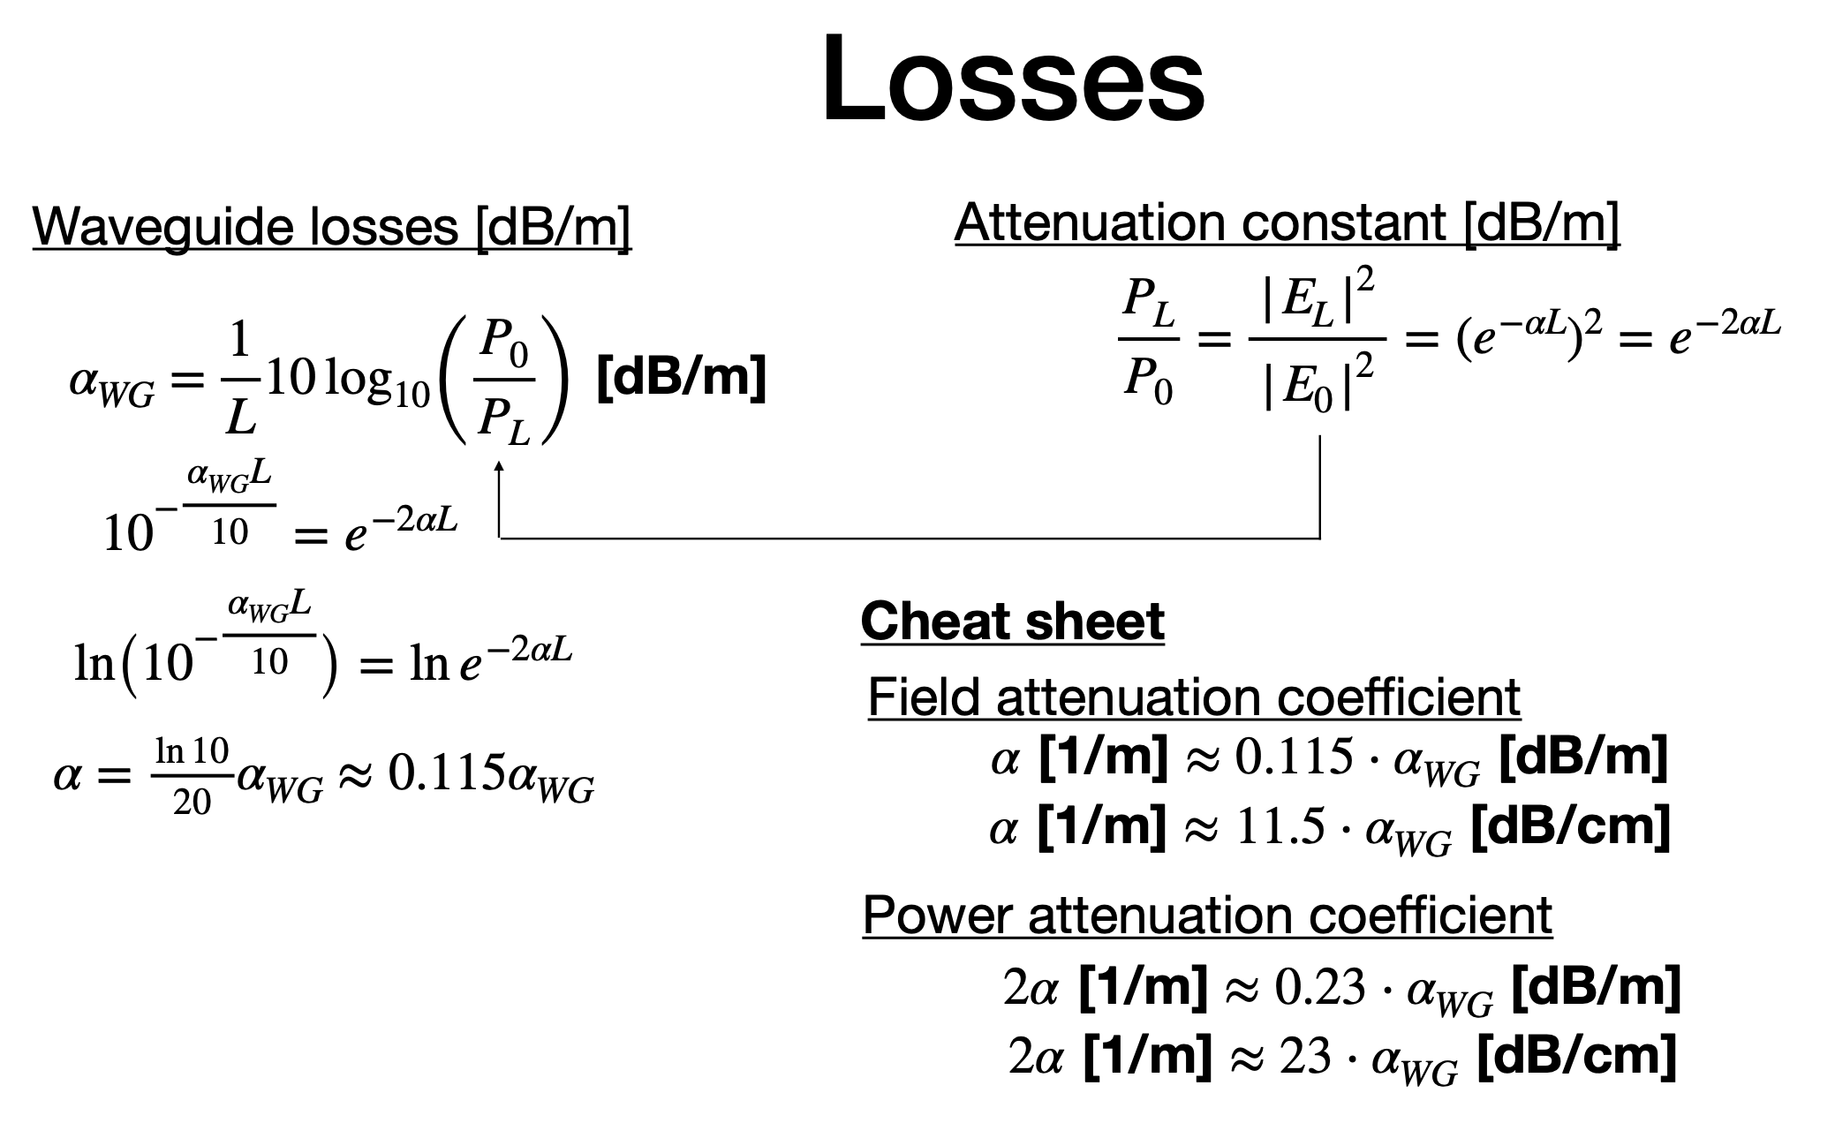
Losses in waveguides

Slide 8

Effective index and group index
$φ=$

Slide 9

Propagation losses
Loss mechanisms in a microring modulator loaded with a PN junction
Propagation losses [dB/cm] : Waveguide propagation losses for a doped waveguide with 0 V bias applied;
Bending losses [dB/cm] : Losses that are dependant on the radius of curvature of the ring;
Perturbative losses [dB/cm] : Losses that are dependant on the bias voltage applied to the PN Junction.

Slide 10
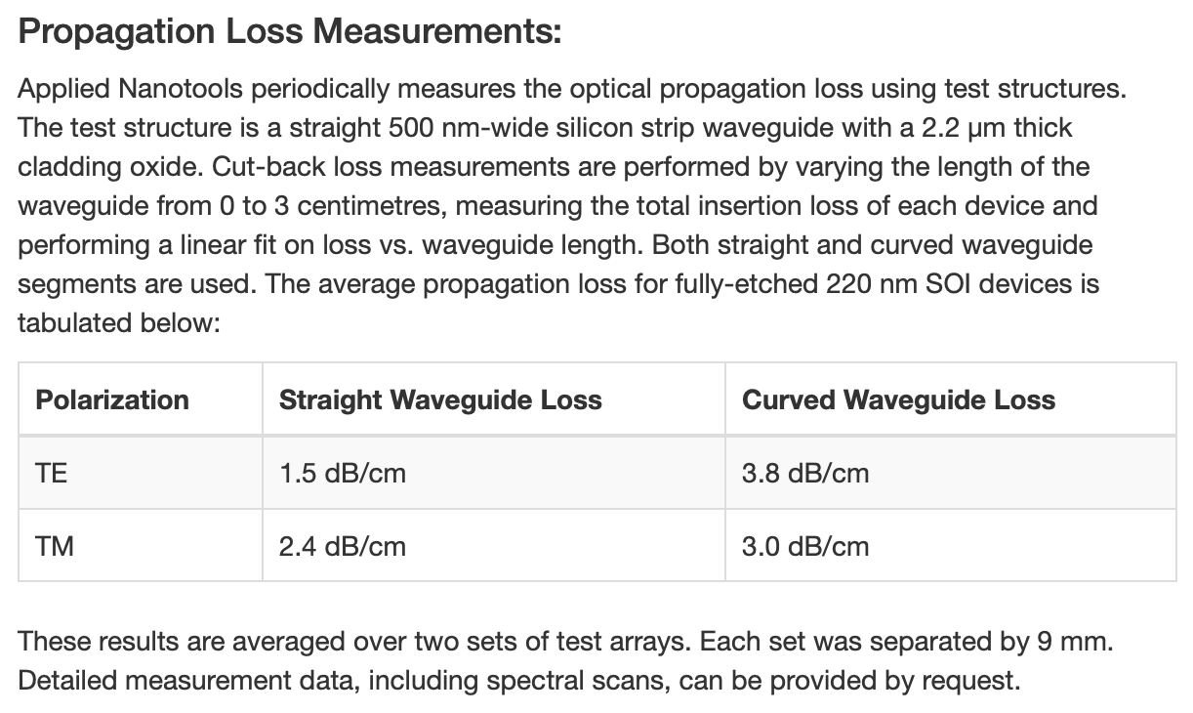
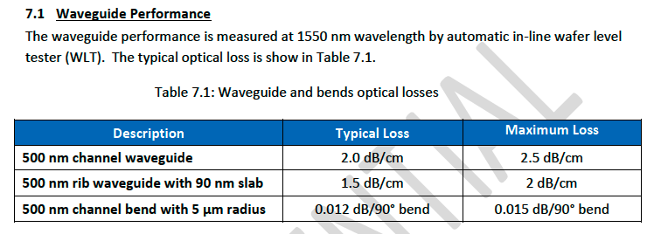
Propagation losses specifications
Applied Nanotools NanoSOI
AMF Silicon Photonics
Data for strip waveguides only. What would be the losses for standard rib waveguides?

Slide 11
Coupling Coefficient vs gap
Target cross section geometry
Power cross coupling coefficient vs gap for the target geometry
Ring Waveguide
Bus
Waveguide
g
220 nm
90 nm
500 nm
500 nm
Target top view geometry
10 µm
g
*We consider the coupling region to be undoped.
** Simulated using 3D FDTD (mesh 3)

Slide 12

PN Junction
Waveguide modulator cross section
Intra-cavity modulation -> ${∆n}_{eff}(V)$ and $∆α\left(V\right)$;
Parameters:
Junction recipe;
L_{PN} : PN junction length [µm];
c_{id} : Intermediary dopants clearance [µm];
c_{hd} : Heavy dopants clearance [µm];
pnC : PN junction coverage [%].
P++
P+
P
N
N+
N++
c_{id}
c_{id}
c_{hd}
c_{hd}
*presume int/heavy doping clearance is symetric
Lumerical DEVICE parameters
MRM top view
R
Circuit model parameters

Slide 13




Total Electro-Optic bandwidth
Not totally accurate: The Q factor depends on the detuning which causes a peaking effect.
The optical bandwidth will be underestimated.

Slide 14
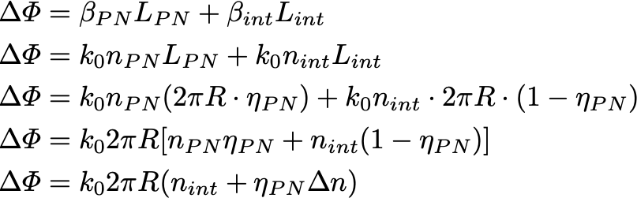


Phase shifter equation
$$∆φ={∆φ}_{doped}+{∆φ}_{undoped}$$
$η_{PN}$: PN coverage [%] /100

Slide 15



How to use the code
w
Transmission + phase
n_{eff}
R
h
Waveguide
T
n_{g}
sh
Specs
MRM
IL
$$κ^{2}(gap)$$
OMA
$$gap$$
Coupler
FSR
$$IL$$
ER
Phase Shifter
RCBW
Q
pnC
PS Efficiency
data
Perturbative losses
BW

Slide 16
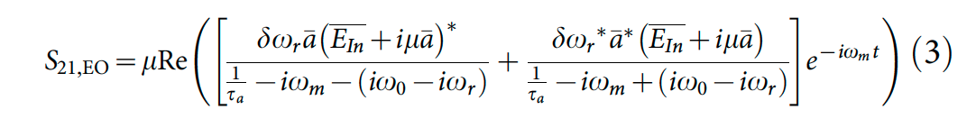
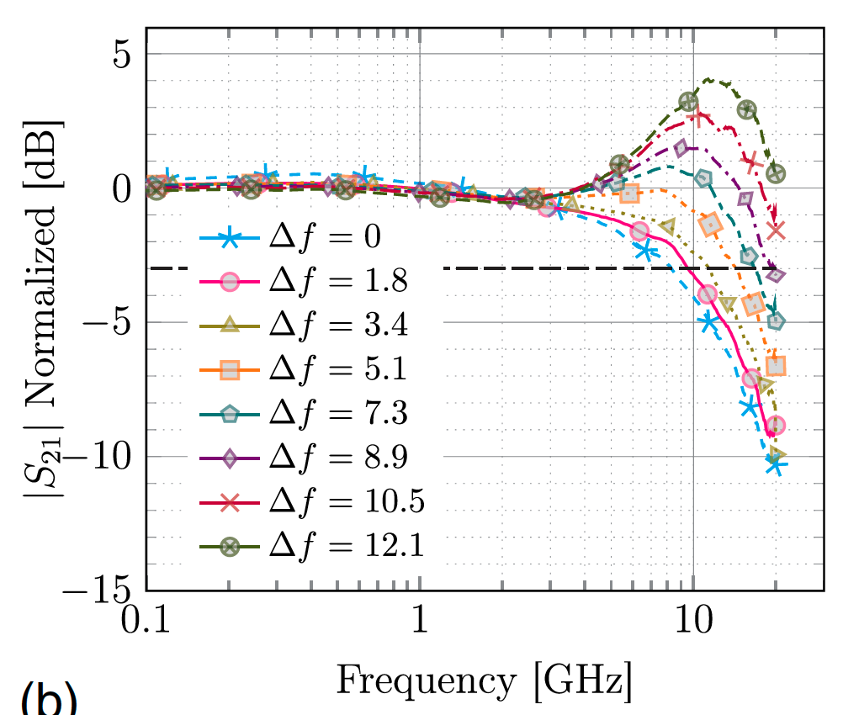
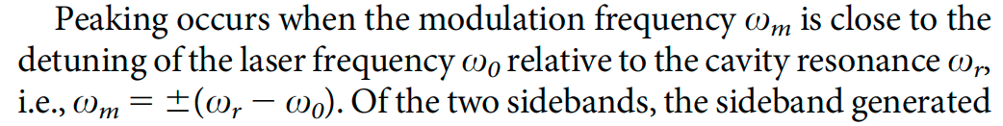
Supplementary - Misc
Peaking effect in microring modulators
$ω_{m}$: Angular frequency of the applied perturbation [rad/s]
$ω_{r}$: Angular resonant frequency of the resonator [rad/s]
$ω_{0}$: Angular frequency of the CW optical carrier from the laser [rad/s]
Source : J. Müller, F. Merget, S. S. Azadeh, J. Hauck, S. R. Garcia, B. Shen, and J. Witzens. Optical peaking enhancement in high-speed ring modulators. Scientific reports, 4:6310, 2014.

