Slide 2




Oracle Corporation
HQ based in Redwood Shores, California, USA
2nd largest software company in the world
120,000+ employees
36,000+ developers and engineers
R&D spent is $5.15 billions in FY15 (316亿RMB)
$38.3B in FY15 (2351亿RMB)
#1 in 50 product or industry categories
400,000 customers, including 100 of the Fortune 100

Slide 3

Oracle in China
Oracle in China
+ 5,800 employees including 2,200+ R&D employees
+11,000 customers
800 partners
250,000 members for Oracle Technology Network & Oracle’s online developer community
Operates through 22 branch offices
5 R&D centers in BJ,SZ,SH,SuZhou,Nanjing
2 partner solution centers (SZ and BJ)
1 customer support center (DL) and one consulting services center (CD)
2012, China Top 100 Best Employers by Zhaopin.com

Slide 4

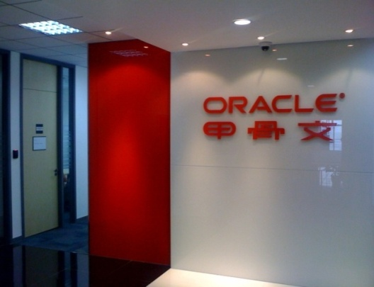
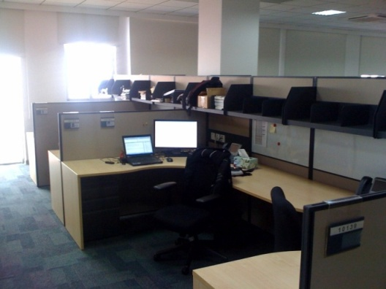
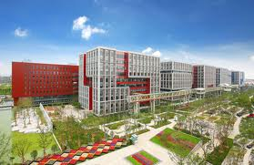

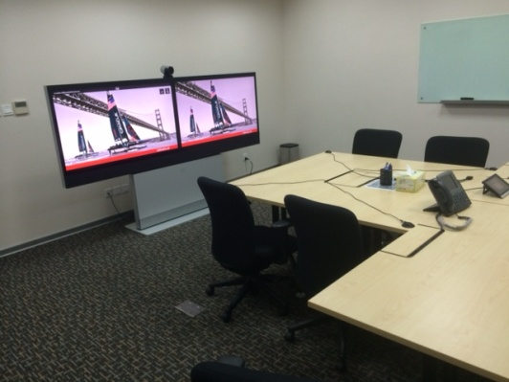
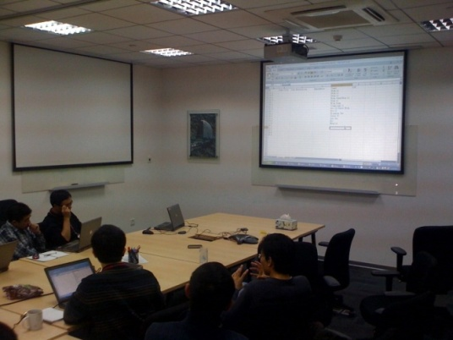
Oracle Suzhou
2 Floors (10F & 4F) with 4,000 SQM
300 R&D staff & Highly cooperative environment
Notes:
This is a sample Two Pictures with Captions Layout slide ideal for including two pictures with brief descriptive statements.
To Replace the Pictures on this Sample Slide (this applies to all slides in this template that contain replaceable pictures)
Select the sample picture and press Delete. Click the icon inside the shape to open the Insert Picture dialog box. Navigate to the location where the picture is stored, select desired picture and click on the Insert button to fit the image proportionally within the shape.
Note: Do not right-click the image to change the picture inside the picture placeholder. This will change the frame size of the picture placeholder. Instead, follow the steps outlined above.

Slide 5

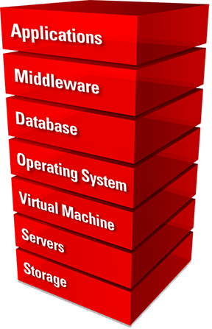
Oracle Products
Notes:
This is a Announcement slide ideal for including a picture and partner or product logo with a brief title and subtitle or description.
To Replace the Picture on this sample slide (this applies to all slides in this template that contain replaceable pictures)
Select the sample picture and press Delete. Click the icon inside the shape to open the Insert Picture dialog box. Navigate to the location where the picture is stored, select desired picture and click on the Insert button to fit the image proportionally within the shape.
Note: Do not right-click the image to change the picture inside the picture placeholder. This will change the frame size of the picture placeholder. Instead, follow the steps outlined above.
To Replace the LOGO on this sample slide:
Right-click the sample LOGO and choose Change Picture. Navigate to the location where the new logo is stored, select desired logo file and click on the Open button to replace the sample logo.

Slide 6

Leader in Key Markets
Database
Data Warehousing
Database on Linux
Database on SAP
Embedded Database
Database on Solaris
Middleware
Application Platform Suites
Identity and Access Management
Enterprise Performance Management
Business Analytics
Business Analytic Tools
Applications in North America *
Applications in Middle East and North Africa *
CRM globally
Human Capital Management globally *
Contract Lifecycle Management
Unix Server
Tape Storage
Banking
GRC for Financial Services
Life Sciences
Notes:
This is a Announcement slide ideal for including a picture and partner or product logo with a brief title and subtitle or description.
To Replace the Picture on this sample slide (this applies to all slides in this template that contain replaceable pictures)
Select the sample picture and press Delete. Click the icon inside the shape to open the Insert Picture dialog box. Navigate to the location where the picture is stored, select desired picture and click on the Insert button to fit the image proportionally within the shape.
Note: Do not right-click the image to change the picture inside the picture placeholder. This will change the frame size of the picture placeholder. Instead, follow the steps outlined above.
To Replace the LOGO on this sample slide:
Right-click the sample LOGO and choose Change Picture. Navigate to the location where the new logo is stored, select desired logo file and click on the Open button to replace the sample logo.

Slide 7


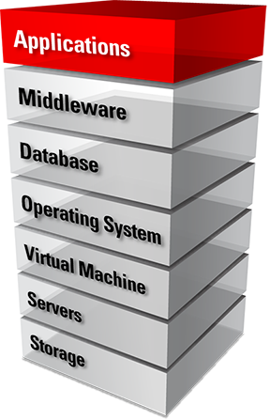









Oracle Products
Suzhou R&D

Slide 8


































Oracle Customers
Suzhou R&D

Slide 9

Oracle Communication – English Spoken
We are a global R&D organization offering product worldwide
Oracle China R&D is NOT : working on localized product for the China market only
We support English improvements
We need to communicate in English for :
All corporate communication (email, website, …)
Communicate to other R&D centers (email, technical documentation, …)
Conference call with the other R&D centers ( All hands meetings with management, feature demo to product management, review of customer issues, …)
Conference calls with worldwide customers when needed

