Slide 1
Who am I?

Slide 2

李明 Seth Lee

Slide 3
Where did I work before?

Slide 4
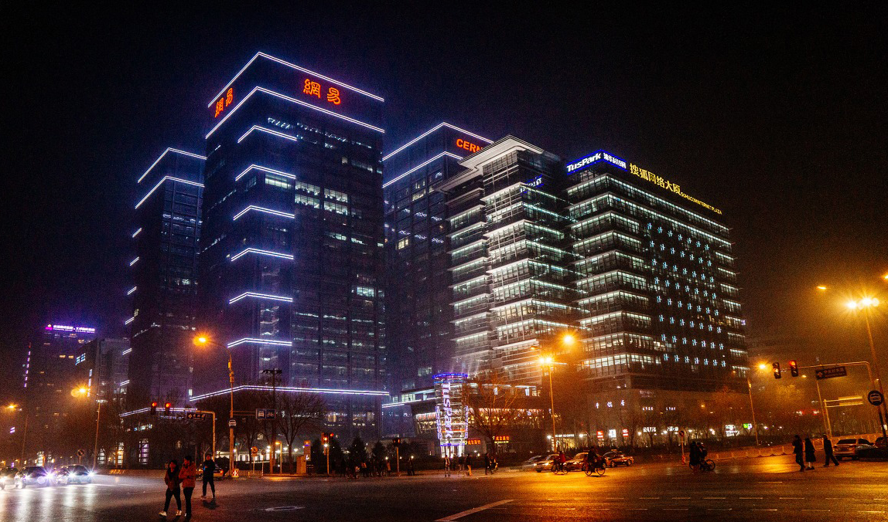
TusPark U-CENTER

Slide 5

NUFRONT Founded in 2004, a high tech company dedicated in the areas of wireless broadband communication and IC design.

Slide 6
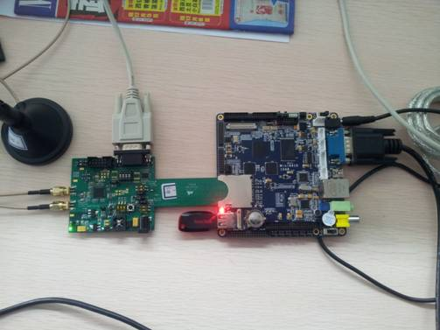
Daily Work
RF and MCU 3in1 SoC (NL6621)
AP（Routers）
or
STA（wireless cards）

Slide 7
What about my current job?

Slide 8
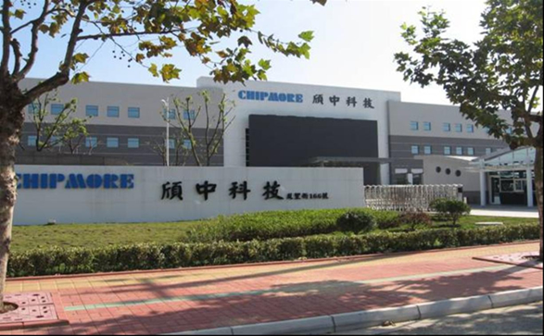
CHIPMORE Also founded in 2004, but it’s an IC factory

Slide 9
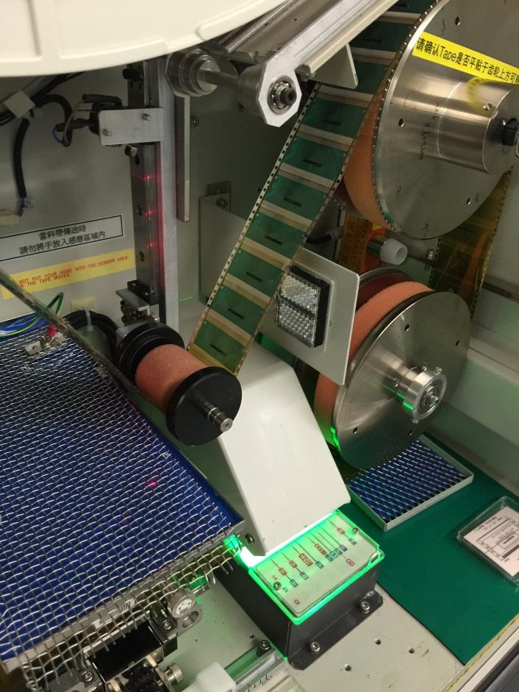
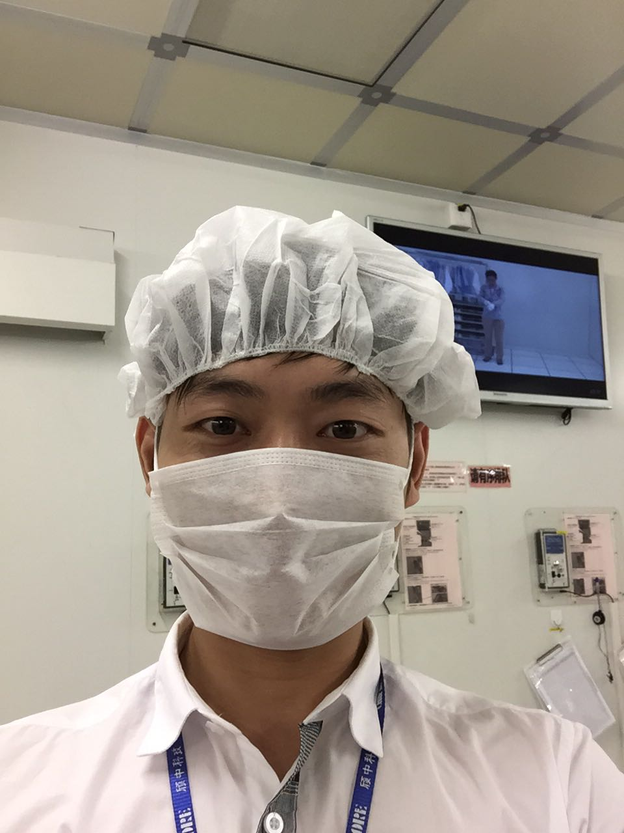
Production line operator
Dust-free production workshop

Slide 10
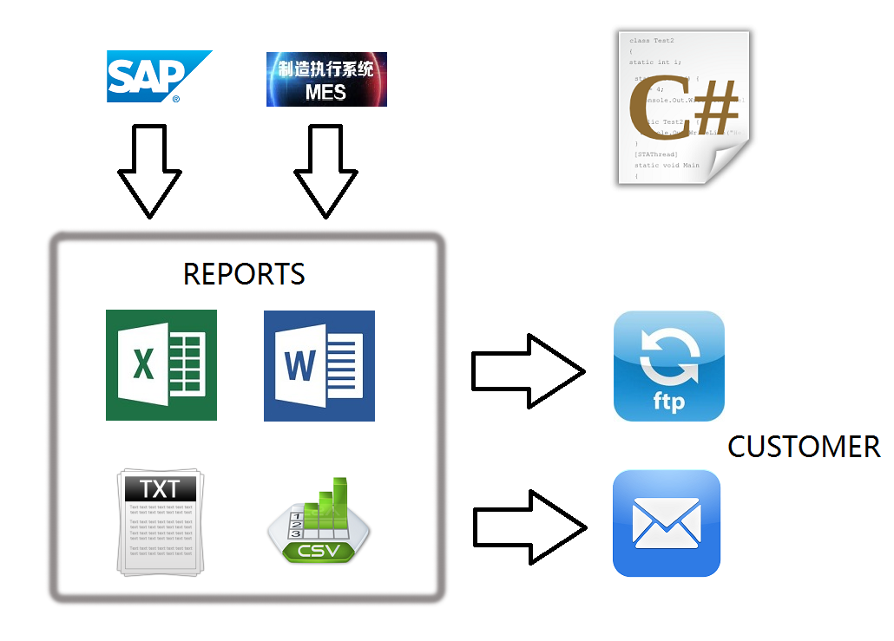
B2B

Slide 11
Why I want to resign?

Slide 12
Where will I go?

Slide 13
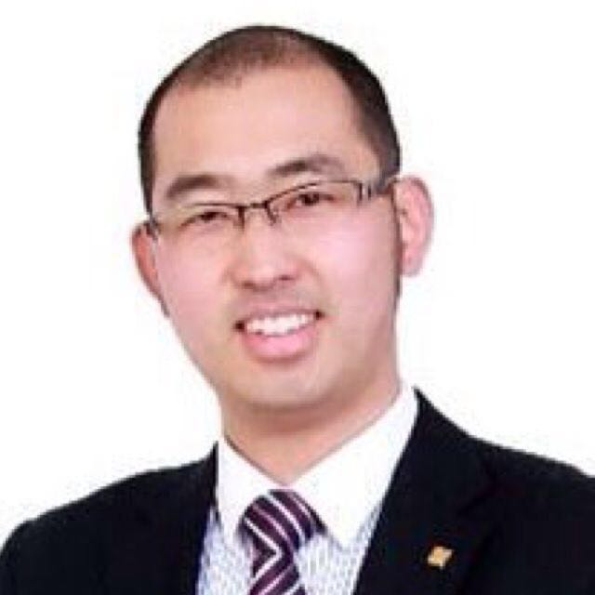
Creative Industrial Park
汇贾

Slide 14
Thank you!

