Slide 1
Rogers Corporation
-- Robert Gu
Notes:
Hello every one. I am glad to have to chance to give you a very brief introduction of my company.
It is my first to do a presentation in front of such huge crowd. I hope I could keep relaxed.
I am a coding farmer as well as a codes porter. So I copied words about my company from our website to my slides.

Slide 2
Agenda
About Rogers Corporation
Our History
Global Locations
Our Solutions
Notes:
Here is a short agenda.

Slide 3



About Rogers Corporation
Global leaders in engineered materials to power, protect and connect our world.
power
Internet Connectivity
protect
Internet Connectivity
connect
Internet Connectivity
Notes:
At Rogers Corporation, we are passionate about helping the world's leading innovators solve their toughest material challenges and create a cleaner, safer, and more connected world.
We are the world’s technology leaders in innovative solutions for power electronics, advanced foams for cushioning and protective sealing, and high-frequency printed circuit materials. When reliability, efficiency and performance are critical, design engineers partner with Rogers to develop and deliver the material technologies they require.
For over 180 years, we have developed new solutions to empower our customers’ breakthroughs and help them create a cleaner, safer, and more connected world. Headquartered in Rogers, Connecticut, USA, we serve our customers and partners around the globe, and manufacture products in the U.S., China, Japan, Korea, Germany, Hungary and Belgium.

Slide 4
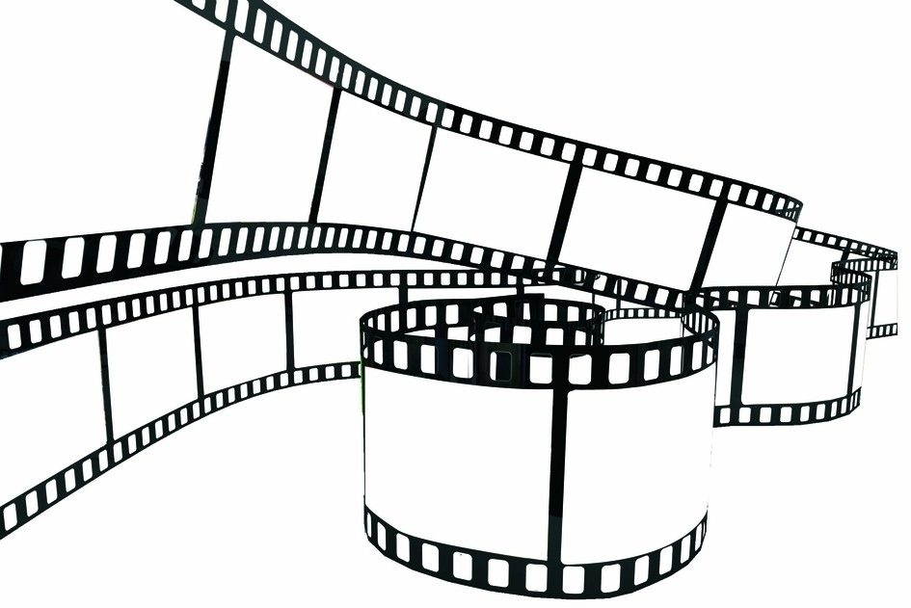

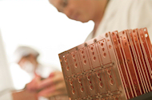

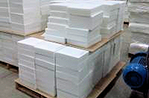
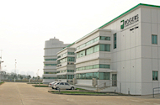
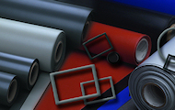
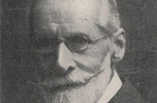
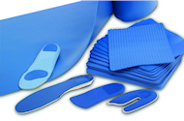
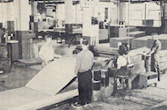
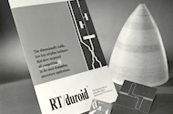

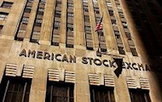
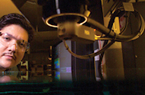
Our History
Founded by Peter Rogers as a materials manufacturer for the textile industry, Rogers has changed a lot since 1832.
2015
Acquired Arlon
2003
Suzhou
1832
Founded
1960
Listed
Notes:
Here is our growth path.
1832
Founded by Peter Rogers as a paper manufacturer
1970
Lurie Research & Development Center Opens
2003
Opened facility in China and acquired full interest in Durel
2015
Acquired Arlon circuit materials and engineered silicones

Slide 5



Our Solutions
Advanced Connectivity Solutions
Enabling step changes in high-frequency, high-speed performance for wired & wireless communications circuits worldwide.
Elastomeric Material Solutions
Ensuring reliability where cushioning, sealing, impact protection, or energy management are critical to product performance.
Power Electronics Solutions
Empowering quantum leaps in efficiency, heat management and performance reliability of power conversion modules and devices.
Notes:
Applications:
ACS: Applications
Wireless Base Stations
Aerospace & Defense
Automotive
High Speed Digital
EMS:
Sealing
Cushioning
Energy Management
Impact Protection
Polishing
PES:
Intelligent power management devices such as Insulated Gate Bipolar Transistor (IGBT) modules that enable highly efficient power conversion required in wind, solar and hybrid electric vehicle applications.
Tesla is our customer.

Slide 6
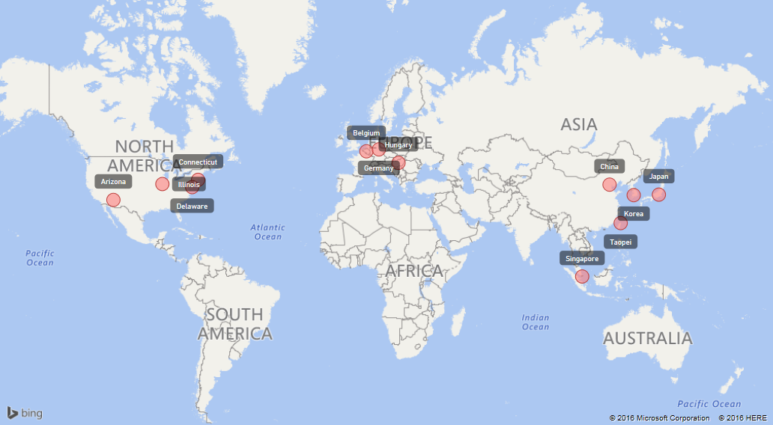
Global Locations
For over 180 years, we have developed new solutions to empower our customers’ breakthroughs and help them create a cleaner, safer, and more connected world.
Notes:
Headquartered in Rogers, Connecticut, USA, we serve our customers and partners around the globe, and manufacture products in the U.S., China, Japan, Korea, Germany, Hungary and Belgium.

Slide 7

More information, please visit
www.rogerscorp.com

