Slide 1
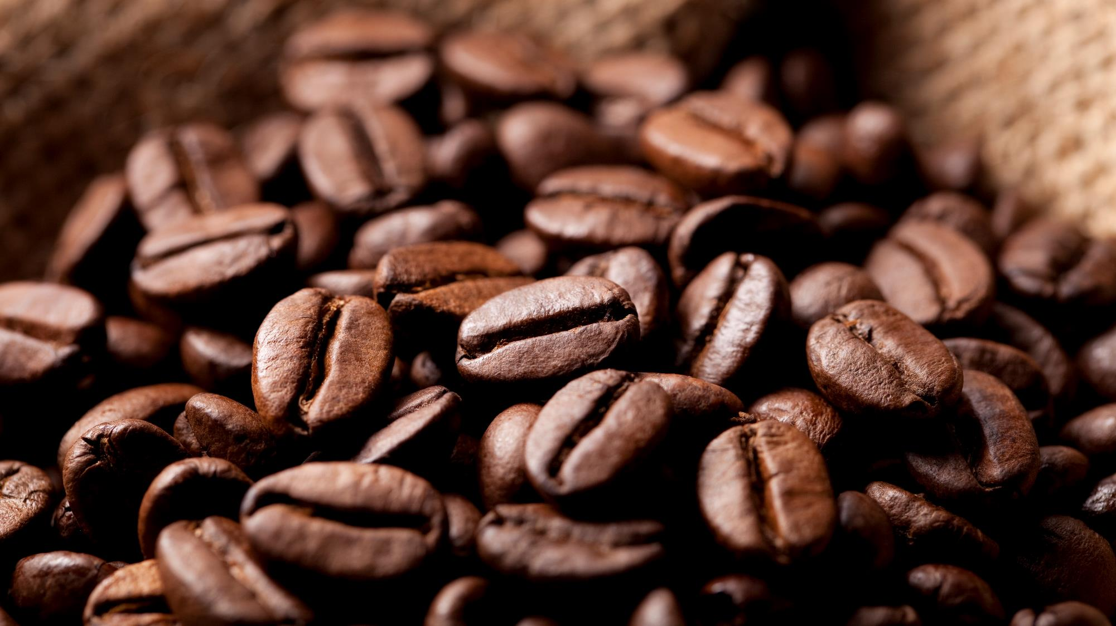
Coffee Logic
Ecosystem
Details: Version 1.00
February 2026

Slide 2
The Vision & Scope
The "Why": Transitioning to a relationship-based model with predictable monthly revenue.
In-Scope: Sensory-based web catalog
Dual-action commerce engine(one-time vs Subscription)
Automated “Batch-Centric” inventory
Out-of-scope: Native mobile apps and wholesale B2B portals(served for phase 2)

Slide 3
The Functional Core (Modules 1-3)
Customers filter by Roast Level, Acidity, and Body
Dual-action Engine seamless toggle between one-time buys and recurring deliveries
Intelligent Checkout secure “one-click” return journey using stripe tokenization-no raw card is ever stored

Slide 4
Operations & Notifications (Modules 4-5)
Batch-Centric Inventory: Real-time tracking of roasted batches to prevent overselling.
Automated Communication
  Transaction receipts
  Renewal alerts sent 48 hours before changes.
  “Dunning” notification for failed payments to recover revenue

Slide 5
Non-Functional Standards (Quality Assurance)
Performance: Core pages load in < 2 seconds, even on slow networks.
Reliability: 99.9% system uptime; "set-it-and-forget-it" automated billing.
Usability: Simple, "respectful" interface designed for all ages.
Scalability: Future-proof database ready for 10 or 10,000 customers.

Slide 6
Timeline & Constraints
Spending : Using open-source software to keep costs low.
End of February Core "Heart" of the system completed.
  Full "Harvest" (advanced features and polish).

Slide 7


Thank You
Email
simongeletaw2@example.com

