Slide 1
Big Data Analytics Abgabe 3
Dominic Baron, Simon Neureither
04.06.2019

Slide 2
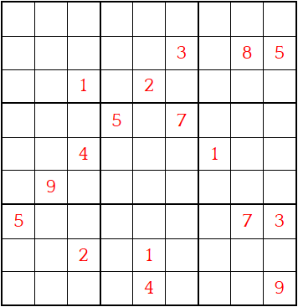
Sudoku

Slide 3
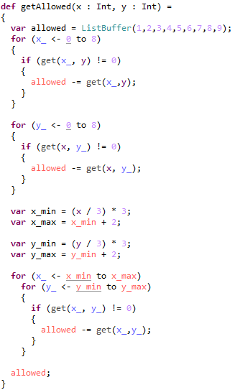
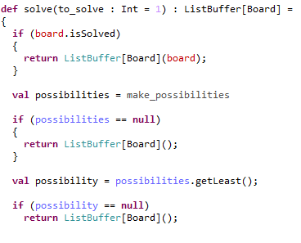
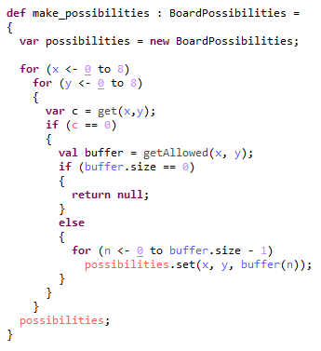
Solver

Slide 4
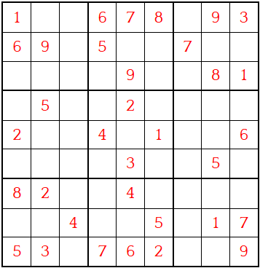
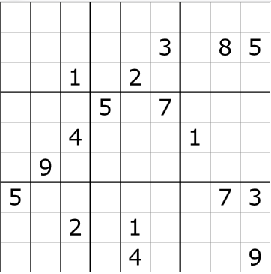
Evaluation
Besetzte Felder | 35 | 34 | 33 | 34 | 35 | 30 | 30 | 28 | 32 | 29 | 27 | 27 | 26 | 28 | 28 | 24 | 26 | 26 | 26 | 25 | 21 | 17 | 17 | 17 | 17 | 17 | 17
Lösungszeit | 11 | 4 | 4 | 4 | 3 | 6 | 6 | 4 | 6 | 5 | 3 | 14 | 5 | 10 | 5 | 30 | 4 | 19 | 23 | 10 | 896 | 3307 | 763 | 334 | 124 | 577 | 123

