Slide 1
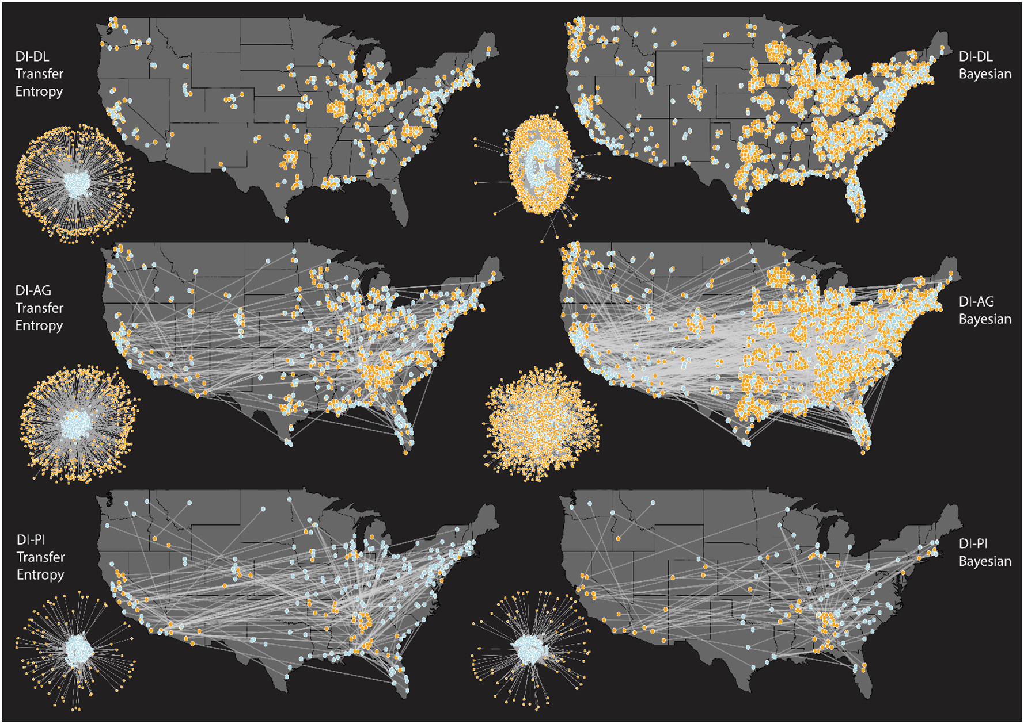
title
Objective
objective_0
Approach
approach_0
approach_1
approach_2
Impact
impact_0
impact_1
impact_2
caption
citation

