Slide 1
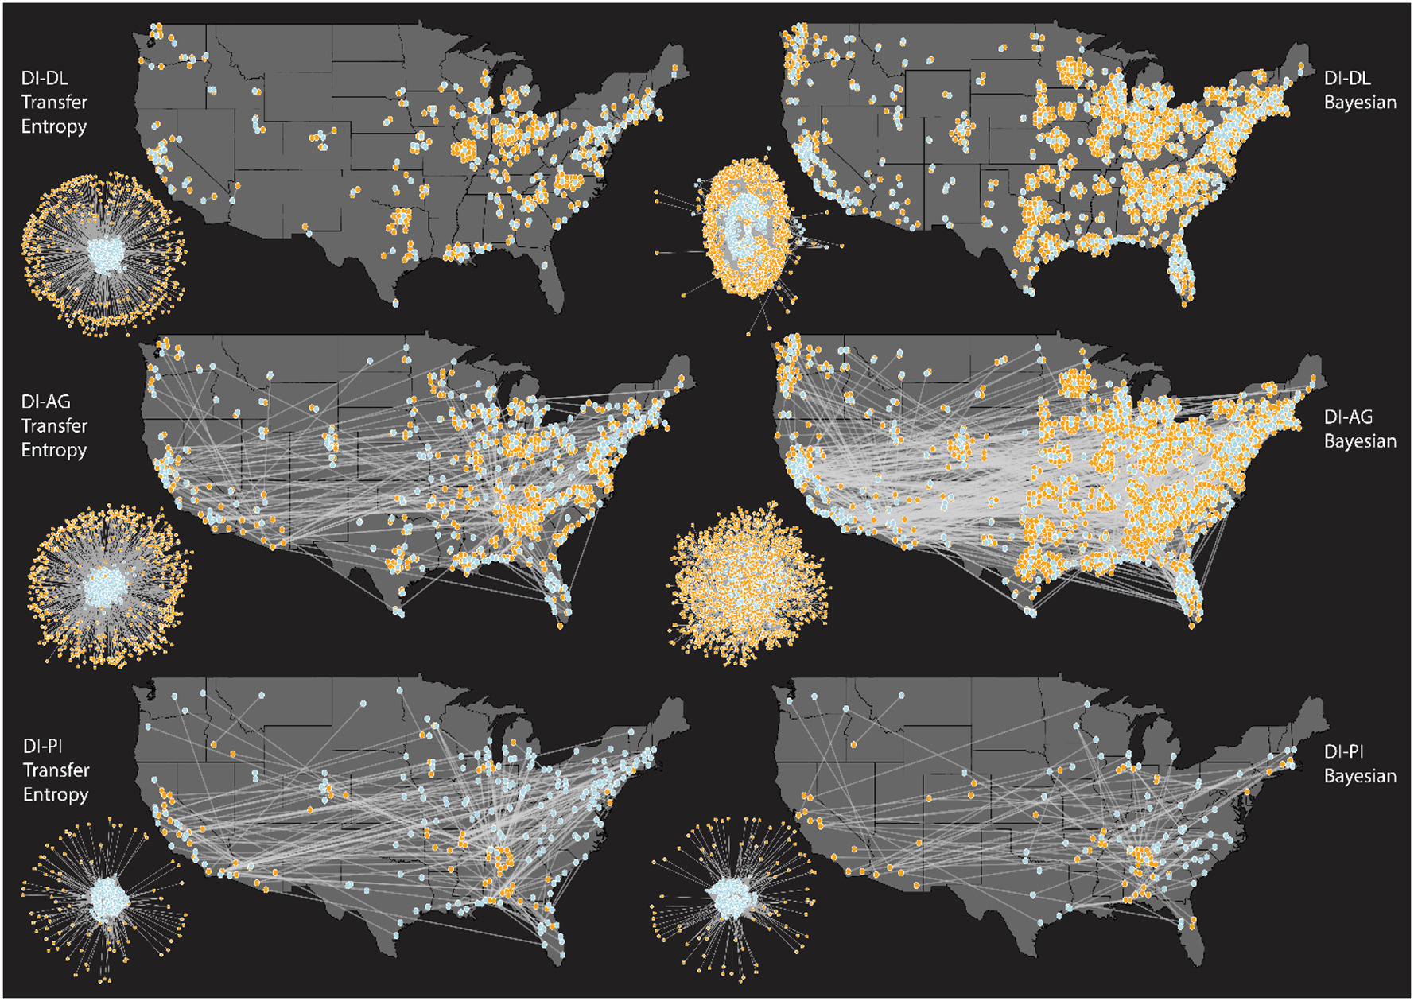
Title
Objective
Present a methodological approach to quantify and map urban land teleconnections in the U.S. using information theory in concert with graphical networks.
Approach
Examine long-term (1950-2016) changes in urban land cover and urban population density in urban areas relative to other cities and rural lands
Use transfer entropy to infer causality among teleconnected areas.
Optimize networks using topological constraints and maximum entropy. Boosted regression trees were used to predict teleconnection strength, for inclusion in future land use and land cover change (LULCC).
Impact
City-city networks are very large and complex, suggesting simultaneous effects of globalization. Proximate urban-rural neighborhoods are influenced directly by individual cities, but each city may be influenced by many teleconnections with other cities.
Rural areas providing agricultural commodities had decreasing agriculture land yet increasing agricultural production intensity. Hence, distal rural commodity areas may support multiple cities, incurring increased land stress in those areas.
Results indicate that local dynamics in rural areas are potentially more important drivers of land use change than urban dynamics.
These maps represent different variables and information theoretic measures (Transfer entropy; Bayesian) explaining urban-rural teleconnections. The top row shows urban areas that affect their nearby neighborhoods (DI-DL). The second and third rows show that distant urban-rural networks are extensive. The middle row shows these networks are driven by urban-induced agricultural land change (DI-AG), while the bottom row shows the importance of urban-induced changes in crop production intensity (DI-PI). Blue dots refer to urban areas while orange dots refer to rural areas.
McManamay, RA, Brinkley, C, Vernon, CR, Raj, S, Rice, JS. 2022. “Urban land teleconnections in the United States: A graphical network approach,” Computers, Environment and Urban Systems, 95: 101822. DOI: 10.1016/j.compenvurbsys.2022.101822

