Slide 1
August 9, 2023

Slide 2
Collaboration on GitHub
QBS 101.5: Applied Data Science
Simon Stone
Research Data Services
Dartmouth College Library

Slide 3
Introduction Data Science
Data Engineer
Data Analyst
Machine Learning Engineer
Collect
Clean
Clean
Build and assess model
Exploratory Data Analysis
Model implementation
Deployment
Data Scientist
Data Science is OSEMN!*
Obtain
Scrub
Explore
Model
iNterpret
*pronounced “awesome” - /ˈɔ.səm/ https://www.datascience-pm.com/osemn

Slide 4


Collaboration on GitHub Outline
Introduction to GitHub
Setting Up Collaboration
Collaborative Workflows
Managing Collaborative
Further resources

Slide 5

Caveat Emptor
Most of today’s content is from a general software developer’s perspective.
Not everything may fit a Data Scientist’s needs or use cases all the time.
Munroe, R. Git. XKCD. Retrieved August 3, 2023, from https://xkcd.com/1597.

Slide 6
Collaboration on GitHub 1. Introduction to GitHub
Git:
Distributed version control system
Lives and works on your local machine
Responsible for tracking changes and managing branches
GitHub:
Cloud-based hosting platform for Git repositories
Allows remote collaboration
Offers tools for project management, collaboration, code sharing, and more

Slide 7


Collaboration on GitHub 2. Setting up collaboration
Cool project
Core development team
Prerequisites:
Every collaborator has a GitHub account
Every collaborator has Git installed on their local machine
Two paradigms of collaboration:
Being part of a team working on a shared code base
Contributing to another team’s code base
Outside contributor

Slide 8
Collaboration on GitHub 3. Collaborative Workflows
The Git Flow:
A branch-based model
Meaningful branching makes for a clean and informative history at different levels

Slide 9
3. Collaborative Workflows Working as a team on a shared code base
The project lives in a single repository hosted on GitHub
All team members are added as collaborators
Each team member works on their own branch
When work is finished, a pull request is opened to request inclusion of the changes into the main branch
Cool project
Core development team
Notes:
Demonstrate the process with a new repository (see Shared-Repo.md)

Slide 10
3. Collaborative Workflows Pull requests
A pull request is the request to merge a source branch to a target branch
Example:
You have been working on the branch “cool_new_feature”. After a couple of commits to this branch, the feature is now ready to be published. You initiate a pull request from “cool_new_feature” to “main”
A pull request helps to adhere to the four-eyes principle
Pull requests are usually reviewed and often changes are requested before they are accepted (see later in this session)

Slide 11

3. Collaborative Workflows Contributing to another team’s code base
Create a copy of the original project in your GitHub account (a ”fork”)
You can always pull changes from the upstream repo
The fork is your repo and you have full control over it
You can ask for changes in your fork to be pulled into the original project (“pull request”)
Cool project
Forked copy
You
Core development team
Notes:
Demonstrate the process (see Outside-Contributor.md)

Slide 12
4. Collaborative Workflows Managing Collaborative Projects
Issues
Flag issues
Plan and track a chunk of work
Project boards
Plan and track work
Assign tasks
Tasks turn into issues
Pull request reviews
Comment or approve proposed changes in a pull request
Request further changes before merging
Discussions
A messageboard attached to your project
Possible references to issues, pull requests, files, …
Notes:
Demonstrate the various features (see Managing-Collaborative-Projects.md)

Slide 13
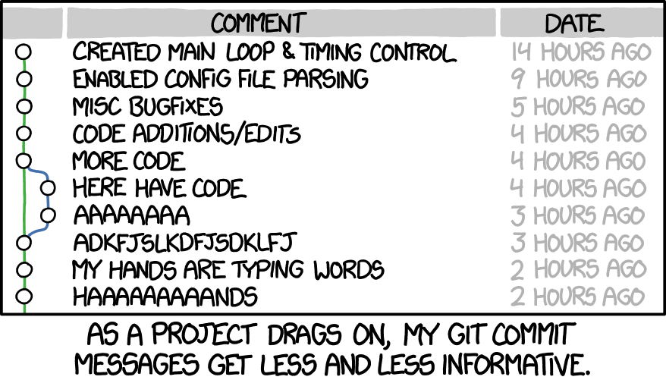
5. Further resources
GitHub Docs: https://docs.github.com/
GitHub integration in VS Code: https://code.visualstudio.com/docs/sourcecontrol/github
Automation (CI/CD): https://github.com/features/actions
Munroe, R. Git Commit. XKCD. Retrieved August 8, 2023, from https://xkcd.com/1296.

Slide 14
Assignment: Peer-review
Review phase:
Share a link to your GitHub repo with me by EOD (simon.stone@dartmouth.edu)
I will share the list of links with the class via email tomorrow (August 10)
Each of you should go over the other repositories and reproduce the respective analyses
Report any bugs or suggested changes as issues in the repo’s page on GitHub by August 16
Your grade will be partially based on participation in this phase
Revision phase:
Engage with the issues flagged in your respective project repository
Push changes addressing all fixable issues
Address all issues you do not fix by commenting on them, explaining why you do not fix them, and close them
Revision phase ends August 23 (same day as presentations)
Your grade will be partially based on your effort to address the flagged issues in these phase

Slide 15
Thank you.

