Slide 1
July 17, 2023

Slide 2
Intro to Machine Learning with scikit-learn
QBS 101.5: Applied Data Science
Simon Stone
Research Data Services
Dartmouth College Library

Slide 3
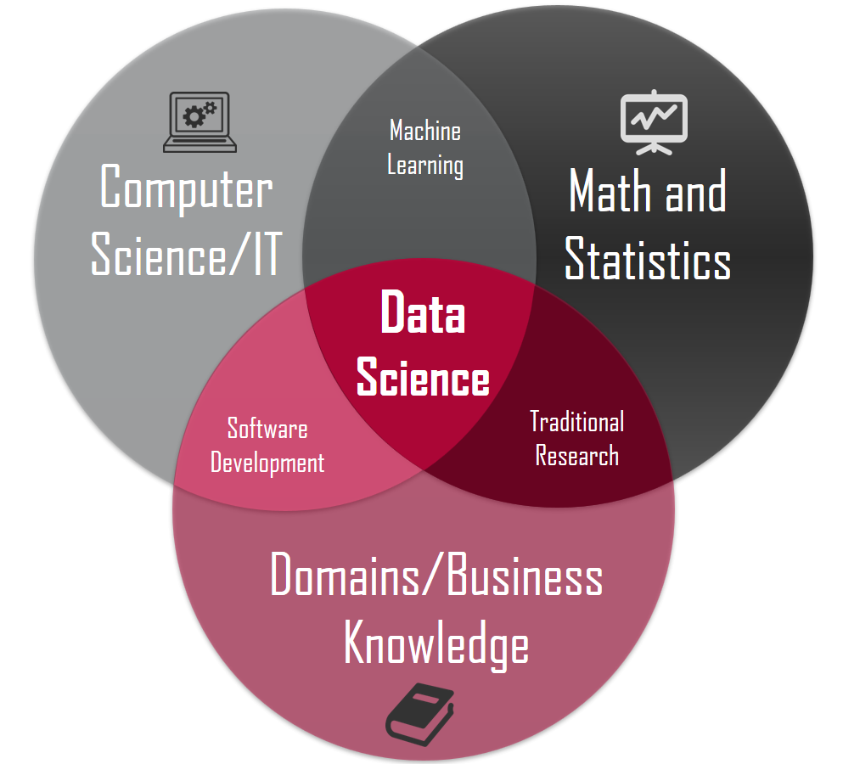
Intro Machine Learning and Data Science
Data Science is at the intersection of multiple disciplines
Each discipline brings its own tools and techniques
Statistics lets us describe distributions of observations and make inferences based on the assumed distributions
Machine Learning uses statistical models, but also (optimization) algorithms that can “discover” the best parameters to make inferences based on a given set of observations (learning from data)
Barber, M. (2018). Venn diagram of disciplines around Data Science. Data science concepts you need to know! Part 1. Towards Data Science. Retrieved July 17, 2023, from https://towardsdatascience.com/introduction-to-statistics-e9d72d818745.

Slide 4
Machine Learning for Human Teachers
scikit-learn:
Powerful framework written with a Python frontend
Contains a vast number of popular algorithms from “classical” machine learning
Only very basic support for neural networks (see next session on PyTorch)
Great evaluation and reporting functionalities
Easily extendable
Quick poll: “Machine Learning Experience”

Slide 5
Introduction Data Science
Data Engineer
Data Analyst
Machine Learning Engineer
Collect
Clean
Clean
Build and assess model
Exploratory Data Analysis
Model implementation
Deployment
Data Scientist
Data Science is OSEMN!*
Obtain
Scrub
Explore
Model
iNterpret
*pronounced “awesome” - /ˈɔ.səm/ https://www.datascience-pm.com/osemn

Slide 6
Why use a framework for machine learning?
Machine Learning is full of trial & error
Algorithms can be very computationally and/or conceptually complex
Recurring programming patterns across projects
Use a framework to harness efficient implementations and modular code design

Slide 7
What you will learn in this session
Basic structure of scikit-learn
Preprocessing
Dimensionality reduction
Training and testing a classifier
Hyperparameter tuning
Reporting results
Creating a complete pipeline

Slide 8




What we will work with in this session
We will use Python, a little bit of Pandas, and plenty of scikit-learn
As a programming environment, we will use a Jupyter notebook

Slide 9
scikit-learn at a glance
Project website:
https://scikit-learn.org/
Installation guide
Excellent user guide
API reference
Examples
Community
…

Slide 10
Let’s get started…

