Slide 1
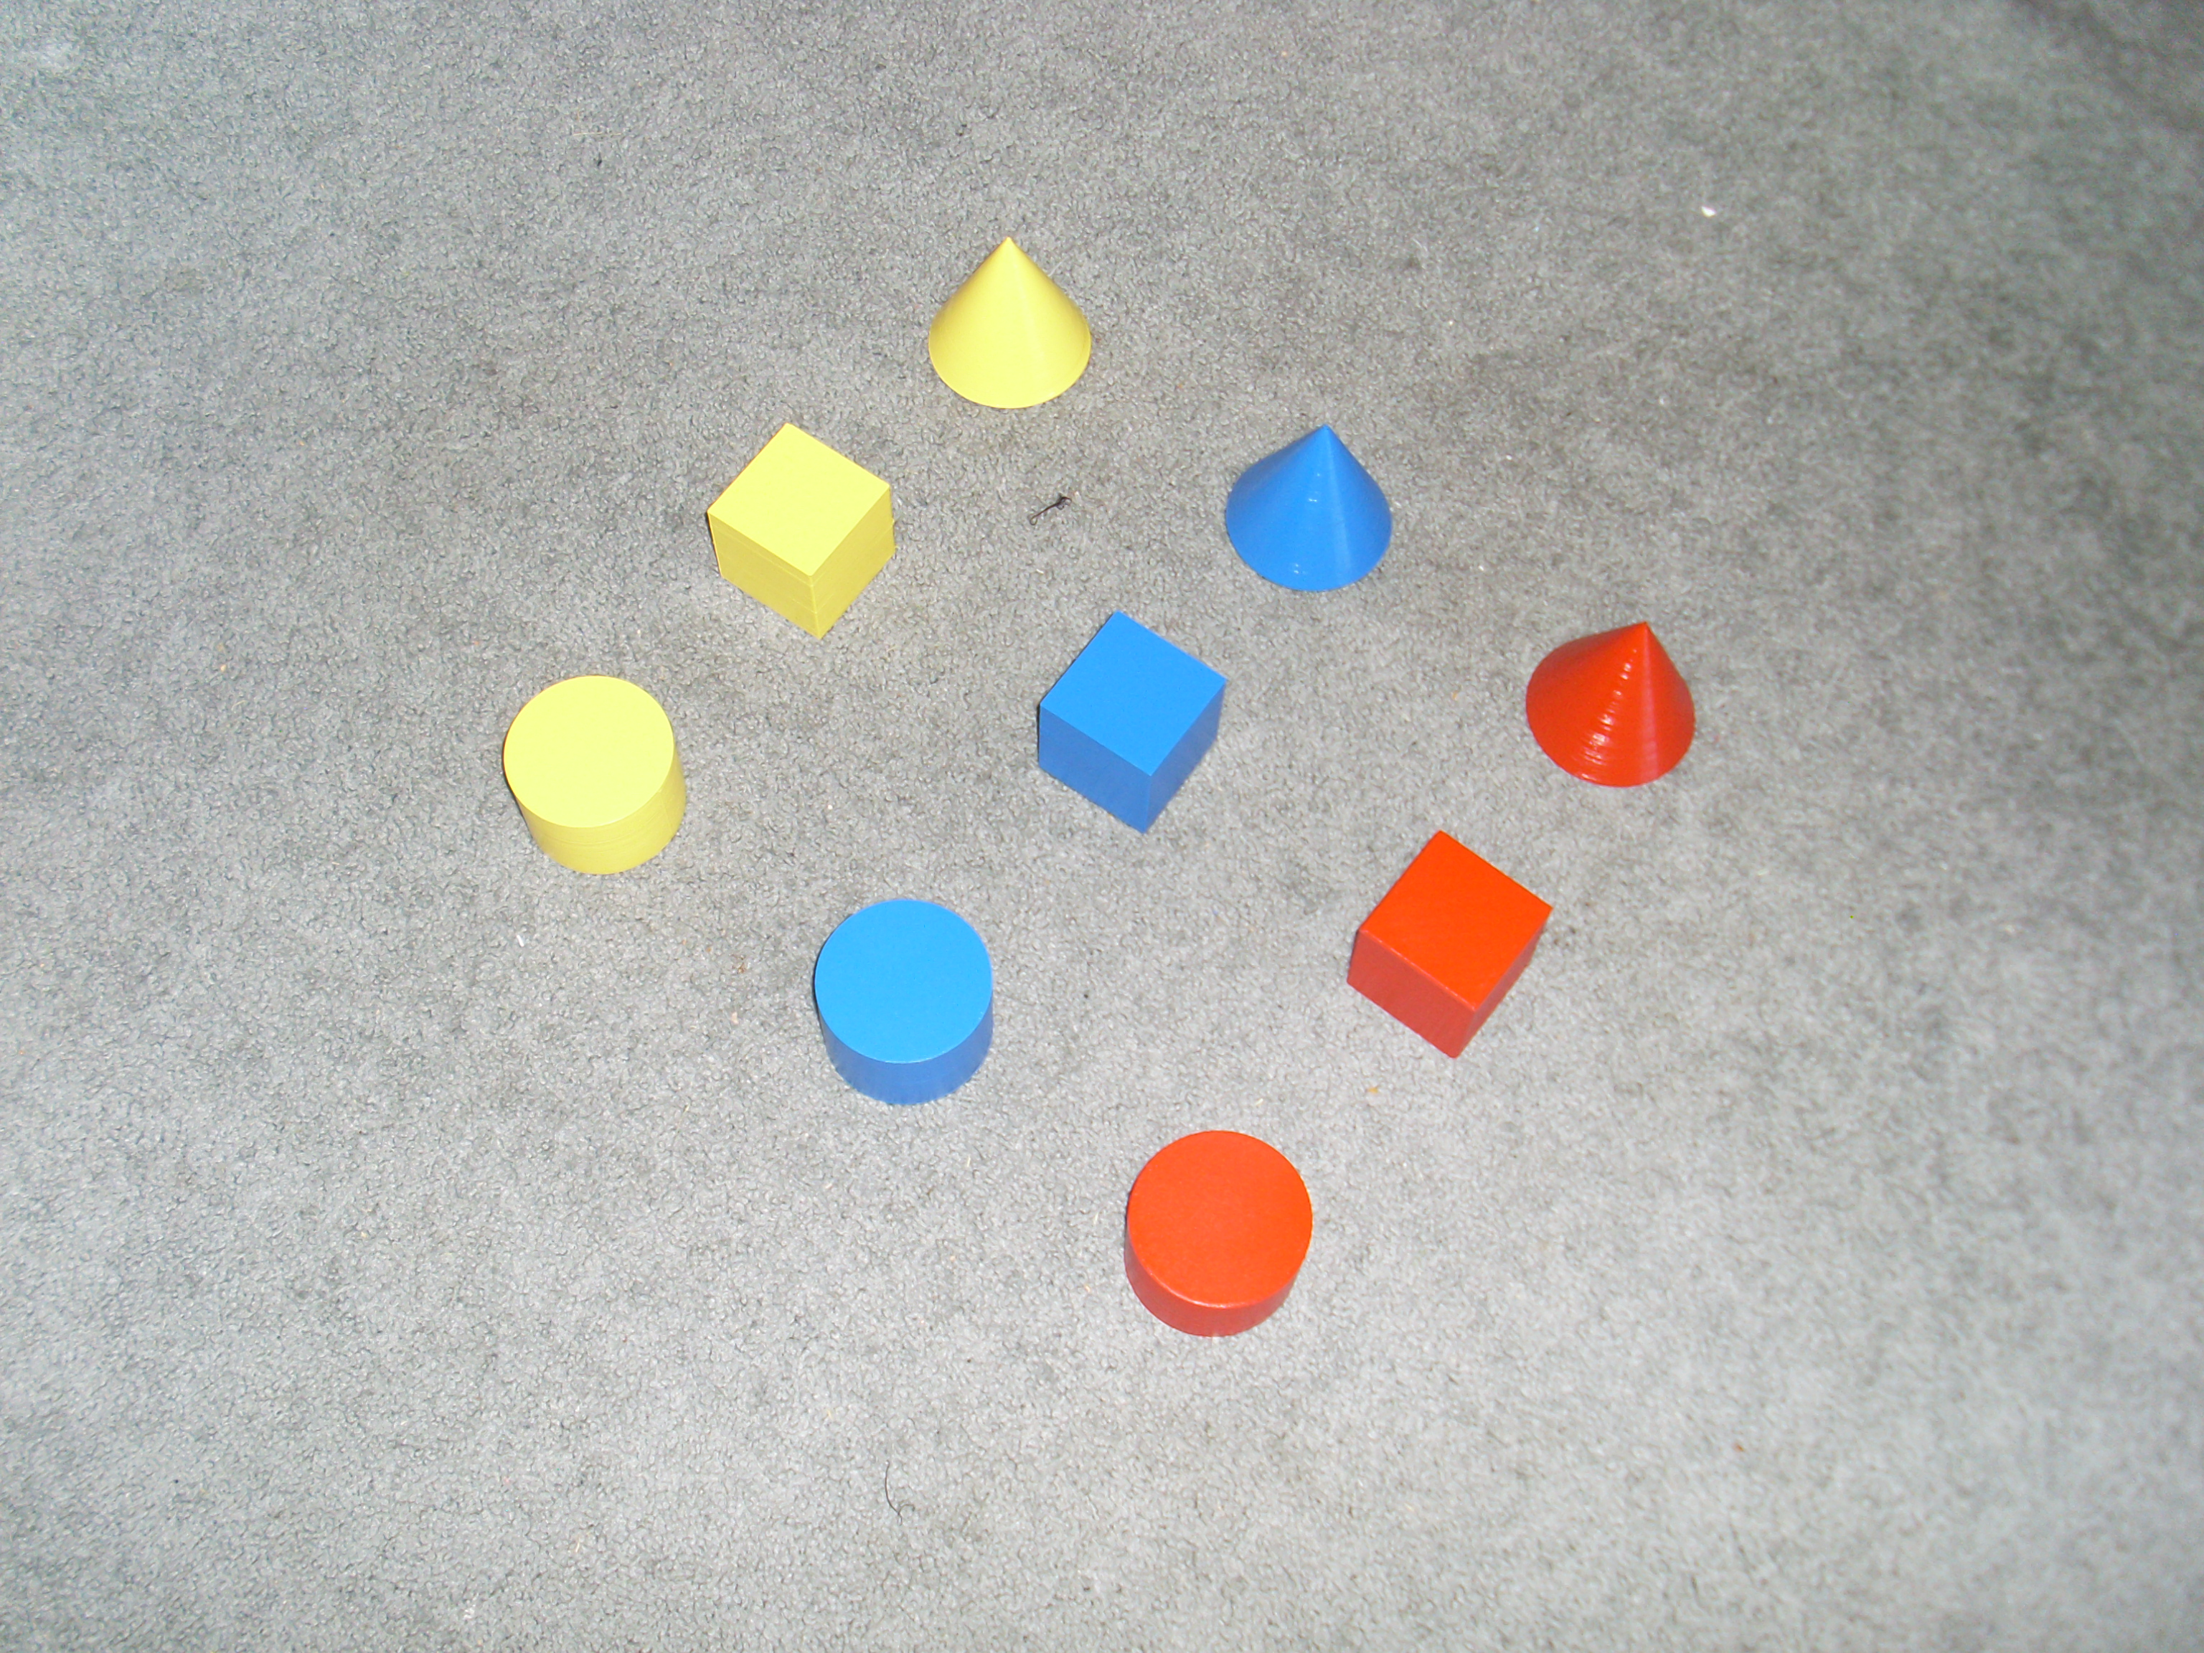
Improving Object Characteristic Enumeration Models with Transfer Learning and Data Augmentation
Simon Swenson

Slide 2
Can a machine learn characteristics of an object?
Example: Given an orange, we know that it’s sweet, tangy, orange-colored, and round. If we trained a machine on an orange, would it also be able to say that a basketball is round?
Caveat: If the machine doesn’t have input for taste, for example, we should not teach it about the taste-based characteristics of an object.

Slide 3
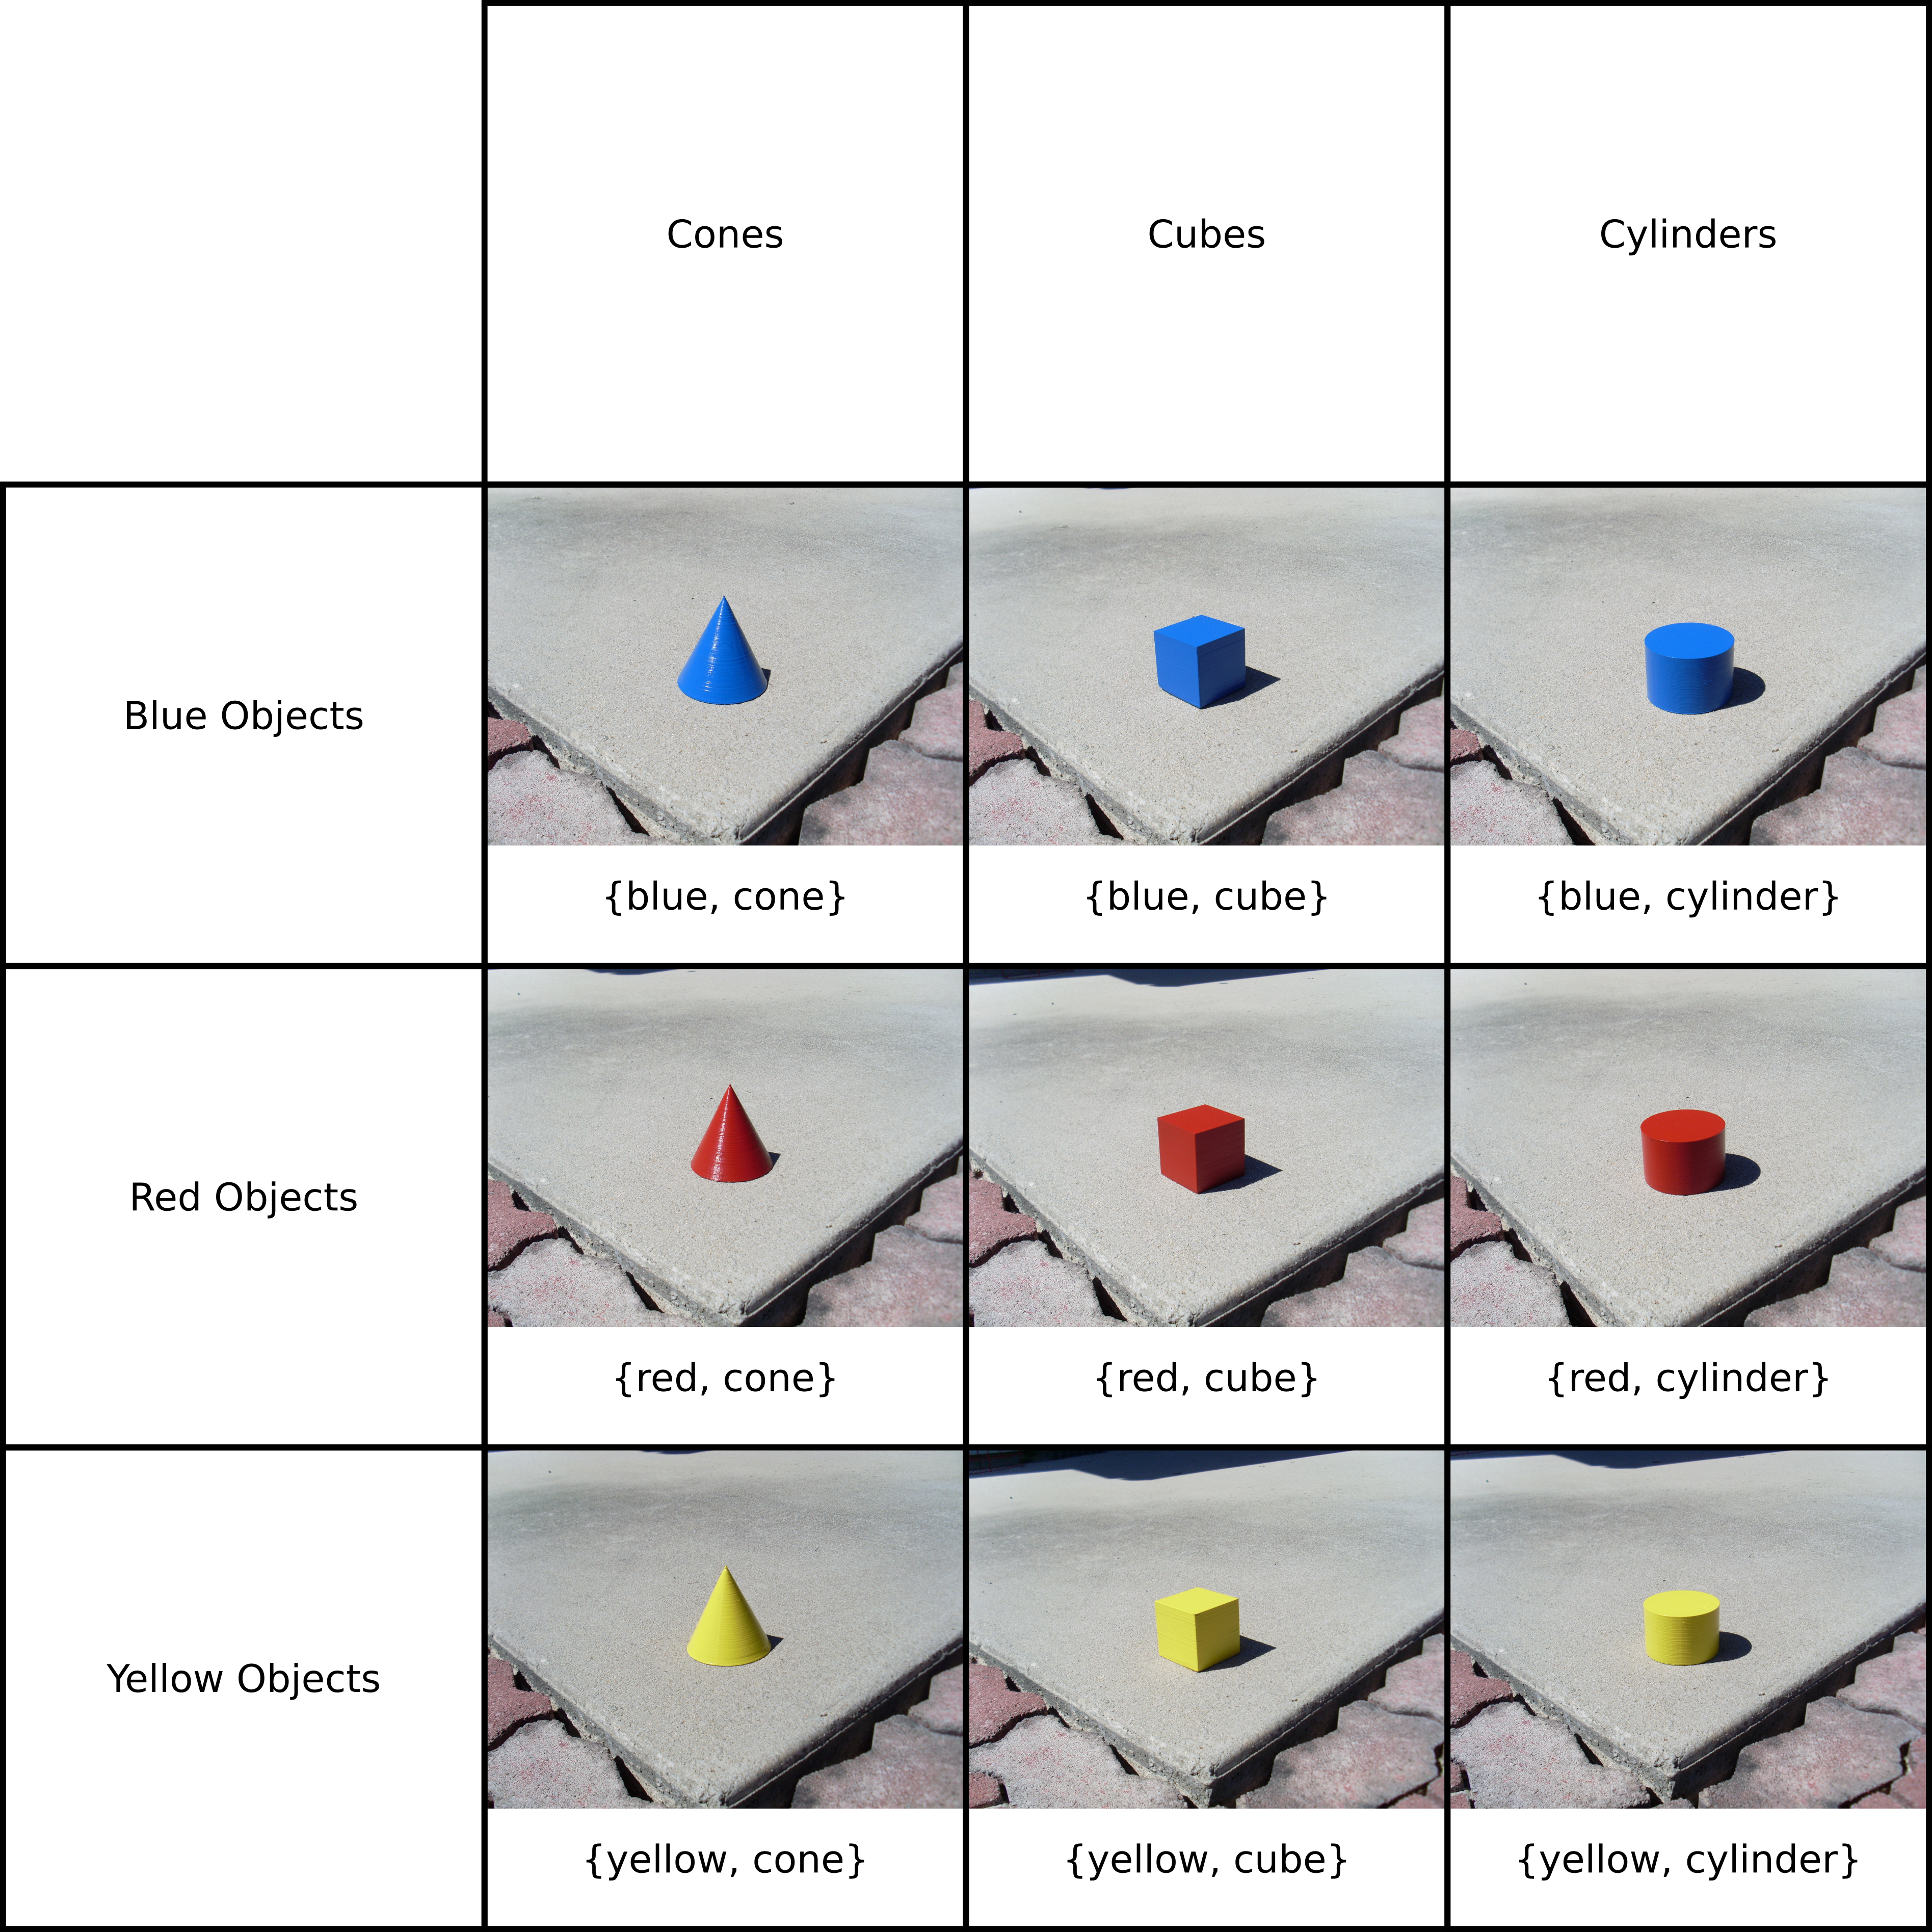
Training Objects

Slide 4
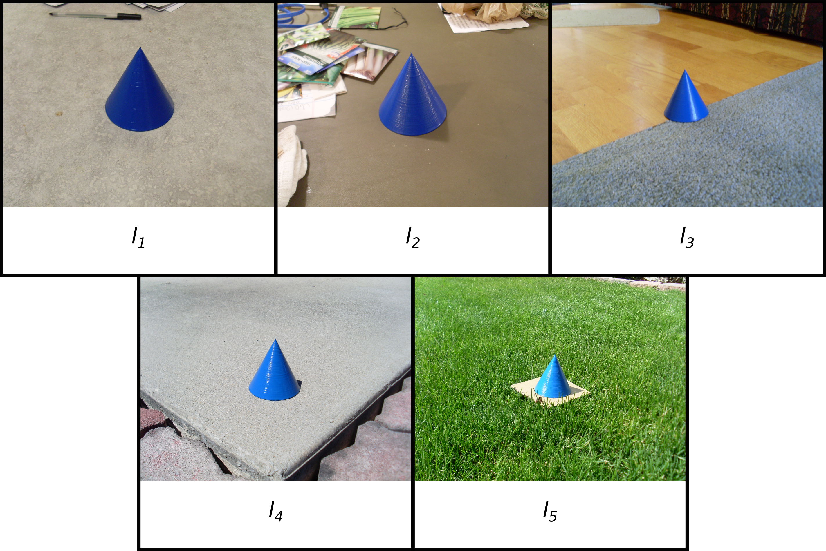
Training Locations

Slide 5
Handling Objects at Different Angles
Not really feasible for me to take all of the pictures from the exact same angle.
In addition, shouldn’t a computer be able to characterize the object at different angles?
Solution: Augment the dataset by taking many pictures of each object in each environment.

Slide 6
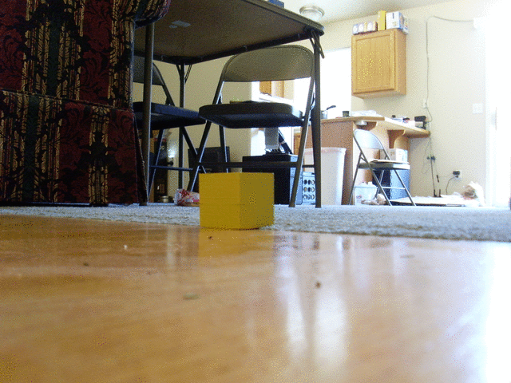
Angles

Slide 7
This is a big problem to think about!
How can we break the problem up to test different aspects of the computer’s comprehension of the characteristics?
  Tr₁: Given an object in the training set but in an unfamiliar environment, can it find the correct characteristics?
  Tr₂:Given an object not in the training set but sharing a characteristic of an object in the training set, can it find at least the trained characteristics?
  Tr₃:Given an object not in the training set but sharing a characteristic of an object in the training set but in an unfamiliar environment, can it find at least the trained characteristics?

Slide 8
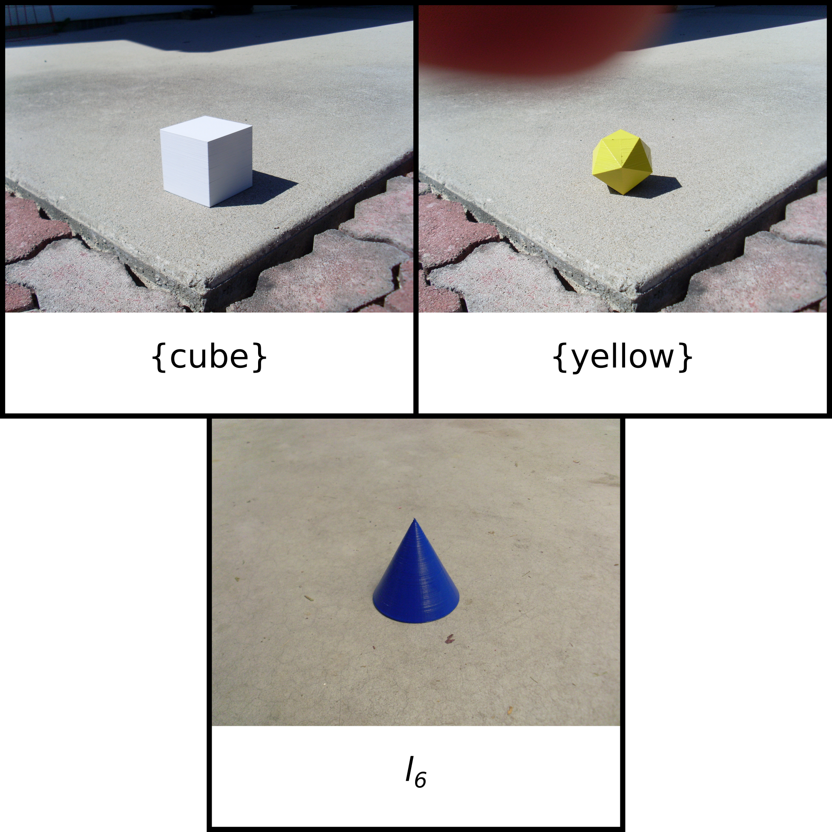
Test Objects and Test Location

Slide 9
Picking a Model
Image Processing – We should probably use a CNN.
Can we use an existing CNN framework?
Keras includes many pre-trained image classifier networks.
Let’s try each pre-trained network at several different layers.
All non-flat layers were flattened to 1 dimension.

Slide 10
Keras Models/Layers Used
Xception: {(classifier, 1000), (add_76, 102400)}
VGG16: {(classifier, 1000), (flatten, 25088), (block4_pool, 100352)}
VGG19: {(classifier, 1000), (flatten, 25088), (block4_pool, 100352)}
ResNet50: {(classifier, 1000), (activation_395, 100352), (activation_392, 100352)}
InceptionV3: {(classifier, 1000), (mixed10, 131072), (average_pooling2d_19, 131072)}
InceptionResNetV2: {(classifier, 1000), (block8_10, 133120), (block8_9_ac, 133120)}
MobileNet: {(classifier, 1000), (conv_pw_12_relu, 50176), (conv_pw_11_relu, 100352)}
DenseNet: {(classifier, 1000), (conv5_block32_concat, 94080), (conv5_block31_concat, 92512)}

Slide 11
Piggybacking on Keras Models
We can use the output of the Keras models as an input for our model.
Since Keras is doing the convolutions, let’s try a dense network.
Network structures to test:
  500, 1000, 1500 neurons per layer
  1, 3, 4 hidden layers

Slide 12
Misc Parameters
Dense layer activations: ReLU for efficiency.
Final layer activation: Sigmoid for allowing multiple outputs fire
Loss function: Binary crossentropy, as it’s really the only usable loss metric for allowing multiple outputs
Optimization function: Adam for automatic parameter finding
Metric: Accuracy
Batch size: 64
Epochs: 1-10

Slide 13
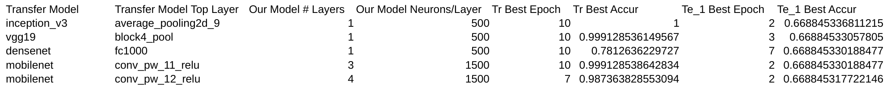
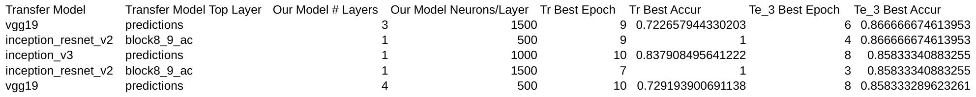
Findings

Slide 14
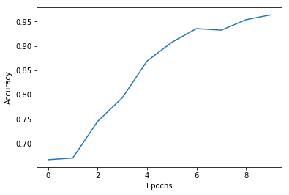
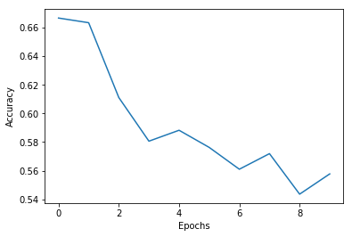
Findings
Training Accuracy
Test Accuracy

Slide 15
Conclusion – What happened?
Did we collect enough data? Was 5 training locations enough to train the network for all possible environments, or at least location 6?
Did the pre-trained network do more harm than good? What if we used a scratch-build CNN?
It’s hard to say, since NNs are black boxes.

Slide 16
Side note: GPU vs CPU
GPU
  +Speed
  −Memory
CPU
  −Speed
  +Memory

