Slide 1
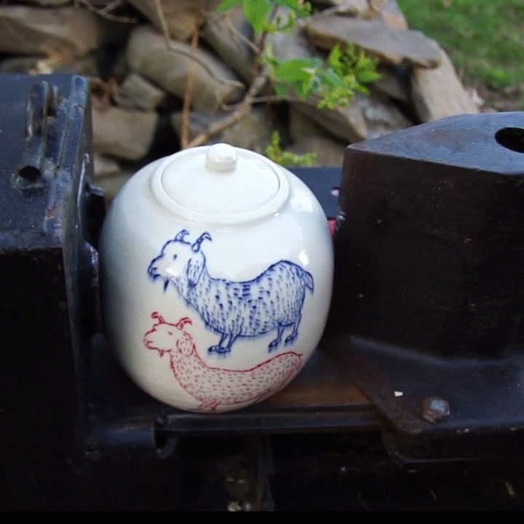
Spatiotemporal Modeling for Fractures of Rigid Objects from One or More Stationary Views
Video courtesy of Ayumi Horie (Youtube v=3ttV7iN-GU8)
Notes:
Break down the title word by word.

Slide 2
Questions We Would Like to Solve
General Physical Modeling
  Can we construct a model that is more-or-less based in classical mechanics?
  Can fragment geometry be recovered?
Fracture Event Modeling
  Can fracture events be identified in time?
  Can fragments be organized into a hierarchy?

Slide 3

“More-or-less” based in classical mechanics
Image courtesy of NASA and STScI (Space Telescope Science Institute)
Notes:
Explain the joke, but don’t belittle physicists. We just use this to say that if even physicists make simplifying assumptions about they’re models, we’re not unjustified in doing the same.

Slide 4
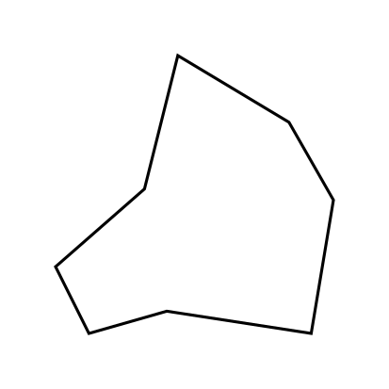
Simplified Observation Sequence
Notes:
Point out this is a 2-d object (not meant to be a 3-d object).

Slide 5

more-or-less based in classical mechanics?
Fragment
Velocity

Slide 6
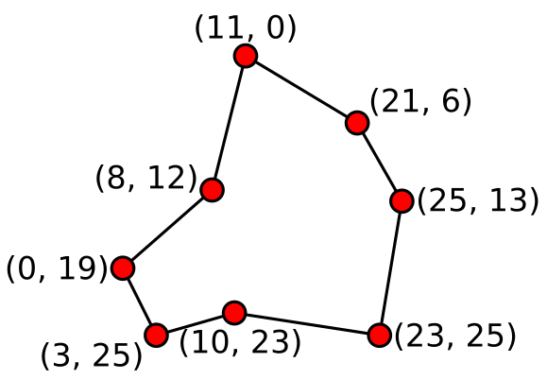
Can fragment geometry be recovered?

Slide 7
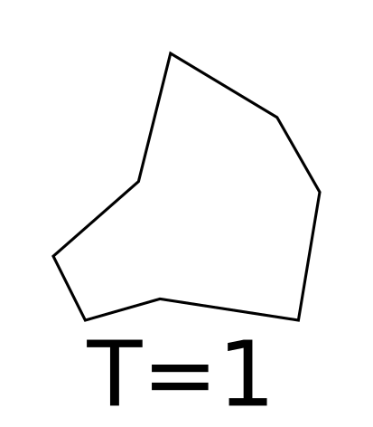
Can fracture events be identified in time?
First fracture between T=3, T=4
Second fracture between T=6, T=7

Slide 8

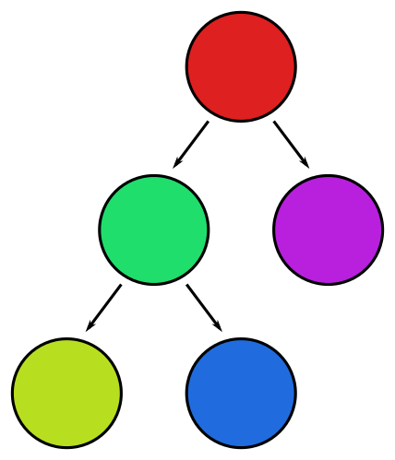
Can fragments be organized into a hierarchy?

Slide 9
Potential Difficulties
Fracture events and fragment movement happen fast, almost instantaneously, compared to a standard camera’s shutter speed (24-30 fps).
Traditional geometric reconstruction techniques do not work well with dynamic object movement or topological changes like fracture.

Slide 10
Related Work – Structure from Motion
Input: Multiple images of a single object in the world
Output: Sparse point cloud, points on the surface of the object

Slide 11
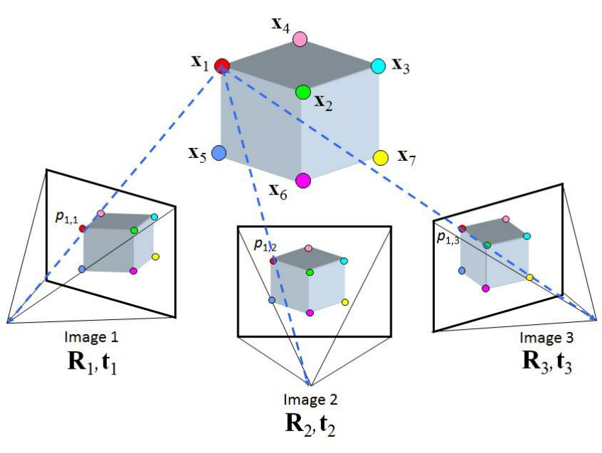
Related Work – Structure from Motion
Image courtesy of Yilmaz et Al.

Slide 12
Shortcomings of SfM
SfM techniques rely on a static scene.
To enforce a static scene, could apply SfM independently at each frame, but:
  Then there is no guarantee of the consistency of the SfM results across multiple frames of the video.
  Need to find a way to match points to objects across time
No physics modeling

Slide 13
Which of the problems does SfM solve?
General Physical Modeling
  Can we construct a model that is more-or-less based in classical mechanics?
  Can fragment geometry be recovered?
Fracture Event Modeling
  Can fracture events be identified in time?
  Can fragments be organized into a hierarchy?

Slide 14
Related Work – Voxel-based Change Modeling
“Image-based 4-d Reconstruction Using 3-d Change Detection”
  Ali Osman Ulusoy and Joseph L. Mundy
“Image Based Detection of Geometric Changes in Urban Environments”
  Aparna Taneja, Luca Ballan, Marc Pollefeys

Slide 15
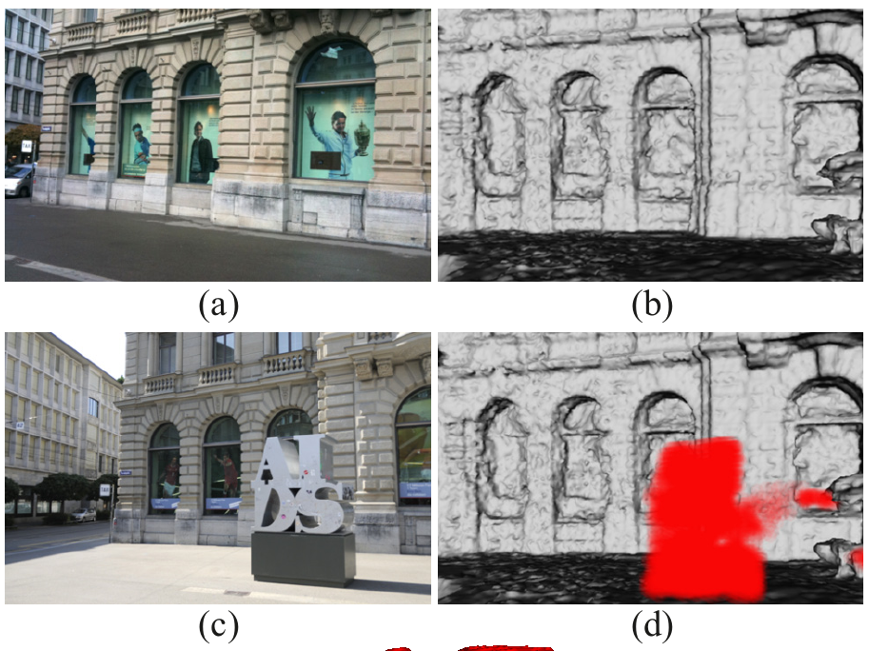
Related Work – Voxel (and Pixel)-based Change Modeling
Image courtesy of Taneja et Al.

Slide 16
Shortcomings of Voxel-based Approaches
Objects are not differentiated from each other
Assumes two image sets: one before the change and one after the change, not during the change
Provides no information about how objects move

Slide 17
Which of the problems do voxel-based approaches solve?
General Physical Modeling
  Can we construct a model that is more-or-less based in classical mechanics?
  Can fragment geometry be recovered?
Fracture Event Modeling
  Can fracture events be identified in time?
  Can fragments be organized into a hierarchy?

Slide 18
Related Work – Object-based Change Detection
“Scene Chronology”
  Kevin Matzen and Noah Snavely
“Probabilistic Temporal Inference on Reconstructed 3D Scenes”
  Grant Schindler and Frank Dellart

Slide 19
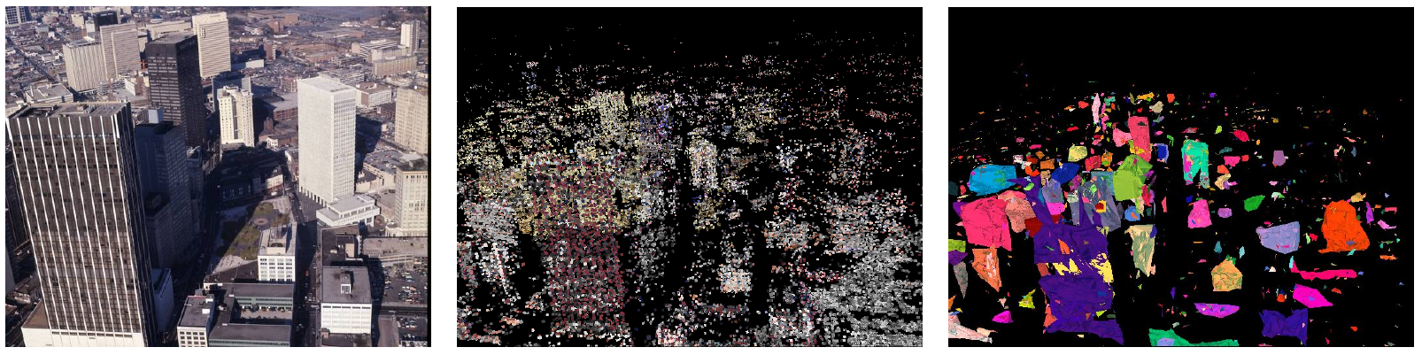
Related Work – Object-based Change Detection
Image courtesy of Schindler et Al.

Slide 20
Shortcomings of Object-based Change Detection
Objects do not move
Object topology cannot change
Objects are independent of one another

Slide 21
Which of the problems do object-based approaches solve?
General Physical Modeling
  Can we construct a model that is more-or-less based in classical mechanics?
  Can fragment geometry be recovered?
Fracture Event Modeling
  Can fracture events be identified in time?
  Can fragments be organized into a hierarchy?

Slide 22
Related Work – Video movement-based clustering
“Object Segmentation by Long Term Analysis of Point Trajectories”
  Thomas Brox and Jitendra Malik
Track how and where objects in a video move.
Cluster points on those objects based on their proximity and similarity of movement. (image segmentation)

Slide 23
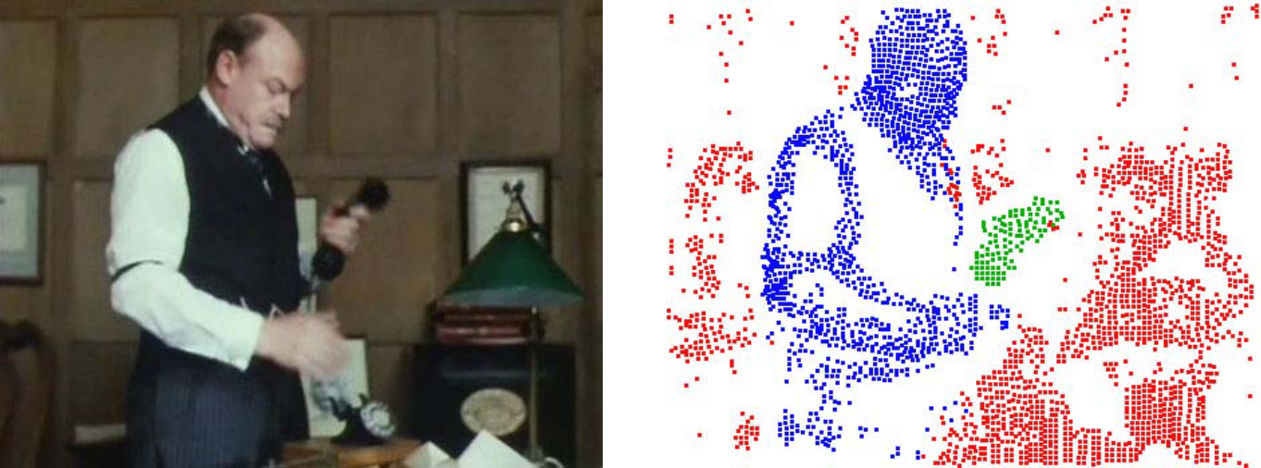
Related Work – Video movement-based clustering

Slide 24
Shortcomings of video movement-based clustering
Sparse segmentation
Because of the technique used, few points will be clustered where objects are moving apart from each other. This makes finding some boundaries imprecise.
Points will have exactly one cluster assignment over the whole video. Fracture cannot be modeled with this approach.
Segmentation is image-based, not world-based

Slide 25
Which of the problems does video movement-based clustering solve?
General Physical Modeling
  Can we construct a model that’s more-or-less consistent with classical mechanics?
  Can fragment geometry be recovered?
Fracture Event Modeling
  Can fracture events be identified in time?
  Can fragments be organized into a hierarchy?

Slide 26
Simplifying Assumptions for Our Approach
Assume the objects are rigid, that is, the only kind of discontinuous transformation allowed is fracture. (No stretching, etc.)
Assume fractures split an object into no more than two fragments at a given time.
Assume a fixed number of final fragments.
Assume fragments do not collide/interact with one another.

Slide 27
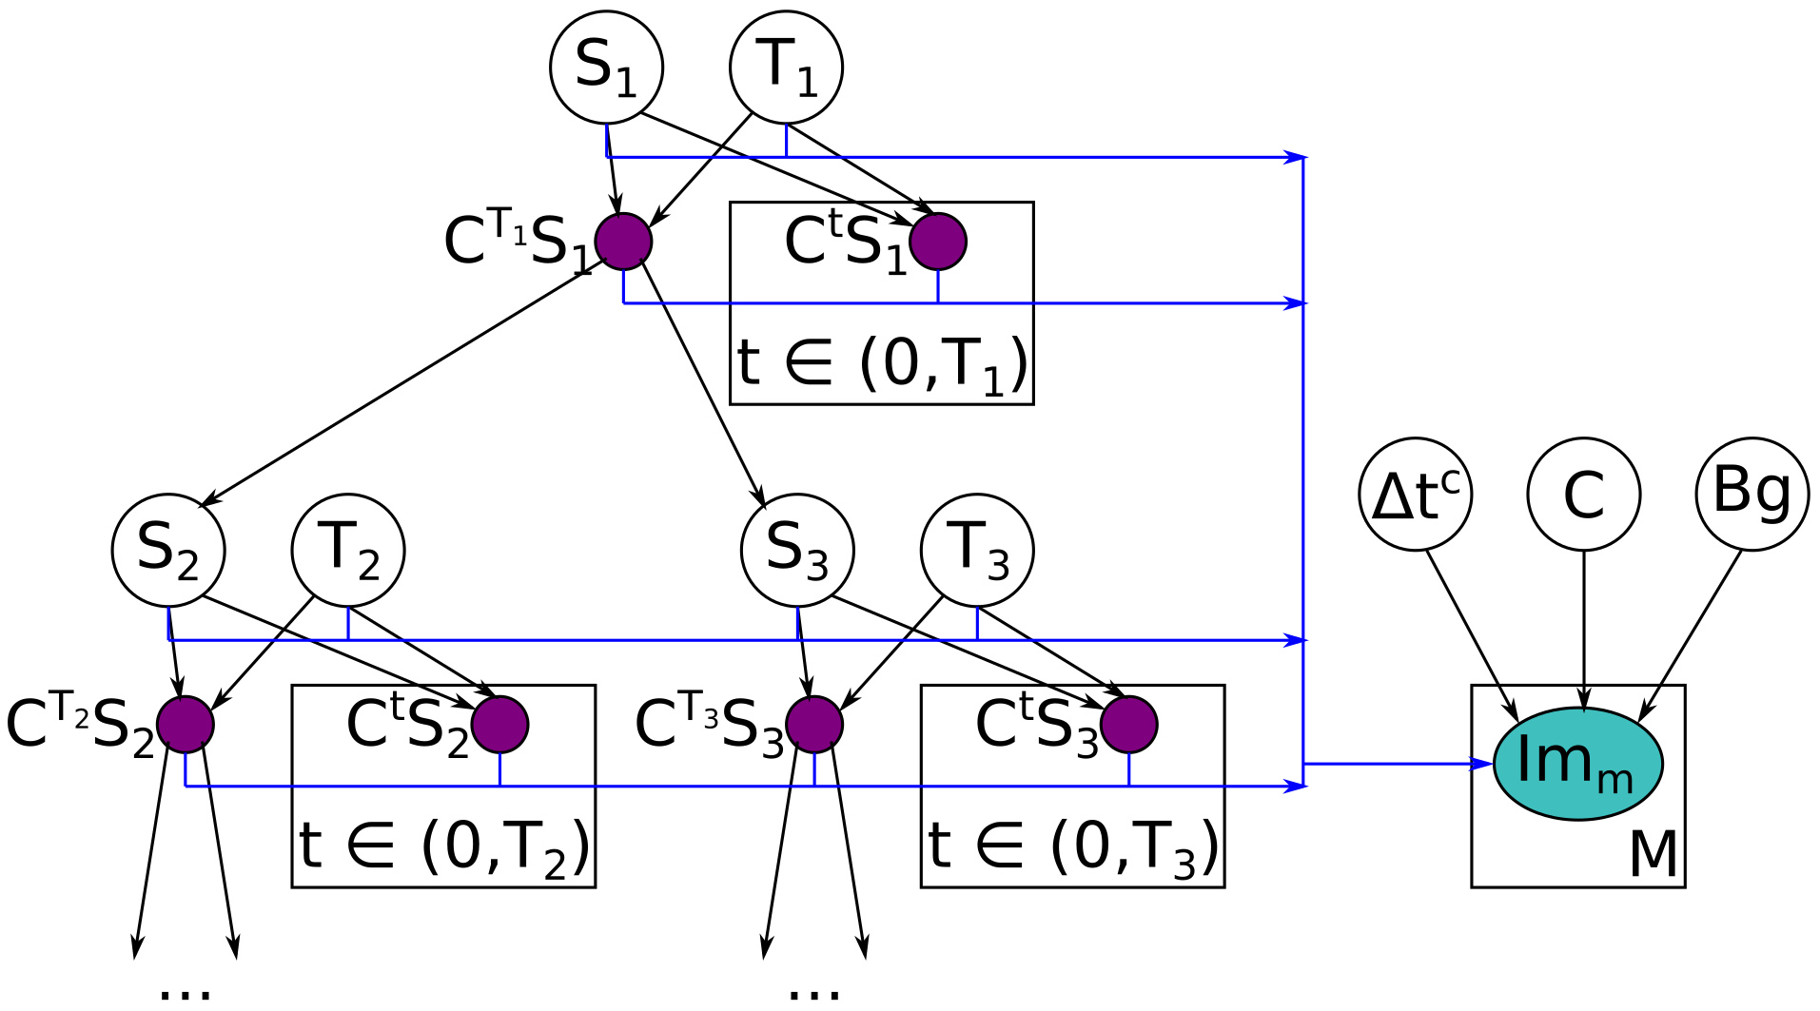
Our Approach – Bayes Net

Slide 28
Our Approach – Bayes Net

Slide 29
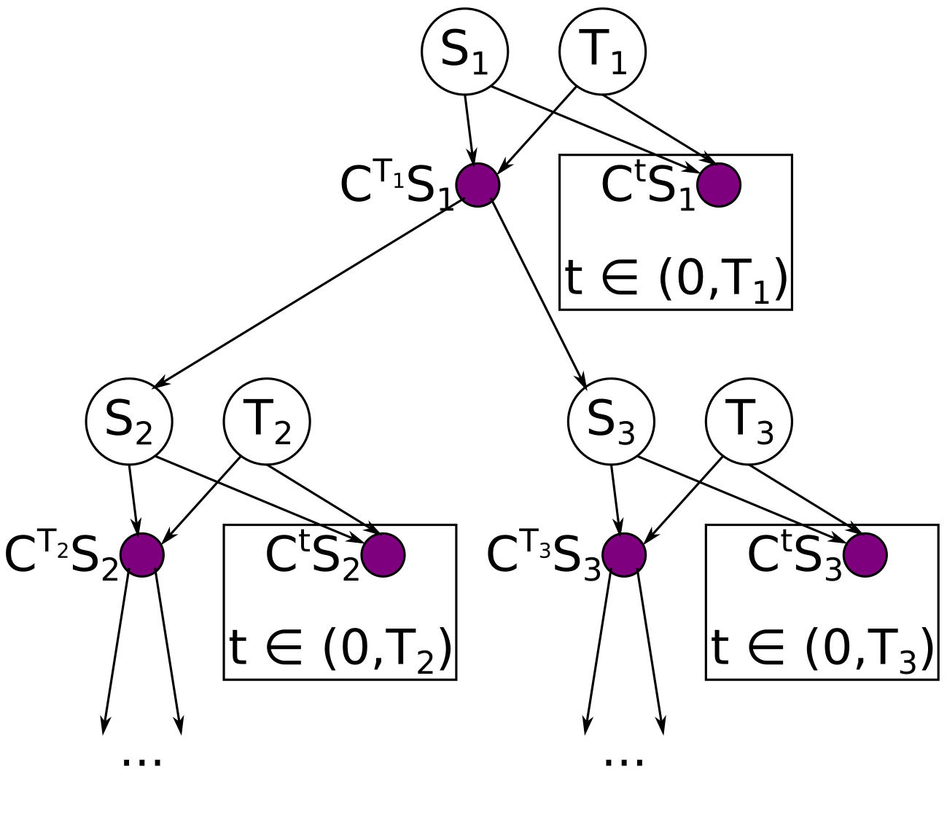
Bayes Net - Physical Modeling Side

Slide 30
Bayes Net - Physical Modeling Side

Slide 31
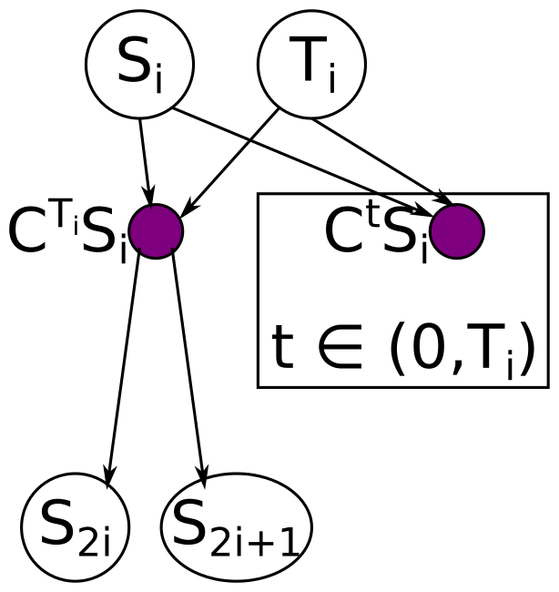
Bayes Net – Single Fragment
S_{i} – initial state (vector) of fragment i.
T_{i} – time offset at which fragment i splits into fragments 2i and 2i+1
C – state transition matrix
S_{2i}, S_{2i+1} – Initial states of the two children once S_{i} fractures

Slide 32
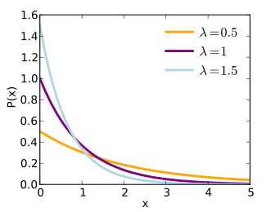
T_{i} Probability Distribution
The first fracture could happen at any time in the video
  Uniform distribution over the video time frame
Subsequent fractures should happen very quickly after the first fracture
  Exponential distribution?

Slide 33
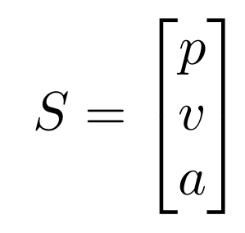
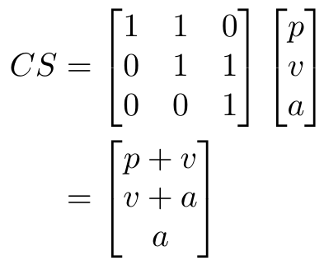
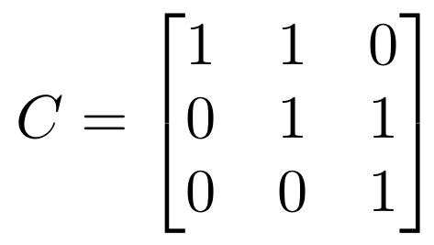
Fragment States and Transitions

Slide 34
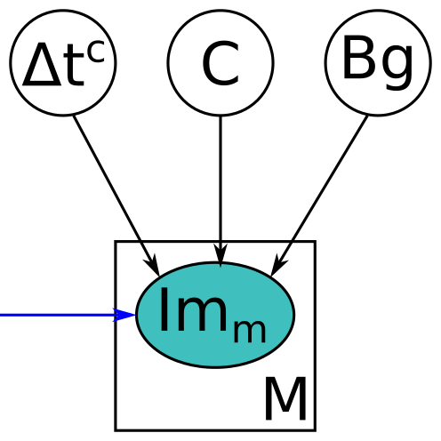
Bayes Net – Camera Observation Side
Δt^{C} – Time between frames for the camera
C – Camera matrix
Bg – Background image/geometry
Im_{m} – mth image in the video sequence

Slide 35
Complete Bayes Net

Slide 36
Which of the problems could our approach solve?
General Physical Modeling
  Can we construct a model that’s more-or-less consistent with classical mechanics?
  Can fragment geometry be recovered?
Fracture Event Modeling
  Can fracture events be identified in time?
  Can fragments be organized into a hierarchy?

Slide 37
Open Questions and Future Work
Probability distributions for Bayes Net nodes
Geometry Information
Better(?) physics model

Slide 38
Probability distributions for Bayes Net nodes
Initial State Nodes (S_{i})? Should have a similar trajectory as parent fragment’s final state. What about the first fragment’s initial state?
Δt^{C}? Probably a binary distribution between either 24 or 30.
C? No idea for this one. The camera matrix is complicated
Bg? Since the background image could be anything, this might be a uniform distribution.
Can/should these distributions be learned?

Slide 39
Geometry information
How should geometry be modeled?
  Point cloud, tetrahedra, voxels
How should geometry variables be incorporated into the Bayes Net?
How much geometric info should we expect to glean?

Slide 40
Better(?) physics model
Currently, we only model position, velocity, and acceleration.
Should we model object rotation?
Should we model application of force?
What kind of modeling is actually feasible, given the camera observations and computation limitations?

Slide 41
Questions?

