Slide 1
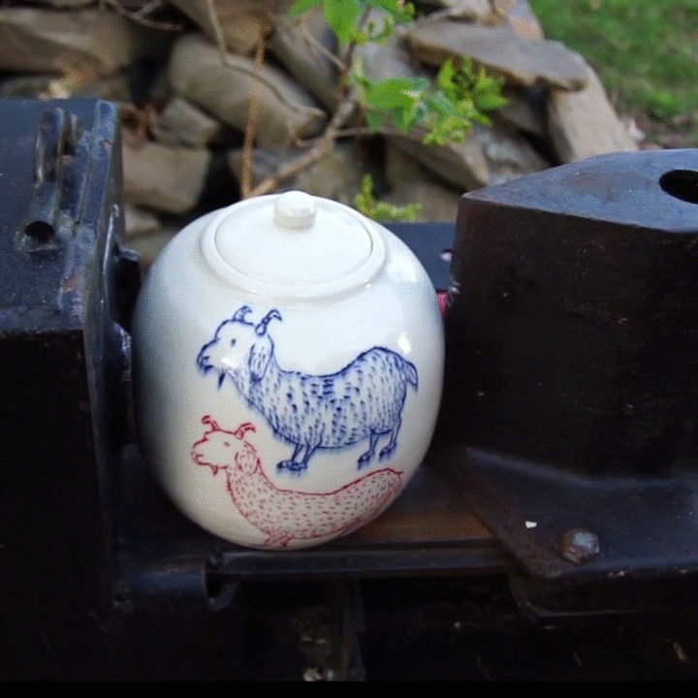
Bayesian Fracture Modeling from Video Evidence
Video courtesy of Ayumi Horie (Youtube v=3ttV7iN-GU8)
Notes:
Break down the title word by word.

Slide 2
What is our Goal?
Use machine learning to gain insights into the the world from the fracture videos.
Offload work to a machine learning framework

Slide 3
What kind of insights? How detailed should the model be?
Geometry of the fragments

Slide 4
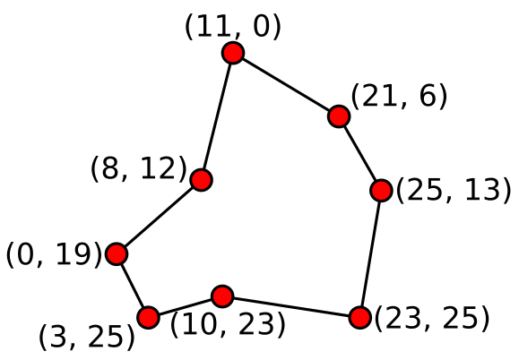
Geometry of the fragments

Slide 5
What kind of insights? How detailed should the model be?
Geometry of the fragments
Physical properties of the fragments
  Position, velocity, acceleration

Slide 6
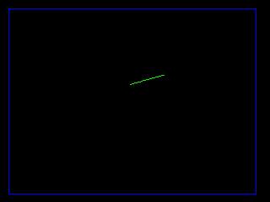
Physical properties of the fragments

Slide 7
What kind of insights? How detailed should the model be?
Geometry of the fragments
Physical properties of the fragments
  Position, velocity, acceleration
Fracture event details
  Time of fracture
  Any additional force added to the system
  How many fragments were there?
  Geometry of the fracture boundary/partition

Slide 8
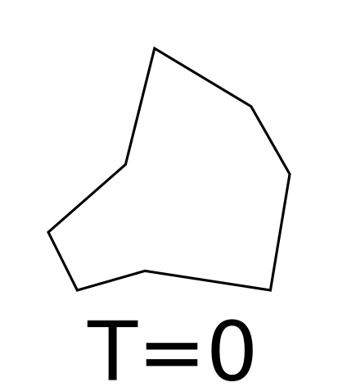
Time of fracture
First fracture:
  T=4
Second fracture:
  T=7

Slide 9


How many fragments were there? (3, in this case)

Slide 10
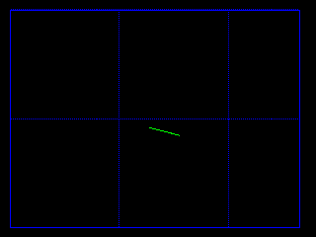
Previous Work – Simple stick in 2-d

Slide 11
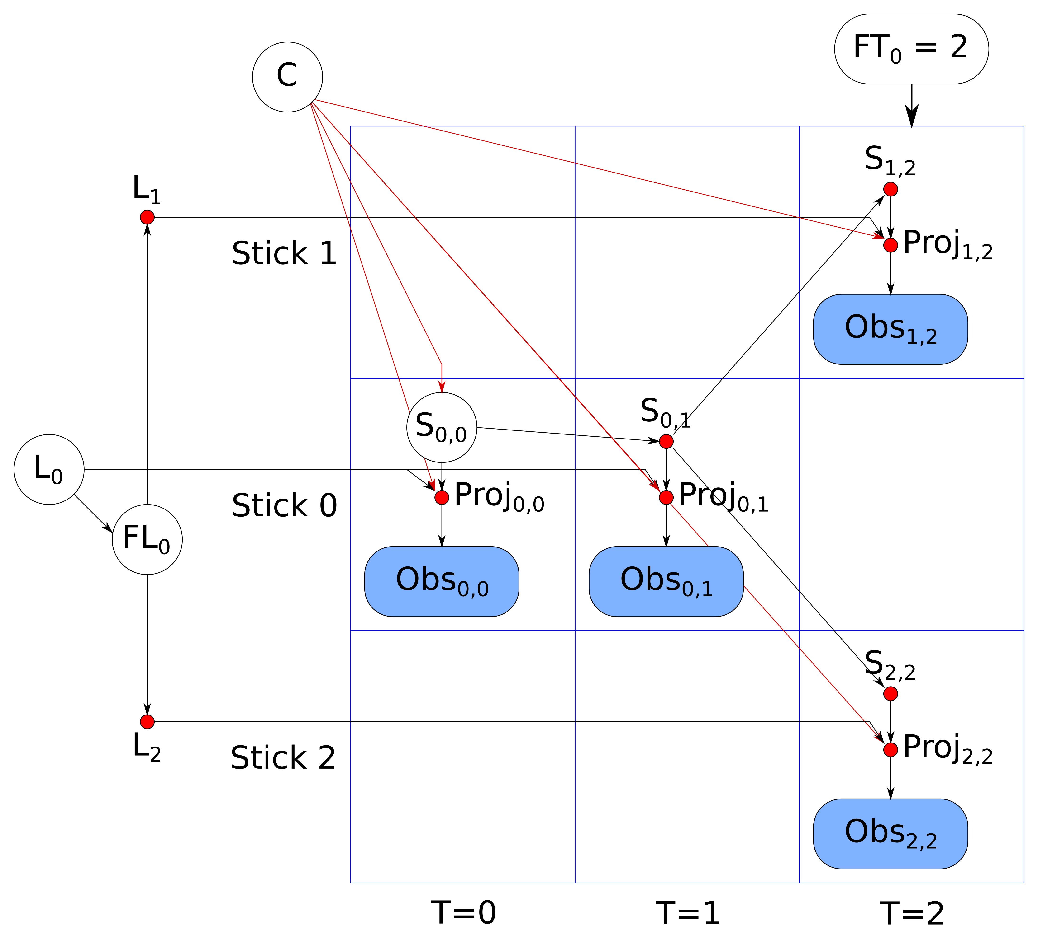

Slide 12
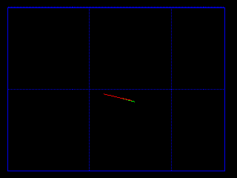
Noisy Observations (stick in 2-d)

Slide 13
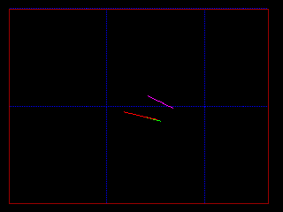
Inference with MCMC

Slide 14
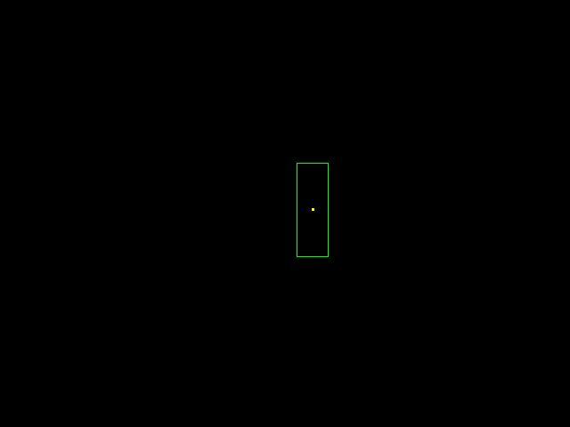
Increasing Object Dimensionality

Slide 15
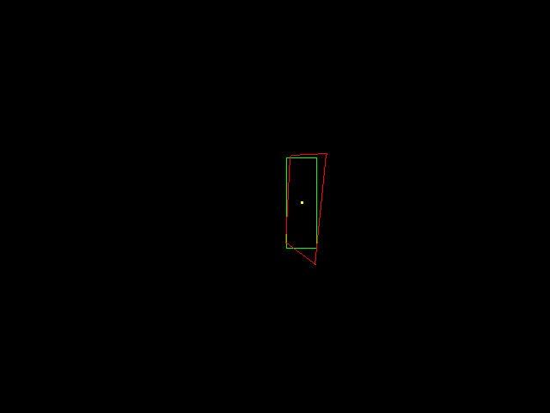
Noisy Observations (block in 2-d)

Slide 16
Future Work
Dealing with unknown dimensionality. (We don’t know how many fragments there are.)
Increasing embedding space dimensionality (to 3-d)
Increasing object dimensionality (to 3-d)
Incorporating energy added to the system
Collision
Incorporating image data
  Image pre-processing. Can this be done in a Bayesian way?
  What should our likelihood term look like?
Improving inference
  Can we use HMC with truncated distributions?

