Slide 1
Metropolis-Hastings for 2D Binary Block Fractures
Simon Swenson

Slide 2
Research Question
Is the Metropolis-Hastings random walk algorithm working correctly?
Is Metropolis-Hastings random walk adequate for the 2D block model with a single, binary fracture?

Slide 3
Preliminary Results
Single data set
Single exploration rate (1.5^5)
16 Markov chains
1,000,000 iterations
Metric: log probability
  log(p(θ)p(D|θ))

Slide 4
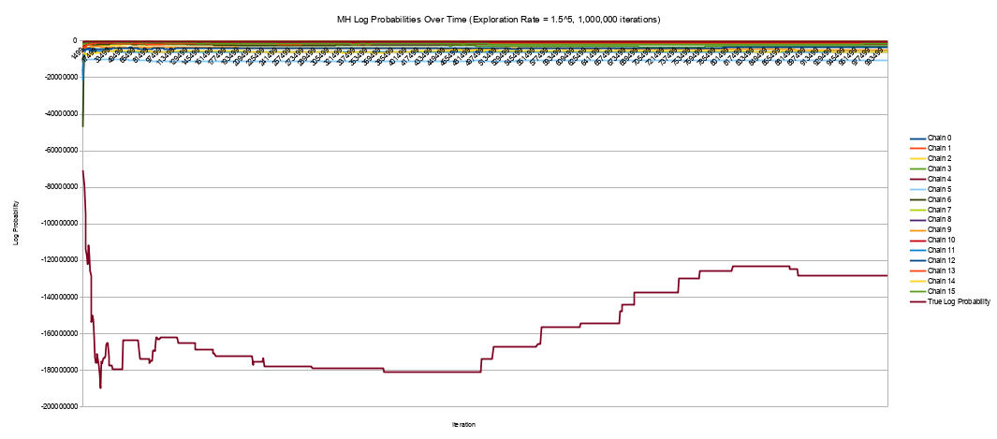
Preliminary Results – All Chains

Slide 5
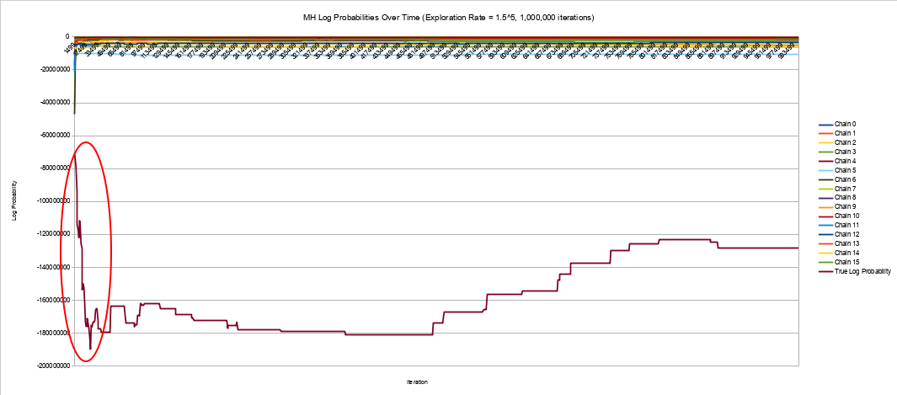
Preliminary Results – All Chains

Slide 6
Insights
Chain 4 is an outlier
Chain 4 has many rejections in a short amount of time, and loses a significant amount of probability.
  e^(-8,000,000) → e^(-19,000,000)
If the MH resampler is working correctly, this would have an extremely low probability of happening.
Conclusion: The resampler is likely not working correctly.

Slide 7
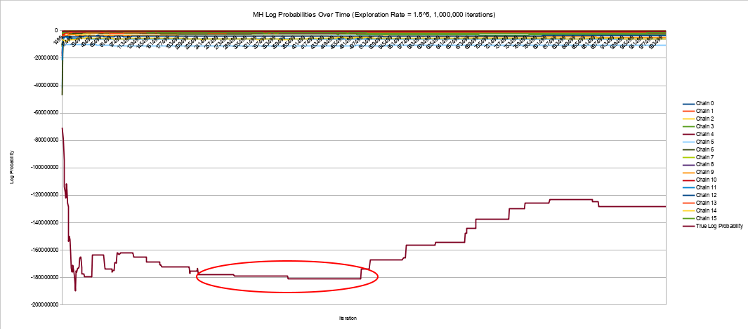
Preliminary Results – All Chains

Slide 8
Insights
Samples are still being rejected.
Conclusion: While samples are being rejected, the condition for rejection is probably not correct.

Slide 9
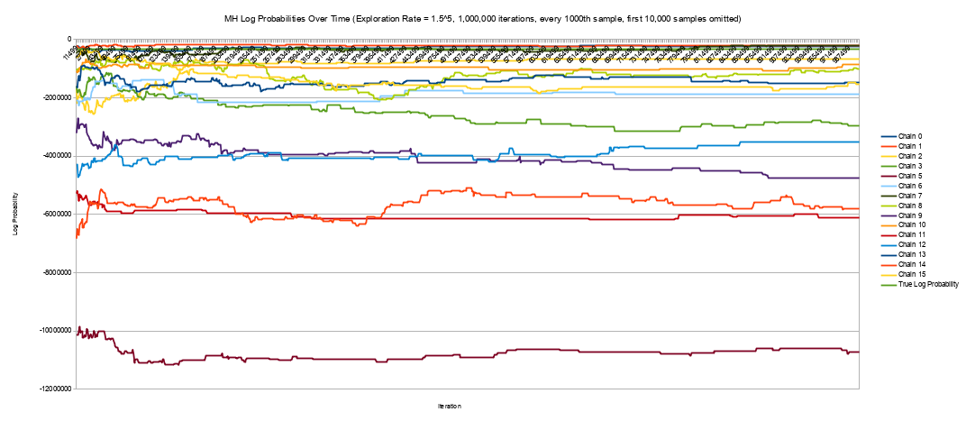
Preliminary Results – Outlier Removed, After Stabilization

Slide 10
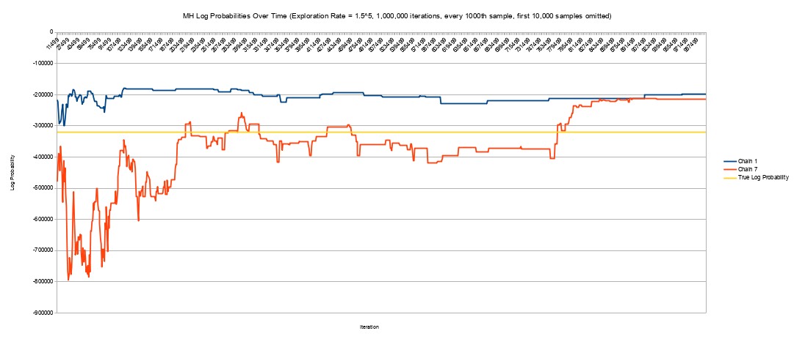
Preliminary Results – Best Two, After Stabilization

Slide 11
Insights
Two chains go above the ground truth probability.
The noise for observations in this model is extremely small:
  σ = sqrt(im_h * im_w)/512 = sqrt(640 * 480)/512 ≈ 1.08 pixels
The observed variables greatly outnumber the hidden variables:
  8 unobserved variables << 4 endpoints * 1 block * 1 frame + 4 endpoints * 2 blocks * 29 frames
  8 << 236
These two facts, combined, make going above the ground truth probability extremely unlikely.
Conclusion: The resampler is likely not working correctly.

Slide 12
Bugs?...

Slide 13
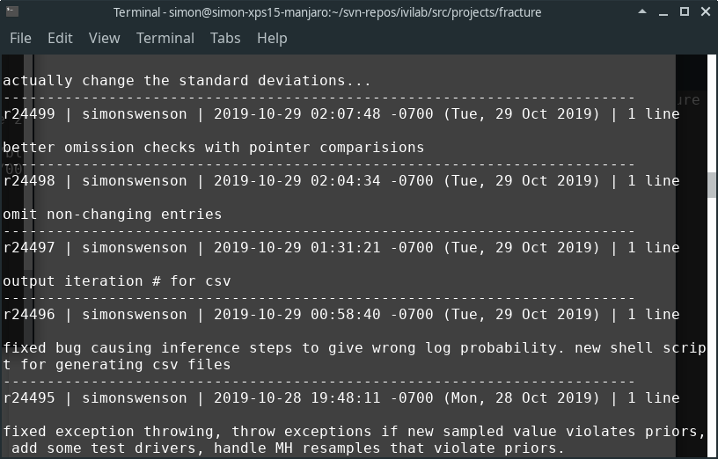
Bugs?... A few!

Slide 14
Have all the bugs been fixed?
Is Metropolis-Hastings acting how it should act?
High exploration rate behavior:
  Many rejections
  Low chance of accepting a lower probability state, since the proposals will be farther away and thus have a much different probability.
Low exploration rate behavior:
  Fewer rejections
  A non-negligible chance of accepting a lower probability state, since the proposals are so close to the previous state.

Slide 15
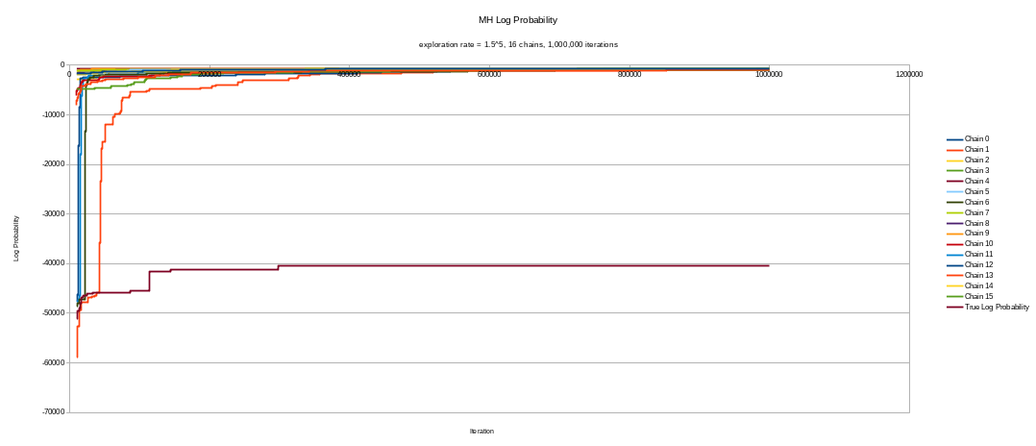
Proper Results – Higher Exploration Rate

Slide 16
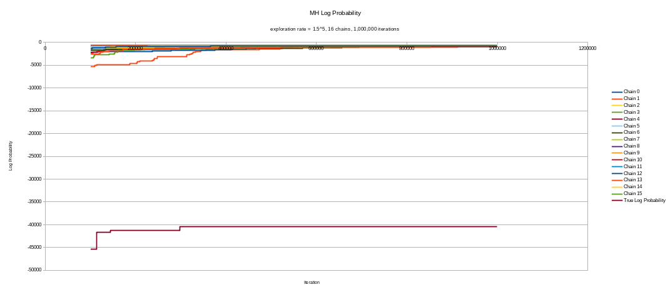
Proper Results – Higher Exploration Rate

Slide 17
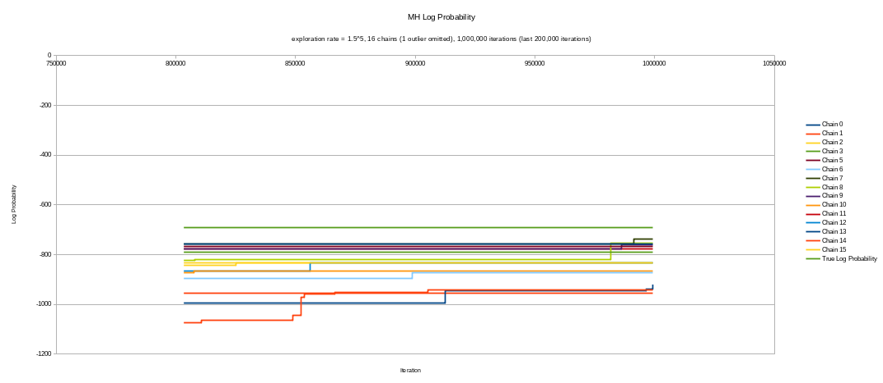
Proper Results – Higher Exploration Rate

Slide 18
Insights
The algorithm is appearing to behave as MH should for higher exploration rates.
Many of the proposals are rejected.
The probability of accepting a proposal with a lower probability than the current state is extremely low, since the exploration rate brings it to more distant states.
One outlier
  Did it just take too long to converge?
  Is it approaching a local minimum?

Slide 19
Proper results – Lower Exploration Rate

Slide 20
Proper results – Lower Exploration Rate

Slide 21
Insights

Slide 22
Future Work
Explore other metrics, like euclidean distance between an inference sample and the ground truth, in terms of the 8 hidden variables.
  May be able to identify multiple local minima that happen to have similar probabilities
Qualitative results: Output MAP images. Do they look good? If not, why?
  Another bug?
  Is our model defined well?
Explore other inference algorithms and compare between them.

