Slide 1
State Management with the Store
Lesson 20.3

Slide 2

Let’s Talk About Pure Functions
And why they’re better than impure functions.
Pure Functions Impure Functions
Pure functions are straightforward with singular purposes.
No side effects inside the function.
Whenever data is modified, it is stored in a new variable.
Include side effects like database and network calls.
Often modify the values that are passed in.
Redux

Slide 3
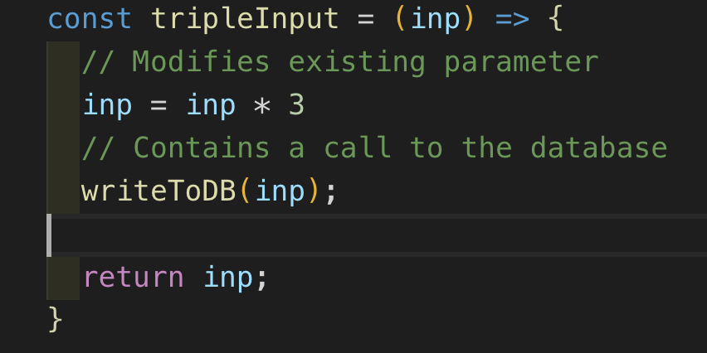
Here’s an Impure Function
Pure vs. Impure functions

Slide 4
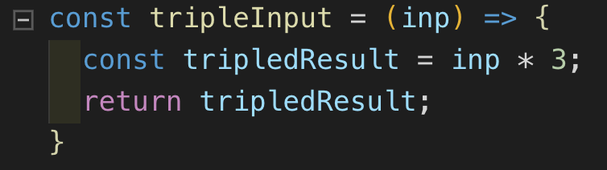
Here’s a Pure Function
Pure vs. Impure functions

Slide 5
Creating pure functions is an effective technique to apply to all of your JavaScript, but it is especially useful when creating React components.
Redux

Slide 6

Redux
Redux is a state management library that helps organize the state of complex applications. Redux requires a lot of boilerplate code, but its utility skyrockets as applications get more complex.
Instead of learning about the Redux library, we will focus on the concepts and design patterns that Redux uses. After learning how to create each function from scratch, we will implement a Redux-like state management system in a small CMS app.

Slide 7
Actions, Reducers, and Store
Today, we will cover three core Redux topics
Action
A declarative object that defines what the store should do to the state.
Reducer
Handles all actions by taking in the previous state and returning a new state.
Store
Grants the entire application access to the reducer function and the global state.

Slide 8
The Principles of Redux

Slide 9
Principle 1: State Tree
The first premise of Redux is that every stateful aspect of your application can be represented by a single JavaScript object known as the state tree.
console.log(store.getState())
/* Prints
{
visibilityFilter: 'SHOW_ALL',
todos: [
{
text: 'Consider using Redux',
completed: true,
},
{
text: 'Keep all state in a single tree',
completed: false
}
]
}
*/

Slide 10
Principle 2: Read Only
The second principle of Redux is that the state tree is read-only. This means that in order to change the state tree, you need to dispatch an action. The action describes the change that the state will undergo in a declarative manner.
store.dispatch({
type: 'COMPLETE_TODO',
index: 1
})
store.dispatch({
type: 'SET_VISIBILITY_FILTER',
filter: 'SHOW_COMPLETED'
})

Slide 11
Principle 3: Changes are made with pure functions
Try to make your reducers pure functions. It is considered bad practice to use side effects inside reducer functions.
function visibilityFilter(state = 'SHOW_ALL', action) {
switch (action.type) {
case 'SET_VISIBILITY_FILTER':
return action.filter
default:
return state
}
}
case 'COMPLETE_TODO':
return state.map((todo, index) => {
if (index === action.index) {
return Object.assign({}, todo, {
completed: true
})
}
return todo
})
default:
return state
}
}

Slide 12
Let’s Get Started!

