Slide 1
CP1406 – Week 2
Building a Webpage Template with HTML 5

Slide 2
Introduction
Building a website from scratch involves a lot of time and planning
Professional web design services are in high demand
Planning before building a website is useful
Includes meeting with clients or stakeholders to discover needs, the purpose of the website, and target audience

Slide 3
Designing a Website
Activities involved in designing a website
Planning
Articulating the website’s purpose
Identifying the target audience
Creating a site map and wireframe
Selecting graphics and colours to use in the site
Determining whether to design for an optimal viewing experience across a range of devices – cross-platform, responsive

Slide 4
Identify Your Goal(s) – Starting Point
Every site has at least one goal
Designing to best achieve that is your goal as a Web designer and developer
Examples
sell new or existing products
promote your business and develop your brand
reduce printing costs or call centre overhead
... what else?

Slide 5
Identify Your Goal(s)
Can you write a short (one- to three-sentence) mission statement that clearly states the site's goal(s)?
What does the client hope to gain from creating and maintaining a Web site?
How will the success of the site be judged?
This question helps check if the goal is valid
If you can't measure the success of the mission, you should change the mission until you can

Slide 6
Compare These Mission Statements
Training Zone is a company that has been around for over 150 years. They specialise in training people in IT and management skills. This website presents information about the company, its history, some sample articles, contact information and links.
The website is intended to increase revenue for Training Zone by promoting the services offered by the company in order to get people to sign up for these services online – increasing both new and repeat customers.

Slide 7
Establish Your Target Audience
Determining who will visit your website is the key to understanding why you need a website, and identifying what it should include.
Design your sites with those visitors in mind.
If you can determine why your visitors will want to visit your site, you can identify your site’s primary purpose and goals.

Slide 8

Design For Your Target Audience
Who is the target audience?
Now how will that affect your design?
Design specifically to suit your specific audience
It is very important to see the connection between planning and design. E.g., If we don't design the site to suit our intended target audience then there's no point knowing the target audience.

Slide 9
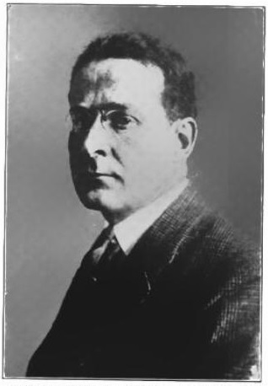
Can you design for "everybody"?
"I can't give you a sure-fire formula for success, but I can give you a formula for failure: try to please everybody all the time."
Herbert Bayard Swope Sr. (1882 – 1958)
The first and three-time recipient of the Pulitzer Prize for Reporting.

Slide 10
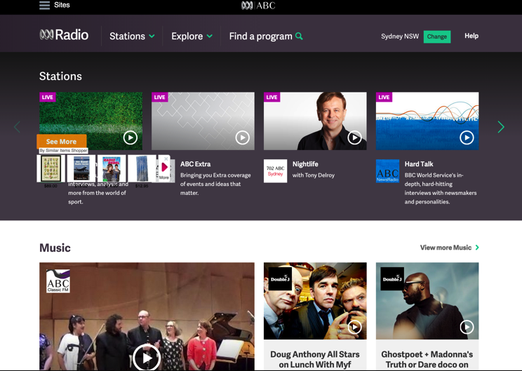
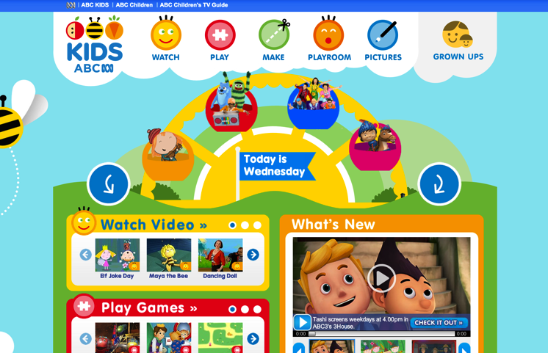
Design For Your Target Audience
Who is the target audience for:
http://www.abc.net.au/radio/
http://www.abc.net.au/abcforkids/

Slide 11
Designing a Website - Example
Purpose of the Website | To promote fitness services and gain new clients. The Forward Fitness Club mission: facilitate a healthy lifestyle and help our clients meet their fitness and nutrition goals.
Target Audience | Forward Fitness Club customers are adults between the ages of 18 and 50 within the local community.
Multiplatform Display | Forward Fitness Club recognises the growth in smartphone and tablet usage and wants a single website that provides an optimal viewing experience regardless of whether visitors are using a desktop, laptop, tablet, or smartphone.
Wireframe and Site Map | The initial website will consist of five webpages arranged in a hierarchal structure with links to the home page on every page. Each webpage will include a header area, navigation area, main content area, and footer area.
Table 2–1 Forward Fitness Club Website Plan

Slide 12
Designing a Website
Graphics | Forward Fitness Club wants to display its fitness equipment and logo to help with local branding. Photos of the facility, members, and staff will increase visual appeal.
Colour | Forward Fitness Club wants to use black and white as the primary colours for a clean, sophisticated look.
Typography | To make the content easy to read, the website will use a serif font style for paragraphs, lists, and other body content, while providing contrast by using a sans serif font style for navigation links and headings – more on Typography later
Accessibility | Standard accessibility attributes, such as alternative text for graphics, will be used to address accessibility.
Table 2–1 Forward Fitness Club Website Plan

Slide 13
Site Map
Indicates how the pages in a website relate to each other
Example: Forward Fitness Club website
Home page: Introduces the fitness centre and its mission statement
About Us page: Showcases the facility’s equipment and services
Classes page: Includes a schedule of available group training and fitness classes
Nutrition page: Provides nutrition tips and simple meal plans
Contact Us page: Provides a phone number, email address, physical address, and form for potential clients to request additional information about the fitness centre’s services

Slide 14
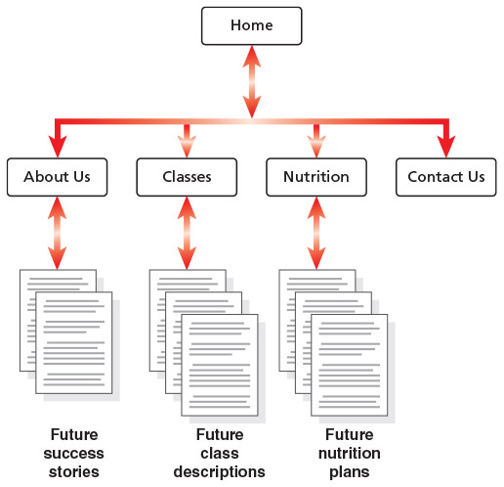
Site Map
Example: Forward Fitness Club website
Figure 2–2

Slide 15
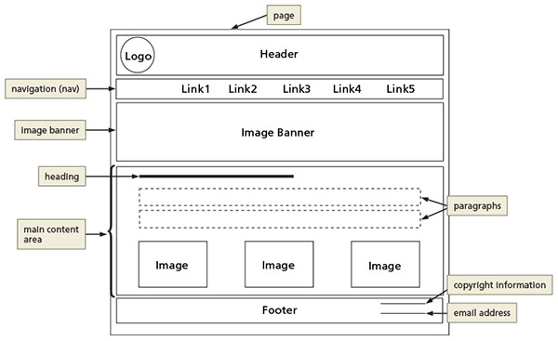
Wireframe
Wireframe depicts the layout of a webpage, including its major content areas
Figure 2–3

Slide 16
File Management
Websites use several types of files
HTML files, images, media such as audio and video files, CSS and JavaScript files
Sites should follow a systematic method to organise files
The main folder, also called the root folder, contains all files and other folders for the website

Slide 17
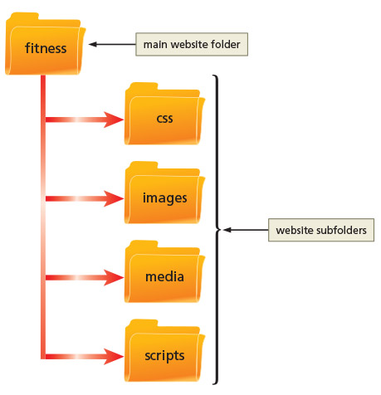
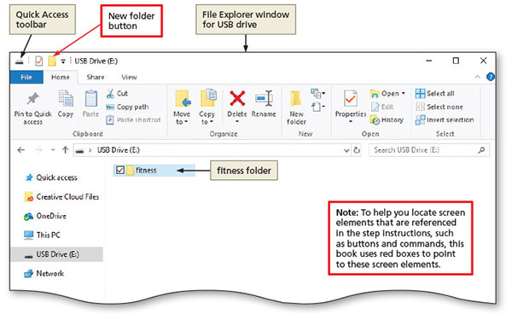

Create a website folder and subfolders
Figure 2-4, 2-5

Slide 18
Using HTML 5 Semantic Elements
Begin a new HTML document by adding the basic required HTML elements
DOCTYPE, html, head, and body elements
HTML 5 introduced several new semantic elements with standardised names
Name of each tag reflects the purpose
header
nav
main
footer

Slide 19
Using HTML 5 Semantic Elements
Element | Description
<header>… </header> | Indicates the header information on the webpage. Header content typically consists of a business name or logo and is commonly positioned immediately after the opening <body> tag.
<nav>…</nav> | Indicates the start and end of a navigation area within the webpage. The nav element contains hyperlinks to other webpages within a website and is commonly positioned immediately after the closing </header> tag.
<main>… </main> | Indicates the start and end of the main content area of a webpage. Contains the primary content of the webpage. Only one main element can appear on a page.
Table 2-2

Slide 20
Using HTML 5 Semantic Elements
Element | Description
<footer>… </footer> | Indicates the start and end of the footer area of a webpage. Contains the footer content of the webpage.
<section>… </section> | Indicates the start and end of a section area of a webpage. Contains a specific grouping of content on the webpage.
<article>… </article> | Indicates the start and end of an article area of a webpage. Contains content such as forum or blog posts.
<aside>… </aside> | Indicates the start and end of an aside area of a webpage. Contains information about nearby content and is typically displayed as a sidebar.
Table 2-2

Slide 21
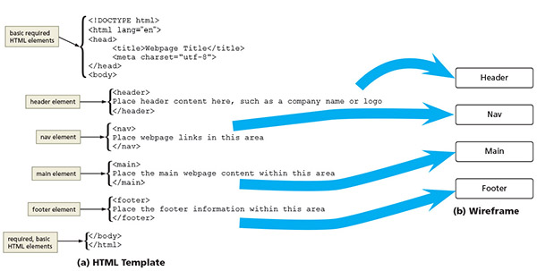
Using HTML 5 Semantic Elements
Figure 2–7

Slide 22
Creating a Webpage Template
A hallmark of a well-designed website is that its webpages have the same look and feel
Pages have the same layout, colour scheme, typography, and style of graphics
Elements work the same way on each page

Slide 23
Creating a Webpage Template
Templates are used to make sure webpages in a site share a standard layout
HTML document containing elements that should appear on each page
Instead of creating a webpage from scratch, open the template document in a text editor and save it using the name of the new webpage
Notes:
(This slide is intentionally different – point out the problem!)

Slide 24
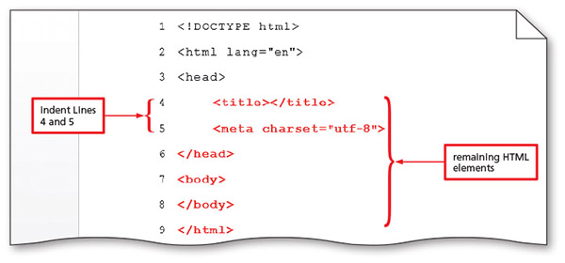
Creating a Webpage Template
Create a webpage template
An HTML document with the HTML elements that define the webpage structure
Figure 2–10

Slide 25
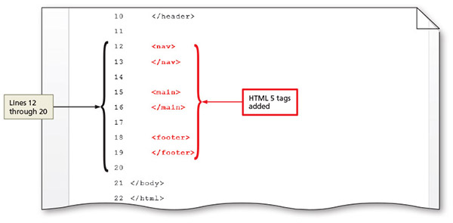
Creating a Webpage Template
Add HTML 5 semantic elements to a webpage template
Define content areas
Figure 2–12

Slide 26
Comments
Comments can provide additional information about the areas within the webpage
Add a comment before a tag using the following tag:
<! - - Place your comment here - - >
Word wrap causes text lines to break at the right edge of the window and appear on a new line
All entered text is visible in the editor window

Slide 27
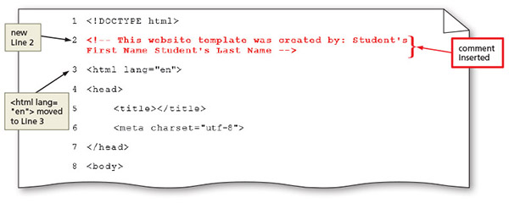
Comments
Add comments to a webpage template
Figure 2–14

Slide 28
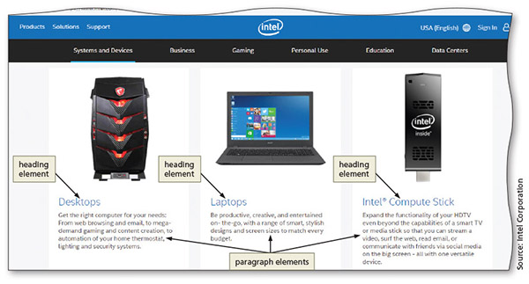
Heading Elements
Heading elements provide a title or heading before a paragraph of text or section of a page
Indicate that a new topic is starting and typically identify or summarise the topic
Appear in a larger font size than normal text
Make it easy for users to quickly scan the page and identify its sections
Figure 2–18

Slide 29
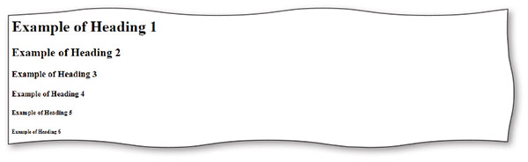
Heading Elements
Figure 2–19

Slide 30
Webpage Content
Static content that will appear on every webpage can be added to the template
Business name or logo, links, and the footer information
Example of content added between header tags:
<header> <h1>Forward Fitness Club</h1>
<h2>Subheading…</h2>
</header>

Slide 31
Using Symbol Entities
A symbol can be added to an HTML webpage by typing its HTML entity name or entity number
Inserting an HTML character entity in the code displays a reserved HTML character on the webpage
Entity name is an abbreviated name
Entity number is a combination of the pound sign (#) and a numeric code

Slide 32
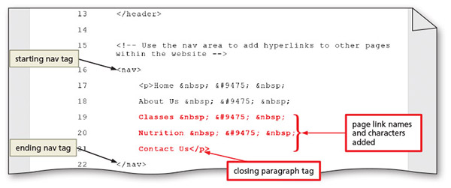
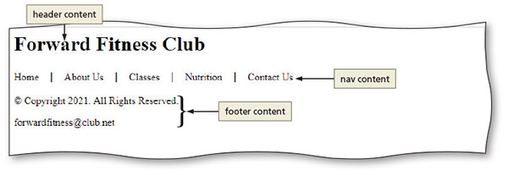
Using Symbol Entities
Add text and nonbreaking spaces to the nav section
Figure 2–23

Slide 33
Using Symbol Entities
Character | Description | Entity Name | Entity Number
© | Copyright symbol | &copy; | &#169;
® | Registered trademark | &reg; | &#174;
€ | Euro | &euro; | &#8364;
& | Ampersand | &amp; | &#38;
< | Less than | &lt; | &#60;
> | Greater than | &gt; | &#62;
 | Nonbreaking space | &nbsp; | &#160;
Table 2–3 Common Symbol Entities

Slide 34
Validating HTML Documents
After creation of an HTML file, the document can be validated to verify HTML code validity
Validator checks for errors, indicates where they are located, and suggests corrections
If the validator detects an error in the code, it displays a warning
Errors and warnings should (almost always) be fixed

Slide 35
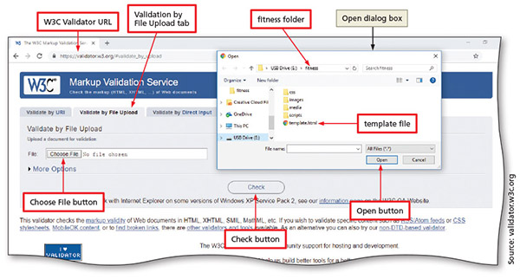
Validating HTML Documents
Validate the webpage template
Figure 2–26

Slide 36
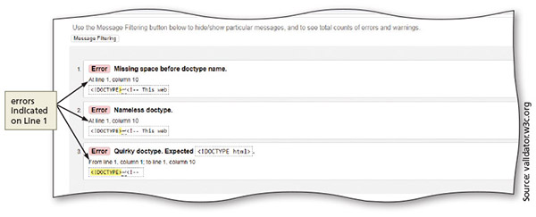
Validating HTML Documents
Validate an HTML document with errors
Figure 2–29

Slide 37
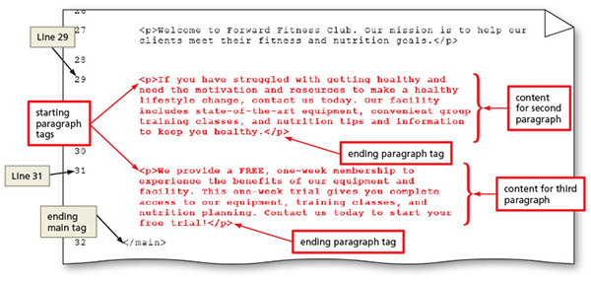
Creating a Home Page Using a Webpage Template
Create a home page using the webpage template (save time) and add content
Figure 2–31

Slide 38
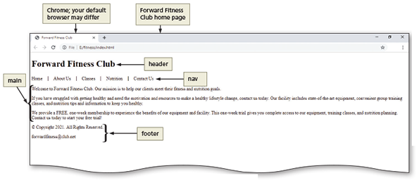
Creating a Home Page Using a Webpage Template
Display a home page in the default browser
Figure 2–32

Slide 39
Chapter Summary
In this chapter, you learned about:
Preparing a website by organising folders for the webpage files
Using HTML 5 structural elements to create a webpage template
Validating the template
Creating the home page

