Slide 1
CP1406 – Week 4
Designing Webpages with CSS

Slide 2
Introduction
Creating a well-designed website that captures your audience’s attention is vital in attracting and obtaining new customers
Web developers can use formatting such as font styles, font colours, white space, and background colours or images to increase the visual appeal of the webpages

Slide 3
Introduction
Cascading Style Sheets (CSS): language used to describe formatting of a document written in a markup language such as HTML
Remember separation of form and function?
Content & Structure = HTML
Style = CSS

Slide 4
Using Cascading Style Sheets
Style rules define the appearance of an element on a webpage
Style sheets are the set of CSS style rules
Provides a means to separate style from content because it gives the flexibility to redesign or rebrand a website – this is especially important when maintaining a large website

Slide 5
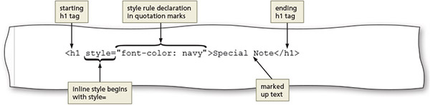
Inline Styles
You can embed CSS directly in an HTML element to restyle that element using the style attribute
Notes:
This selects the element it's in

Slide 6
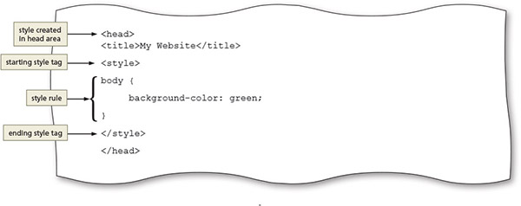
Internal/Embedded Style Sheets
You can embed style rules in the <head> of an HTML document, which apply to the current page
Notes:
This needs to include the selectors

Slide 7
External Style Sheets
You can write CSS rules in a separate file. These styles can be applied to multiple pages in a website
Also called a linked style sheet
Text file with the .css extension

Slide 8
Linking an HTML Document to a CSS File
After creating a CSS file, link it to all the webpages that will use its styles
Use a link element within the <head> section
Link element uses two attributes
The rel attribute uses the stylesheet value to indicate the document is linked to a style sheet
The href attribute value specifies the file path or file name of the CSS file
Example: link to a style sheet named styles.css in the current folder:
<link rel="stylesheet" type="text/css" href="styles.css">

Slide 9
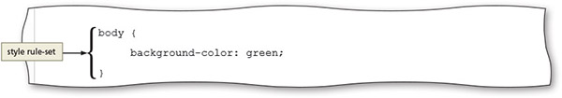
External Style Sheets
Provide flexibility to quickly change webpage formats because the styles used in it are applied to every page linked to it
Changing the look of an entire website is sometimes called reskinning the website

Slide 10
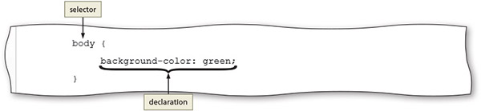
CSS Basics
Each CSS rule consists of a selector and a declaration

Slide 11
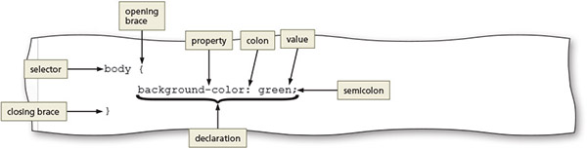
CSS Basics - Declaration
Declaration defines the exact formatting of the style
The property is the attribute to change (colour, width, font…) ,
The value is the value to set that property to (red, 100%, Arial…)

Slide 12
Selectors
Selector: part of the statement that identifies (selects) what to style
An HTML element name (body, nav, div, p, h1…)
An id attribute value (unique)
A class attribute value (reusable)
An id selector uses the id attribute value of an HTML element to select a single element
A class selector selects elements that include that class attribute to select one or more elements

Slide 13
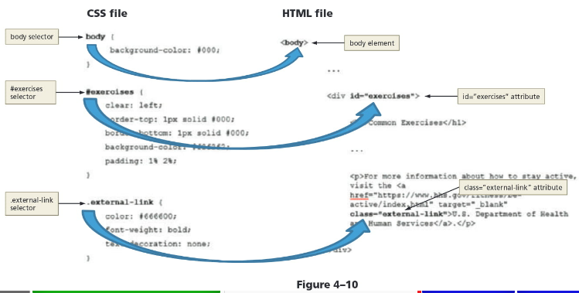
Selecting, 3 ways

Slide 14
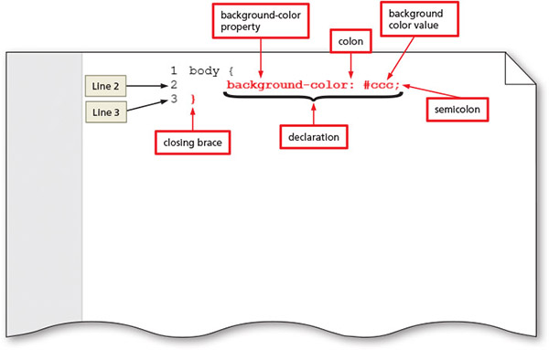
To Create a CSS File and a Style Rule for the Body Element

Slide 15
Use descendent selectors to be more specific
A descendant selector is used to create a style that applies to an element contained within another element
Example:
header h1 { color: red }
This selects only h1 elements that are inside the header element
<header> <h1>Heading here selected</h1>
</header>
<h1>This heading NOT selected</h1>

Slide 16
CSS Basics - Property
The property identifies the style attribute or characteristic to apply
color (text colour)
background-color
text-indent
border-width
font-style
…
Notice that "color" is American spelling

Slide 17
Style Sheet Precedence
Style sheets are said to “cascade” because each type of style has a specified level of precedence (or priority) in relationship to the others
CSS properties can be inherited from a parent element through a principle called inheritance
If a selector has more than one CSS rule, specificity determines which CSS rule to apply

Slide 18
CSS Text Properties
Use CSS styles to format text in a variety of ways
Fallback values can be provided for the font-family property in case the browser does not support the primary font
There are a variety of CSS measurement units possible, including pixels, points, and ems, keyword and percentage

Slide 19
CSS Text Properties
Unit | Definition | Example | Comments
em | Relative to the default font size of the element | font-size: 1.25em; | Recommended by W3C; sizes are relative to the browser’s default font size
% | Relative to the default font size of the element | font-size: 50%; | Recommended by W3C; sizes are relative to the browser’s default font size
px | Number of pixels | font-size: 25px; | Depends on screen resolution
pt | Number of points | font-size: 12pt; | Use for printing webpages
keyword | Relative to a limited range of sizes | font-size: xx-small; | Sizes are relative to the browser’s default font size, but size options are limited
Table 4–2 Font Size Measurement Units

Slide 20
CSS Colours
HTML uses colour names or codes to designate colour values
Three types of colour codes can be used with CSS
Hexadecimal values consist of a six-digit (or 3) number code that corresponds to RGB (Red, Green, Blue) colour values
RGB (Red, Green, Blue) colour values
HSL (hue, saturation, lightness) colour values

Slide 21


CSS Colours
You can set foreground, background and other colours depending on the property chosen
For example, to style a background colour as grey use: background-color: #808080 (or the keyword gray)

Slide 22
CSS Colours - Examples
colour | Hexadecimal | RGB | HSL
Black | #000000 | rgb(0,0,0) | hsl(0, 0%, 0%)
White | #ffffff | rgb(255,255,255) | hsl(0, 0%, 100%)
Red | #ff0000 | rgb(255,0,0) | hsl(0, 100%, 50%)
Green | #008000 | rgb(0,128,0) | hsl(120, 100%, 25%)
Blue | #0000ff | rgb(0,0,255) | hsl(240, 100%, 50%)
Yellow | #ffff00 | rgb(255,255,0) | hsl(60, 100%, 50%)
Orange | #ffa500 | rgb(255,165,0) | hsl(39, 100%, 50%)
Grey | #808080 | rgb(128,128,128) | hsl(0, 0%, 50%)
Table 4–3 colour Values

Slide 23
Understanding Inline Elements and Block Elements
HTML elements are positioned on the webpage as a block or as inline content
A block element appears as a block because it starts and ends with a new line, such as the main element or a paragraph element
Inline elements are displayed without line breaks, so they flow within the same line (like words in text)
Inline content always appears within block elements

Slide 24
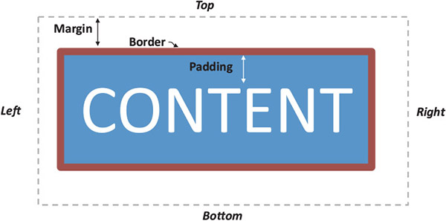
CSS Box Model
Each block element such as a header, nav, main, div… is displayed in the browser as a box with content
The CSS box model describes content boxes

Slide 25
CSS Box Model
Each content box can have margins, borders, and padding
Margin provides passive white space between block elements (including between the top or bottom of a page)
Border separates the padding and the margin of the block element (line around box)
Padding is the passive white space between the content and the border of a block element

Slide 26
Creating a Webpage Layout
To design a webpage to look the way you want, you cannot use HTML alone
Use CSS to design a webpage layout
float property allows you to position an element to the right or left of other elements, while remaining within its parent element
Valid values: left, right, inherit, and none
clear property is used to remove the float effect
Valid values: right, left, and both

Slide 27
Aligning Webpage Content
One way to align webpage content is to use the text-align property
Applies to block elements
Can use left (the default), center, right, or justify as its value
The following rule centers the text of an h1 element:
h1 {
text-align: center;
}

Slide 28
Aligning Webpage Content
To centre all the elements of a webpage using a single style rule, set the left and right margins to auto
Set the width to less than 100% (e.g., 80%)
This leaves the rest (e.g., 20%) of the page for margins
container { width: 80%; margin: 0 auto; }

Slide 29
Creating Style Rules for Structural Elements
header section should appear at the top of a page
You usually want this to stand out and attract visitors to the page
nav section should be formatted differently from the other structural elements
Should be prominent and easy to find on the webpage

Slide 30
Creating Style Rules for Structural Elements
Each page contains different content within the main element
Must create various style rules to style the content for each page

Slide 31
Creating Style Rules for Structural Elements
You can use an HTML list for navigation links
To make the navigation links more appealing on the webpage, you can format them with CSS
CSS list properties
Used to control the appearance of numbered and bulleted lists

Slide 32
Creating Style Rules for id Selectors
Example: style rule for an id attribute value of contact:
#contact {
text-align: center;
}
The above style rule will center-align text within an element that has the id attribute value of contact <div id="contact">

Slide 33
Creating Style Rules for class Selectors
Example: style rule for a class attribute value of contact:
.contact {
text-align: center;
}
The above style rule will center-align text within an element that has the class attribute value of contact <div class="contact">
A class attribute name can be applied to more than one HTML element on a webpage

Slide 34
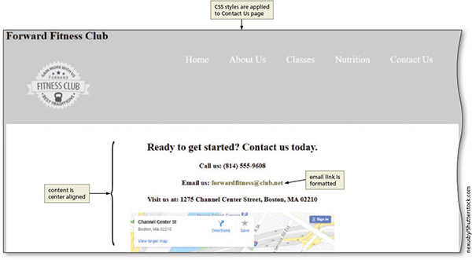
Creating Style Rules for id Selectors

Slide 35
What if we want to apply a style to something that is not an HTML element?
<p>This text is my favourite thing</p>
We can rewrite the code to use a logical element, if there is one that makes sense:
<p>This text is my <em>favourite</em> thing</p>
You can use the <span> element to group inline elements together on a webpage and apply CSS to this
<p>This text is my <span class="favourite">favourite</span> thing</p>

Slide 36
CSS Reset
A CSS reset is a style rule that is applied to the webpage before any other style rule defined within the style sheet
Example of a CSS reset:
body, header, nav, footer {
margin: 0;
padding: 0;
border: 0;
}

Slide 37

Adding Comments to CSS Files
Comments provide additional information about the area where the styles are applied or other helpful explanations, such as what the styles do
The syntax for a comment is as follows:
/* Place your comment here */
https://www.w3schools.com/css/tryit.asp?filename=trycss_comments

Slide 38
Validating CSS Files
You can validate CSS code to verify it follows the established rules for CSS (not that it does what you intended!)
Many online validation services are used to assure that CSS code follows standards
Validation should always be a part of web development testing

Slide 39
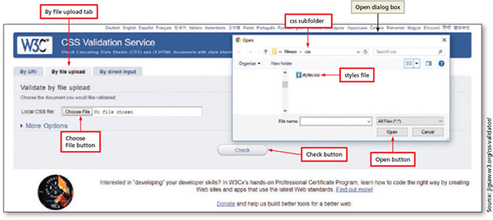
Validating CSS Files

Slide 40
Chapter Summary
In this chapter, you learned how to:
Create a CSS file with rules to style HTML elements on a webpage
Link the CSS file to all the webpages of a website

