Slide 1
CP1406 – Week 5
Responsive Design Designing for Mobile Devices

Slide 2
Introduction
Responsive design is a website development strategy that strives to provide an optimal user experience of a website regardless of the device used
By applying responsive design principles, the webpage and content respond to the screen size of the user’s device
Minimises unnecessary scrolling and zooming, making reading and interacting with the site convenient

Slide 3
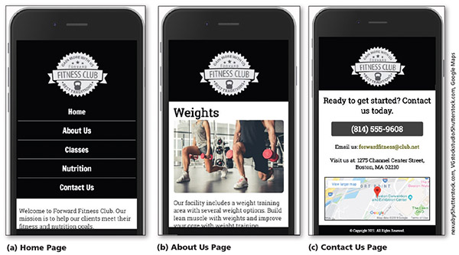
Project — Redesign a Website for Mobile Devices

Slide 4
Exploring Responsive Design
Content is easy to read and navigate on devices of three sizes: desktop browser, tablet, and phone
Philosophy that is constantly refined as HTML and CSS standards, browsers, and technology evolve and improve

Slide 5
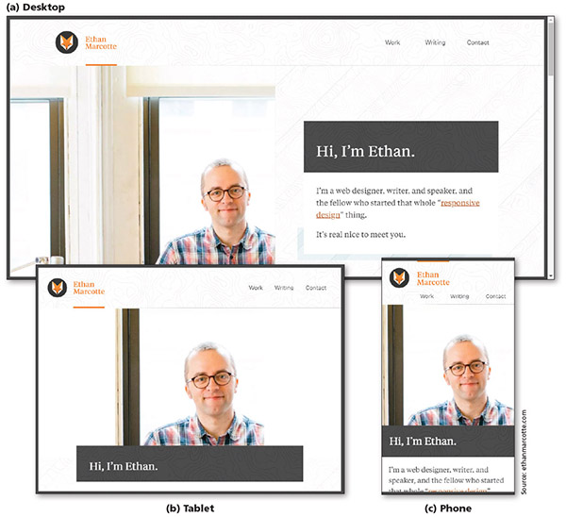
Exploring Responsive Design

Slide 6
Exploring Responsive Design
Fluid layout
Applies proportional size measurements to the webpage wireframe and content
The viewport is the viewing area for the webpage - the area of the webpage that a user sees at any one time, regardless of device, browser, screen size, screen resolution, window size, or orientation

Slide 7
Exploring Responsive Design
Responsive or flexible images
Shrink or grow based on the size of the viewport
Do not have height and width attributes or values in the HTML document (?)
Use CSS rules to resize the image relative to the wireframe and viewport

Slide 8
Exploring Responsive Design
Media queries
Allow the webpage developer to detect the size of the current viewport in pixels
Allow the developer to selectively apply CSS rules that work best for that viewport size

Slide 9
Designing for Mobile Devices
One strategy: Separate website optimised for mobile users to address problems with viewports
Often identified with a subdomain like m. mo. mobile.
Optimises the viewing experience for a wide range of devices using one website
Major downside: multiplies the work required to maintain what becomes two separate websites for the same organisation

Slide 10
Designing for Mobile Devices
Mobile-first strategy - employs responsive design principles
Web developer designs a flexible wireframe and essential content for the smallest viewport first, progressively adding more content as the viewport grows
Media queries are used to add styles for progressively larger viewports, progressing from tablet to desktop
More productive and effective way to build a website from scratch compared to adding separate mobile website after

Slide 11
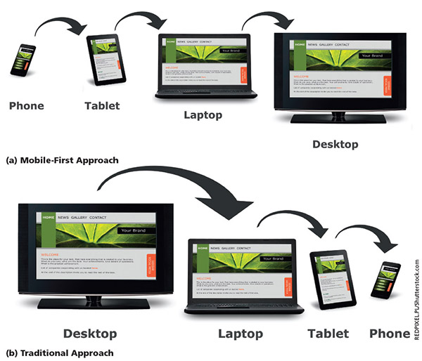
Designing for Mobile Devices

Slide 12
Designing for Mobile Devices
Implementation of the website development approach depends on many factors
Current environment
Target audience
Available resources
Time available to tackle the project

Slide 13
Using Responsive Design
Webpage with a fluid layout adjusts the webpage design and content based on the size of the viewport
Responsive designs are based on fluid layouts
Fixed layouts do not change in width based on the size of the viewport
Use fixed measurement units such as pixels to define the width of the areas of the wireframe that “fix” the width of the content regardless of the size of the viewport

Slide 14
Creating a Fluid Layout
A fluid layout requires a fluid grid, media queries, and responsive images
To create a fluid grid, you design a webpage that uses a grid or columns
A mobile viewport should use a single-column design, which is ideal for a smaller viewport
As the viewport’s size increases, the number of columns can increase

Slide 15
Following a Mobile-First Strategy
It is better to use a single-column layout for a mobile display as this prevents scrolling horizontally
Displaying what mobile device users need and want on a single screen with minimal scrolling creates a more enjoyable experience
Styling content for mobile devices requires that each page be analysed
Determine the most important content on the page and style that content

Slide 16
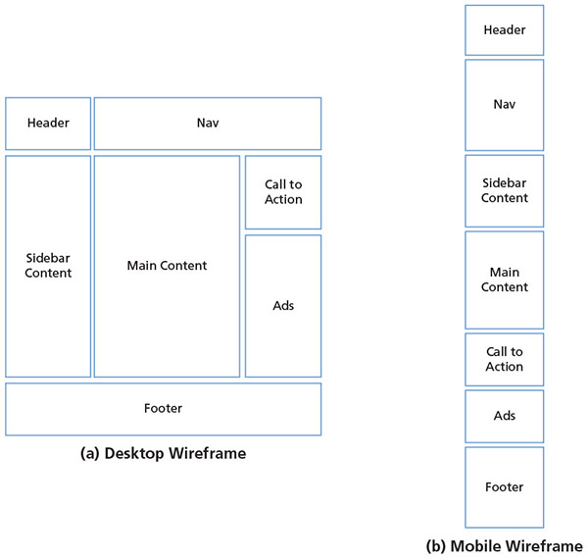
Following a Mobile-First Strategy

Slide 17
Following a Mobile-First Strategy
Some key practices when designing for mobile viewports
Make use of 100% of the screen space
Keep load times minimal
Display essential page content and hide nonessential page content
Make the content easy to access and read
Design a simple layout

Slide 18
Following a Mobile-First Strategy
When creating a website with a responsive design, a meta viewport element must be included within every HTML file
Provides the browser with information about the page’s dimensions and how to adjust scaling on the webpage
A mobile simulator displays an example of how a website would appear on a mobile device
Many available online or in browser tools

Slide 19
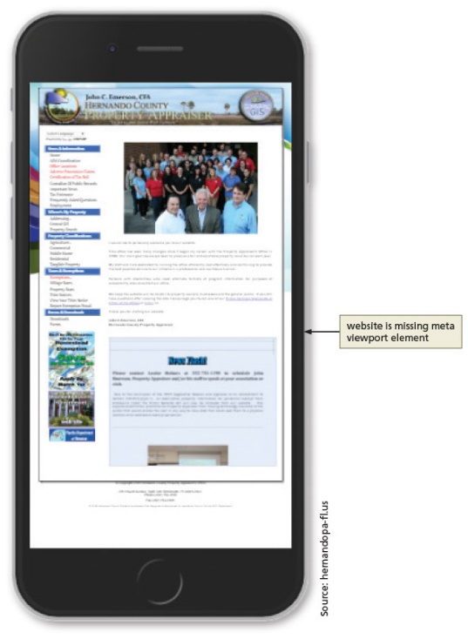
Following a Mobile-First Strategy

Slide 20
Following a Mobile-First Strategy
Steps in a mobile-first strategy
First, analyse each page to determine the most essential content and whether to hide some of the content on a mobile device
Depending on the design, you may want the company name or logo to remain at the top of the webpage as the user scrolls down
To accomplish this task, you create a fixed or sticky header, known as a sticky element

Slide 21
Following a Mobile-First Strategy
The navigation system for a website can look different in each viewport
Many mobile viewport designs use a hamburger button or icon to display or toggle a navigation system
Typography is a design element to consider when designing a website
Today, many custom fonts can be used by downloading them onto web servers or by linking to them in HTML files

Slide 22
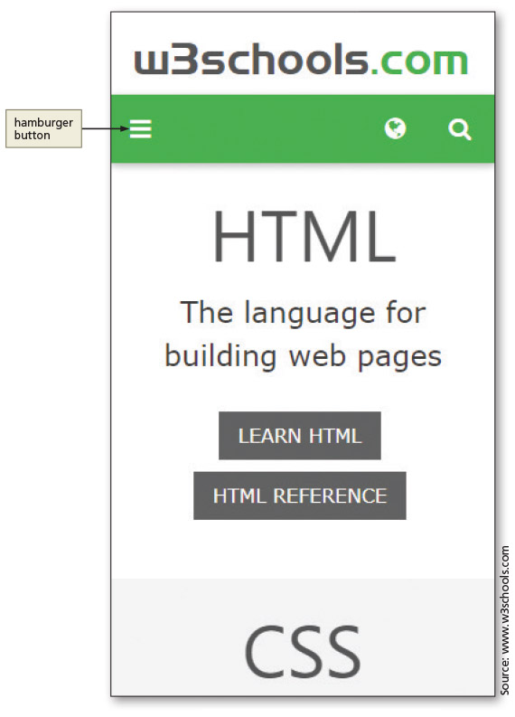
Following a Mobile-First Strategy

Slide 23
Following a Mobile-First Strategy
A pseudo-class can be used with a selector to specify the state of an element
For example, you can specify a style to apply when a mouse hovers over an element
Essential information can be added to the home page without removing the content for webpage visitors with a desktop device
You can set display: none in CSS to accomplish this task

Slide 24
Following a Mobile-First Strategy
By default, element borders use a 90-degree angle at each corner
You can see the angle when you specify a border all around an element
Images also have a default 90-degree angle at each corner
Change default appearance by applying CSS border-radius
e.g. border-radius: 25px;

Slide 25
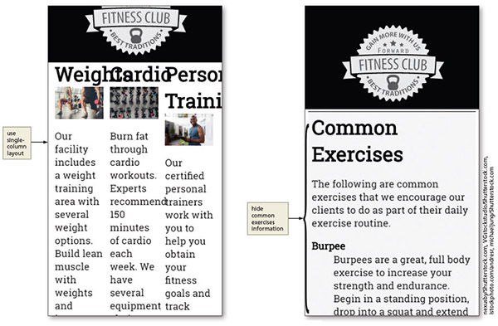
Analyse the About Us Page for Mobile-First Design

Slide 26
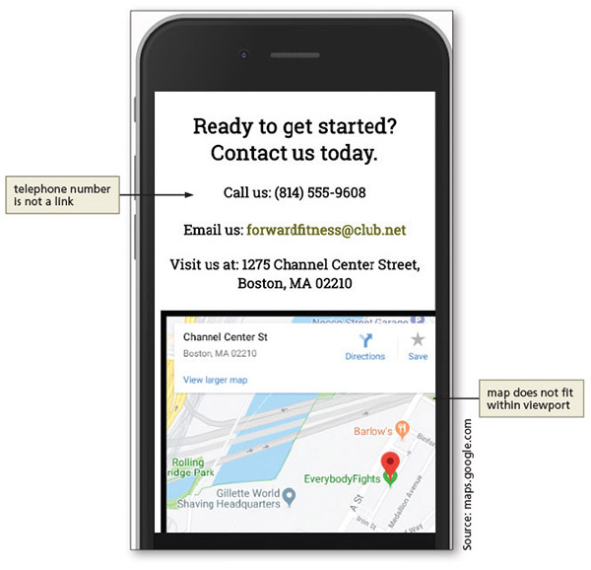
Analyse the About Us Page for Mobile-First Design

Slide 27
Mobile-Friendly Test
Once you have completed your design for a mobile viewport, view and test it on multiple smartphone devices
Google Chrome’s device mode is helpful during the design process
Testing on an actual device is optimal

Slide 28
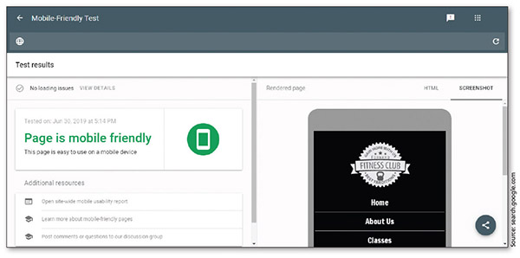
Mobile-Friendly Test

Slide 29
Using Media Queries
Detects the media type and capabilities of the device that the browser is running on
Applies styles that work well for the current state
Applies styles to move, hide, or display content on the page, change text or colours, or add any other styles to make the page easier to read in a particular situation

Slide 30
Using Media Queries
Basic example of a media query inserted into the link tag of an HTML page
<link rel="stylesheet" href="css/styles.css" media="screen">
<link rel="stylesheet" href="css/stylesprint.css" media="print">

Slide 31
Using Media Queries
Breakpoints
Set to understand the code and syntax of how a media query detects viewport size
Point at which a webpage is required to change
Where different styles are applied to the webpage to cause it to change in a way that makes it easier to read and navigate for a particular viewport

Slide 32
Using Media Queries
Device | Minimum Viewport Width | Maximum Viewport Width
Small smartphones | 320px | 480px
Larger smartphones and tablets | 481px | 768px
Tablets in landscape orientation, laptops, and small desktop monitors | 769px | 1279px
Large desktop monitors | 1280px | NA
Table 6–1 Common Viewport Breakpoints

Slide 33
Media Query Expressions
Media queries can use a logical expressions to test whether a viewport has reached a particular breakpoint
Includes:
the name of a media query feature,
a characteristic of the environment, and
a breakpoint value to be tested
If the logical expression evaluates to “true,” the media query applies the styles that follow

Slide 34
Media Query Expressions
Media queries can also test for both minimum and maximum breakpoints
Example:
<link rel="stylesheet" href="styles-tablet.css" media="screen and (min-width: 481px) and (max-width: 768px)">
The code directs browsers to apply the styles-tablet.css stylesheet when screens have a viewport width between 481px and 768px
When testing for minimum and maximum widths, the word “and” separates each part of the media attribute value

Slide 35
Media Query Expressions
Another way to implement media queries is to code them directly into a single CSS file using the @media rule
Most common types are screen, print, and all

Slide 36
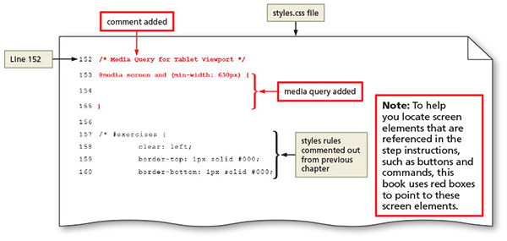
Media Query Expressions

Slide 37
Media Query Expressions
Feature | Description
max-width min-width | Width of the viewport in pixels
max-resolution min-resolution | Resolution of the output device in dots per inch or dots per centimeter
max-height min-height | Height of the viewport in pixels
orientation | Orientation of the device (landscape or portrait)
Table 6–2 Common Media Query Features

Slide 38
Adding Media Queries to an External Style Sheet
Mobile-first strategy
Mobile styles are listed first as they are the default styles
Media queries are used to add styles for larger viewports, progressing from tablet to desktop
Styles created for the smaller viewports apply to larger viewports by default
To modify the appearance of an element for a larger viewport, a media query is created for the larger viewport, and then a new style is created
Don't repeat yourself

Slide 39
Designing for Tablet Viewports
With so many tablet sizes, it is difficult to design a “one size fits all” layout for a tablet device
With the use of responsive web design and media queries, designing multiple tablet layouts is not required
If a particular tablet device has a viewport smaller than the minimum size specified in the media query, the layout will default to the mobile viewport layout

Slide 40
Designing for Tablet Viewports
When designing for a tablet viewport
Maintain the same color scheme, typography, and general look of the website
Website should look the same from viewport to viewport; only thing that should change is layout and placement of content
To determine ideal layout for a website’s tablet viewport, review the mobile site to confirm where the content should be added and if any content should be hidden

Slide 41
Designing for Tablet Viewports
Navigation design for a tablet viewport
It is not necessary to maintain a vertical list of navigation buttons as a tablet screen is larger than a smartphone screen
Align the navigation buttons in a horizontal line; this frees space for the main content below the navigation area, improving its visibility by displaying it in the middle of the screen

Slide 42
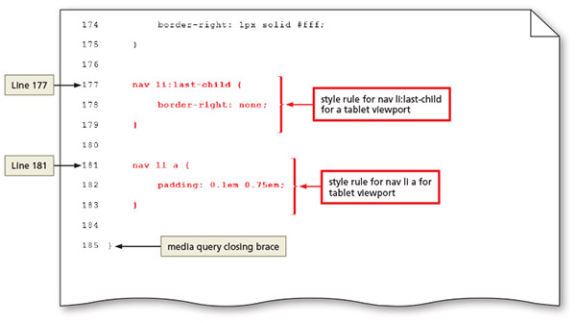
Designing for Tablet Viewports

Slide 43
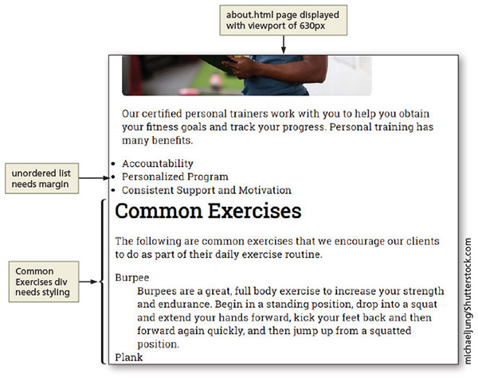
Designing for Tablet Viewports
About Us page design for a tablet viewport

Slide 44
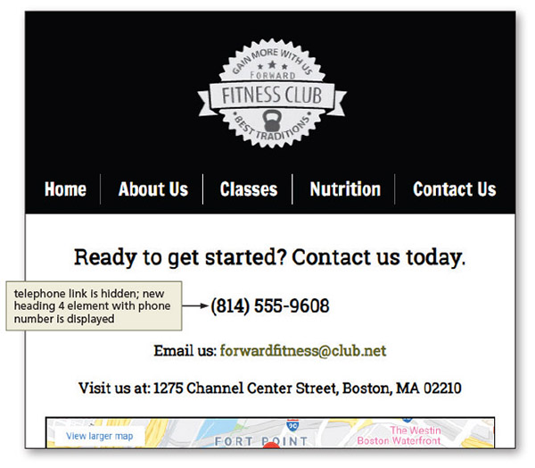
Designing for Tablet Viewports
Contact Us page design for a tablet viewport

Slide 45
Designing for Desktop Viewports
Principles of desktop viewport design
Use simple, intuitive navigation, clear images, and typography and apply the same colour scheme
Maintain the same look and feel of the site, but change some formatting to best accommodate the desktop viewport
Provides an opportunity for a multiple-column layout

Slide 46
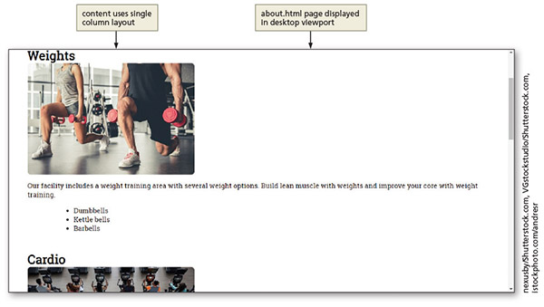
Designing for Desktop Viewports
About Us page design for a desktop viewport

Slide 47
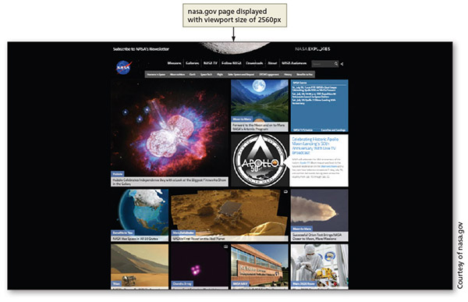
Designing for Desktop Viewports
Media query for large viewports

Slide 48
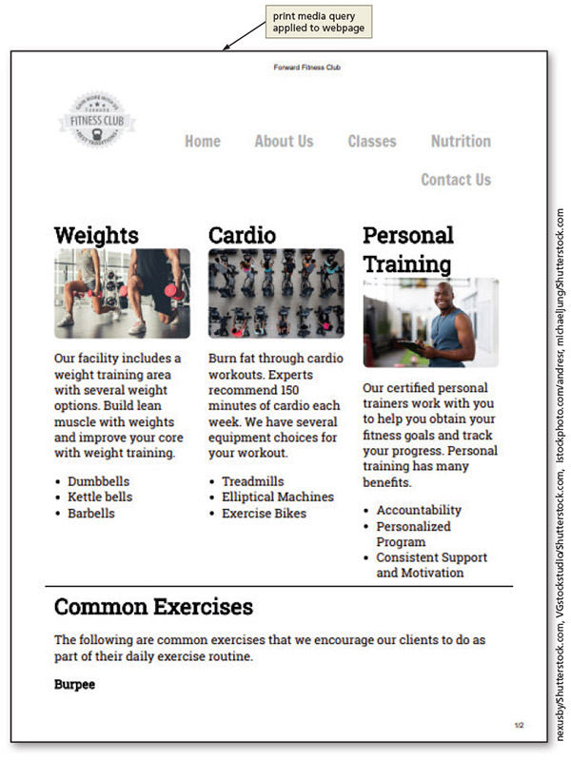
Designing for Desktop Viewports
Media query for print

Slide 49
Modifying Breakpoints
Breakpoint is the point at which different styles are applied to a webpage depending on the viewport
Determined by the content on the page

Slide 50
Using Dynamic Pseudo-Classes
Pseudo-classes allow changes to the style of a link based on four link states: link, visited, hover, and active
Must be used in the following order: link, visited, hover, active
A pseudo-class is attached to a selector with a colon to specify a state or relation to the selector to give the web developer more control over that selector
A unique style for normal, visited, hover, and active links is defined by creating four separate style rules with a:link, a:visited, a:hover, and a:active as the selectors

Slide 51
Using Dynamic Pseudo-Classes
Dynamic Pseudo-Class | Used to Style
:link | Unvisited link
:visited | Link that has been clicked
:hover | Link when the mouse is hovering over it
:active | Link at the moment it is clicked

Slide 52
Using Dynamic Pseudo-Classes
It is not necessary to use all of the pseudo-classes
If omitted from the design, it is important to maintain the same order of the pseudo-class styles in the CSS code
Often used in a desktop viewport
Not used in mobile and tablet devices as they do not have a hover or a click option

Slide 53
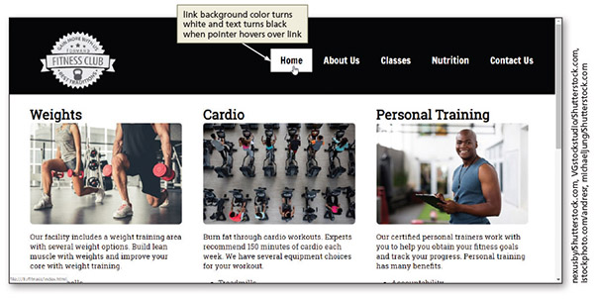
Using Dynamic Pseudo-Classes

Slide 54
Using Gradients
Gradient is a gradual transition from one colour to another
CSS has two types
Linear gradient
Can transition from several different angles
Default transition is from the top to the bottom
Can also transition up, left, right, or diagonally

Slide 55
Using Gradients
Radial gradients
Specified by their centre
Colour begins in the center and transitions in a radial direction to another colour or colours
At least two colours must be specified

Slide 56
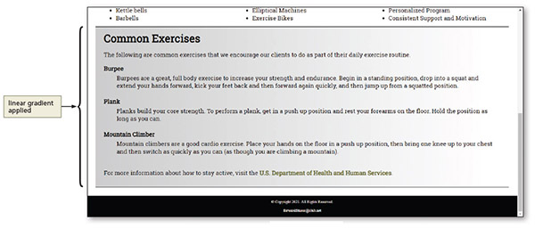
Using Gradients

