Slide 1
CP1406 – Week 6
Improving Web Design with New Page Layouts

Slide 2
Using HTML Semantic Elements
HTML semantic elements are a set of starting and ending HTML tags
These provide a standard naming convention for webpage content, making webpages more universal, accessible, and meaningful to search engines

Slide 3
Article Element
A complete, self-contained composition in a document, page, application, or site
Independently distributable or reusable, e.g., in syndication
Start and end tags of article elements are <article> and </article>
Content placed between these tags will appear on a webpage as part of the article element

Slide 4
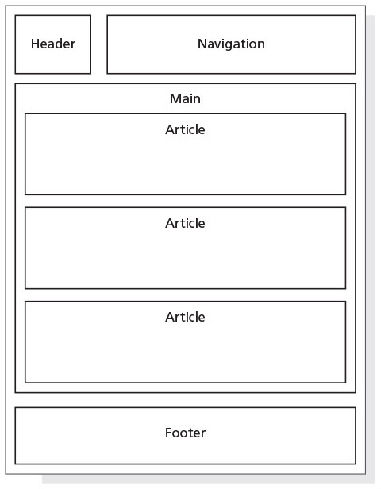
Article Element
Articles may be nested within other HTML elements such as the main element, section element, or other article elements
Articles are commonly used to contain news articles, blog and forum posts, or comments

Slide 5
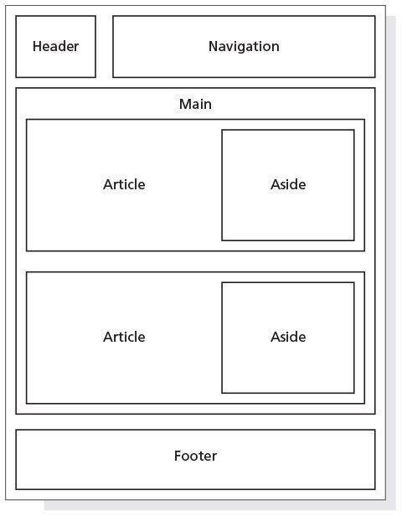
Aside Element
Used as a sidebar that contains additional information about a particular item mentioned within another element
Can be nested within article elements or within main or section elements
Example: a recipe article could include an aside element with more information about one of the key ingredients

Slide 6
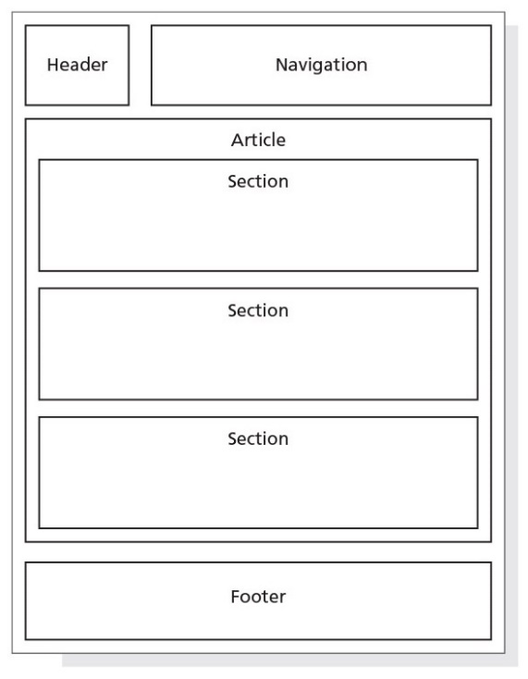
Section Element
Represents a generic section of a document or application
A section is a thematic grouping of content
The theme of each section should be identified, typically by a heading
Not a generic container element
A general rule is that the section element is appropriate only if the element’s contents would be listed explicitly in the document’s outline

Slide 7
Section Element
The following is part of an example with several section elements nested within an article element
<article>
<h1>Tutorials: Cooking Basics</h1>
<p>Watch our tutorials to learn the basics of good cooking.</p>
<section>
<h1>Tutorial 1</h1>
<p>Assembling basic kitchen tools.</p>
</section>
…
</article>

Slide 8
Figure and Figure Caption Elements
The figure element is used to group content, such as illustrations, diagrams, and photos
Represents some flow content that is self-contained and is typically referenced as a single unit from the main flow of the document

Slide 9
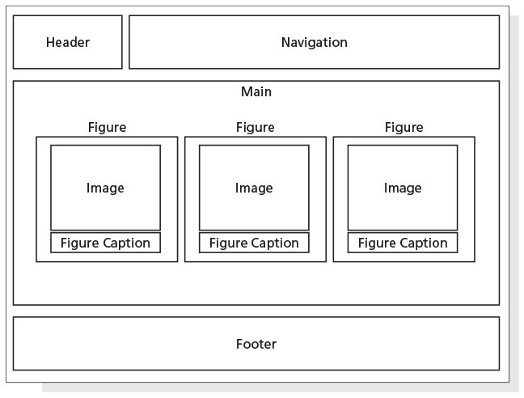
Figure and Figure Caption Elements
Can contain one or more img elements
May contain an optional figure caption element, which is used to provide a caption for the figure element
<figcaption> … </figcaption>

Slide 10
CSS grid layout
Newer webpage design model used to create a single or multiple-column layout by controlling the size and position of boxes of content on a webpage
Learn and try it at: https://www.w3schools.com/css/css_grid.asp
Notes:
Compare with: tables, floats, flexbox

Slide 11
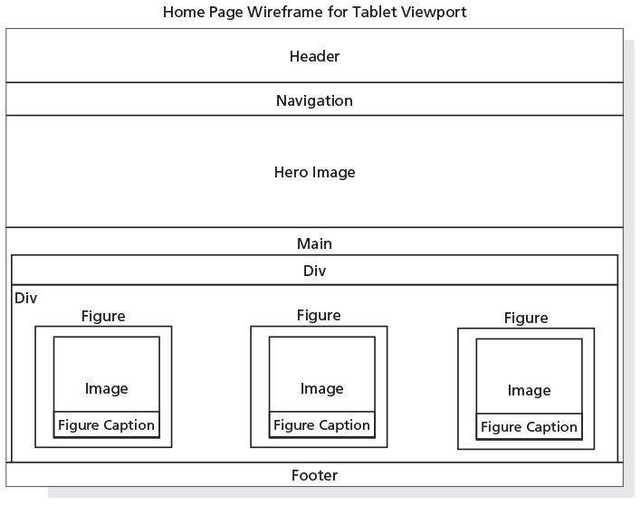
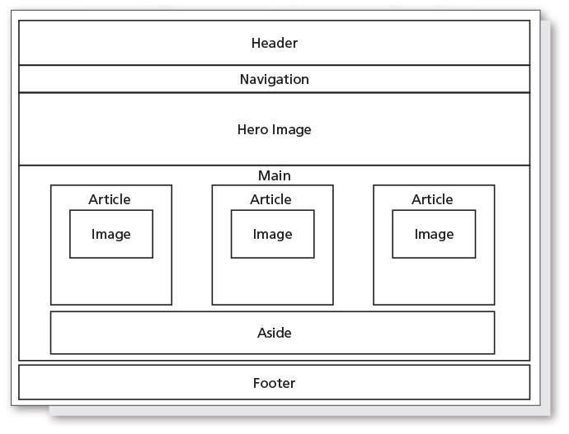
Redesigning the Home Page
Home page can be improved by adding figure and figcaption elements with pictures
Provide more visual content for potential clients

Slide 12
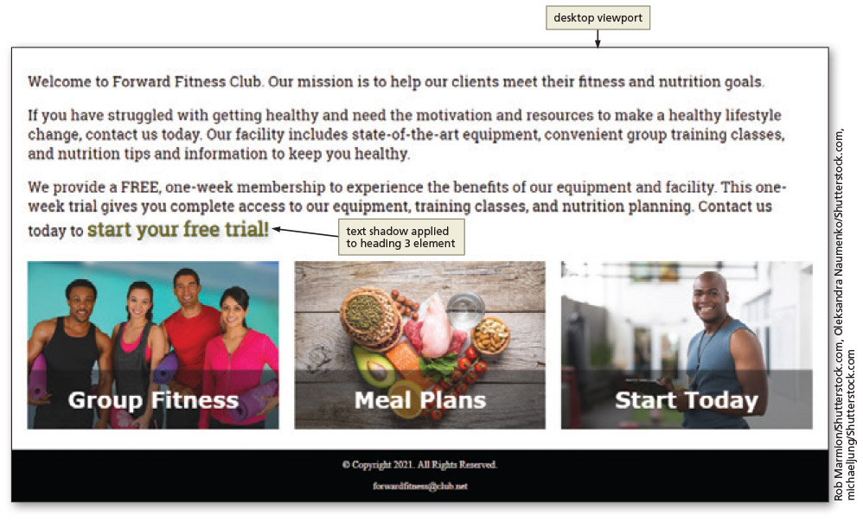
Redesigning the Home Page

Slide 13
Improving Design with CSS
Opacity
Specifies the amount of transparency of an element
CSS shadows
Box-shadow applies a shadow to an element
Text-shadow property applies a shadow to text
CSS box-sizing
Allows any specified padding or border to be included within the element’s total size

Slide 14
Using pseudo-classes
Structural pseudo-class, nth-of-type() is used to select specific elements within a parent element
Example: if you have a series of paragraphs, you may could apply a different background colour to all odd, or all even, ones
p:nth-of-type(odd) {
background-color: #ccc;
}

Slide 15
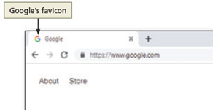
Adding a Favicon
Small image that appears on the browser tab that represents the business
Might be a logo or another graphic that identifies the business brand
Helps improve search engine results display
Can be PNG, GIF, or ICO file
Image sizes are based upon the favicon’s use

Slide 16
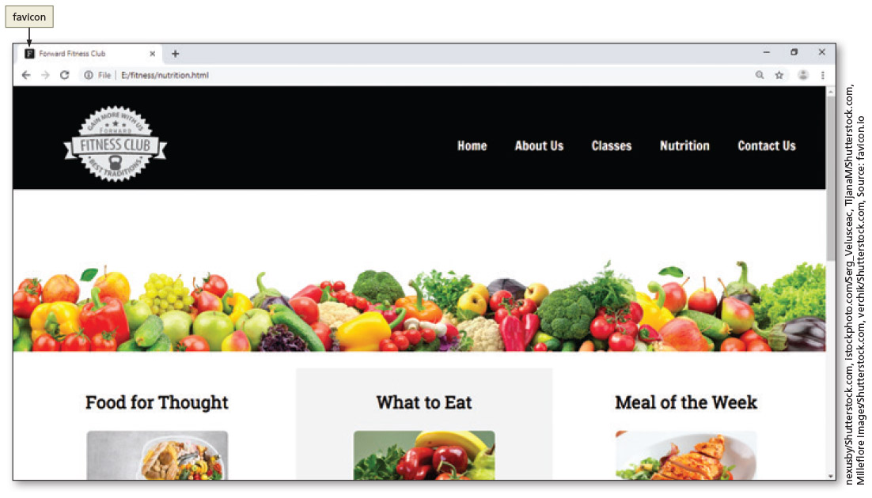
Adding a Favicon
<head>
<title>Forward Fitness Club</title>
<link rel="icon" type="image/x-icon" href="images/favicon.ico">
</head>

Slide 17
Chapter Summary
In this chapter, you learned how to:
Use the HTML figure, figcaption, section, article, and aside semantic elements
Create and modify style rules in the style sheet to format the new elements and adapt to the website design
Use a CSS grid layout to create multiple columns
Create style rules to add opacity, box shadows, and text shadows
Add a favicon to a website

