Slide 1
CP1406 – Week 7
Creating Tables
and Forms

Slide 2
Introduction
Tables present related information in rows and columns
Useful when comparing types of data or listing topics and details
Helpful when you need to provide tabular data
Forms are used to collect information about/from visitors/customers
Common information includes a customer’s first and last names, address, email address, and phone number

Slide 3
Discovering Tables
Tables structure data or outline a detailed topic, such as a schedule or menu, in a compact format
Row: horizontal line of information
Column: vertical line of information
Cell: intersection of a row and a column and usually contains data
Header cell for logical header (displays text as bold and centre-aligned by default)
Data cell for normal data (displays left-aligned text)

Slide 4
Creating a Table with HTML Elements
Creating a table on a webpage
<table> and </table> tags indicate the start/end of a table
<tr> and </tr> tags indicate the start/end of each table row
<td> and </td> tags indicate the start/end tags for data elements – this is where your content goes
<table>
<tr><th>Person</th><th>Score</th><th>Result</th></tr>
<tr><td>Derek</td><td>89</td><td>HD</td></tr>
<tr><td>Smitty</td><td>58</td><td>P</td></tr>
</table>

Slide 5
Creating a Table with HTML Elements
Element | Indicates the start and end of: | Contains:
<table> … </table> | Table within a webpage | All related table elements
<tr> … </tr> | Table row within a table | Table data cells
<th> … </th> | Table header cell | Table header content
<td> … </td> | Table data | Table cell content
<caption> … </caption> | Table caption | Table caption or title
<thead> … </thead > | Table header area | Grouped header content
<tbody> … </tbody > | Table body area | Grouped body content
<tfooter> … </tfooter > | Table footer area | Grouped footer content
HTML Table Elements

Slide 6
Table Borders, Headers, and Captions
Table border
Line that defines the perimeter of the table
Table header
Heading cell
Identifies the row or column content
Defined with a starting <th> tag and an ending </th> tag

Slide 7
Table Borders, Headers, and Captions
Table caption
Descriptive text that serves as a title or identifies the table’s purpose
Defined with <caption>…</caption
Inserted after the starting <table> tag
A table can have only one caption

Slide 8
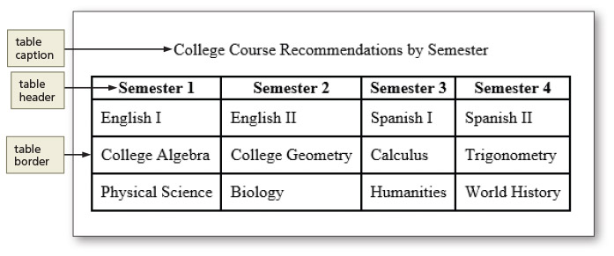
Table Borders, Headers, and Captions

Slide 9
Table Element Attributes
The colspan attribute is used to span cells across two or more columns
<td colspan="2">Sum: $180</td>
The rowspan attribute is used to span across two or more rows
<td rowspan="2">$50</td>

Slide 10
Use of Tables
Before you add a table, first determine whether it is suitable for the content
As general rule, use a table for the kind of information you might store in a spreadsheet (structured, organised information/data)
If your table does not have a header, you probably don't want a table at all
Don't use tables to design a layout for a webpage

Slide 11
Planning the Table
To create effective tables, plan the information that will appear in columns and rows
Create a design that presents the information clearly
Planning a table for responsive web design
Consider the mobile viewport because of its screen size

Slide 12
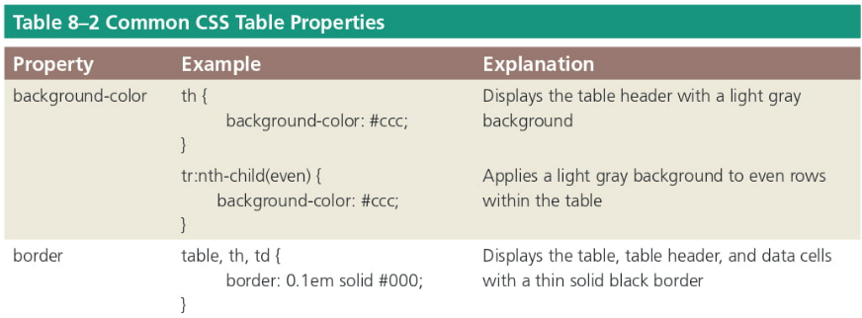
Styling Table Elements
After creating a table, style it by adding style rules to the style sheet for the website
You can specify style rules for each table element

Slide 13
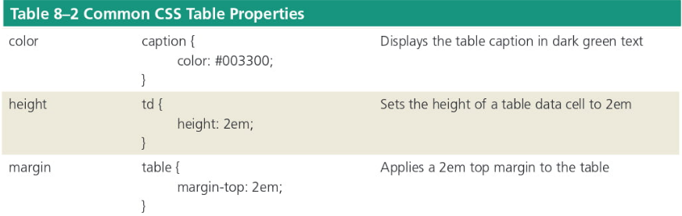
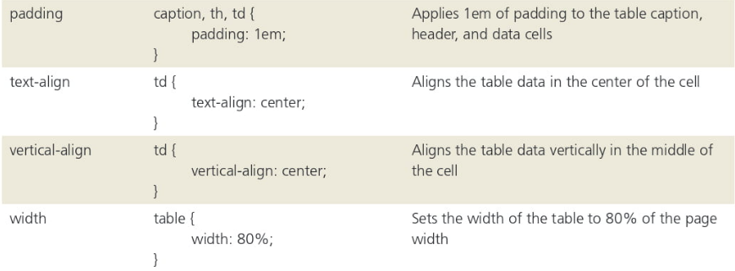

Slide 14
Styling Table Elements
Separated border
When a border is applied to table elements, by default, each cell has its own border, making the table appear to use double lines between each table data cell
Collapsed border
Use the border-collapse property with a value of collapse to display a table with single, consolidated borders

Slide 15
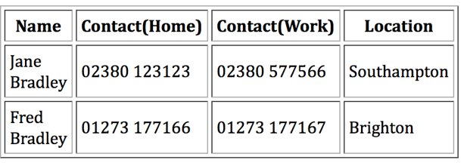
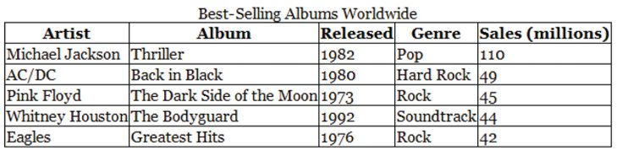
Collapsing Table Borders
"Separated" borders with cellspacing​
Collapsed border

Slide 16
Styling Tables for Responsive Web Design
It can be difficult to style a table for a mobile viewport, especially when the table consists of several columns
Determine whether you can format the table, so it is still easy to read in a mobile viewport
If the table is too large or complex to format, you can display the content in a different format such as a list or a chart in a mobile viewport

Slide 17
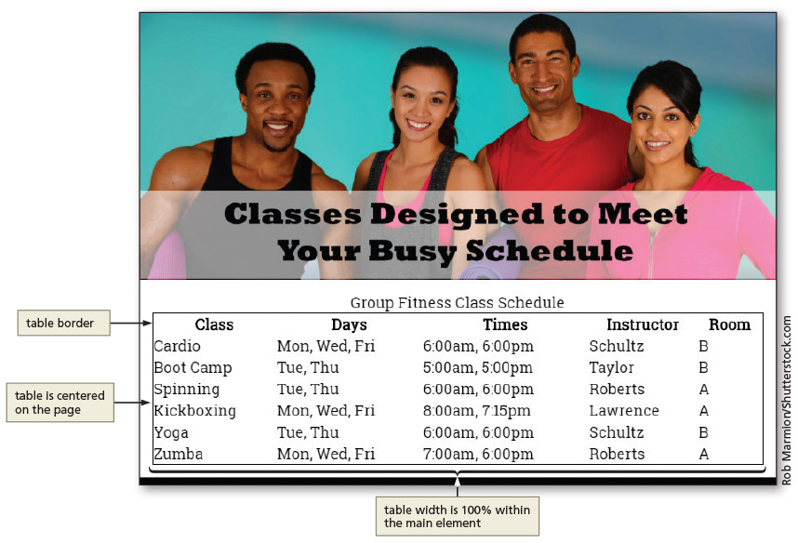
Style a Table for a Tablet Viewport

Slide 18
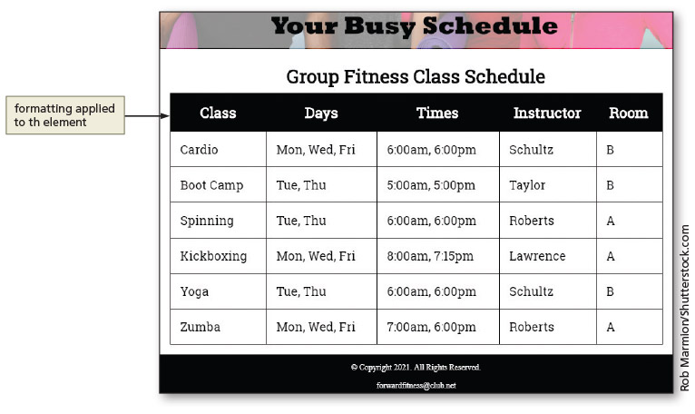
Style a Table for a Tablet Viewport

Slide 19
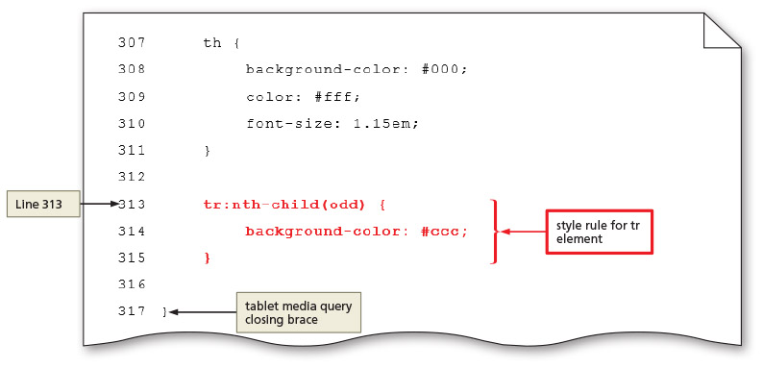
Style a Table for a Tablet Viewport

Slide 20
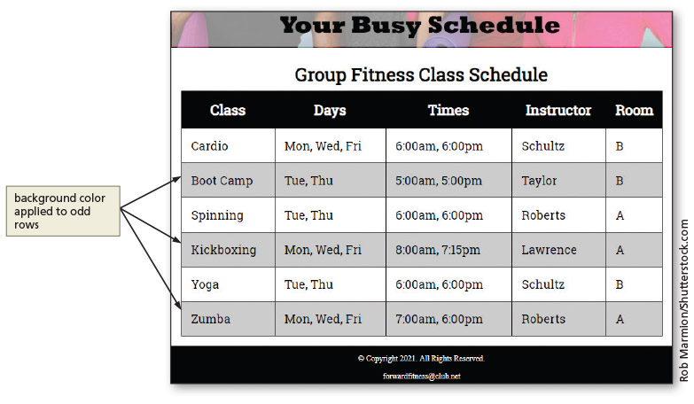
Style a Table for a Tablet Viewport

Slide 21
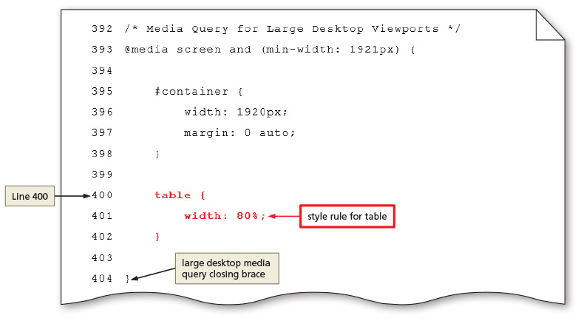
Style a Table for a Tablet Viewport

Slide 22
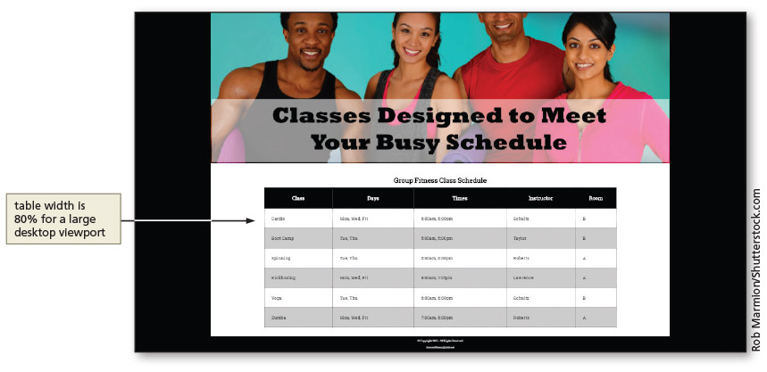
Style a Table for a Tablet Viewport

Slide 23
Web Forms

Slide 24
Creating Webpage Forms
Forms provide a structured way to collect information from webpage visitors
Visitors complete webpage forms to register for an account or to make a purchase
Businesses use forms to gather visitor or customer information and store it in a database for future use

Slide 25
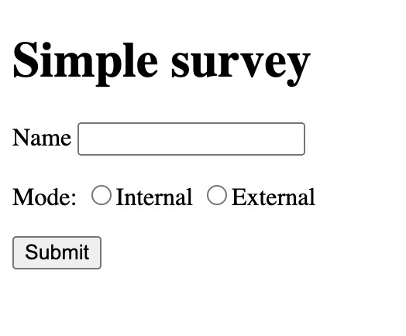
Creating Webpage Forms
<form name="form1" method="get" action="">
<p><label for="name">Name</label> <input type="text" name="name" id="name"> </p>
<p>Mode: <label><input type="radio" name="mode" value="internal" id="internal">Internal</label>
<label><input type="radio" name="mode" value="external" id="external"> External</label> </p>
<input type="submit" name="submit" id="submit" value="Submit">
</form>

Slide 26
Form Controls
All form elements are contained within <form>…</form>
Input control: interactive mechanism for users to enter text or make selections on a form
Label: text describing the type of information to enter with an input control
Most controls in an HTML form are defined by using the type attribute of the input element
Other controls such as textarea and select are separate elements

Slide 27
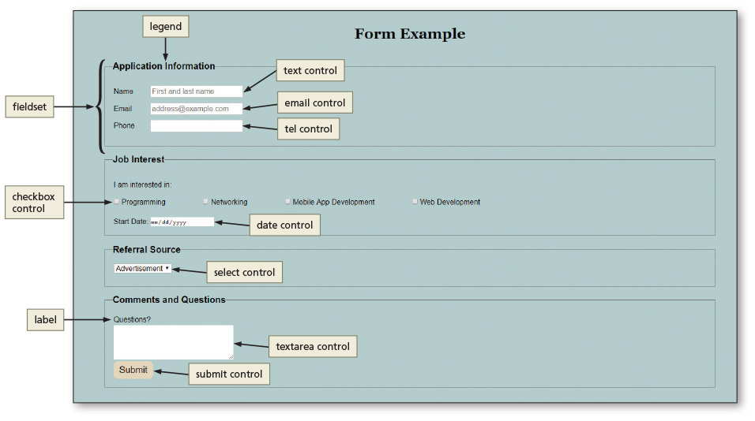
Form Controls

Slide 28
Form Controls
Data input control: used to make a selection or perform a command
a radio button (input type="radio"),
a check box (input type="checkbox"),
a submit button (input type="submit"),
a reset button (input type="reset"),
or a selection menu (select element).
Text input control: accepts text, such as names, dates, and passwords
Others include password, email, telephone, date

Slide 29
Form Controls – Name, ID, and Value
Each input control has attributes that are used more frequently than the others
Name: identifies the specific information that is being sent when the form is submitted for processing (like a variable name)
All controls have a name
Id: provides a unique ID for the element
Use the id attribute with input controls
Value: specifies the value of an input element
Varies depending on input type (like the value of a variable)

Slide 30

Form Controls – Text Input
These text input controls have two frequently used attributes:
Size: determines width of the control in characters
Maxlength: specifies maximum number of characters accepted
<input type="text" id="fname" name="fname" maxlength="4">
Notes:
https://www.w3schools.com/html/tryit.asp?filename=tryhtml_input_text <!DOCTYPE html>
<html>
<body>
<h2>Text field</h2>
<p>The <strong>input type="text"</strong> defines a one-line text input field:</p>
<form action="/action_page.php">
<label for="fname">First name:</label><br>
<input type="text" id="fname" name="fname" maxlength="4"><br>
<label for="lname">Last name:</label><br>
<input type="text" id="lname" name="lname"><br><br>
<input type="submit" value="Submit">
</form>
<p>Note that the form itself is not visible.</p>
<p>Also note that the default width of a text field is 20 characters.</p>
</body>
</html>

Slide 31
Form Controls – Password, Email, Tel, Date Controls
Password control: text control; provides a text box for the password a visitor enters (****)
Email control: text box where visitors enter an email address (automatic email verification)
Tel control: text box where visitors enter a telephone number
Date control: text box that accepts a date

Slide 32
Form Controls – Textarea Control
Textarea control: creates a text box that allows multiple lines of input
To create a textarea control, use the textarea element instead of the input element
Two primary attributes set the size
Rows: specifies the number of rows, or lines, in the textarea control
Cols: sets the width of the textarea control as the number of columns, with each column containing one character
Think about interaction design… A bigger box implies more information is expected.

Slide 33
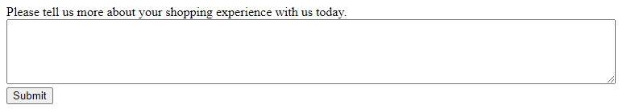
Form Controls – Textarea Control
Example of HTML code defining a textarea control:
<label>Please tell us more about your shopping experience with us today.</label>
<textarea name="feedback" rows="5" cols="100"></textarea>

Slide 34
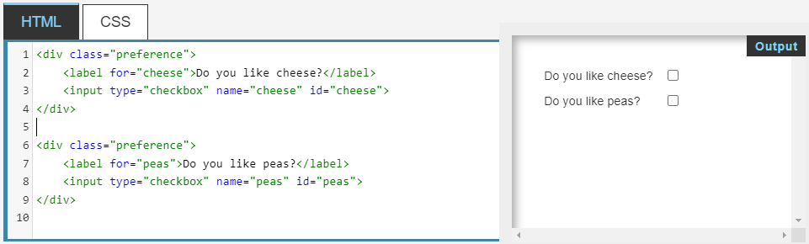
Form Labels
Form labels describe the input control
To connect them to their controls, include the for attribute with the same value as the input control’s id value
This makes labels clickable
Notes:
<div class="preference">
<label for="cheese">Do you like cheese?</label>
<input type="checkbox" name="cheese" id="cheese">
</div>
<div class="preference">
<label for="peas">Do you like peas?</label>
<input type="checkbox" name="peas" id="peas">
</div>

Slide 35
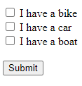
Form Controls – Checkbox Control
Checkbox control allows a webpage visitor to select items from a list of zero or more choices
Each choice appears with a graphical box, which can be checked (selected or on) or unchecked (deselected or off)
By default, all check boxes are deselected
To set a particular check box to be preselected as the default, use the checked attribute and value (checked="checked") within the <input> tag
https://www.w3schools.com/tags/tryit.asp?filename=tryhtml5_input_type_checkbox
Notes:
<!DOCTYPE html>
<html>
<body>
<h1>Show Checkboxes</h1>
<form action="/action_page.php">
<input type="checkbox" id="vehicle1" name="vehicle1" value="Bike">
<label for="vehicle1"> I have a bike</label><br>
<input type="checkbox" id="vehicle2" name="vehicle2" value="Car">
<label for="vehicle2"> I have a car</label><br>
<input type="checkbox" id="vehicle3" name="vehicle3" value="Boat">
<label for="vehicle3"> I have a boat</label><br><br>
<input type="submit" value="Submit">
</form>
</body>
</html>

Slide 36
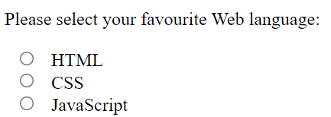
Form Controls – Radio Control
Radio control limits the webpage visitor to only one choice from a list of choices
Each choice has a radio button, or option button, which appears as an open circle
By default, all radio buttons are deselected
To set a particular button as the default, use the checked attribute and value within the <input> tag
Notes:
<!DOCTYPE html>
<html>
<body>
<h1>Display Radio Buttons</h1>
<form action="/action_page.php">
<p>Please select your favorite Web language:</p>
<input type="radio" id="html" name="fav_language" value="HTML">
<label for="html">HTML</label><br>
<input type="radio" id="css" name="fav_language" value="CSS">
<label for="css">CSS</label><br>
<input type="radio" id="javascript" name="fav_language" value="JavaScript">
<label for="javascript">JavaScript</label>
<br>
<p>Please select your age:</p>
<input type="radio" id="age1" name="age" value="30">
<label for="age1">0 - 30</label><br>
<input type="radio" id="age2" name="age" value="60">
<label for="age2">31 - 60</label><br>
<input type="radio" id="age3" name="age" value="100">
<label for="age3">61 - 100</label><br><br>
<input type="submit" value="Submit">
</form>
</body>
</html>

Slide 37
Form Controls – Select Control
Select control creates a selection menu (drop-down list) from which the visitor makes one or more choices
Prevents the visitor from having to type information into a text or textarea control
Suitable when a limited number of choices are available
Appears on a form as a text box with a list arrow

Slide 38
Form Controls – Submit Control
Submit button sends the form information to the specified location (action attribute of the form) for processing
When it is clicked on the form, the name of each control and the value of its data are sent to the server to be processed
Notes:
<!DOCTYPE html>
<html>
<body>
<h1>Display a Reset Button</h1>
<p>Click on the reset button to reset the form.</p>
<form action="/action_page.php">
<label for="email">Enter your email:</label>
<input type="email" id="email" name="email"><br><br>
<label for="pin">Enter a PIN:</label>
<input type="text" id="pin" name="pin" maxlength="4"><br><br>
<input type="reset" value="Reset">
<input type="submit" value="Submit">
</form>
</body>
</html>

Slide 39
Form Controls – Reset Control
Reset button clears any input entered in the form, resetting the input controls to their default values
The value attribute specifies the text on the button
You might want to give the user the chance to confirm (JavaScript)

Slide 40
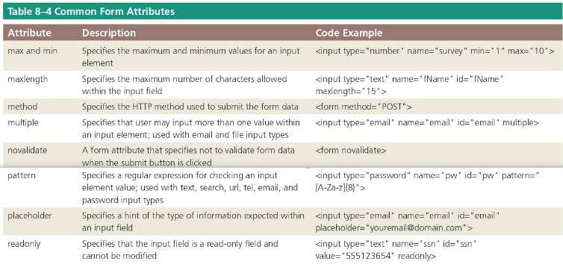
Attributes of HTML Tags Used to Create Forms
Many of the HTML tags used to create forms have several attributes
If an attribute is not supported, it will be ignored

Slide 41
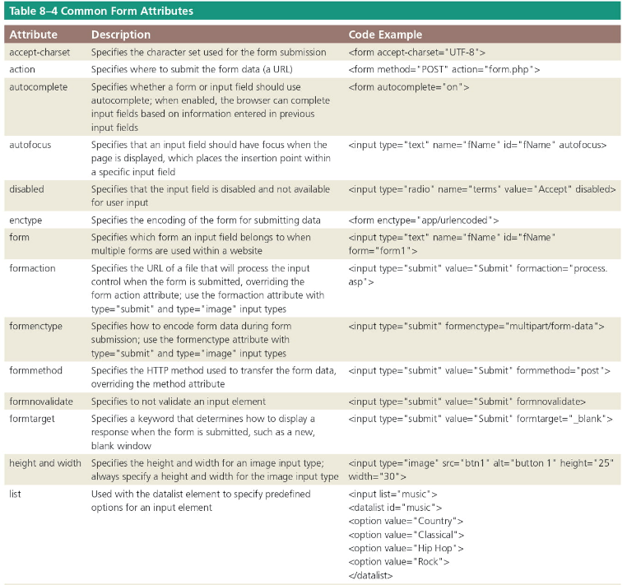


Slide 42
Make User Friendly Forms
Use labels for all fields, especially check boxes and radio buttons
Use a proper submit button
Think about tab order – natural for keyboard use
Use conventional field names so users have their previous data available for auto-fill (e.g., name=“email” not name=“emailfield”)
Aim for fewest clicks (e.g., radio buttons vs. lists)
Consider your (global) audience
Most important – design the process start-to-finish

Slide 43
Form Processing
The action attribute of the <form> tag is used to specify the browser’s action (URL) when submitting the form
Browsers can send information entered in forms to be processed by a script/program on a web server or send it by email to an email address
Many websites use form processing software tools available from the web server or website hosting provider

Slide 44
Form Processing
The method attribute of the <form> tag specifies how to send the data entered in the form to the server to be processed
The get method appends the name-value pairs to the URL indicated in the action attribute (query string)
The post method sends a separate data file with the name-value pairs

Slide 45
Styling Forms
CSS styles are applied to forms to improve the appeal and usefulness of the form and its controls
As with tables, consider forms in the context of responsive design
Controls can be included to collect optional information, such as product feedback, in tablet and desktop viewports

Slide 46
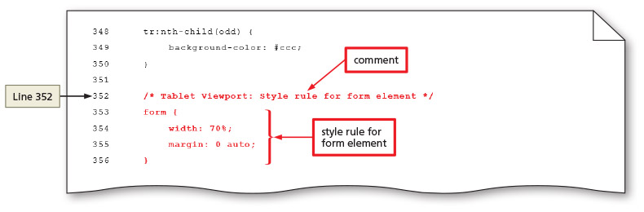
Styling Forms

Slide 47
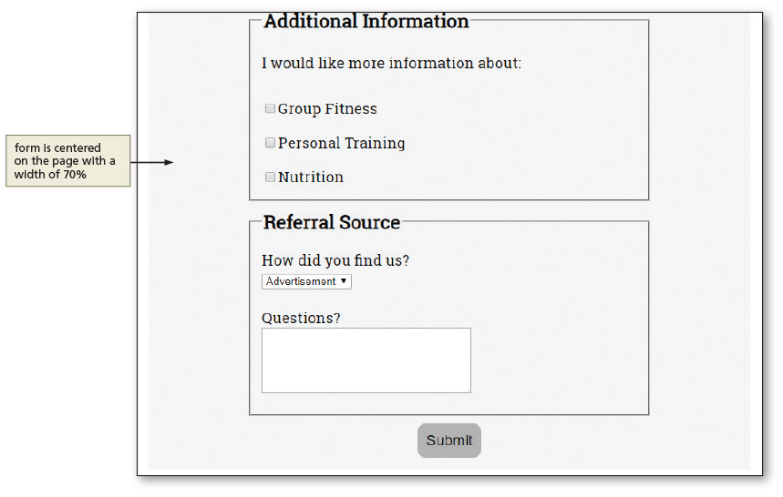
Styling Forms
Notes:
Figure 8–64

Slide 48
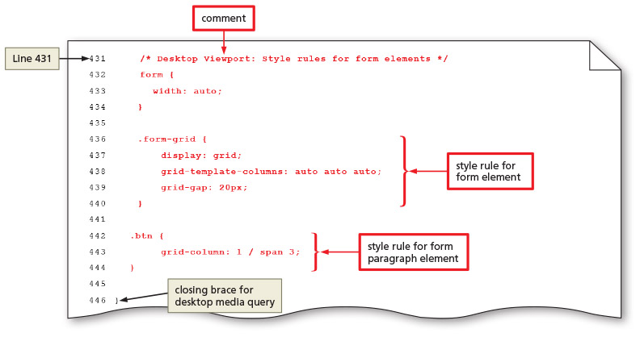
Styling Forms

Slide 49
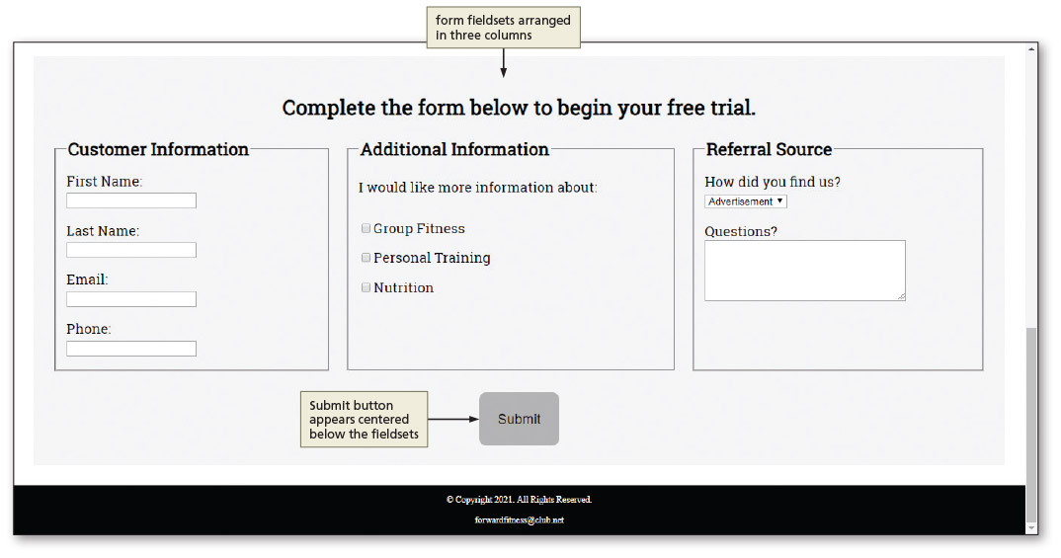
Styling Forms

Slide 50
Chapter Summary
In this chapter, you learned how to:
Include tables and forms on webpages
Create a table that displays related information and format it using CSS properties
Use webpage forms and form controls, including the HTML elements, attributes, and values for creating the controls you need
Use CSS styles to format a form for mobile, tablet, and desktop viewports

