Slide 1
CP1406 – Week 8
Creating Interactivity with CSS and JavaScript

Slide 2
Introduction
Most modern websites include some form of interactivity
Commonly integrated within a website using CSS and JavaScript, a web programming language used to enhance a website and create interactivity
We will just touch on what's possible with JavaScript in this subject

Slide 3
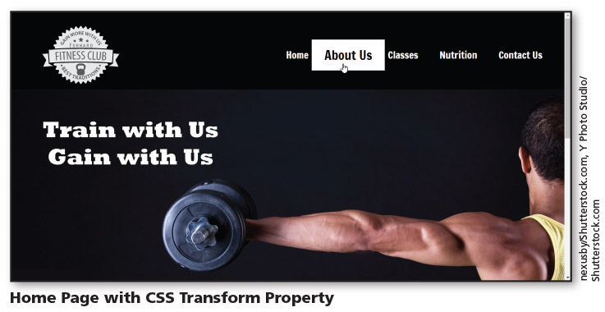
Introduction – CSS Transform Property

Slide 4
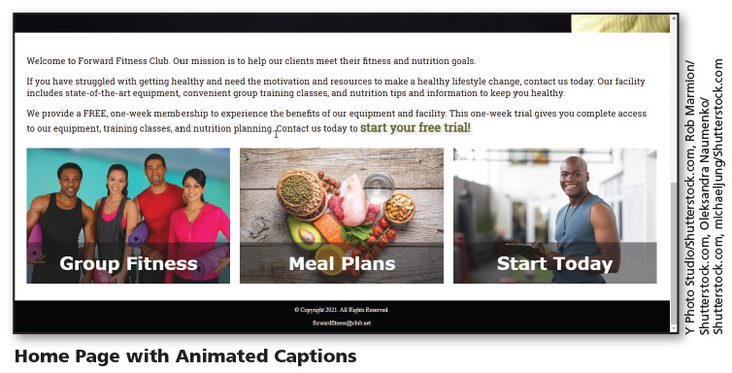
Introduction – Animated Captions

Slide 5
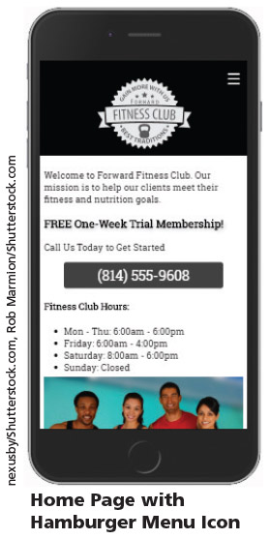
Introduction – Hamburger Menu Icon

Slide 6
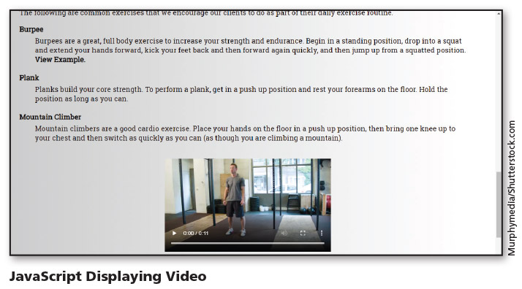
Introduction - JavaScript

Slide 7
Using CSS to Create Interactivity
CSS began as a simple way to add colour and design a webpage. Today, it has evolved to become so much more.
CSS can be used to change the properties of any element on a webpage (colour, location, size, etc.)

Slide 8
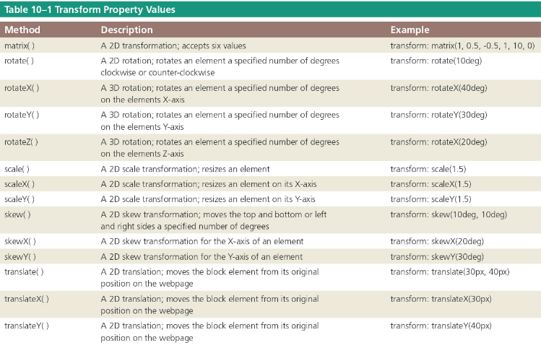
Using CSS to Create Interactivity
CSS transform property allows you to rotate, scale, skew, or translate a block element

Slide 9
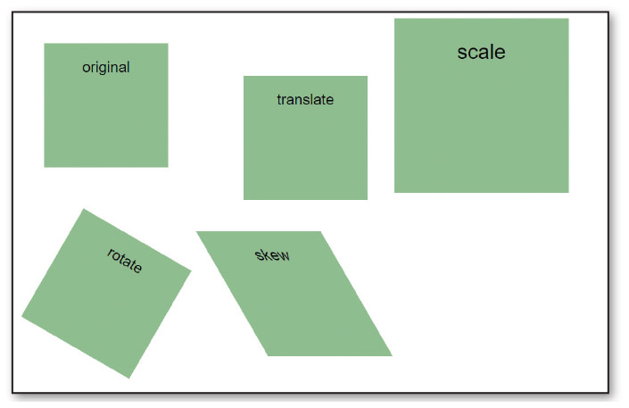
Using CSS to Create Interactivity
Figure above demonstrates, the translate method moves the element from its original position. The scale method increases the size of the original element. The rotate method rotates the element 30 degrees clockwise. The skew method skews the sides of the element.

Slide 10
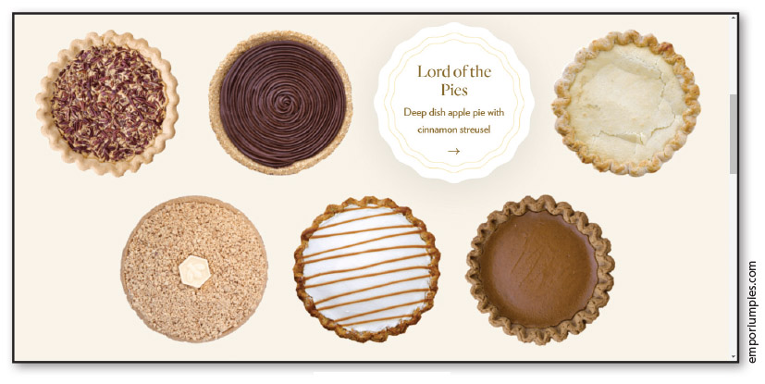
Using CSS to Create Interactivity
https://emporiumpies.com/pies

Slide 11
Incorporating JavaScript
Scripting language that provides various types of functionality to webpages, such as the ability to interact with the user
Client-side scripting language: browser interprets and renders the JavaScript

Slide 12

Incorporating JavaScript

Slide 13
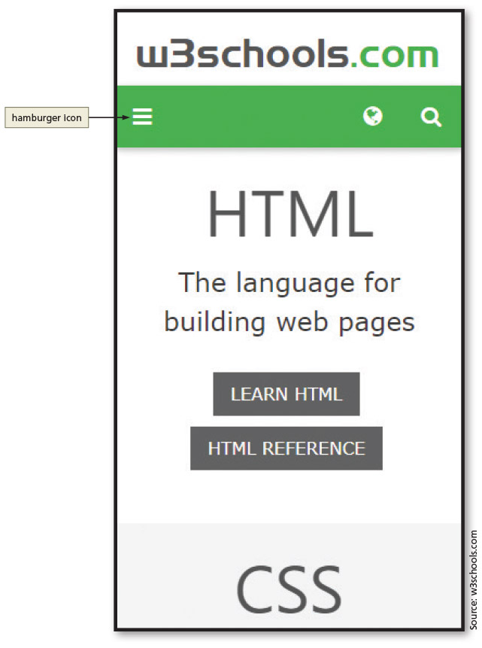
Incorporating JavaScript
Many mobile websites integrate an icon commonly called the hamburger icon for use as a menu button
Consists of three, horizontal, parallel lines and uses JavaScript to display a menu and allow users to select an option

Slide 14
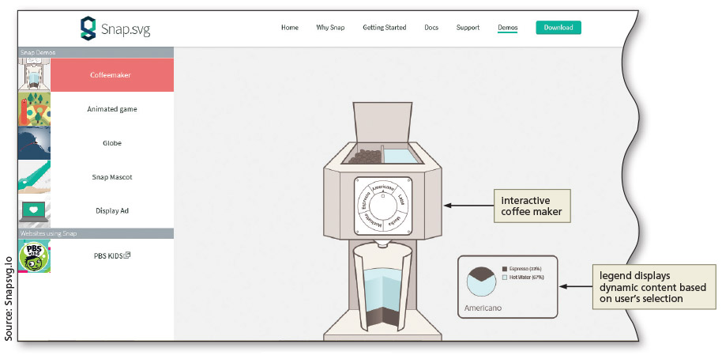
Incorporating JavaScript
http://snapsvg.io/demos/

Slide 15
JavaScript Terminology
To use JavaScript effectively, you should be familiar with its basic terminology
Statement: line of programming instructions to be executed by the client (the browser)
Object: programming code and data that can be treated as its own entity
Property: attribute that describes an object’s characteristics
Method: (function) action that an object can perform

Slide 16
JavaScript Terminology
To use JavaScript effectively, you should be familiar with its basic terminology
Argument: value given to the parameter of a method
Function: set of JavaScript statements that perform a specific task
Variable: container that holds a value
Event handler: used by JavaScript to associate an action with a function

Slide 17
Writing JavaScript Code
Syntax rules and guidelines should be followed when writing JavaScript code
JavaScript is case sensitive
One-line comment and multiline comments are written as follows:
// Single line comment syntax
/* Multiple line comment syntax */
Semicolons are used to end JavaScript statements

Slide 18
Writing JavaScript Code
JavaScript can be written within an HTML page or as a separate JavaScript file with the filename extension .js
When written within an HTML page, the code may be within the head element or the body element
When created as an external .js file, a script element is placed in the head element of the HTML file to specify the external .js file as the file source, e.g.,
<script src="scripts/myfunction.js"></script>

Slide 19
How to include JavaScript in websites​
Embedded in HTML directly, e.g., ​<a id="button" href="#" ​ onclick="alert('Hello World')">Link</a> ​
Function calls in HTML + scripts in same file or linked file​ <a id="button" href="#" onclick="fn()">Link </a> ​
Unobtrusive - HTML doesn't know anything about JS except to link to it​ <script src="js/scripts.js"></script> ​

Slide 20
Unobtrusive
HTML: ​
<script src="js/scripts.js"></script> ​
…​
<a id="button" href="#">Link</a> ​
​
JavaScript file (js/scripts.js):​ ​
button = document.getElementById('button');​ button.addEventListener("click", function() {​ console.log("Hello World!");​ }); ​

Slide 21
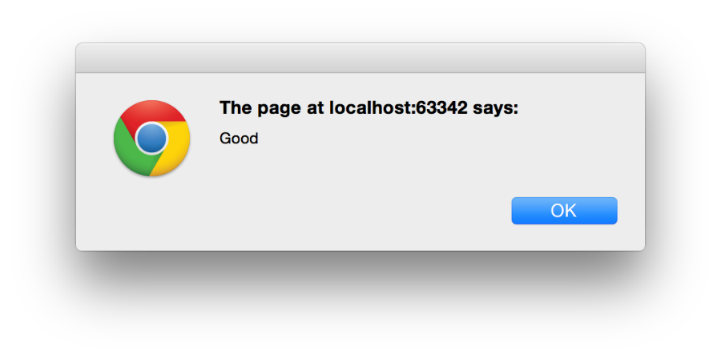

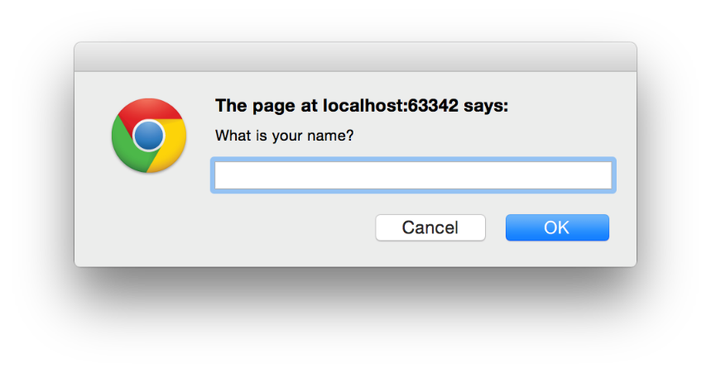
Useful commands & functions
alert('Good’);
return confirm('Do you want X?');
return prompt('What is your name?’);
When you get input, use the return statement to send the value somewhere

Slide 22
Variables and Types
Create variables using the var keyword:
var age = 18;
Every variable has a type
JavaScript has six different types of value. There are five primitive data types:
string
number
Boolean
undefined
null
Everything else is an object

Slide 23
Properties and methods
Objects have properties and methods
(Primitive types also have these thanks to JavaScript implicitly creating wrapper objects so they appear to be objects)
>> name = "Abraham "
<< "Abraham "
>> typeof name
<< "string"
>> name.length
<< 9
>> name["length"]
<< 9
>> name.trim()
<< "Abraham"
>> Code
<< Output
Notes:
This can be executed in the browser's console.

Slide 24
JavaScript is weakly (not strongly) typed
Type coercion is the process of converting the type of a value in the background to try and make an operation work.
"6" * 2 results in 12 (number)
"6" + 2 results in "62" (string)
Use type constructors to convert types more safely, e.g.
Number("23”)
String(6)

Slide 25
Functions
In JavaScript, functions are considered to be just another value.
This means that they do all the same tasks that other values and objects can do, such as be assigned to variables, changed and stored in arrays.
You can even define a function inside another function.
In technical terms, this means that functions are considered to be first-class objects in JavaScript.

Slide 26
Creating functions
Function Literals
function goodbye() { alert("Goodbye World!"); }
Function Expressions This assigns an anonymous function to a variable:
var goodbye = function(){ alert("Goodbye World!"); };
In both cases, the function would be called like: goodbye();

Slide 27
Example
HTML:
<input type="text" name="email" id="email" onBlur="changeColor(this)" onFocus="changeStyle(this)">
JS:
function changeStyle(element) { element.style.color = "#FF0000"; }
event
function
parameter
HTML attribute
CSS property
JavaScript properties

Slide 28
This is it
this is a special keyword
Inside the body of a function, this refers to the object the function is called on
In HTML, this refers to the element where the code is, e.g., here, this is the input element with id=“email”:
<input type="text" name="email" id="email" onBlur="changeColor(this)" onFocus="changeStyle(this)">

Slide 29
DOM Methods
DOM stands for Document Object Model
Every element on an HTML page is an object
HTML DOM consists of all the HTML elements, their attributes, and content
Together, all these items are the objects on the page

Slide 30
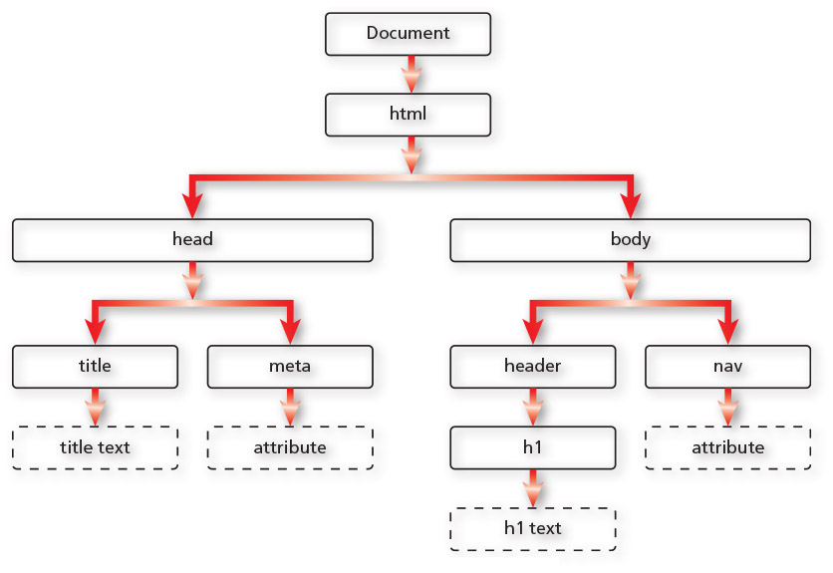
DOM Methods

Slide 31
DOM Methods
Each item in the DOM tree is also known as a node
Any of these objects can be accessed using JavaScript DOM methods
Using a DOM method, you can use JavaScript to manipulate an HTML element (e.g., change its attributes)

Slide 32
DOM Methods
Method | Description
getElementsByClassName( ) | Returns all HTML elements with the specified class name
getElementsByName( ) | Returns all HTML elements with the specified name value attribute
getElementsByTagName( ) | Returns all HTML elements with the specified tag name
querySelector( ) | Returns the first HTML element with the specified CSS selector
querySelectorAll( ) | Returns a list of all HTML elements with the specified CSS selector
DOM Methods

Slide 33
Using if/else Statements
Common programming construct that assesses a specified condition
if condition is true: a specific block of code is executed
else: a different block of code is executed
function checkForm() {
var name = document.getElementById("name").value;
if (name == "Lindsay")
return true;
else
return false;
}

Slide 34
jQuery
Commonly used JavaScript library that can significantly reduce the amount of code (and time) needed to complete a web project

Slide 35
Chapter Summary
In this chapter, you learned how to:
Integrate interactivity using CSS and JavaScript
Use the CSS transform property
Create a JavaScript file and write JavaScript functions
Use event handlers to call JavaScript functions

