Slide 1

CS 542 Final Project
Link-state Routing Algorithm
Professor : Dr.Michael Y.Choi
TA : Viswatej Kasapu
By : Song wang
Cwid : A20435988
Seat# :29

Slide 2
Link-state Routing Algorithm
One of the routing protocol used for calculating the least-cost path from source router to destination
Only information related connectivity is passed in link-state routing
Every node finds or evaluates the best path from itself to every other node in the network
It is performed by each and every switching node/router which is used to forward the packet
Every node has a map which is in the form of graph which has information of which node is connected to which other node
All the nodes/routers has the routing table which is formed by all the best paths calculated in the topology given
The entire routing table is not broadcasted by the routers

Slide 3
Link-state Routing Algorithm
The main steps of this algorithm is initialization and looping
Steps:
Initialization
Mark the source u = visited
For all nodes v
If : v is neighbor of u
then D(v) = c (u,v)
Else : D(v) = Infinity
Loop :
Find node w not visited and who’s D(w) = min
Mark node w as visited
Update D(v) for all the neighbor v of w , not visited
Set D(v) = min (D(v) + D(w) + c(w,v))
/* new cost to v is either the old cost to v or least cost of the path to w + cost from w to v */
Repeat unless all the nodes are visited
Source / Reference : Textbook – Computer Networking – A Top Down Approach

Slide 4
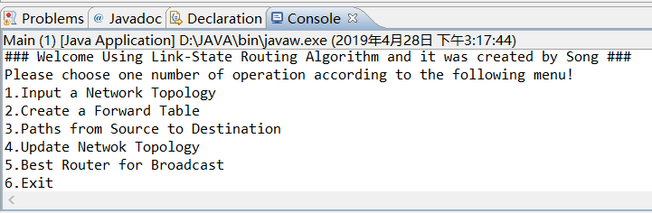
Execution of the Program
Steps:
Open the Eclipse Application and move the main.java and getfile.java into a new package, which is called CS542_2019SP_Project_29_Wang_Song
Starting with Run button and show the Main operations
Thereafter the Main menu is displayed then choose the options you want the main to perform
Note : User need to install the Eclipse App for Windows System firstly
The User Interface will show in the following as the figure shown

Slide 5
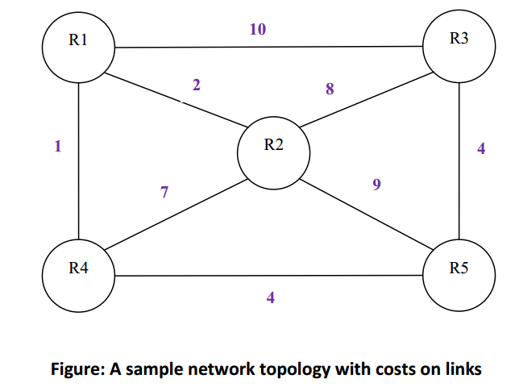
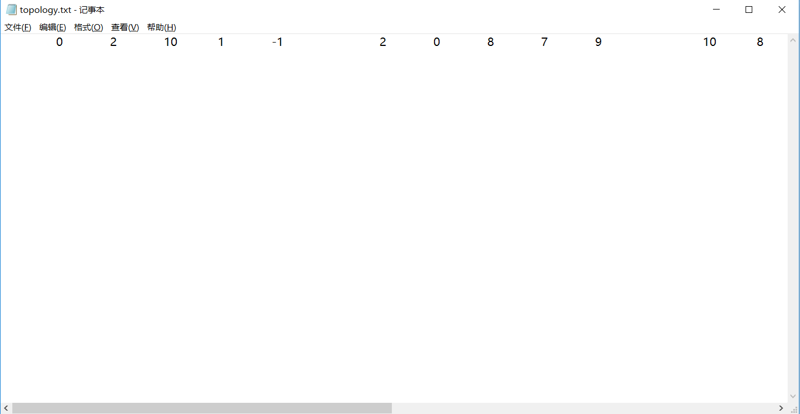
Network Topology & Adjacency Matrix
The network topology and its adjacency matrix on which I worked is as given below:

Slide 6
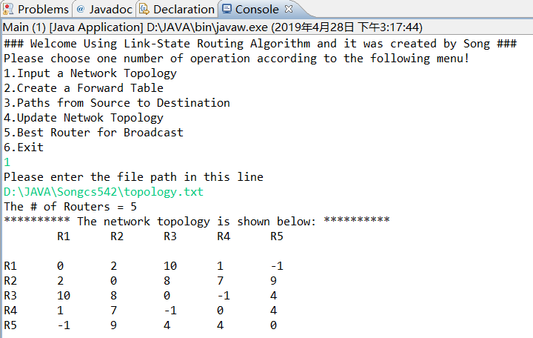
Output –Command 1
Input a Network Topology
Explanation :
When the user selects the 1st option then asks the user to input the file path (text file) which contains the network topology
When the program is run by the user, it displays the Menu above and asks the user for what s/he wants the Main to perform from the given options
The first operation will show the total Router number in network topology matrix and print the Matrix as shown in the figure
If user enter the number above 6, there will show a error message

Slide 7
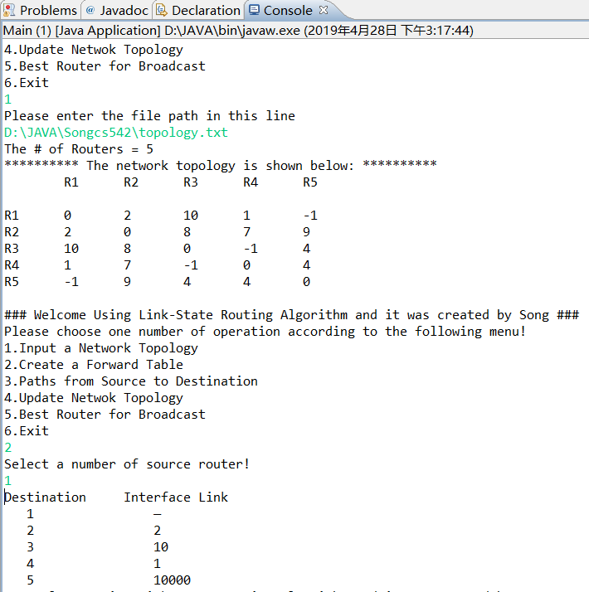
Output –Command 2
Create a Forward Table
Explanation :
the 2nd option will happen after finishing the first operation and showing the topology matrix
So I set a check variable that use to check whether the user start with the following operations before processing the first operation
If user enter the number above 6, there will show a error message

Slide 8
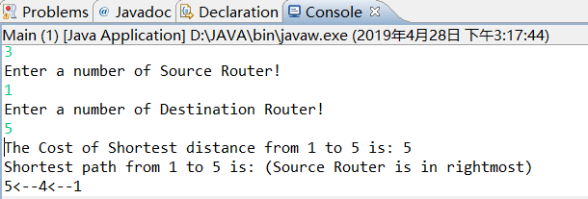
Output –Command 3
Path From Source to Destination
(Shortest Path using Dijkstra Algorithm)
Explanation :
The 3rd option will show the least-cost path and the total Cost
User have to enter the correct Source Router number and the Destination Router number
Also user have to start with the following operations before processing the first operation
Here, the Source router is 1 and destination router is 5, hence , shortest distance is 5 and shortest path is 5←4←1 from 1 to 5 from the given network topology

Slide 9
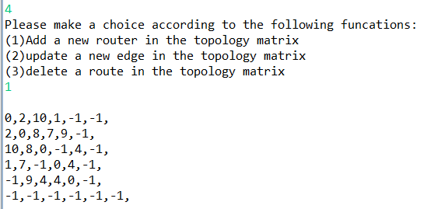
Output –Command 4
Update Network Topology
(First Step: Add a new Router)
Explanation :
The 4th option contains three operations
The First operation use to show the new topology matrix when user wants to add a new Router in the Recent Topology Matrix
This operation only finish the processing of adding a new Router and show its value
So we need to process the next step to update every cost between two routers in the topology matrix

Slide 10
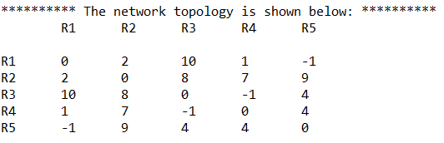
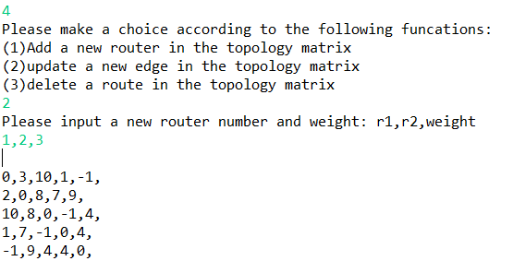
Output –Command 4
Update Network Topology
(Second Step: Update a new edge)
Explanation :
The 4th option contains three operations
The Second step will change the cost between two routers that user enter
For this time, I changed the cost = 2 between Router1 and Router2 to new cost = 3 as shown in the figures above

Slide 11
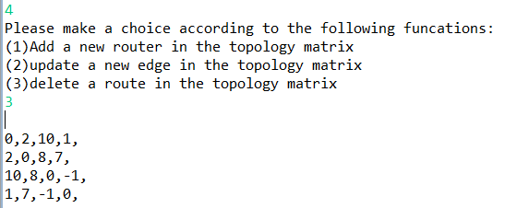
Output –Command 4
Update Network Topology
(Third Step: Delete a Router)
Explanation :
The 4th option contains three operations
The Third step will delete a router in the topology matrix
For this time, I deleted Router5 in the topology matrix and then show the new topology matrix as shown above

Slide 12
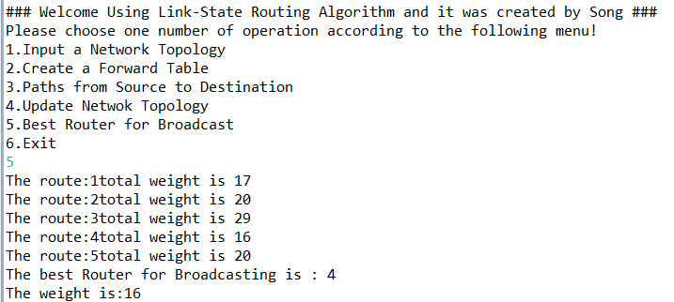
Output –Command 5
Showing Best Router for Broadcast
Explanation :
The 5th option will show total cost for every router and the Best Router for Broadcast
This operation will show every router cost for Broadcast and use their cost to compare and get the least one
The result shows Router4 has the least-cost for Broadcast and the total cost is 16

Slide 13
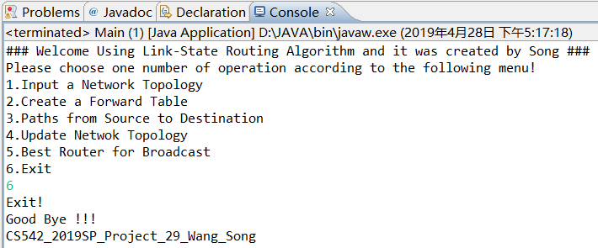
Output –Command 6
Exit
Explanation :
This step will exit from the project and display “Good Bye !!!”, “CS542_2019SP_Project_29_Wang_Song”

Slide 14
Thanks for your time!

