Slide 1
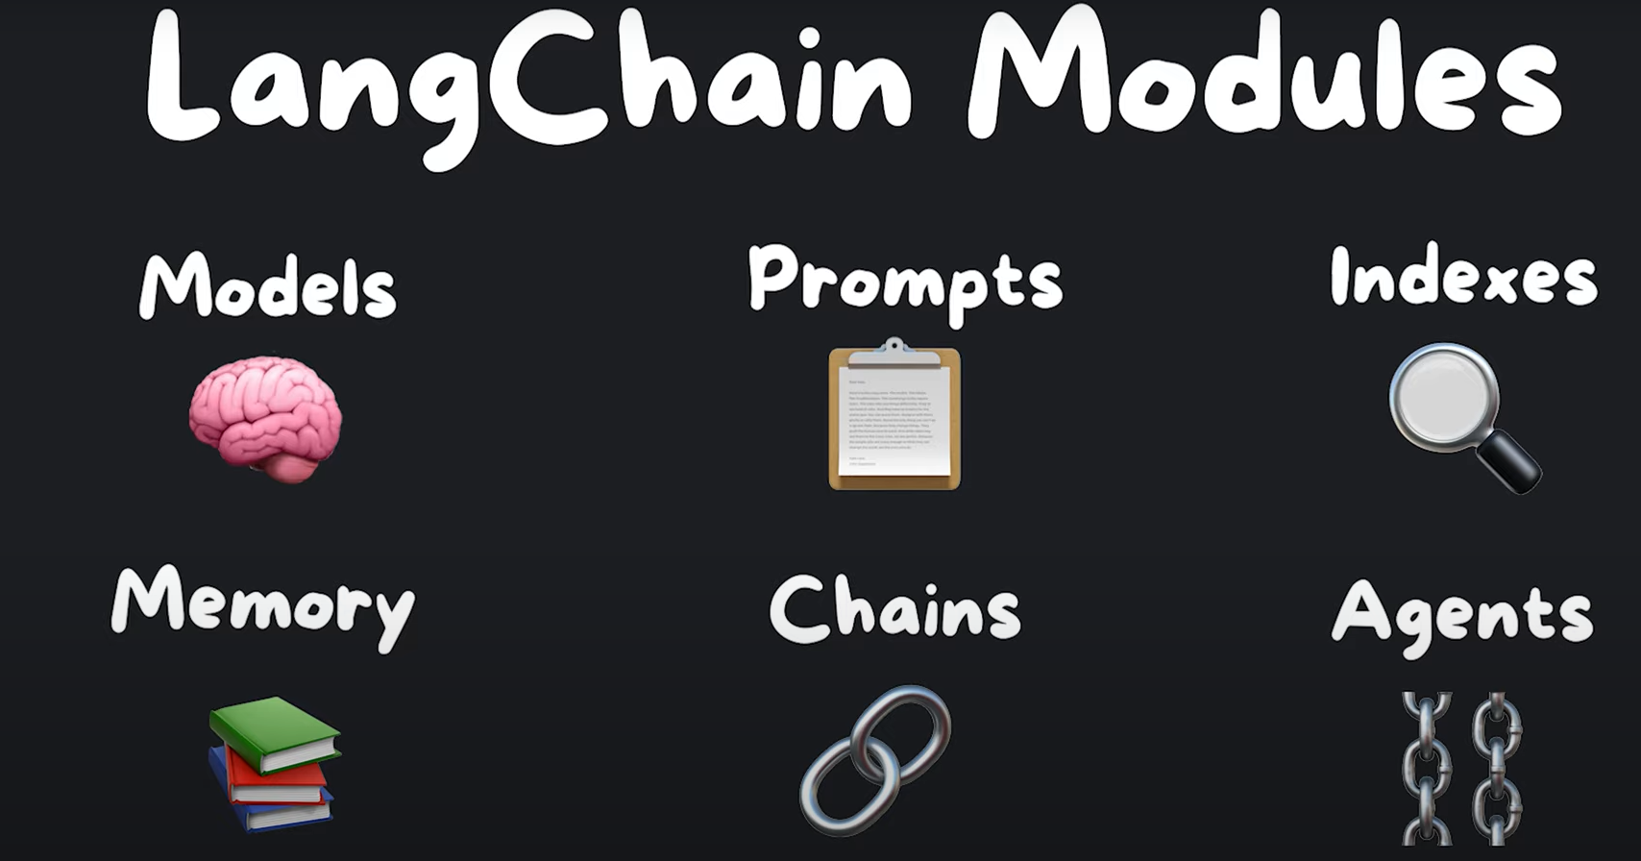

Slide 2
1. Models
Language Models
LLMs: “text” → “more text”
OpenAI()
Chat Models: “Hi” → AI: “wyd”
ChatOpenAI()
Text Embedding Models
“text” = [0.93, 0.32, …, 0.76]
Hugging Face Embeddings (free)
OpenAI Embeddings (paid)

Slide 3
2. Prompts
Prompt Templates
Output Parser
Example Selectors
Chat Prompt Templates

