Slide 1


Improving Software Maintainability through Automated Refactoring
Author: Simon Baars
Company Supervisor: Xander Schrijen
Host Company: Software Improvement Group
Academic Supervisor: Ana Oprescu
Location: Amsterdam
Date: 28 August 2019

Slide 2
25%
Notes:
Up to 25% of code is cloned. This is 25% extra code that has to be maintained.

Slide 3

One “simple” change...
25%
Notes:
Up to 25% of code is cloned. This is 25% extra code that has to be maintained.

Slide 4
“If you see the same code structure in more than one place, you can be sure that your program will be better if you find a way to unify them”
~ Martin Fowler & Kent Beck in Refactoring

Slide 5

Find clones
Assess
impact
Refactor clones

Slide 6



Find clones
Assess
impact
Refactor clones

Slide 7

Find clones
Assess
impact
Refactor clones

Slide 8
RQ1.
How can we define clone types such that they can be automatically refactored?

Slide 9
RQ1.
How can we define clone types such that they can be automatically refactored?
RQ2.
How can we prioritize refactoring opportunities based on the context of clones?

Slide 10
RQ1.
How can we define clone types such that they can be automatically refactored?
RQ2.
How can we prioritize refactoring opportunities based on the context of clones?
RQ3.
What are the discriminating factors to decide when a clone should be refactored

Slide 11
Clone Types
Each clone type allows more variance between cloned fragments.
Notes:
In literature several definitions of clones have been proposed to argue about duplicated code fragments. These are several types of clones that each allow more variability between cloned fragments. Each statements found as cloned for type 1 is also found for type 2.

Slide 12
Type 1.
Textually identical code fragments except for variations in whitespace and comments.

Slide 13
Type 1.
Textually identical code fragments except for variations in whitespace and comments.
package com.sb.cryo.addition;
import com.notificationlib.*;
import java.util.List;
public class AdditionUtils {
public void addToList(List l) {
l.add(getClass().getName());
}
public int addTen(int x) {
x = x + 10; // add number
Notifier.notifyChanged(x);
return x;
}
}
package com.sb.cryo.util;
import com.sb.cryo.notifier.*;
import java.awt.List;
public class StringUtils {
public void addToList(List l) {
l.add(getClass().getName());
}
public String concatTen(String x) {
x = x + 10; // concat number
Notifier.notifyChanged(x);
return x;
}
}

Slide 14
Type 1R.
Contextually & textually identical code fragments except for variations in layout and comments.
package com.sb.cryo.addition;
import com.notificationlib.*;
import java.util.List;
public class AdditionUtils {
public void addToList(List l) {
l.add(getClass().getName());
}
public int addTen(int x) {
x = x + 10; // add number
Notifier.notifyChanged(x);
return x;
}
}
package com.sb.cryo.util;
import com.sb.cryo.notifier.*;
import java.awt.List;
public class StringUtils {
public void addToList(List l) {
l.add(getClass().getName());
}
public String concatTen(String x) {
x = x + 10; // concat number
Notifier.notifyChanged(x);
return x;
}
}
Notes:
We propose type 1R. Type 1R takes into account the context of expressions to be sure we are talking about the same functional concepts. This ensures that the code can be refactored without introducing side effects.

Slide 15
Type 1R.
Contextually & textually identical code fragments except for variations in layout and comments.
package com.sb.cryo.addition;
import com.notificationlib.*;
import java.util.List;
public class AdditionUtils {
public void addToList(List l) {
l.add(getClass().getName());
}
public int addTen(int x) {
x = x + 10; // add number
Notifier.notifyChanged(x);
return x;
}
}
package com.sb.cryo.util;
import com.sb.cryo.notifier.*;
import java.awt.List;
public class StringUtils {
public void addToList(List l) {
l.add(getClass().getName());
}
public String concatTen(String x) {
x = x + 10; // concat number
Notifier.notifyChanged(x);
return x;
}
}
java.util.List
java.awt.List
Notes:
Fully Qualified Identifier
The types referenced by these type references differ, so this line isn’t seen as cloned.

Slide 16
Type 1R.
Contextually & textually identical code fragments except for variations in layout and comments.
package com.sb.cryo.addition;
import com.notificationlib.*;
import java.util.List;
public class AdditionUtils {
public void addToList(List l) {
l.add(getClass().getName());
}
public int addTen(int x) {
x = x + 10; // add number
Notifier.notifyChanged(x);
return x;
}
}
package com.sb.cryo.util;
import com.sb.cryo.notifier.*;
import java.awt.List;
public class StringUtils {
public void addToList(List l) {
l.add(getClass().getName());
}
public String concatTen(String x) {
x = x + 10; // concat number
Notifier.notifyChanged(x);
return x;
}
}
java.util.List.add(java.lang.Object)
java.awt.List.add(java.lang.String)
Notes:
Type 1R takes into account the Fully Qualified Signature of method references.

Slide 17
Type 1R.
Contextually & textually identical code fragments except for variations in layout and comments.
package com.sb.cryo.addition;
import com.notificationlib.*;
import java.util.List;
public class AdditionUtils {
public void addToList(List l) {
l.add(getClass().getName());
}
public int addTen(int x) {
x = x + 10; // add number
Notifier.notifyChanged(x);
return x;
}
}
package com.sb.cryo.util;
import com.sb.cryo.notifier.*;
import java.awt.List;
public class StringUtils {
public void addToList(List l) {
l.add(getClass().getName());
}
public String concatTen(String x) {
x = x + 10; // concat number
Notifier.notifyChanged(x);
return x;
}
}
int
java.lang.String
int
java.lang.String
int
java.lang.String
Notes:
Type 1R checks the type of variable references.

Slide 18
Type 1R.
Retrieving contextual information can be challenging!
package com.sb.cryo.addition;
import com.notificationlib.*;
import java.util.List;
public class AdditionUtils {
public void addToList(List l) {
l.add(getClass().getName());
}
public int addTen(int x) {
x = x + 10; // add number
Notifier.notifyChanged(x);
return x;
}
}
package com.sb.cryo.util;
import com.sb.cryo.notifier.*;
import java.awt.List;
public class StringUtils {
public void addToList(List l) {
l.add(getClass().getName());
}
public String concatTen(String x) {
x = x + 10; // concat number
Notifier.notifyChanged(x);
return x;
}
}
?
Notes:
Language dependent
Need everything surrounding a software system to be sure referenced symbols are equal.

Slide 19
Type 1R Summarized
In addition to type 1 rules, we compare contextual information of:
1. Type references (Fully Qualified Identifier)
2. Variable references (type)
3. Method references (Fully Qualified Signature)
Retrieving fully qualified identifiers/signatures can be challenging!
Notes:
Type 1R checks the type of variable references.

Slide 20
Type 2.
Structurally/syntactically identical fragments except for variations in identifiers, literals, types, layout, and comments.

Slide 21
Type 2.
Structurally/syntactically identical fragments except for variations in identifiers, literals, types, layout, and comments.
public boolean containsOnlyRedCircles(List<Circle> circles){
return circles.stream().allMatch(Shape::isRed);
}
public boolean containsOnlyRedCircles(List<Circle> circles){
return circles.stream().allMatch(Shape::isRed);
}
public boolean containsOnlyRedCircles(List<Circle> circles){
return circles.stream().allMatch(Shape::isRed);
}
public Apple getEdibleApple(FruitBasket<Apple> basket){
return basket.getFruit().getApple(Fruit::notEaten);
}

Slide 22
Type 2R.
Type 1R clones except for variations in a controlled set of expressions.
No design tradeoff
  Type declaration names
  Method names
  Variable names/references (sometimes)
Design tradeoff
  Literals (of the same type)
  Variable references (sometimes)
  Called methods (same type & parameters)

Slide 23
Type 2R clones
No design tradeoff
  Type declaration names
  Method names
  Variable names/references (sometimes)
Design tradeoff
  Literals (of the same type)
  Variable references (sometimes)
  Called methods (same type & parameters)
public class A {
public void doA() {
print("hello");
}
}
public class B {
public void doB() {
print("hello");
}
}

Slide 24
Type 2R clones
No design tradeoff
  Type declaration names
  Method names
  Variable names/references (sometimes)
Design tradeoff
  Literals (of the same type)
  Variable references (sometimes)
  Called methods (same type & parameters)
public void doA() {
String message = "hello";
print(message);
}
public void doB() {
String hello = "hello";
print(hello);
}

Slide 25
Type 2R clones
No design tradeoff
  Type declaration names
  Method names
  Variable names/references (sometimes)
Design tradeoff
  Literals (of the same type)
  Variable references (sometimes)
  Called methods (same type & parameters)
// Original
void doABC(){
doA();
doB("abc");
doC();
}
void doDEF(){
doA();
doB("def");
doC();
}
// Refactored
void doABC(){
doThis("abc");
}
void doDEF(){
doThis("def");
}
void doThis(String letters){
doA();
doB(letters);
doC();
}

Slide 26
Type 2R clones
No design tradeoff
  Type declaration names
  Method names
  Variable names/references (sometimes)
Design tradeoff
  Literals (of the same type)
  Variable references (sometimes)
  Called methods (same type & parameters)
// Original
String abc = "abc";
String def = "abc";
void doABC(){
doA();
doB(abc);
doC();
}
void doDEF(){
doA();
doB(def);
doC();
}
// Refactored
String abc = "abc";
String def = "abc";
void doABC(){
doThis(abc);
}
void doDEF(){
doThis(def);
}
void doThis(String letters){
doA();
doB(letters);
doC();
}

Slide 27
Type 2R clones
No design tradeoff
  Type declaration names
  Method names
  Variable names/references (sometimes)
Design tradeoff
  Literals (of the same type)
  Variable references (sometimes)
  Called methods (same type & parameters)
// Original
void doABC(){
doA();
doB();
doC();
}
void doADC(){
doA();
doD();
doC();
}
// Refactored
void doABC(){
doThis(this::doB);
}
void doADC(){
doThis(this::doD);
}
void doThis(Runnable r){
doA();
r.run();
doC();
}

Slide 28
void doABC(){
doA();
doB();
doC();
}
void doADC(){
doA();
doD();
doC();
}

Slide 29
Type 3.
Copied fragments with further modifications. Statements can be changed, added or removed in addition to variations in identifiers, literals, types, layout, and comments.
void doCwithA(){
int a = getA();
doC(a);
}
void multiplyA(){
int a = getA();
a *= 5;
doC(a);
}

Slide 30
Type 3R.
Type 2R clones with optional gaps of non cloned statements.
// Refactored
void doCwithA(){
modifyA(false);
}
void multiplyA(){
modifyA(true);
}
void modifyA(boolean multiply){
int a = getA();
if(multiply) a *= 5;
doC(a);
}
// Original
void doCwithA(){
int a = getA();
doC(a);
}
void multiplyA(){
int a = getA();
a *= 5;
doC(a);
}
Notes:
There are a few “rules” for the gap:
→ The clones surrounding it must be valid clones
→ The gap may not span different blocks

Slide 31
// Original
void doCwithA(){
int a = getA();
doC(a);
}
void multiplyA(){
int a = getA();
a *= 5;
doC(a);
}
Notes:
Note that this threshold can go over 100%

Slide 32
Summarized
Type 1R.
Contextually & textually identical code fragments except for variations in layout and comments.
Type 2R.
Type 1R clones except for variations in a controlled set of expressions.
Type 3R.
Type 2R clones with optional gaps of non cloned statements.
Notes:
There are a few “rules” for the gap:
→ The clones surrounding it must be valid clones
→ The gap may not span different blocks

Slide 33
Clone Context
Determining how a clone should be refactored.
Relation
Common Class
Common Hierarchy
Common Interface
Unrelated
Location
Method Level
Class Level
Interface Level
Enum Level
Contents
Full Declaration
Partial Body
Only Fields
Several Methods
Other

Slide 34
Refactorability
Determining whether a clone can be refactored using “Extract Method”.
Partial Block
Top-Level Node is not a Statement
if(result == 1){
println("Error!");
handleError(result);
}
doSomething();
if(result == 1){
println("Error!");
}
try {
doSomethingDangerous();
}catch (DangerException e) {
println("Danger!");
}
doSomething();
try {
doSomethingDangerous();
}catch (DangerException e) {
println("Danger!");
}

Slide 35
CloneRefactor
Notes:
Detect clones: T1-T3, T1R-T3R
Map Context: Relation, Location, Contents
Refactor: Determine Refactorability, Apply Transformations, Measure Impact

Slide 36
CloneRefactor
Type 1R-3R
Type 1-3
Relation
Location
Contents
Determine Refactorability
Apply Transformations
Measure Impact
Notes:
Detect clones: T1-T3, T1R-T3R
Map Context: Relation, Location, Contents
Refactor: Determine Refactorability, Apply Transformations, Measure Impact

Slide 37

CloneRefactor
Type 1R-3R
Type 1-3
Relation
Location
Contents
Determine Refactorability
Apply Transformations
Measure Impact
Notes:
Detect clones: T1-T3, T1R-T3R
Map Context: Relation, Location, Contents
Refactor: Determine Refactorability, Apply Transformations, Measure Impact

Slide 38
CloneRefactor

Slide 39
CloneRefactor

Slide 41
Refactoring
Determining the impact of refactoring the clone.
Characteristics
Clone Size
Relation
Return Category
Parameters
Metrics
Duplication
Volume
Complexity
Number of Parameters
Risk Profiles
Low Risk
Moderate Risk
High Risk
Very High Risk

Slide 42
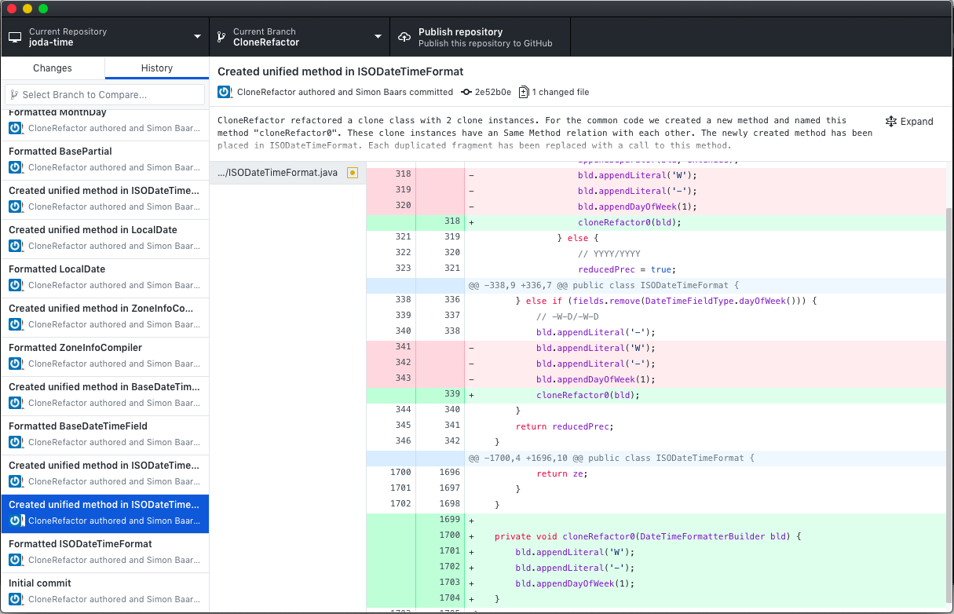

Slide 43
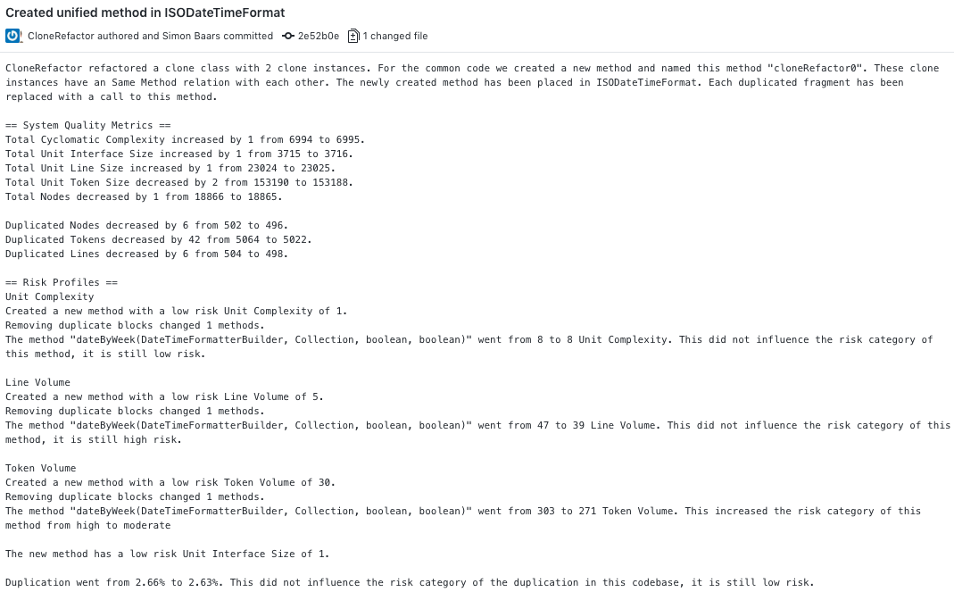

Slide 44


Slide 47
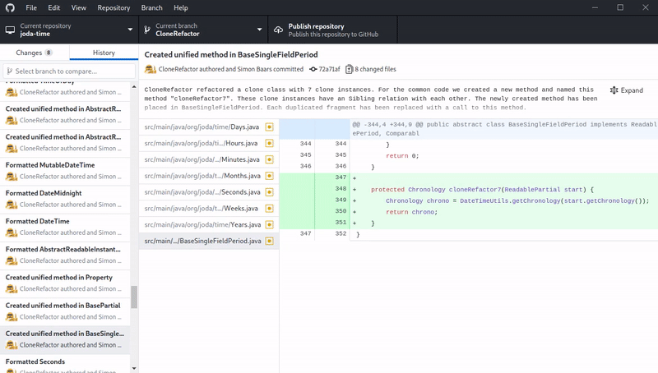

Slide 48

Experiments
GitHub Corpus with 2.267 Java projects
Experiments:
  Clone Types
  Context
  Refactorability
  Thresholds
Notes:
GitHub projects select on basis of number of forks.
We filtered it for all Maven projects, so we have all dependencies for the projects we analyze.

Slide 49
Clone Types
Amount of clones found
Performance

Slide 50
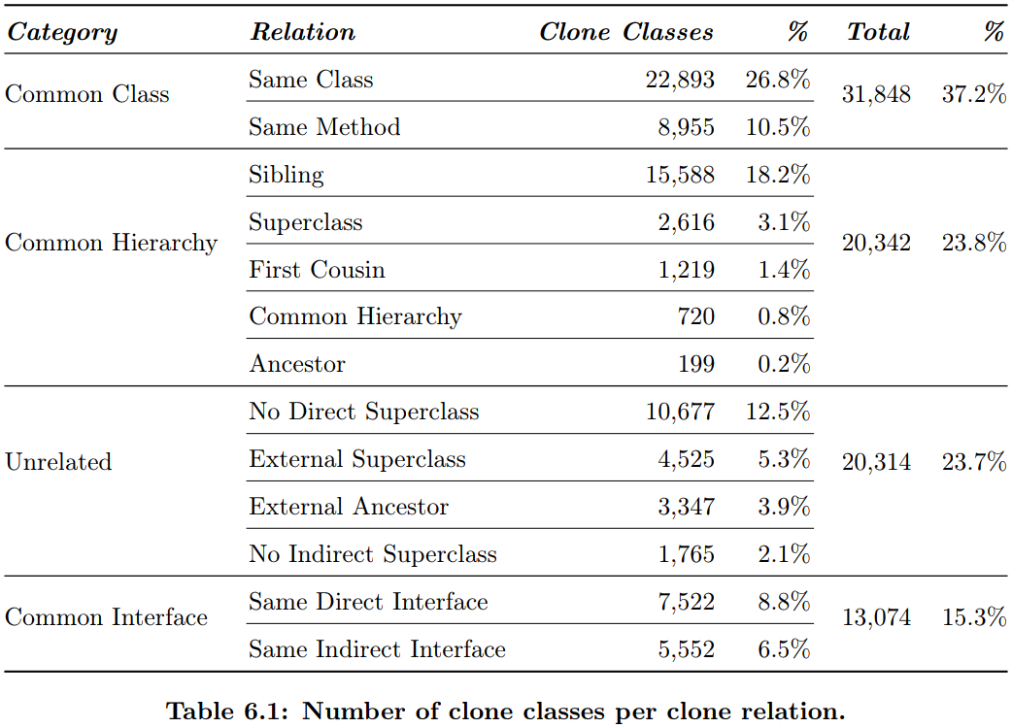
Relation

Slide 51
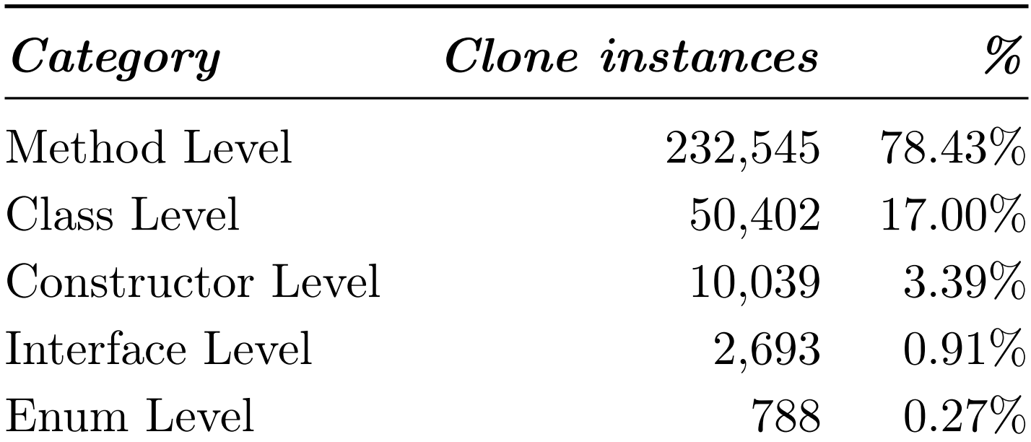
Location

Slide 52
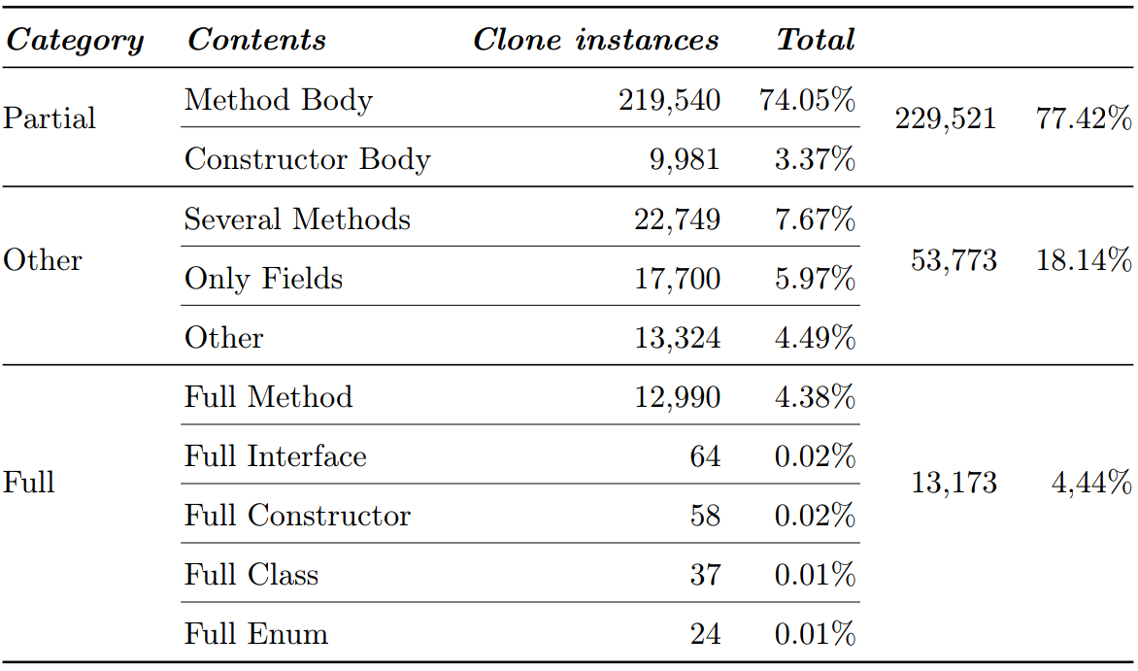
Contents

Slide 53
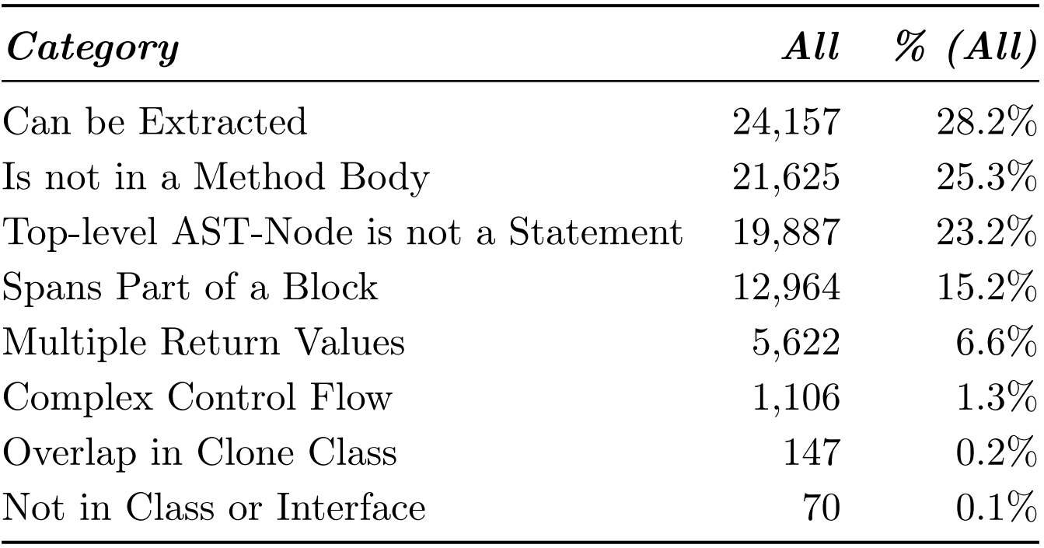
Contents

Slide 54
Refactoring Experiments
12.683 refactorings performed
Characteristics:
  Clone Size
  Relation
  Return Category
  Parameters
Metrics
  Δ Duplication
  Δ Volume
  Δ Complexity
  Δ Number of Parameters
Notes:
GitHub projects select on basis of number of forks.
We filtered it for all Maven projects, so we have all dependencies for the projects we analyze.

Slide 55
Calculate Maintainability Score
Aggregating the used maintainability metrics to give each refactoring a score.
Δ Duplication
Δ Volume
Δ Complexity
Δ Number of Parameters
Notes:
Calculate normal score. Metric delta minus mean divided by the standard deviation

Slide 56
Clone Size
Ways to measure the size of a clone.
Number of Statements
Number of Tokens
Token Volume
Notes:
Calculate normal score. Metric delta minus mean divided by the standard deviation

Slide 57
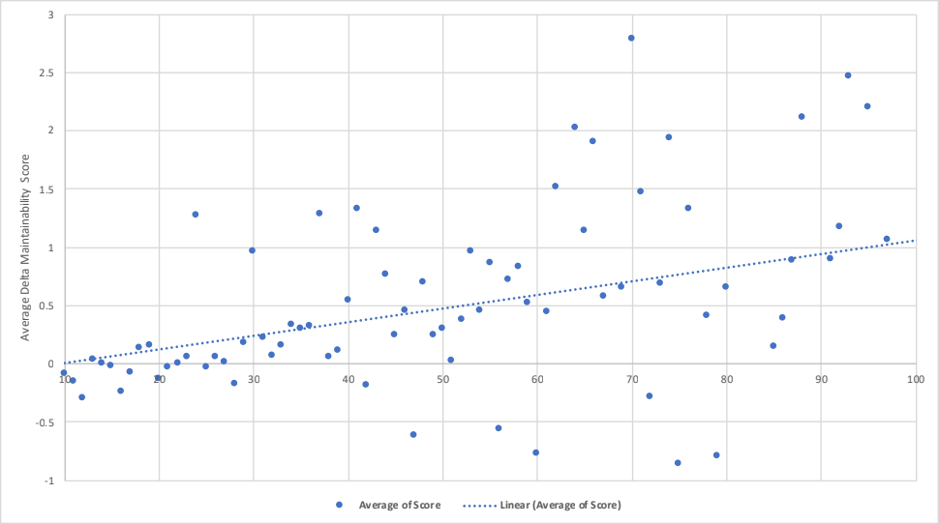
Tokens in one clone instance

Slide 58
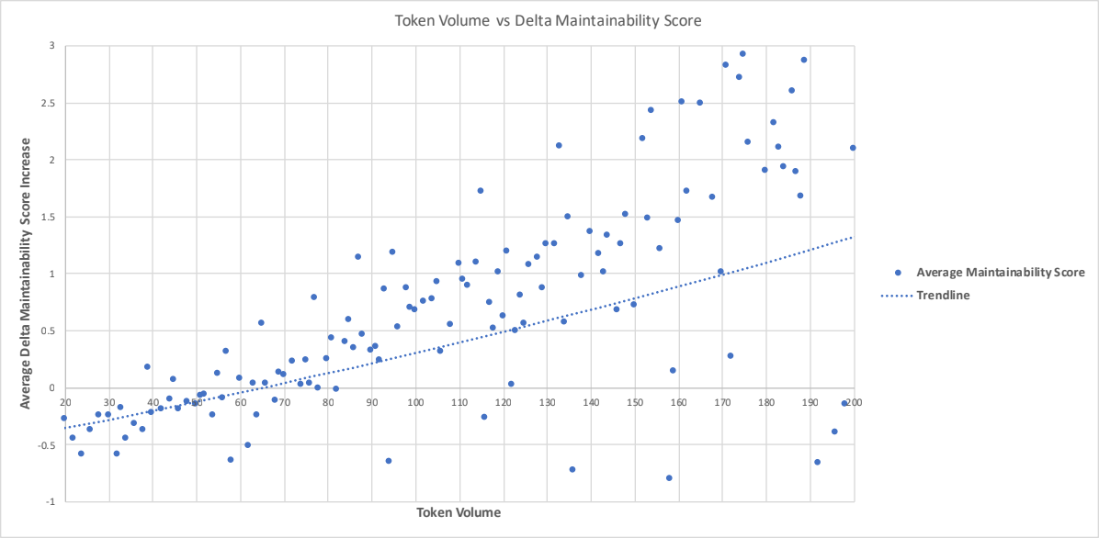
Token Volume

Slide 59
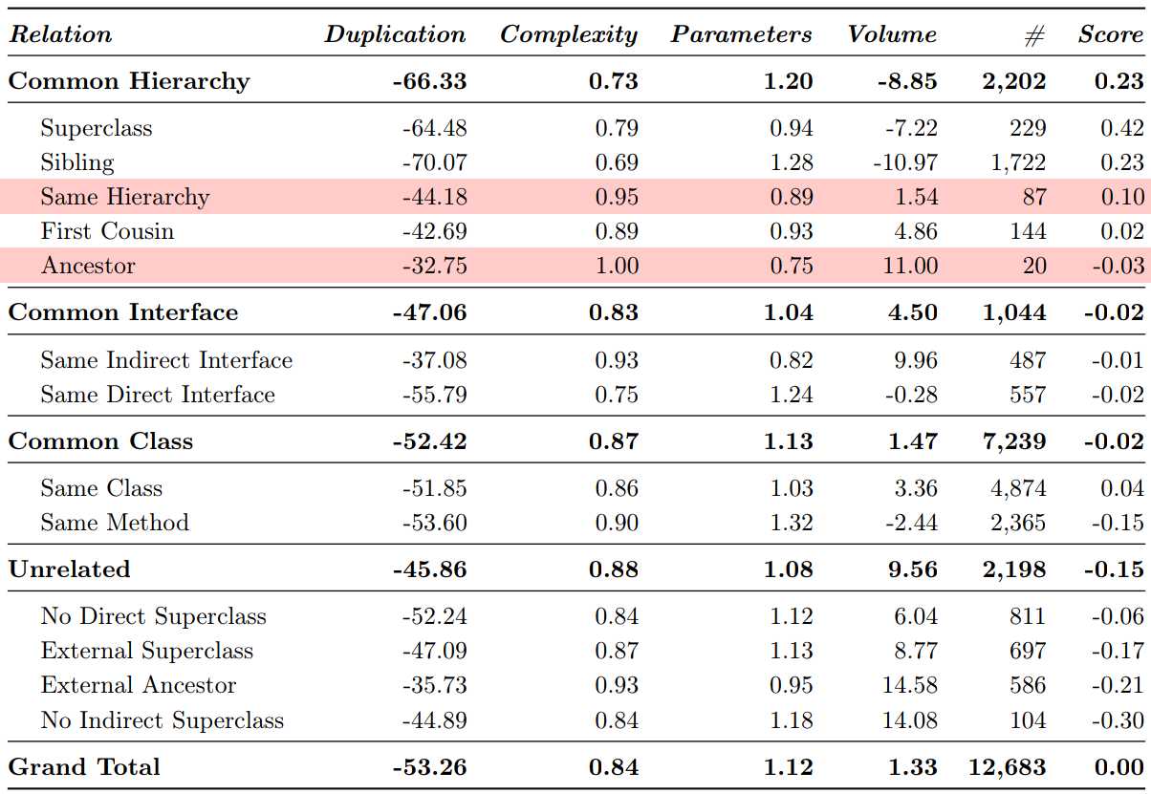
Relation

Slide 60
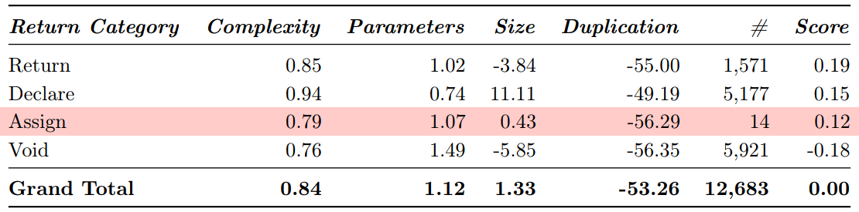
Return Category

Slide 61
Parameters
Any Token Volume

Slide 62
Parameters
Any Token Volume
63+ Token Volume

Slide 63
Token threshold
node = Statement/Declaration

Slide 64
Token threshold

Slide 65
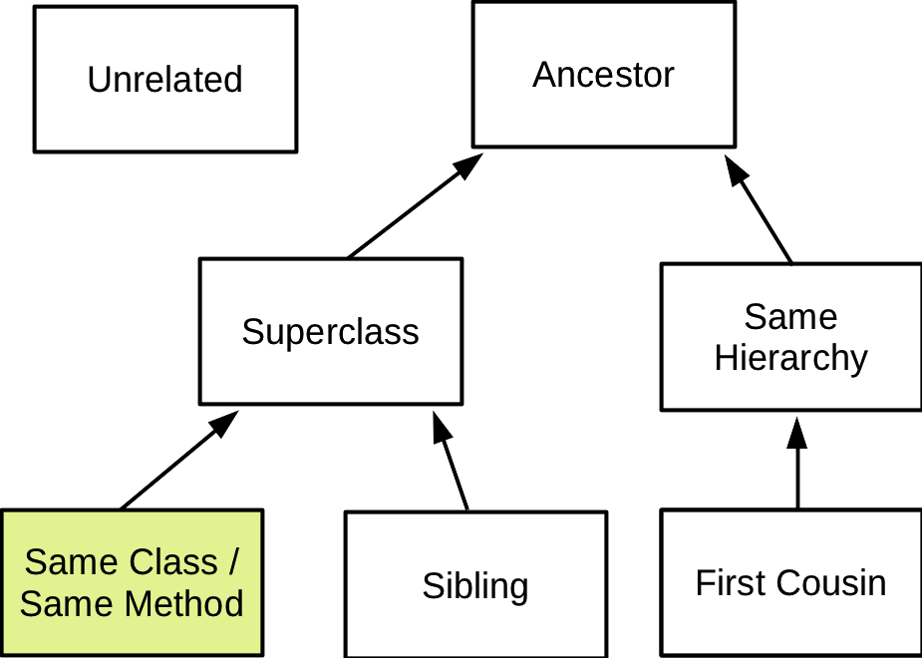
Clone Relations
Relation through inheritance between clone instances
Notes:
We took the categories from an existing study.
We don’t take into account external classes, as they aren’t interesting for refactoring.
We have an extra category that is not modelled here: same external superclass.

Slide 66
RQ1.
How can we define clone types such that they can be automatically refactored?
RQ2.
How can we prioritize refactoring opportunities based on the context of clones?
RQ3.
What are the discriminating factors to decide when a clone should be refactored
Conclusion

Slide 67
Summary
T1R. Textually identical code fragments except for variations in whitespace and comments.
T2R. Type 1R clones except for variations in a controlled set of expressions.
T3R. Type 2R clones with optional gaps of non cloned statements.
Relation. 37% Same Class, 24% Same Hierarchy, 24% Unrelated and 7% Same Interface
Location. 78% Method Level, 17% Class Level, 4% Constructor Level and 1% Other
Contents. 74% Method Body (77% including constructor), 8% Several Methods, 6% Only Fields and 4% Full Method.
Refactorability. 28% can be extracted, 25% is not in a method body, 23% top-level AST-node is not a statement, 15% spans part of a block and 6% multiple return values.
Token Volume. Clone classes with a Token Volume higher than 63 results in refactorings that, on average, improve maintainability.
Number of Parameters. When an extracted method has more than two parameters , it is more likely to decrease maintainability.
Relation and Return Category. These two factors have a minor influence on maintainability.

